Slide 1
Chapter 3: Introduction to SQL

Slide 2
Outline
Overview of The SQL Query Language
SQL Data Definition
Basic Query Structure of SQL Queries
Additional Basic Operations
Set Operations
Null Values
Aggregate Functions
Nested Subqueries
Modification of the Database
Notes:
1

Slide 3
SQL Parts
DML -- provides the ability to query information from the database and to insert tuples into, delete tuples from, and modify tuples in the database.
integrity – the DDL includes commands for specifying integrity constraints.
View definition -- The DDL includes commands for defining views.
Transaction control –includes commands for specifying the beginning and ending of transactions.
Embedded SQL and dynamic SQL -- define how SQL statements can be embedded within general-purpose programming languages.
Authorization – includes commands for specifying access rights to relations and views.

Slide 4
Data Definition Language
The SQL data-definition language (DDL) allows the specification of information about relations, including:
The schema for each relation.
The type of values associated with each attribute.
The Integrity constraints
The set of indices to be maintained for each relation.
Security and authorization information for each relation.
The physical storage structure of each relation on disk.

Slide 5
Domain Types in SQL
char(n). Fixed length character string, with user-specified length n.
varchar(n). Variable length character strings, with user-specified maximum length n.
int. Integer (a finite subset of the integers that is machine-dependent).
smallint. Small integer (a machine-dependent subset of the integer domain type).
numeric(p,d). Fixed point number, with user-specified precision of p digits, with d digits to the right of decimal point. (ex., numeric(3,1), allows 44.5 to be stores exactly, but not 444.5 or 0.32)
real, double precision. Floating point and double-precision floating point numbers, with machine-dependent precision.
float(n). Floating point number, with user-specified precision of at least n digits.

Slide 6
Domain Types in SQL
Type | Used for | Example
CHAR(n) | Fixed-length text | 'IN'
VARCHAR(n) | Variable-length text | 'Einstein'
SMALLINT | Small whole numbers | 8
INT | Whole numbers | 75000
NUMERIC(p,d) | Exact decimal numbers | 75000.50
REAL | Approximate floating-point | 3.14159
DOUBLE PRECISION | Approximate floating-point with more precision | 3.1415926535
FLOAT(n) | Floating-point with specified precision | scientific values

Slide 7
Create Table Construct
An SQL relation is defined using the create table command:
create table r
(A₁ D₁, A₂ D₂, ..., A_{n} D_{n},
(integrity-constraint₁),
...,
(integrity-constraint_{k}))
  r is the name of the relation
  each A_{i} is an attribute name in the schema of relation r
  D_{i} is the data type of values in the domain of attribute A_{i}
Example:
create table instructor (
ID char(5),
name varchar(20),
dept_name varchar(20),
salary numeric(8,2))

Slide 8
Integrity Constraints in Create Table
Types of integrity constraints
  primary key (A₁, ..., A_{n} )
  foreign key (A_{m}, ..., A_{n} ) references r
  not null
SQL prevents any update to the database that violates an integrity constraint.
Example:
create table instructor (
ID char(5),
name varchar(20) not null,
dept_name varchar(20),
salary numeric(8,2),
primary key (ID),
foreign key (dept_name) references department);

Slide 9
Integrity Constraints in Create Table
Constraint | What does it ensure? | Example
PRIMARY KEY | Every entity can be uniquely identified | No two instructors have the same ID
FOREIGN KEY | Referenced data actually exists | Instructor's department must exist
NOT NULL | Required data cannot be missing | Instructor must have a name

Slide 10
And a Few More Relation Definitions
create table student (
ID varchar(5),
name varchar(20) not null,
dept_name varchar(20),
tot_cred numeric(3,0),
primary key (ID),
foreign key (dept_name) references department);
create table takes (
ID varchar(5),
course_id varchar(8),
sec_id varchar(8),
semester varchar(6),
year numeric(4,0),
grade varchar(2),
primary key (ID, course_id, sec_id, semester, year) ,
foreign key (ID) references student,
foreign key (course_id, sec_id, semester, year) references section);

Slide 11
And more still
create table course (
course_id varchar(8),
title varchar(50),
dept_name varchar(20),
credits numeric(2,0),
primary key (course_id),
foreign key (dept_name) references department);

Slide 12
Updates to tables
Insert
  insert into instructor values ('10211', 'Smith', 'Biology', 66000);
Delete
  Remove all tuples from the student relation
    delete from student
Drop Table
  drop table r
Alter
  alter table r add A D
    where A is the name of the attribute to be added to relation r and D is the domain of A.
    All exiting tuples in the relation are assigned null as the value for the new attribute.
  alter table r drop A
    where A is the name of an attribute of relation r
    Dropping of attributes not supported by many databases.

Slide 13
Updates to tables
Command | What it changes
INSERT | Adds rows/data
DELETE | Removes rows/data
ALTER TABLE | Changes table structure
DROP TABLE | Removes the entire table

Slide 14
Basic Query Structure
A typical SQL query has the form:
select A₁, A₂, ..., A_{n}
from r₁, r₂, ..., r_{m}
where P
  A_{i} represents an attribute
  R_{i} represents a relation
  P is a predicate.
The result of an SQL query is a relation.
Notes:
2

Slide 15
The select Clause
The select clause lists the attributes desired in the result of a query
  corresponds to the projection operation of the relational algebra
Example: find the names of all instructors:
select name
from instructor
NOTE: SQL names are case insensitive (i.e., you may use upper- or lower-case letters.)
  E.g., Name ≡ NAME ≡ name
Notes:
3

Slide 16
The select Clause (Cont.)
SQL allows duplicates in relations as well as in query results.
To force the elimination of duplicates, insert the keyword distinct after select.
Find the department names of all instructors, and remove duplicates
select distinct dept_name
from instructor
The keyword all specifies that duplicates should not be removed.
select all dept_name
from instructor
Notes:
4

Slide 17
The select Clause (Cont.)
SELECT DISTINCT dept_name, salary FROM instructor;
SQL does not independently remove duplicate departments and duplicate salaries.
It considers the entire combination of selected columns.
dept_name | salary
Physics | 95000
Physics | 87000
Physics | 95000
dept_name | salary
Physics | 95000
Physics | 87000
DISTINCT applies to the complete selected row, not individually to each column.

Slide 18
The select Clause (Cont.)
An asterisk in the select clause denotes “all attributes”
select *
from instructor
SELECT name, 'Instructor' AS person_type FROM instructor;
name | person_type
Einstein | Instructor
Wu | Instructor
Gold | Instructor
Notes:
5

Slide 19
The select Clause (Cont.)
The select clause can contain arithmetic expressions involving the operation, +, –, ∗, and /, and operating on constants or attributes of tuples.
  The query:
  select ID, name, salary/12
  from instructor
  would return a relation that is the same as the instructor relation, except that the value of the attribute salary is divided by 12.
  Can rename “salary/12” using the as clause:
  select ID, name, salary/12 as monthly_salary
Notes:
5

Slide 20
The where Clause
The where clause specifies conditions that the result must satisfy
  Corresponds to the selection predicate of the relational algebra.
To find all instructors in Comp. Sci. dept
select name
from instructor
where dept_name = 'Comp. Sci.'
SQL allows the use of the logical connectives and, or, and not
The operands of the logical connectives can be expressions involving the comparison operators <, <=, >, >=, =, and <>.
Comparisons can be applied to results of arithmetic expressions
To find all instructors in Comp. Sci. dept with salary > 70000
  select name
  from instructor
  where dept_name = 'Comp. Sci.' and salary > 70000
Notes:
6

Slide 21
The from Clause
The from clause lists the relations involved in the query
  Corresponds to the Cartesian product operation of the relational algebra.
Find the Cartesian product instructor X teaches
select ∗
from instructor, teaches
  generates every possible instructor – teaches pair, with all attributes from both relations.
  For common attributes (e.g., ID), the attributes in the resulting table are renamed using the relation name (e.g., instructor.ID)
Cartesian product not very useful directly, but useful combined with where-clause condition (selection operation in relational algebra).
Notes:
8

Slide 22
Examples
Find the names of all instructors who have taught some course and the course_id
  select name, course_id
  from instructor , teaches
  where instructor.ID = teaches.ID
Find the names of all instructors in the Art department who have taught some course and the course_id
  select name, course_id
  from instructor , teaches
  where instructor.ID = teaches.ID
  and instructor. dept_name = 'Art'
Notes:
9

Slide 23
The Rename Operation
The SQL allows renaming relations and attributes using the as clause:
old-name as new-name
SELECT name AS instructor_name FROM instructor;
Find the names of all instructors who have a higher salary than
some instructor in 'Comp. Sci'.
  select distinct T.name
  from instructor as T, instructor as S
  where T.salary > S.salary and S.dept_name = 'Comp. Sci.’
Keyword as is optional and may be omitted
instructor as T ≡ instructor T
Aliases are especially useful when the same table must participate more than once in a query, because each occurrence needs a different name so that its attributes can be distinguished.
Notes:
9

Slide 24
The Rename Operation
ID | name | dept_name | salary
1 | Einstein | Physics | 95,000
2 | Wu | Finance | 90,000
3 | Katz | Comp. Sci. | 75,000
4 | Srinivasan | Comp. Sci. | 65,000
5 | Mozart | Music | 40,000
S.name | S.salary
Katz | 75,000
Srinivasan | 65,000
name
Einstein
Wu
Katz

Slide 25
String Operations
SQL includes a string-matching operator for comparisons on character strings. The operator like uses patterns that are described using two special characters:
  percent ( % ). The % character matches any substring.
  underscore ( _ ). The _ character matches any character.
Find the names of all instructors whose name includes the substring “dar”.
select name from instructor where name like '%dar%'
Pattern | Meaning | Example matches
'dar%' | Starts with dar | darwin, darren
'%dar' | Ends with dar | sundar
'%dar%' | Contains dar anywhere | sundar, darwin
'%' | Any string pattern | virtually any non-NULL string

Slide 26
String Operations
WHERE name LIKE 'A_i’
Amit? ✗
Ali ✓
Ani ✓
Axi ✓
Ai ✗
Match the string “100%”
like '100 \%' escape '\' in that above we use backslash (\) as the escape character.

Slide 27
String Operations (Cont.)
Patterns are case sensitive.
Pattern matching examples:
  'Intro%' matches any string beginning with “Intro”.
  '%Comp%' matches any string containing “Comp” as a substring.
  '_ _ _' matches any string of exactly three characters.
  '_ _ _ %' matches any string of at least three characters.
SQL supports a variety of string operations such as
  concatenation (using “||”)
  converting from upper to lower case (and vice versa)
  finding string length, extracting substrings, etc.

Slide 28
String Operations (Cont.)
SELECT first_name || last_name FROM student;
SELECT first_name || ' ' || last_name AS full_name FROM student;
SELECT CONCAT(first_name, ' ', last_name) AS full_name FROM student;
SELECT LOWER('SHIRAZ KHURANA’);
SELECT UPPER(name) FROM instructor;
SELECT CHAR_LENGTH(name) FROM instructor;
SELECT name, CHAR_LENGTH(name) AS name_length FROM instructor;

Slide 29
Ordering the Display of Tuples
List in alphabetic order the names of all instructors
select distinct name
from instructor
order by name
We may specify desc for descending order or asc for ascending order, for each attribute; ascending order is the default.
  Example: order by name desc
Can sort on multiple attributes
  Example: order by dept_name, name
  Sort by A first; when A is the same for several rows, use B to decide their order.

Slide 30
Ordering the Display of Tuples
name | dept_name
Srinivasan | Comp. Sci.
Einstein | Physics
Katz | Comp. Sci.
Gold | Physics
Brandt | Comp. Sci.
ORDER BY dept_name, name;
dept_name | name
Comp. Sci. | Brandt
Comp. Sci. | Katz
Comp. Sci. | Srinivasan
Physics | Einstein
Physics | Gold

Slide 31
Ordering the Display of Tuples
SELECT dept_name, name, salary FROM instructor ORDER BY dept_name ASC, salary DESC;
dept_name | name | salary
Comp. Sci. | Katz | 75000
Comp. Sci. | Brandt | 92000
Comp. Sci. | Srinivasan | 65000
Physics | Einstein | 95000
Physics | Gold | 87000
dept_name | name | salary
Comp. Sci. | Brandt | 92000
Comp. Sci. | Katz | 75000
Comp. Sci. | Srinivasan | 65000
Physics | Einstein | 95000
Physics | Gold | 87000

Slide 32
Where Clause Predicates
SQL includes a between comparison operator
Example: Find the names of all instructors with salary between $90,000 and $100,000 (that is, ≥ $90,000 and ≤ $100,000)
  select name
  from instructor
  where salary between 90000 and 100000
Tuple comparison
  select name, course_id
  from instructor, teaches
  where (instructor.ID, dept_name) = (teaches.ID, 'Biology’);
  SELECT name, course_id FROM instructor, teaches WHERE instructor.ID = teaches.ID AND dept_name = 'Biology';
Notes:
7

Slide 33
Where Clause Predicates
ID | name | dept_name
101 | Amit | Biology
102 | Neha | Physics
103 | Ravi | Biology
ID | course_id
101 | BIO-101
101 | BIO-201
102 | PHY-101
103 | BIO-301
name | course_id
Amit | BIO-101
Amit | BIO-201
Ravi | BIO-301

Slide 34
Set Operations
Find courses that ran in Fall 2017 or in Spring 2018
(select course_id from section where sem = 'Fall' and year = 2017)
union
(select course_id from section where sem = 'Spring' and year = 2018)
Find courses that ran in Fall 2017 and in Spring 2018
(select course_id from section where sem = 'Fall' and year = 2017)
intersect
(select course_id from section where sem = 'Spring' and year = 2018)
Find courses that ran in Fall 2017 but not in Spring 2018
(select course_id from section where sem = 'Fall' and year = 2017)
except
(select course_id from section where sem = 'Spring' and year = 2018)

Slide 35
Set Operations (Cont.)
Set operations union, intersect, and except
  Each of the above operations automatically eliminates duplicates
To retain all duplicates use the
  union all,
  intersect all
  except all.

Slide 36
Null Values
It is possible for tuples to have a null value, denoted by null, for some of their attributes
null signifies an unknown value or that a value does not exist.
The result of any arithmetic expression involving null is null
  Example: 5 + null returns null
The predicate is null can be used to check for null values.
  Example: Find all instructors whose salary is null.
select name
from instructor
where salary is null
The predicate is not null succeeds if the value on which it is applied is not null.

Slide 37
Null Values
Expression | Meaning
NULL | Unknown/missing/not applicable value
5 + NULL | NULL
salary IS NULL | Salary is missing/unknown
salary IS NOT NULL | Salary has a non-NULL value
salary = NULL | Do not use for NULL checking
salary <> NULL | Do not use for NULL checking

Slide 38
Null Values (Cont.)
SQL treats as unknown the result of any comparison involving a null value (other than predicates is null and is not null).
  Example: 5 < null or null <> null or null = null
The predicate in a where clause can involve Boolean operations (and, or, not); thus the definitions of the Boolean operations need to be extended to deal with the value unknown.
  and : (true and unknown) = unknown,
  (false and unknown) = false,
  (unknown and unknown) = unknown
  or: (unknown or true) = true,
  (unknown or false) = unknown
  (unknown or unknown) = unknown
Result of where clause predicate is treated as false if it evaluates to unknown

Slide 39
Aggregate Functions
These functions operate on the multiset of values of a column of a relation, and return a value
avg: average value
min: minimum value
max: maximum value
sum: sum of values
count: number of values

Slide 40
Aggregate Functions Examples
Find the average salary of instructors in the Computer Science department
  select avg (salary)
  from instructor
  where dept_name= 'Comp. Sci.';
Find the total number of instructors who teach a course in the Spring 2018 semester
  select count (distinct ID)
  from teaches
  where semester = 'Spring' and year = 2018;
Find the number of tuples in the course relation
  select count (*)
  from course;

Slide 41
Aggregate Functions – Group By
Find the average salary of instructors in each department
  select dept_name, avg (salary) as avg_salary
  from instructor
  group by dept_name;

Slide 42
Aggregation (Cont.)
Attributes in select clause outside of aggregate functions must appear in group by list
  /* erroneous query */
  select dept_name, ID, avg (salary)
  from instructor
  group by dept_name;

Slide 43
Aggregate Functions – Having Clause
Find the names and average salaries of all departments whose average salary is greater than 42000
Note: predicates in the having clause are applied after the formation of groups whereas predicates in the where clause are applied before forming groups
FROM instructor
↓
WHERE
(filter individual instructor rows)
↓
GROUP BY dept_name
(create department groups)
↓
AVG(salary)
(calculate average for each group)
↓
HAVING
(filter those groups)
↓
SELECT
(show the result)
select dept_name, avg (salary) as avg_salary
from instructor
group by dept_name
having avg (salary) > 42000;

Slide 44
Nested Subqueries
SQL provides a mechanism for the nesting of subqueries. A subquery is a select-from-where expression that is nested within another query.
The nesting can be done in the following SQL query
select A₁, A₂, ..., A_{n}
from r₁, r₂, ..., r_{m}
where P
as follows:
  From clause: r_{i} can be replaced by any valid subquery
  Where clause: P can be replaced with an expression of the form:
  B <operation> (subquery)
  B is an attribute and <operation> to be defined later.
  Select clause:
    A_{i} can be replaced be a subquery that generates a single value.

Slide 45
Nested Subqueries
SELECT name FROM instructor WHERE salary > (SELECT AVG(salary) FROM instructor);
SELECT dept_name, avg_salary FROM (SELECT dept_name, AVG(salary) AS avg_salary FROM instructor GROUP BY dept_name) AS dept_avg WHERE avg_salary > 42000;
dept_name | avg_salary
Biology | 72,000
Comp. Sci. | 85,000
Music | 40,000
Physics | 91,000
INNER QUERY
↓
Produces a table
↓
Outer query uses that table
↓
Final result

Slide 46
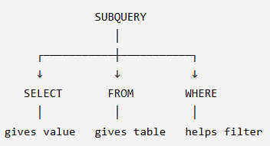
Nested Subqueries
SELECT name, salary, (SELECT AVG(salary) FROM instructor) AS avg_salary FROM instructor;
name | salary | avg_salary
Einstein | 95,000 | 75,000
Gold | 87,000 | 75,000
Katz | 75,000 | 75,000
Mozart | 40,000 | 75,000

Slide 47
Set Membership

Slide 48
Set Membership
Find courses offered in Fall 2017 and in Spring 2018
Find courses offered in Fall 2017 but not in Spring 2018
select distinct course_id
from section
where semester = 'Fall' and year= 2017 and
course_id in (select course_id
from section
where semester = 'Spring' and year= 2018);
select distinct course_id
from section
where semester = 'Fall' and year= 2017 and
course_id not in (select course_id
from section
where semester = 'Spring' and year= 2018);

Slide 49
Set Membership (Cont.)
Name all instructors whose name is neither “Mozart” nor Einstein”
select distinct name
from instructor
where name not in ('Mozart', 'Einstein')
Find the total number of (distinct) students who have taken course sections taught by the instructor with ID 10101
select count (distinct ID)
from takes
where (course_id, sec_id, semester, year) in
(select course_id, sec_id, semester, year
from teaches
where teaches.ID= 10101);

Slide 50
Set Comparison

Slide 51
Set Comparison – “some” Clause
Find names of instructors with salary greater than that of some (at least one) instructor in the Biology department.
Same query using > some clause
select distinct T.name
from instructor as T, instructor as S
where T.salary > S.salary and S.dept name = 'Biology';
select name
from instructor
where salary > some (select salary
from instructor
where dept name = 'Biology');

Slide 52
Set Comparison – “all” Clause
Find the names of all instructors whose salary is greater than the salary of all instructors in the Biology department.
select name
from instructor
where salary > all (select salary
from instructor
where dept name = 'Biology');

Slide 53
Set Comparison
Condition | Meaning
> SOME (...) | Greater than at least one value
> ANY (...) | Greater than at least one value
> ALL (...) | Greater than every value

Slide 54
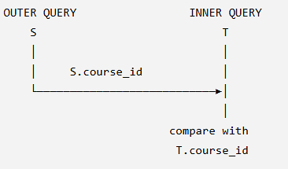
Use of “exists” Clause
“Find all courses taught in both the Fall 2017 semester and in the Spring 2018 semester”
select course_id
from section as S
where semester = 'Fall' and year = 2017 and
exists (select *
from section as T
where semester = 'Spring' and year= 2018
and S.course_id = T.course_id);
Correlation name – variable S in the outer query
Correlated subquery – the inner query

Slide 55
Use of “exists” Clause
course_id | semester | year
CS-101 | Fall | 2017
CS-347 | Fall | 2017
PHY-101 | Fall | 2017
CS-101 | Spring | 2018
CS-315 | Spring | 2018
PHY-101 | Spring | 2018
CS-101
CS-347
PHY-101
SELECT *
FROM section AS T
WHERE semester = 'Spring'
AND year = 2018
AND 'CS-101' = T.course_id;
course_id
CS-101
PHY-101

Slide 56
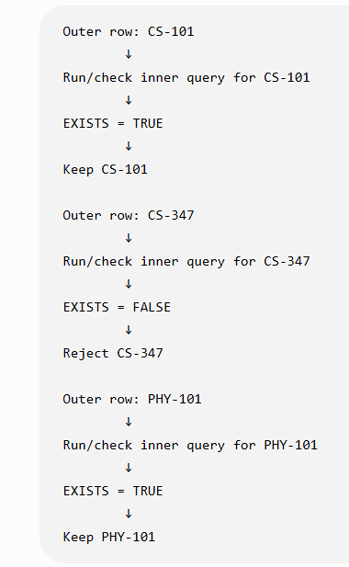
Use of “exists” Clause

Slide 57
Use of “not exists” Clause
Find all students who have taken all courses offered in the Biology department.
Student | Courses taken
Amit | BIO-101, BIO-201, BIO-301
Ravi | BIO-101, BIO-201
Neha | BIO-101, BIO-201, BIO-301, CS-101
Notes:
Meaning of not exist: Keep the student if there does NOT EXIST any Biology course that the student has not taken.
Query: For each student S, take the set of all Biology courses and subtract the courses taken by S. If nothing remains, select that student.
Query: Select a student if there is NO Biology course that the student is missing.

Slide 58
Use of “not exists” Clause
Find all students who have taken all courses offered in the Biology department.
Note that X – Y = Ø ⇔ X ⊆ Y
Note: Cannot write this query using = all and its variants
select distinct S.ID, S.name
from student as S
where not exists ( (select course_id
from course
where dept_name = 'Biology')
except
(select T.course_id
from takes as T
where S.ID = T.ID));
First nested query lists all courses offered in Biology
Second nested query lists all courses a particular student took
Notes:
Meaning of not exist: Keep the student if there does NOT EXIST any Biology course that the student has not taken.
Query: For each student S, take the set of all Biology courses and subtract the courses taken by S. If nothing remains, select that student.
Query: Select a student if there is NO Biology course that the student is missing.

Slide 59
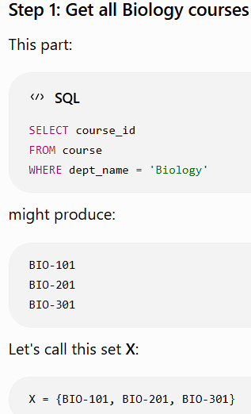
Use of “not exists” Clause
(select course_id from course where dept_name = 'Biology')

Slide 60
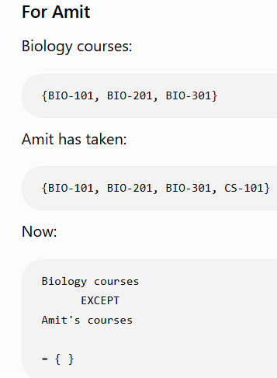
Use of “not exists” Clause
SELECT T.course_id FROM takes AS T WHERE S.ID = T.ID
All Biology courses
EXCEPT
Courses taken by Amit
X = {BIO-101, BIO-201, BIO-301}
Y = {BIO-101, BIO-201, BIO-301}
EXISTS(empty set) → FALSE
NOT EXISTS(empty set) → TRUE
NOT EXISTS
→ "I cannot find even one Biology course that this student has failed to take."

Slide 61
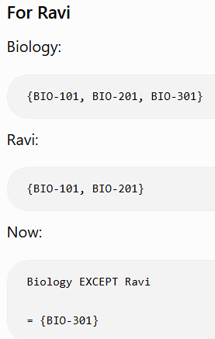
Use of “not exists” Clause
SELECT T.course_id FROM takes AS T WHERE S.ID = T.ID

Slide 62
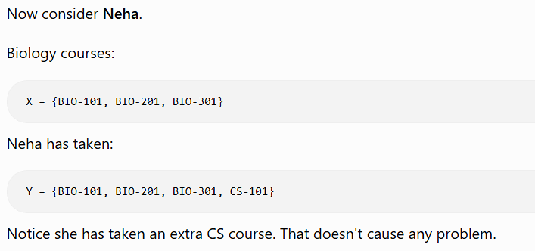
Use of “not exists” Clause
{BIO-101, BIO-201, BIO-301}
-
{BIO-101, BIO-201, BIO-301, CS-101}
= { }

Slide 63
Use of “exists” and “not exists” Clause
EXISTS
→ "Can I find at least one matching row?"
NOT EXISTS
→ "I cannot find even one matching row.“

Slide 64
Test for Absence of Duplicate Tuples
The unique construct tests whether a subquery has any duplicate tuples in its result.
The unique construct evaluates to “true” if a given subquery contains no duplicates .
Find all courses that were offered at most once in 2017
  select T.course_id
  from course as T
  where unique ( select R.course_id
  from section as R
  where T.course_id= R.course_id
  and R.year = 2017);

Slide 65
Test for Absence of Duplicate Tuples
course_id | sec_id | semester | year
CS-101 | 1 | Fall | 2017
CS-101 | 2 | Fall | 2017
CS-315 | 1 | Spring | 2017
CS-347 | 1 | Fall | 2018
CS-101
CS-315
CS-347
Course Table
SELECT R.course_id FROM section AS R WHERE R.course_id = 'CS-101'
AND R.year = 2017;
course_id
CS-315
CS-347

Slide 66
For offered exactly once in 2017
SELECT T.course_id FROM course AS T
WHERE UNIQUE (SELECT R.course_id
FROM section AS R
WHERE T.course_id = R.course_id
AND R.year = 2017)
AND EXISTS
(SELECT * FROM section AS R WHERE T.course_id = R.course_id
AND R.year = 2017);

Slide 67
Subqueries in the From Clause

Slide 68
Subqueries in the From Clause
SQL allows a subquery expression to be used in the from clause
Find the average instructors’ salaries of those departments where the average salary is greater than $42,000.”
  select dept_name, avg_salary
  from ( select dept_name, avg (salary) as avg_salary
  from instructor
  group by dept_name)
  where avg_salary > 42000;
Note that we do not need to use the having clause
Another way to write above query
  select dept_name, avg_salary
  from ( select dept_name, avg (salary)
  from instructor
  group by dept_name)
  as dept_avg (dept_name, avg_salary)
  where avg_salary > 42000;

Slide 69
HAVING version:
instructor
↓
GROUP BY
↓
AVG(salary)
↓
HAVING AVG(salary) > 42000
Subquery version:
instructor
↓
GROUP BY
↓
AVG(salary)
↓
temporary table
↓
WHERE avg_salary > 42000

Slide 70
With Clause
The with clause provides a way of defining a temporary relation whose definition is available only to the query in which the with clause occurs.
Find all departments with the maximum budget
with max_budget (value) as
(select max(budget)
from department)
select department.name
from department, max_budget
where department.budget = max_budget.value;
The WITH version is useful because for larger queries, giving an intermediate result a meaningful name can make the SQL easier to read and reuse within the statement.

Slide 71
With Clause
name | building | budget
Biology | Watson | 90,000
Comp. Sci. | Taylor | 120,000
Finance | Painter | 120,000
Music | Packard | 80,000
Physics | Watson | 100,000
value
120000
Department | Budget | budget = 120000
Biology | 90,000 | No
Comp. Sci. | 120,000 | Yes
Finance | 120,000 | Yes
Music | 80,000 | No
Physics | 100,000 | No

Slide 72
Complex Queries using With Clause
Find all departments where the total salary is greater than the average of the total salary at all departments
with dept _total (dept_name, value) as
(select dept_name, sum(salary)
from instructor
group by dept_name),
dept_total_avg(value) as
(select avg(value)
from dept_total)
select dept_name
from dept_total, dept_total_avg
where dept_total.value > dept_total_avg.value;

Slide 73
Scalar Subquery
Scalar subquery is one which is used where a single value is expected
List all departments along with the number of instructors in each department
select dept_name,
( select count(*)
from instructor
where department.dept_name = instructor.dept_name)
as num_instructors
from department;
Runtime error if subquery returns more than one result tuple

Slide 74
Scalar Subquery
dept_name | building | budget
Biology | Watson | 90000
Comp. Sci. | Taylor | 100000
Music | Packard | 80000
Physics | Watson | 95000
SELECT COUNT(*) FROM instructor
WHERE 'Biology’ = instructor.dept_name;
dept_name | num_instructors
Biology | 2
ID | name | dept_name
101 | Amit | Biology
102 | Ravi | Biology
103 | Neha | Comp. Sci.
104 | Raj | Comp. Sci.
105 | Tina | Comp. Sci.
106 | Mohan | Physics
dept_name | num_instructors
Biology | 2
Comp. Sci. | 3
Music | 0
Physics | 1

Slide 75
Modification of the Database
Deletion of tuples from a given relation.
Insertion of new tuples into a given relation
Updating of values in some tuples in a given relation

Slide 76
Deletion
Delete all instructors
delete from instructor
Delete all instructors from the Finance department
delete from instructor
where dept_name= 'Finance’;
Delete all tuples in the instructor relation for those instructors associated with a department located in the Watson building.
delete from instructor
where dept name in (select dept name
from department
where building = 'Watson');

Slide 77
Insertion
Add a new tuple to course
insert into course
values ('CS-437', 'Database Systems', 'Comp. Sci.', 4);
or equivalently
insert into course (course_id, title, dept_name, credits)
values ('CS-437', 'Database Systems', 'Comp. Sci.', 4);
Add a new tuple to student with tot_creds set to null
insert into student
values ('3003', 'Green', 'Finance', null);

Slide 78
Insertion (Cont.)
Make each student in the Music department who has earned more than 144 credit hours an instructor in the Music department with a salary of $18,000.
insert into instructor
select ID, name, dept_name, 18000
from student
where dept_name = 'Music' and total_cred > 144;
The select from where statement is evaluated fully before any of its results are inserted into the relation.
Otherwise queries like
insert into table1 select * from table1
would cause problem

Slide 79
Insertion (Cont.)
ID | name | dept_name | total_cred
101 | Amit | Music | 150
102 | Ravi | Music | 130
103 | Neha | Physics | 155
104 | Tina | Music | 160
Student | Music? | Credits > 144? | Selected?
Amit | Yes | 150 > 144 | ✓
Ravi | Yes | 130 > 144 | ✗
Neha | No | 155 > 144 | ✗
Tina | Yes | 160 > 144 | ✓
ID | name | dept_name | salary
201 | Smith | Biology | 65000
202 | Brown | Physics | 72000
101 | Amit | Music | 18000
104 | Tina | Music | 18000

Slide 80
Updates
Give a 5% salary raise to all instructors
  update instructor
  set salary = salary * 1.05
Give a 5% salary raise to those instructors who earn less than 70000
update instructor
set salary = salary * 1.05
where salary < 70000;
Give a 5% salary raise to instructors whose salary is less than average
update instructor
set salary = salary * 1.05
where salary < (select avg (salary)
from instructor);

Slide 81
Updates (Cont.)
Increase salaries of instructors whose salary is over $100,000 by 3%, and all others by a 5%
  Write two update statements:
  update instructor
  set salary = salary * 1.03
  where salary > 100000;
  update instructor
  set salary = salary * 1.05
  where salary <= 100000;
  The order is important
  Can be done better using the case statement (next slide)

Slide 82
Case Statement for Conditional Updates
Same query as before but with case statement
update instructor
set salary =
case
when salary <= 100000
then salary * 1.05
else
salary * 1.03
end

Slide 83
Updates with Scalar Subqueries
Recompute and update tot_creds value for all students
update student S
set tot_cred = (select sum(credits)
from takes, course
where takes.course_id = course.course_id and
S.ID= takes.ID.and takes.grade <> 'F' and
takes.grade is not null);
Sets tot_creds to null for students who have not taken any course
Instead of sum(credits), use:
case
when sum(credits) is not null then sum(credits)
else 0
end

Slide 84
ID | name | tot_cred
101 | Amit | 20
102 | Ravi | 15
103 | Neha | 10
104 | Mohan | 5
course_id | title | credits
CS-101 | Programming | 4
CS-201 | DBMS | 3
CS-301 | Networks | 4
MA-101 | Mathematics | 3
ID | course_id | grade
101 | CS-101 | A
101 | CS-201 | B
101 | MA-101 | A
102 | CS-101 | A
102 | CS-301 | F
103 | CS-201 | B
103 | MA-101 | NULL
ID | name | new tot_cred
101 | Amit | 10
102 | Ravi | 4
103 | Neha | 3
104 | Mohan | NULL

