Slide 1
NPV variance

Slide 2
NPV
$NPV=\frac{Year 1 inflow}{{\left(1+discount \%\right)}^{1}}+\frac{Year 2 inflow}{({1+discount \%)}^{2}}+\frac{Year 3 inflow}{({1+discount \%)}^{3}}…−Initial investment$

Slide 3
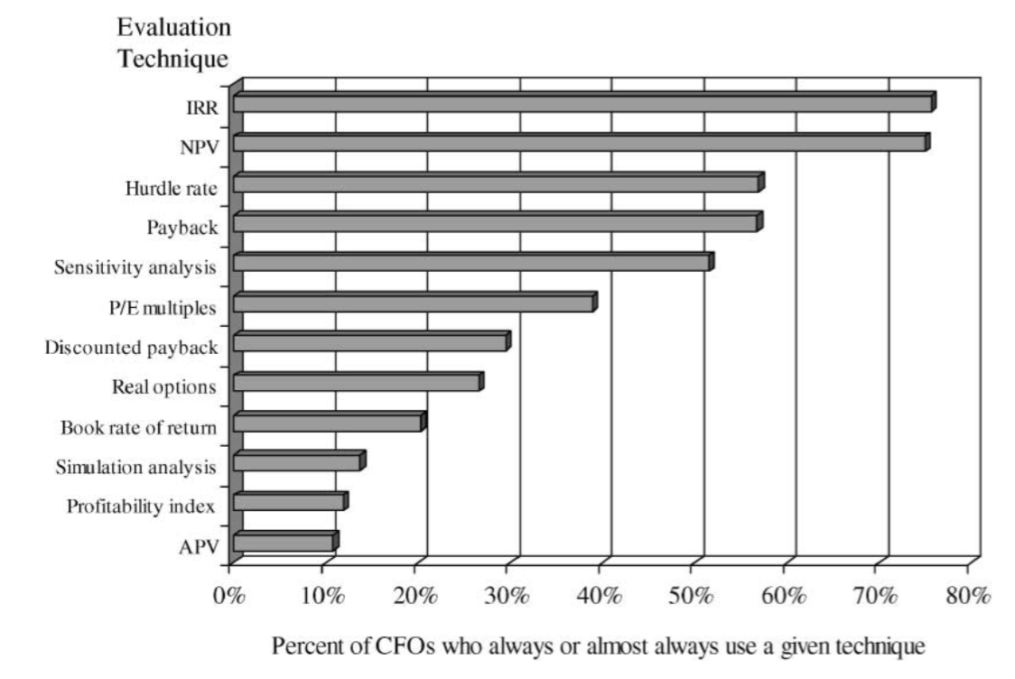
NPV is used very frequently
75%
Sample: 392 CFOs (Graham & Harvey, 2001)
Predictors:
Large firms > small firms
High debt ratio > small debt ratio

Slide 4
The NPV paradox
“Although the NPV method is criticized by both practitioners and academics, the traditional NPV calculation is by far the most commonly used tool for [exploration & production] project valuation.” (Willigers et al., 2017)
“NPV is almost always applicable but is almost always wrong” (Fox, 2008)
“the NPV rule as governing all capital budgeting decisions may not be appropriate” (Arya et al., 1998)

Slide 5
Consequences
Researchers studied 174 cases of fraudulent financial reporting
Fraudulent “facts” vs “forecasts”
Forecasts based on unreasonable accounting assumptions
Form 40% of fraud cases
Account for 44% of economic losses
Total damages by fraudulent facts: US$ 27 billion
Total damages by fraudulent forecasts: US$ 23 billion

Slide 6
NPV
$NPV=\frac{Year 1 inflow}{{\left(1+discount \%\right)}^{1}}+\frac{Year 2 inflow}{({1+discount \%)}^{2}}+\frac{Year 3 inflow}{({1+discount \%)}^{3}}…−Initial investment$
Where do these cash inflows come from?

Slide 7
“It’s impossible to forecast most projects’ actual cash flows accurately” (Myers, 1984)

Slide 8
Forecasting is error-prone
Future forecasts tend to be overly-optimistic
For longevity
For relationships
When dopamine is increased
In animal behaviour
Executives are similarly overly-optimistic
In stock market returns
For firm earnings

Slide 9
Forecasting is error-prone
CFO survey between 2001-2011
Over the next year, I expect the annual S&P 500 return will be:
There is a 1-in-10 chance the actual return will be less than ___%.
I expect the return to be: ___%.
There is a 1-in-10 chance the actual return will be greater than ___%.
13,346 estimates

Slide 10
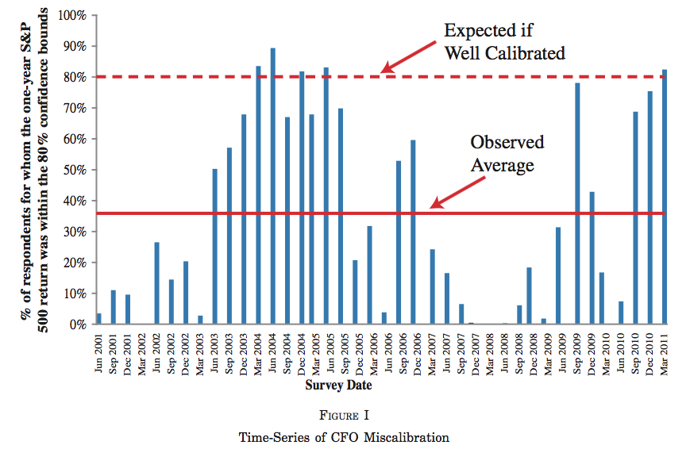
Forecasting is error-prone
36%

Slide 11
Paying attention to variance
Ranges are frequently used for forecast estimates
80% of the time between 2002-2010
Taking account of variance increases forecasting accuracy

Slide 12
Paying attention to variance - Example
Project A
Project B
Range: 400-600
Range: 0-1000
Mean = 500
Identical NPV!
Will you rely more on both measures equally?

Slide 13
Summary
NPV is used a lot, but criticised by some
The costs of poor forecasting are potentially high
NPV relies on forecasting
Executives may underestimate forecast variance

Slide 14
Bottom line
Pay attention to cash inflow variance
Not all NPVs are created equal
NPV based on more variance should be weighted less than other measures

