Slide 1

Sign Language for Numbers
Hand Gesture Recognition Datasets for Numbers

Slide 2

Index
Team Details
The Story
The Data
Architecture
Work Details
Data Preprocessing – Prabhanjan Trivedi
SVM – Harshita Patil
KNN – Shireesha Maddi
CNN – Vasim Shaikh
Ensemble Method
Results
Conclusion

Slide 3
Team Details
Team Name – Debug Entity
Group – 5
Harshita Patil - hp2qm@umsystem.edu
Shireesha Maddi - smy44@umsystem.edu
Prabhanjan Trivedi - ptzwb@umsystem.edu
Vasim Shaikh – vfs73f@umsystem.edu

Slide 4
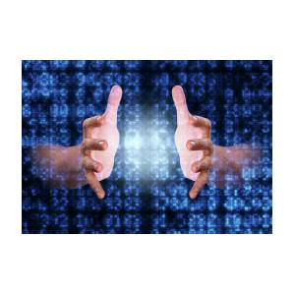
The Story
The Sign language is very important for people who have hearing and speaking deficiency generally called Deaf And Mute.
It is the only mode of communication for such people to convey their messages and it becomes very important for people to understand their language.
Sign language recognition (SLR) system takes an input expression from the hearing-impaired person gives output to the other person in the form of text or voice.

Slide 5
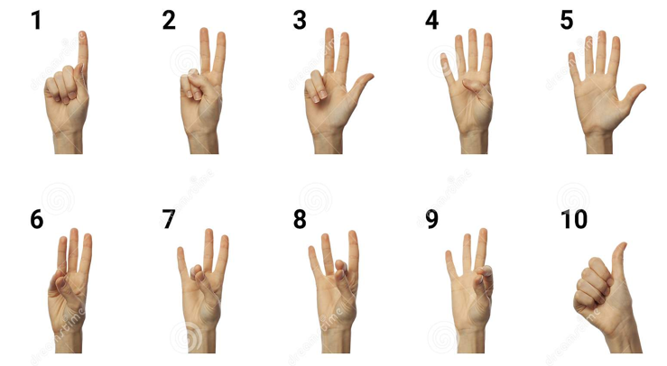
The Data Details
Sign language datasets for hand gesture recognition for numbers
Source of data – Kaggle – Link in reference slide
Sample hand signs are in below picture
Total number of training images – 1500 images for each sign = 16,500
Covering hand images 0 – 9 and unknown (Total classes – 11)
Input data type – RGB Images(3 channels)
Assumption – All input images are front facing

Slide 6
Architecture
Input Data
Data Pre-processing
Get RGB Data
Convert to Grey image
Image resizing
Pixel Scaling
(axbx3)
axbx1
Build the model
Training Data
Extract Features
Model
Test Data
Prediction
Model Output

Slide 7
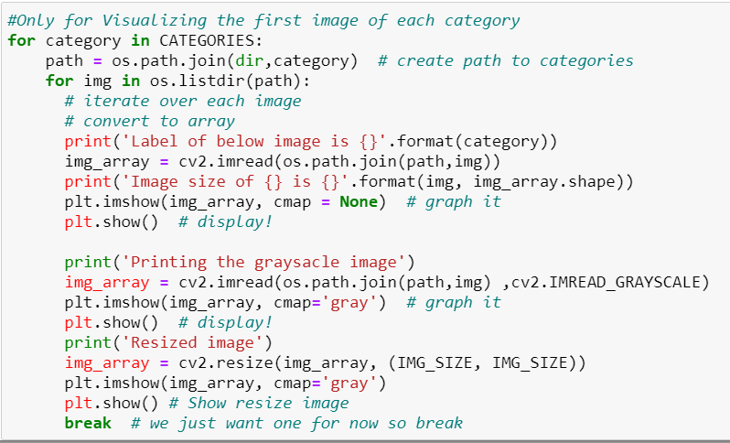
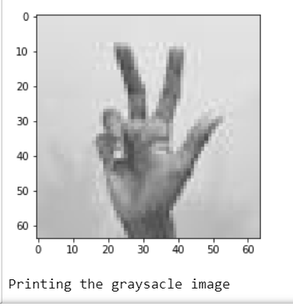
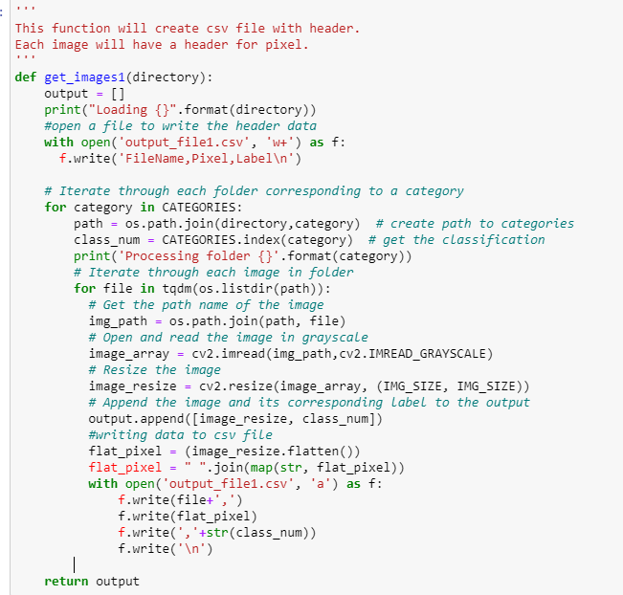
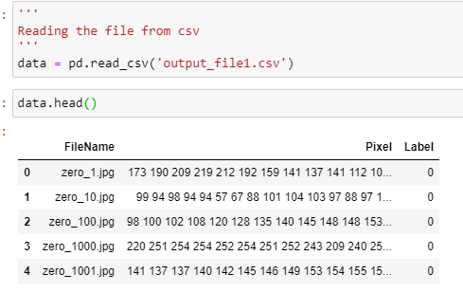
Data Pre-processing

Slide 8
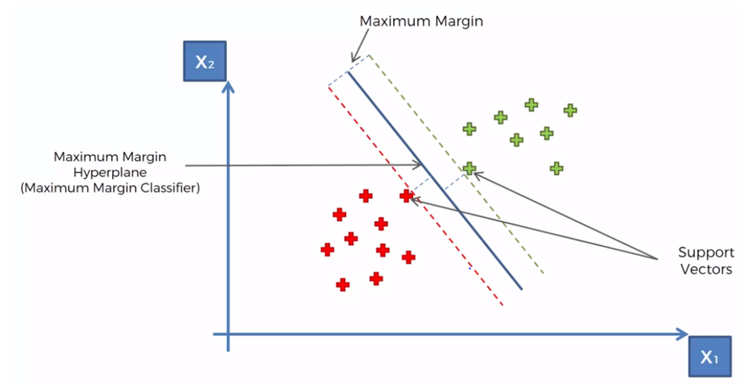
SVM - Support Vector Machine
SVM is Supervised learning algorithm.
Can be used for classification as SVC.
Types of kernels –
Linear Kernel
Radial basis function(RBF)
Polynomial Kernel
For Input image data linear kernel accuracy = 69.99%
For same input RBF accuracy is 79.99%.
Due to higher accuracy used RBF kernel for this project.

Slide 9
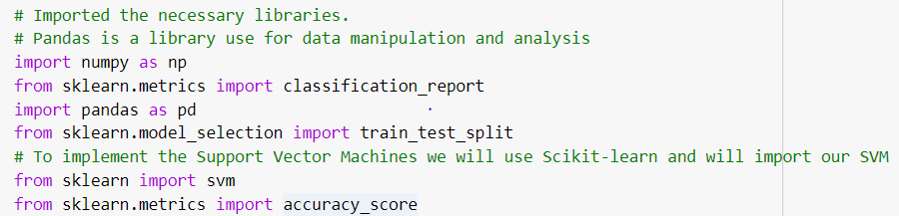
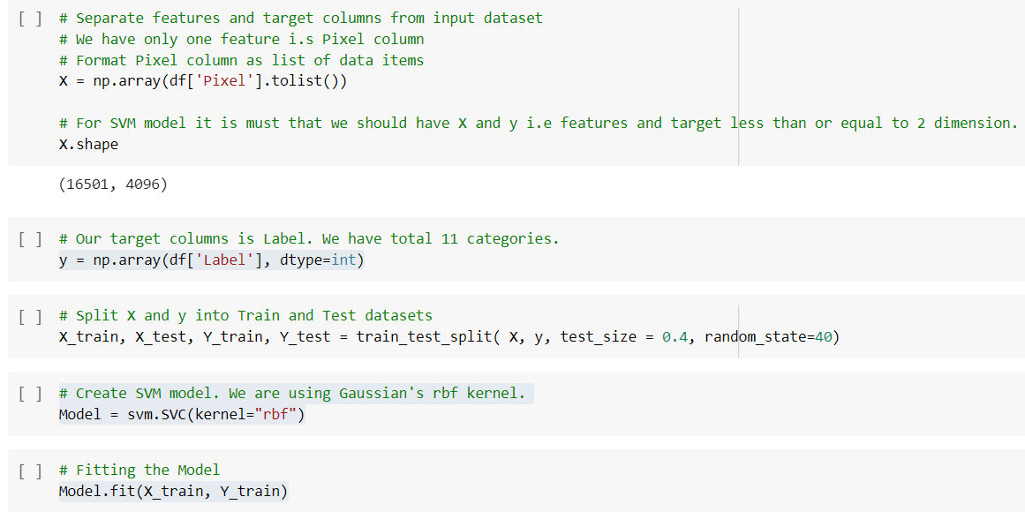
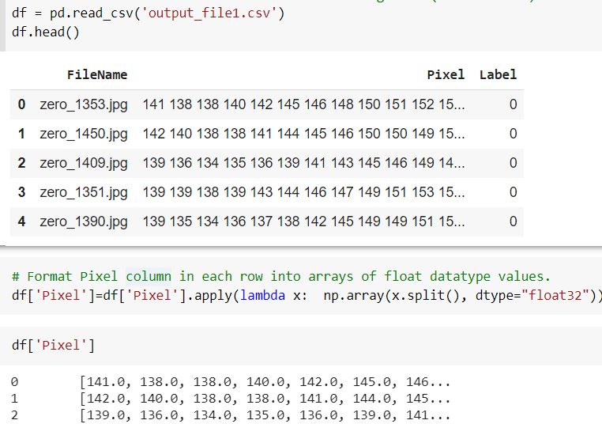
SVM
Step 1: Data Load and formatting.
Step 2: Create, Train & Fit model.

Slide 10
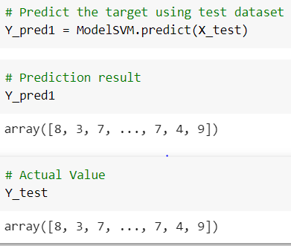
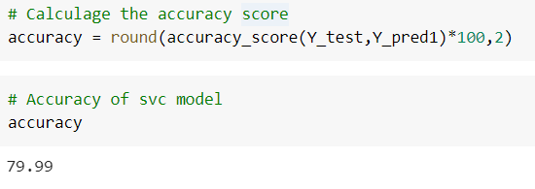
SVM
Prediction:
Accuracy:

Slide 11
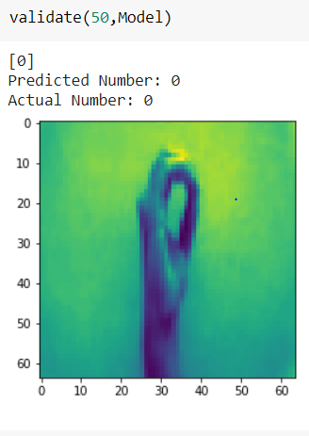
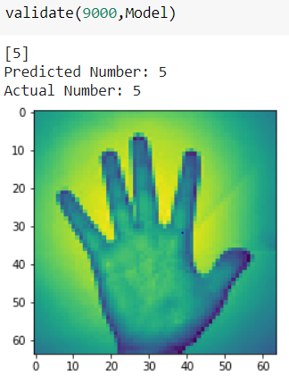
SVM
Validation on Test Images

Slide 12
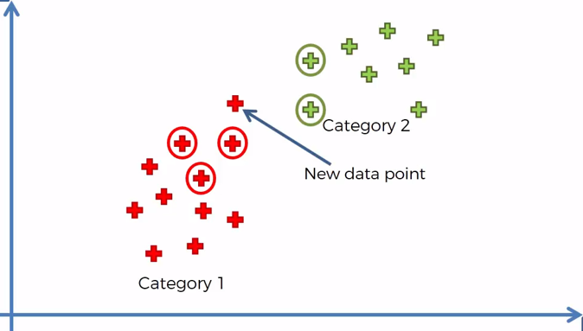
KNN - K Nearest Neighbor
K-NN model is a Machine learning method.
K-NN model is classified under supervised learning algorithm.
The algorithm uses K-neighbor classifier with k values.
By using Euclidean distance, the nearest numbers of the new data point are taken.
K-NN classifier, this predicts label based on nearest images in the training set.
Observations in Sign Language for Numbers:
For K = 1, K-NN classifier accuracy= 84%
For K = 3, K-NN classifier accuracy =79%
By observing the accuracy of different K values, smaller K – value is giving more accuracy compared to larger K- value.

Slide 13


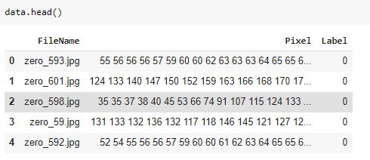


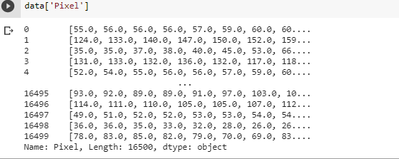

KNN
Step 1: Data load and formatting
Step 2: Create, Train/Test and Fitting Model

Slide 14
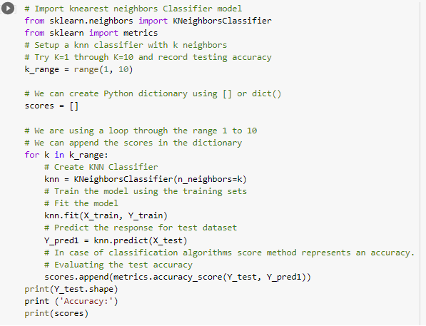
KNN
No. of
K neighbors
Knn classifier
Fit the model
Prediction
Accuracy

Slide 15
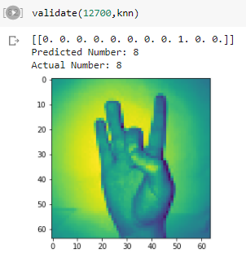

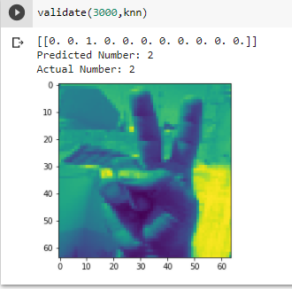

KNN
Accuracy values for KNN, with K values from 1 to 10

Slide 16
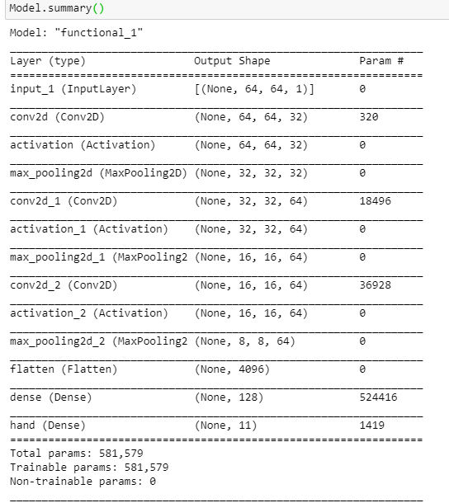
CNN Model
CNNs are used for image classification and recognition because of its high accuracy
Input Data
CONV 2D , relu
MaxPooling 2D
CONV 2D , relu
MaxPooling 2D
CONV 2D , relu
MaxPooling 2D
Flatten
Dense – 128, relu
Dense – 11, softmax

Slide 17

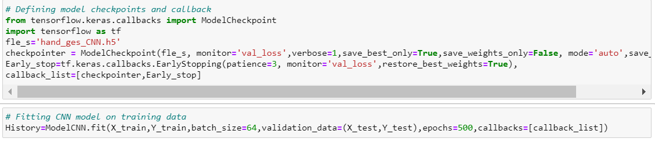
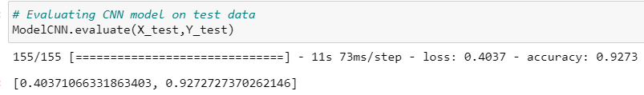
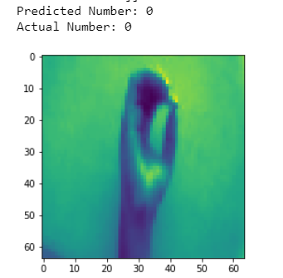
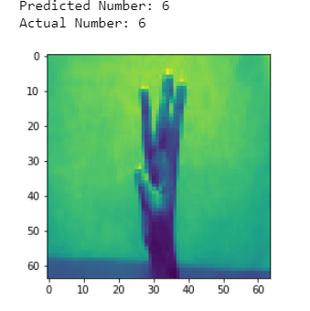
CNN Model

Slide 18
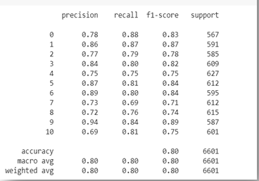
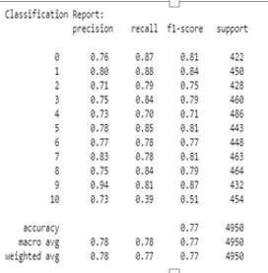
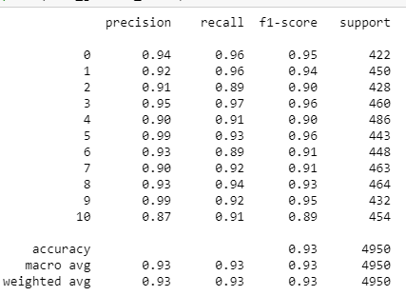
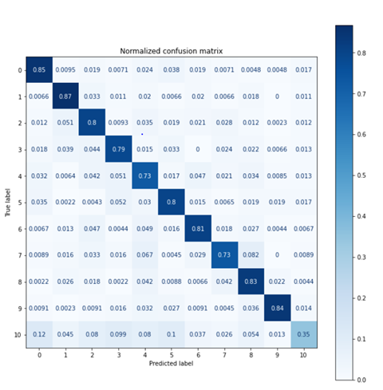
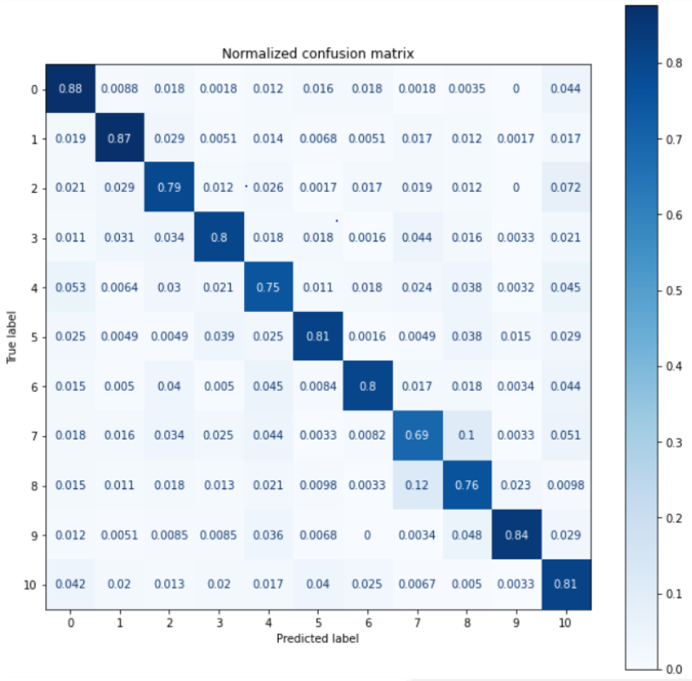
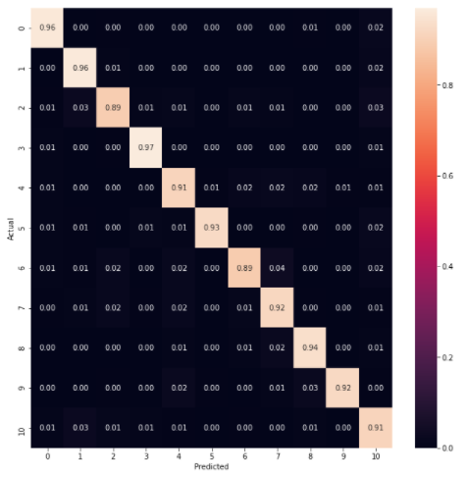
Model Evaluation
SVM
KNN
CNN

Slide 19
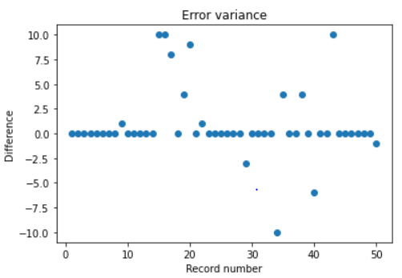
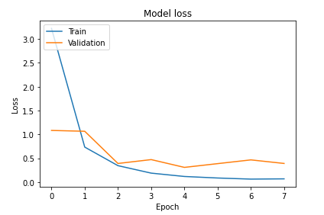
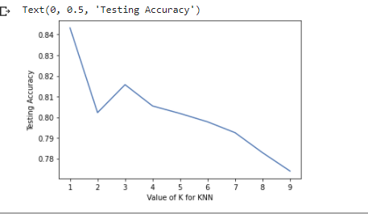
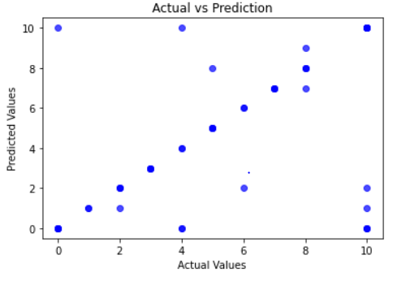
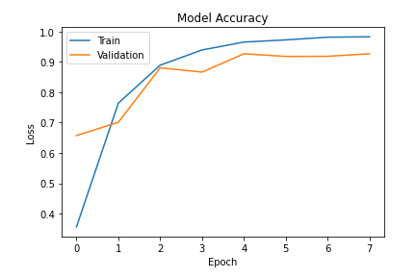
Results
SVM
KNN
CNN

Slide 20
Conclusion and Future Work
Successful implemented all the models – SVM , KNN and CNN to identify Sign Language for Numbers
Were able to get comparable results to solutions which were implemented with separate models for predicting each of the categories
Improved performance with Deep learning model as compared to machine learning models
Future work – implement different deep learning models and ensemble model

Slide 21
References
https://www.kaggle.com/muhammadkhalid/sign-language-for-numbers
https://heartbeat.fritz.ai/introduction-to-machine-learning-model-evaluation-fa859e1b2d7f
https://data-flair.training/blogs/sign-language-recognition-python-ml-opencv/
https://towardsdatascience.com/metrics-to-evaluate-your-machine-learning-algorithm-f10ba6e38234

Slide 22
Q & A

Slide 23
THANK YOU

