Slide 1

Distributed Caching-based Acceleration Mechanisms in Datacenter Networks
4th Year Project, Progress Presentation
Project Number: p-2022-093
Students: Anna Axalrod, Shir Granit.
Supervisors: Prof. Chen Avin, Dr. Gabriel Scalosub.

Slide 2
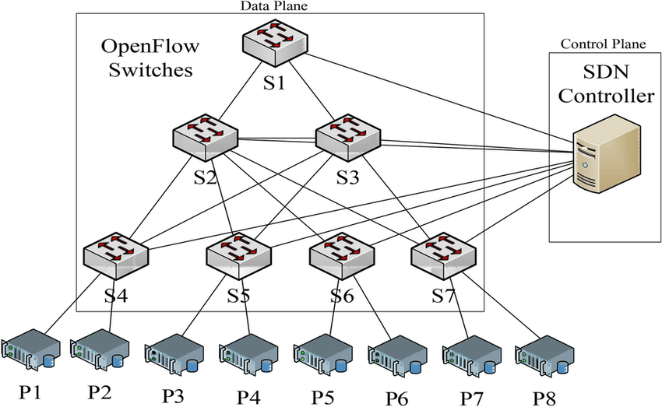
Introduction
The purpose of the project is to prove a significant speedup of the routing process in data center networks.
Distributed or non-distributed cache mechanism, based on an existing solution.
From: Montazerolghaem, Ahmadreza. (2021). Software-defined load-balanced data center: design, implementation and performance analysis.

Slide 3
Our Goals
Create and emulate a distributed datacenter environment, which will consist of switches, hosts, and an SDN network controller with in-network cache management capabilities, in several topologies.
Using the environment to evaluate the performance of a given caching algorithm and measure its efficiency and accuracy.

Slide 4
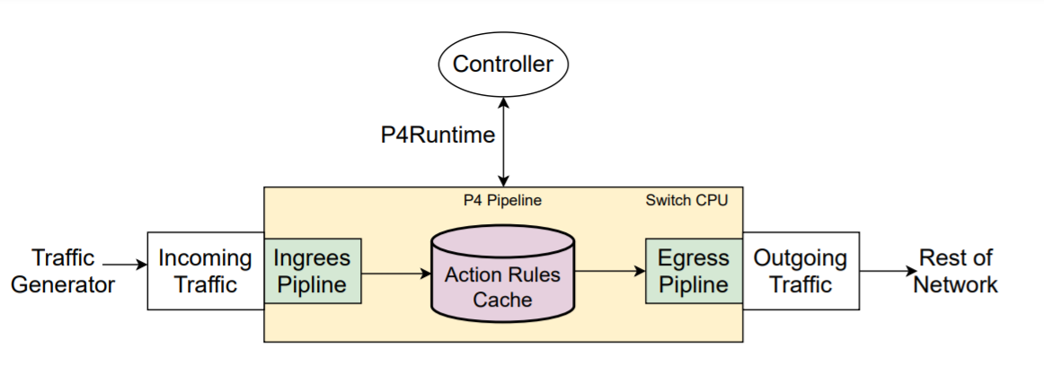
General flow

Slide 5
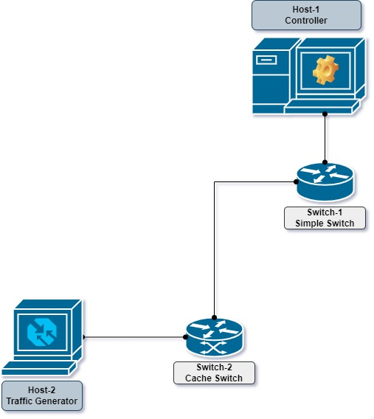
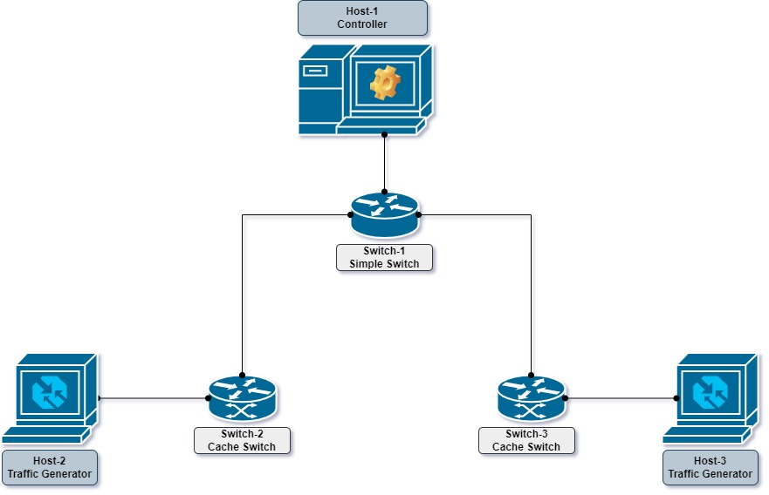

Our System
Experiment #1
Line Topology
Experiment #2
Hat Topology
Running different topologies in Mininet emulation environment.
P4 programing language.
Implementing the cache mechanism:
  Type 1: Each switch communicated directly with the controller to receive rules for it’s cache table.
  Type 2: Switches first look up in neighbors cache tables before addressing the controller.
Type 2 experiment is the main goal for our project.
Experiment #3
Triangle Topology

Slide 6
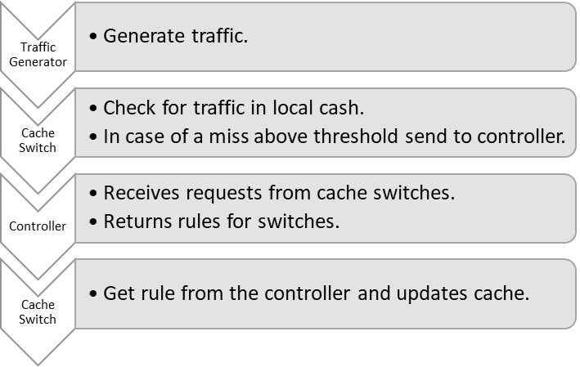
Type 1
Experiment Flow

Slide 7
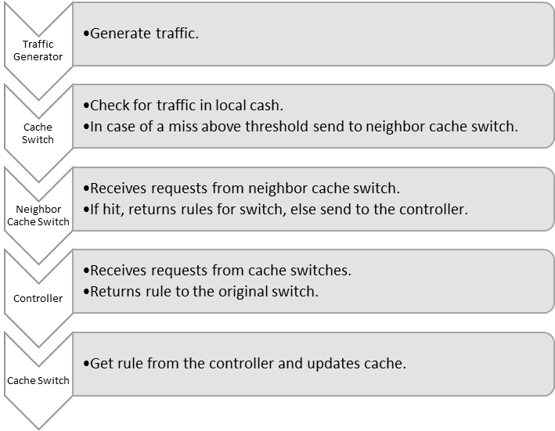
Type 2
Experiment Flow

Slide 8
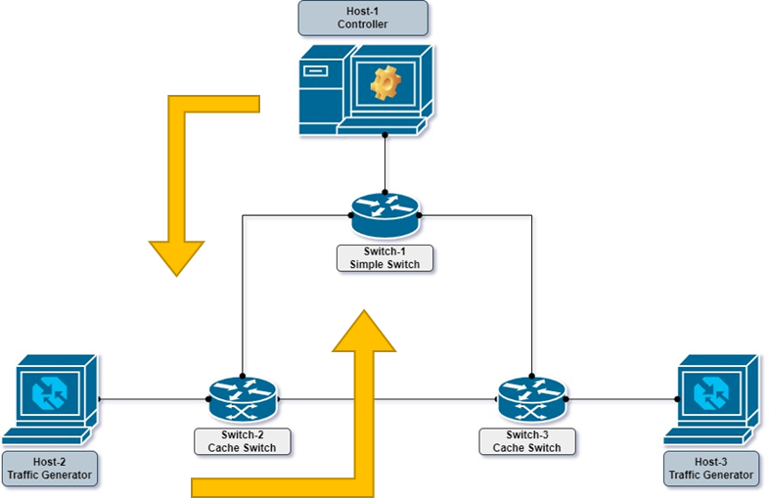
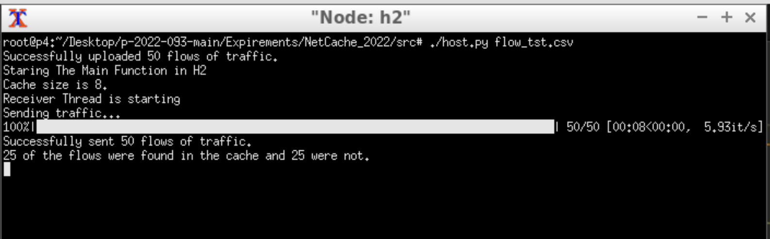
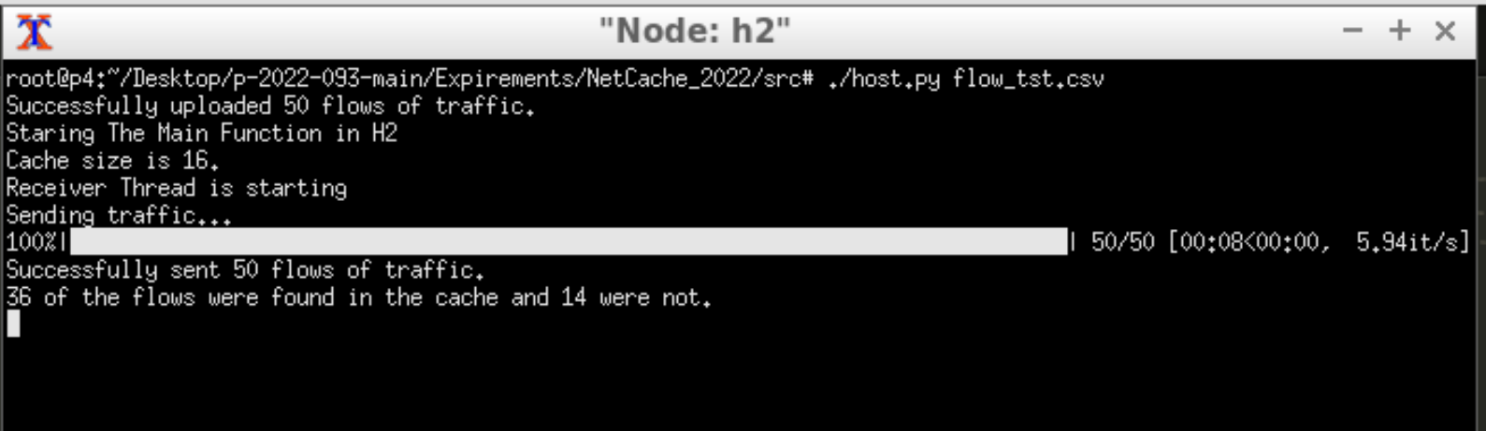
Results So Far
Setting up the Mininet environment.
Preliminary tests for different cache sizes (mock variables for sanity check).
Establishing desired settings for the components of the environment (smart switches and the controller).
Hit-Miss result for host generating 50 packets of traffic from 25 different sources.
Controller policy contains all addresses in traffic, cache size 8, no threshold.
Hit-Miss result for host generating 50 packets of traffic from 25 different sources.
Controller policy contains all addresses in traffic, cache size 16, no threshold.

Slide 9
Looking forward
Main holdback so far – refactoring and revisioning code.
Establishing the Mininet environment, changing the open-source code to adjust the system to our needs.
Experimenting with the parameters chosen for comperisson.
Creating measurement tools to show the results of the experiments.

Slide 10
Time Frames
Month | March | April | May | June | July
Timeframe | End of exam period | Spring Semester |  |  | Exam Period
Mandatory Assignment | Progress Submission. |  |  | Poster Submission. | Final Submission.
 |  |  |  | Presentation Submission.
Top Tasks | Fix bug - p4 data plain |  | Define type 2 flow experiment (triangle) | Run experiments (final results)
 | Divide to the different topologies. | Traffic generating for different hosts | Set configuration files

