Slide 1
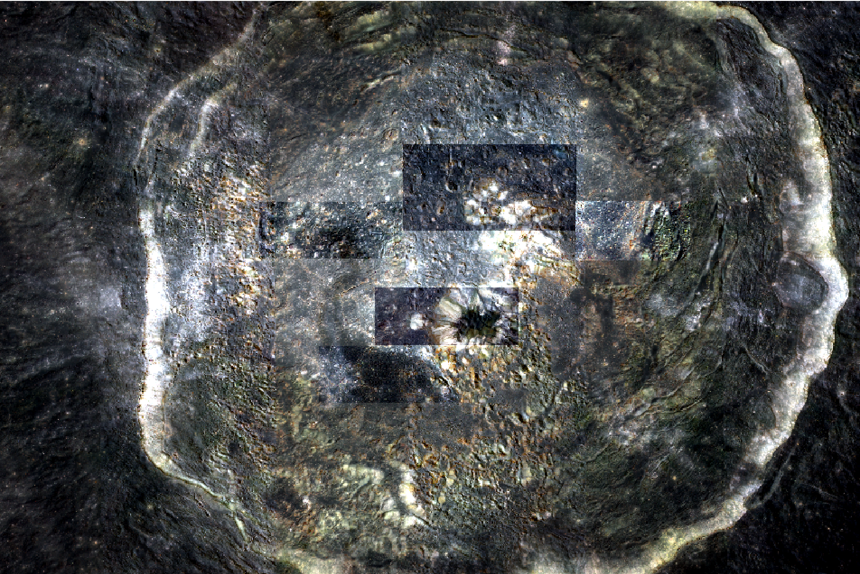
Area5
Area3
Area4
Area1
Area2
Location of each Area in MI image

