Slide 1
DarkSoCV on GPDK045
RTL-to-signoff physical implementation: Innovus · Tempus · Pegasus
45 nm generic PDK · 70% initial utilization · Floorplan → Place → CTS → Route → STA, DRC & LVS

Slide 2
Implementation flow
Tools and checkpoints used, in order
1
Floorplan & power plan
2
Placement
3
Pre-CTS opt
Innovus 22.18 · 70% utilization
Innovus
timeDesign -preCTS
4
Clock tree
5
Route
6
Signoff
CTS + CTD debug
timeDesign -postRoute
Tempus · Pegasus
Signoff coverage: multi-corner STA (Tempus 23.14), DRC and LVS (Pegasus 22.13).
DarkSoCV · gpdk045 · PnR → Signoff
2

Slide 3
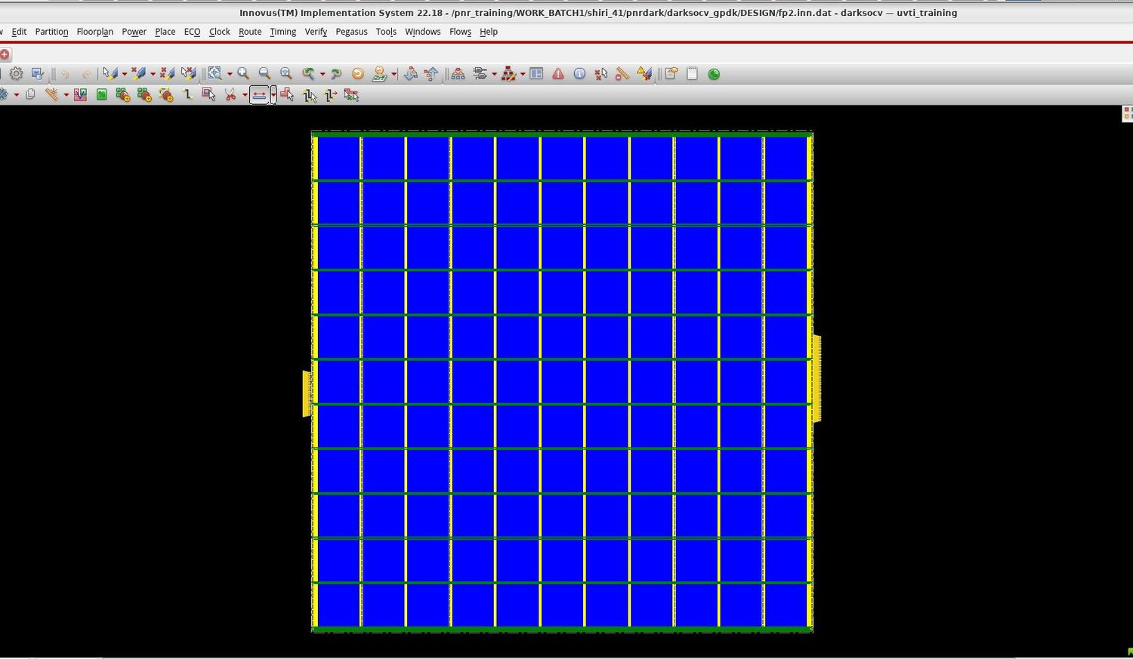
Floorplan & power plan
fp2.inn.dat · 70% initial utilization
Square core sized for 70% initial utilization
Power grid mesh: vertical stripes (yellow) crossed by horizontal stripes (green)
Power rings around the core edge
IO pins on the left and right edges
Saved as the fp2 checkpoint before placement
DarkSoCV · gpdk045 · PnR → Signoff
3

Slide 4
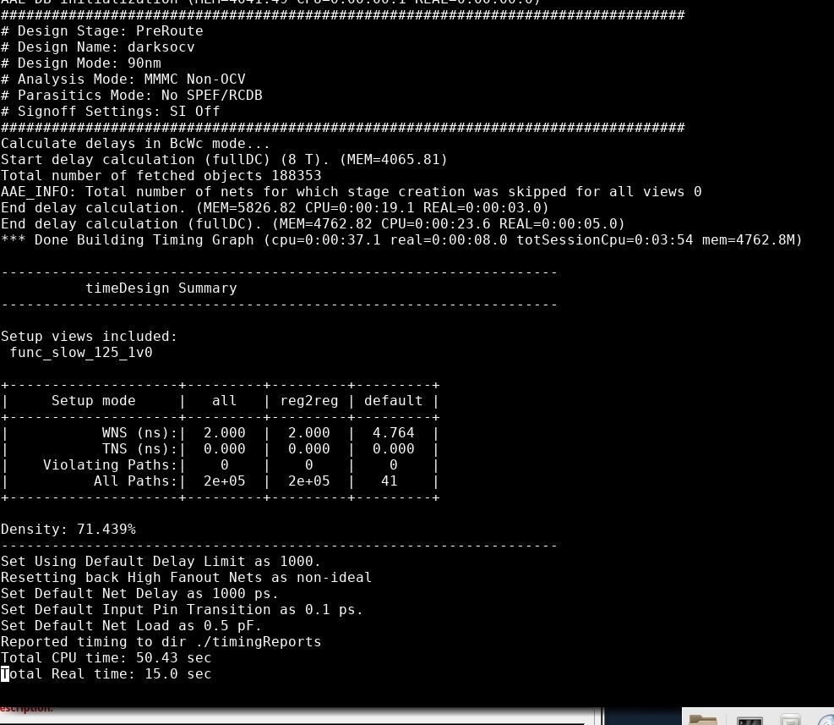
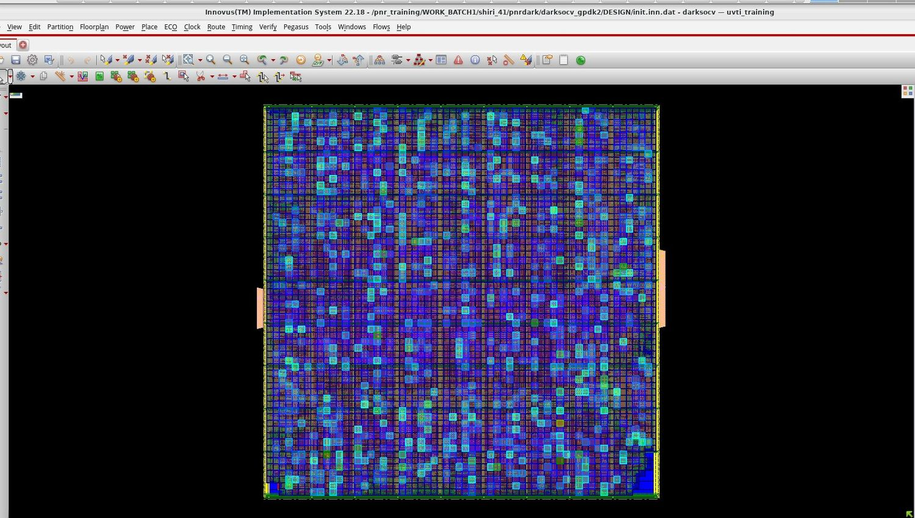
Placement & congestion
Initial utilization 70%
Post-placement timeDesign (func_slow_125_1v0)
Congestion map after placement
71.4%
+2.000 ns
Placement-stage timing is relaxed with large positive slack
Congestion map shows no concentrated hot spot
placement density
WNS · 0 violating
DarkSoCV · gpdk045 · PnR → Signoff
4

Slide 5
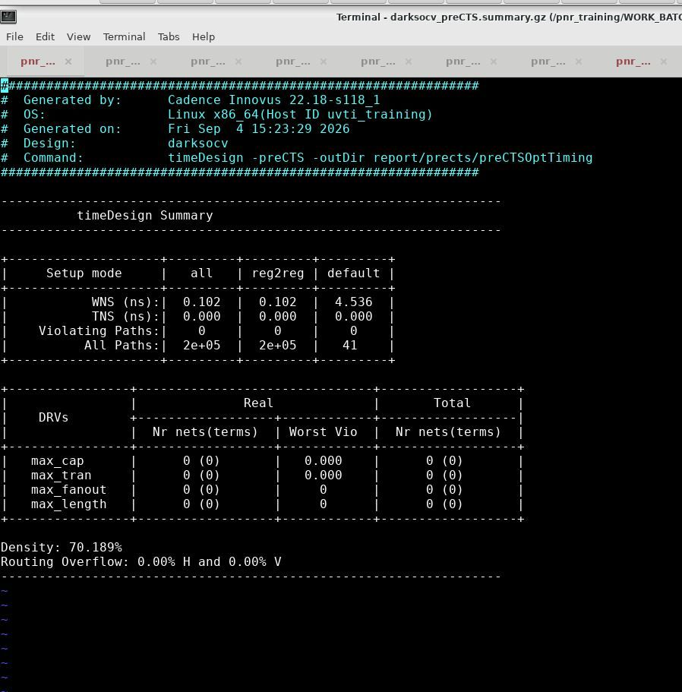
Pre-CTS optimisation
timeDesign -preCTS
+0.102 ns
WNS (reg2reg) · TNS 0.000
0
violating paths · 0 DRVs
70.2%
density
0.00% H / 0.00% V
routing overflow
DarkSoCV · gpdk045 · PnR → Signoff
5

Slide 6
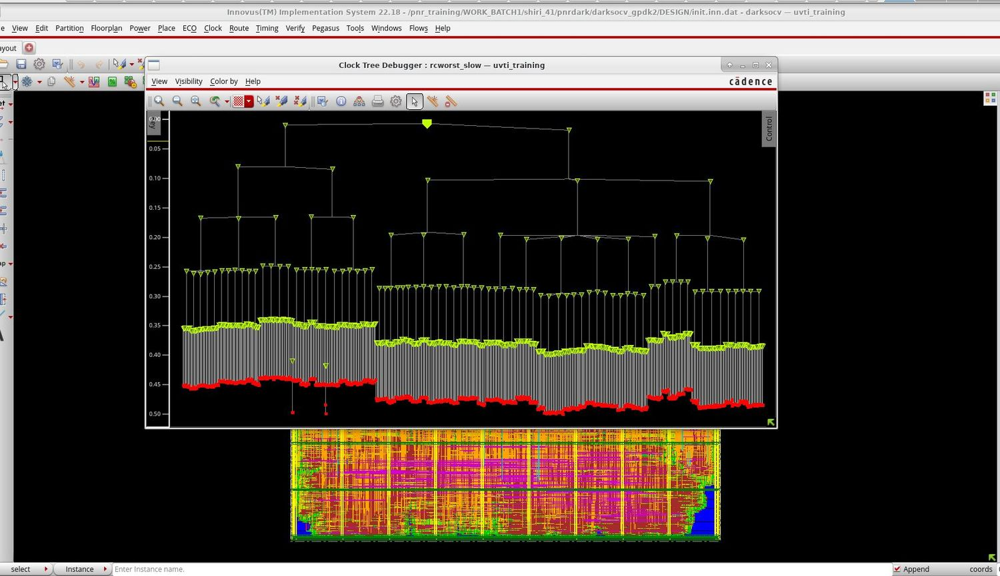
Clock tree
Clock Tree Debugger, rcworst_slow corner
Multi-level balanced tree from a single root buffer
Sink insertion delays about 0.35–0.50 ns (read from CTD plot)
Sub-trees are well matched, with a small step between blocks
A few outlier sinks sit just below the main sink band
DarkSoCV · gpdk045 · PnR → Signoff
6

Slide 7
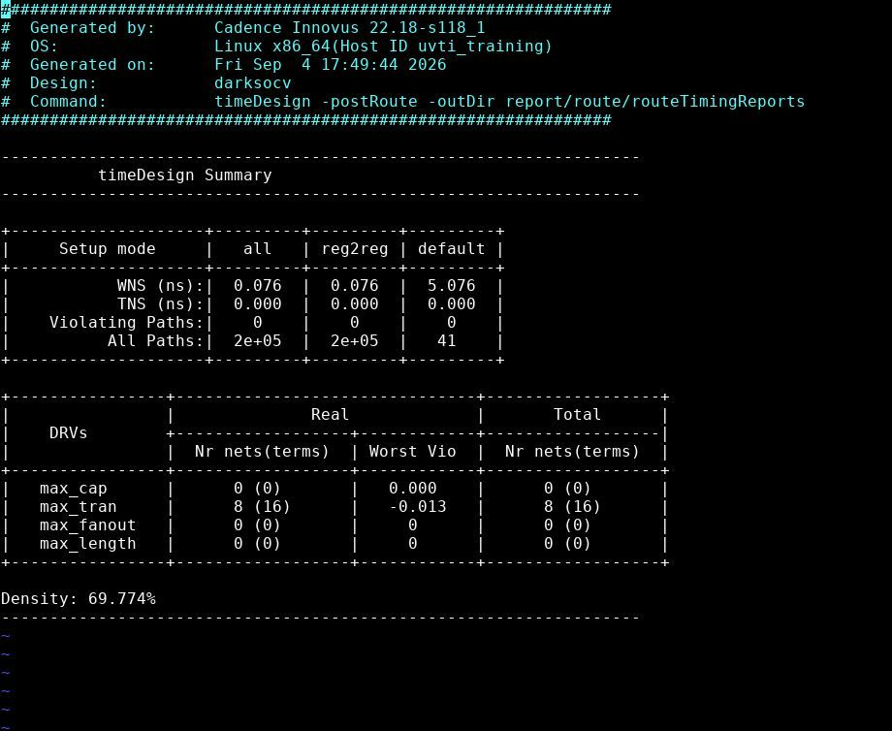
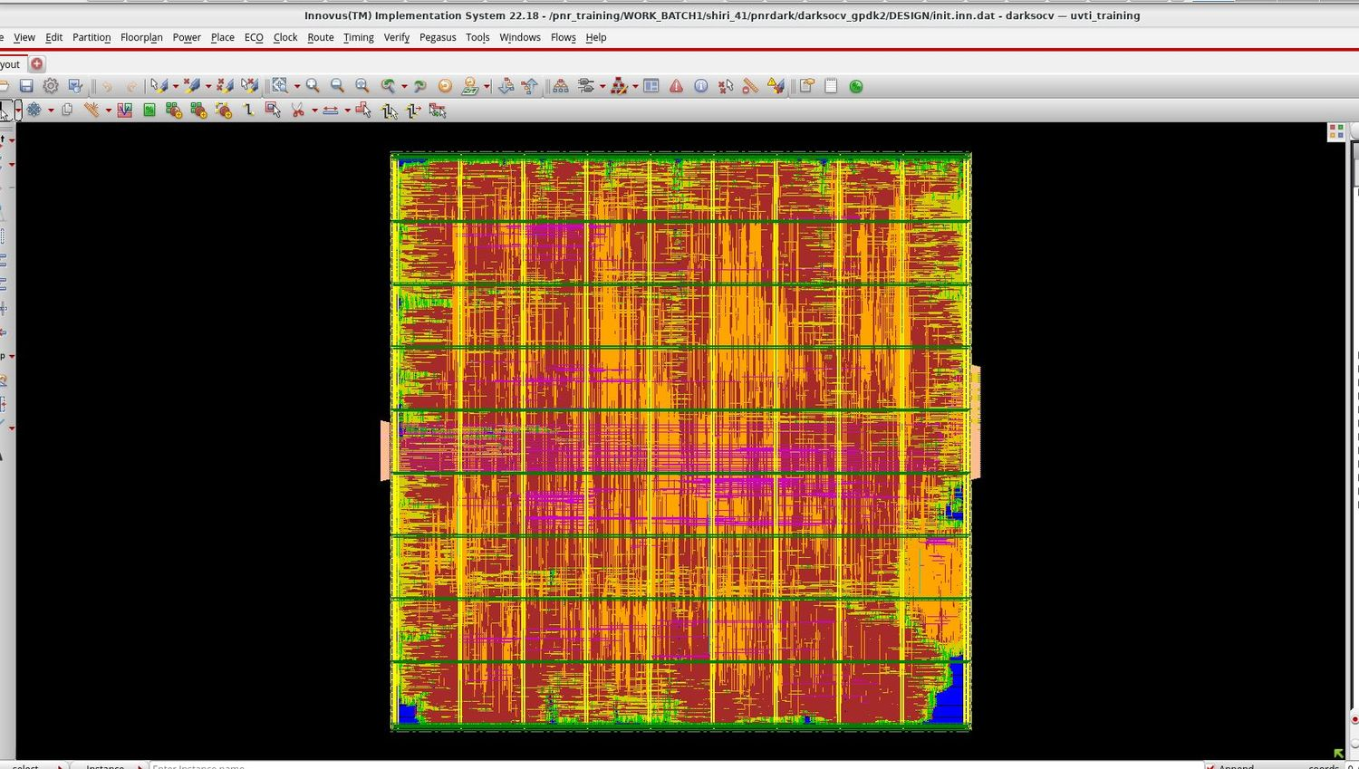
Routing & post-route timing
70% run · timeDesign -postRoute
Routed design
Post-route timing summary
+0.076 ns
0
8 nets
69.8%
WNS · TNS 0.000
violating paths
max_tran, worst −0.013
final density
DarkSoCV · gpdk045 · PnR → Signoff
7

Slide 8
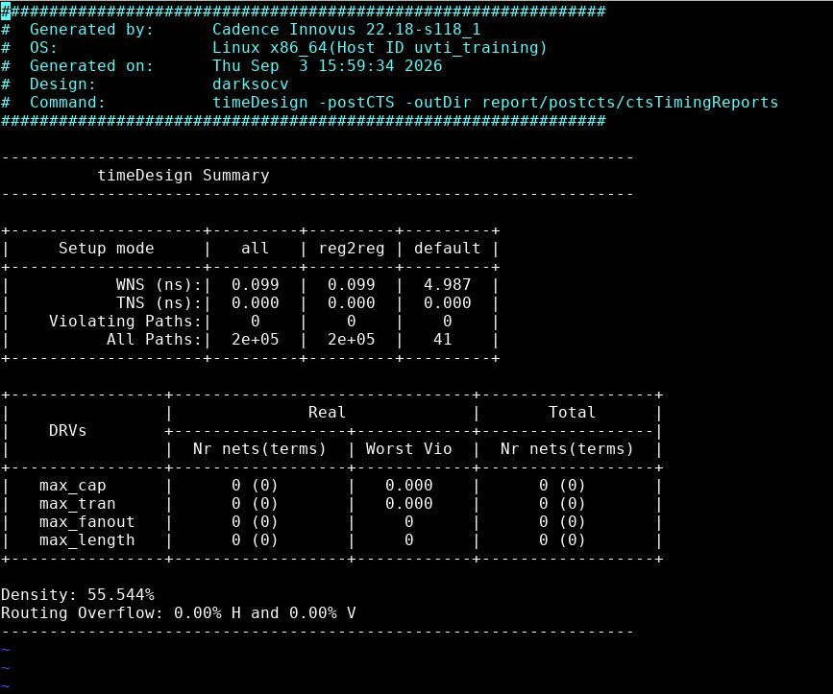
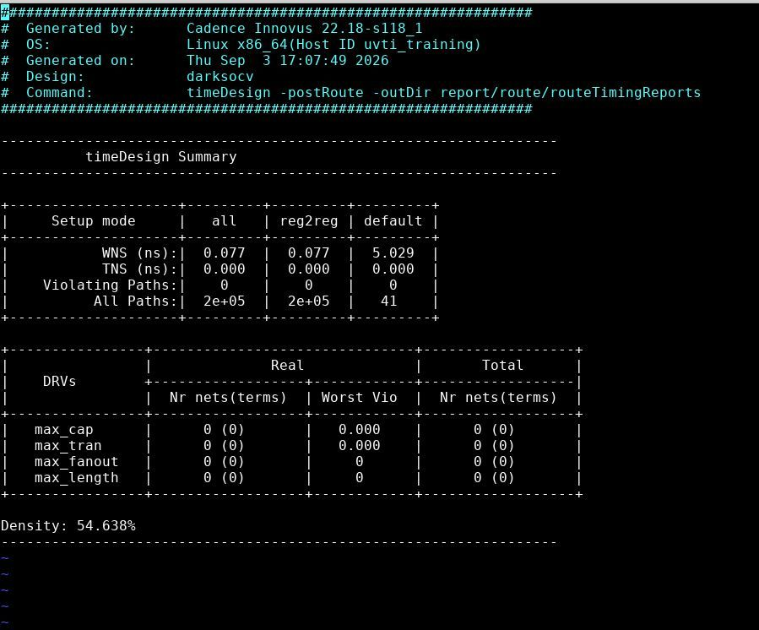
Lower-density run for reference
Earlier run, about 55% density (reports dated Sep 3)
Post-CTS timing
Post-route timing
Post-CTS WNS +0.099 ns, density 55.5%, overflow 0.00%
Post-route WNS +0.077 ns, density 54.6%, 0 DRVs
Timing is almost identical to the 70% run (+0.076 ns), but only the 70% run shows max_tran violations
DarkSoCV · gpdk045 · PnR → Signoff
8

Slide 9
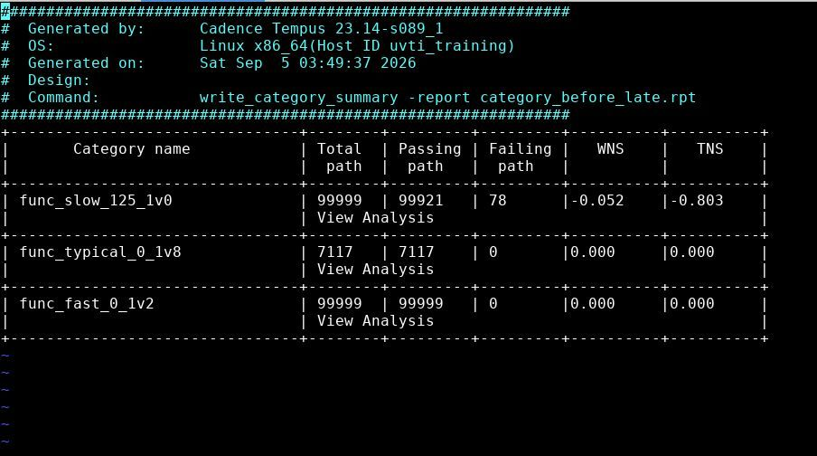
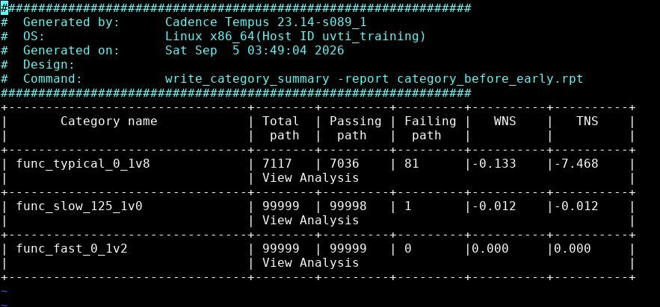
Tempus signoff – before fixes
write_category_summary, early (hold) and late (setup)
category_before_early.rpt
category_before_late.rpt
Early: typical WNS −0.133 ns, TNS −7.468, 81 failing paths; slow 1 failing path (−0.012 ns)
Late: slow WNS −0.052 ns, TNS −0.803, 78 failing paths
Fast corner clean in both; typical clean in late
DarkSoCV · gpdk045 · PnR → Signoff
9

Slide 10
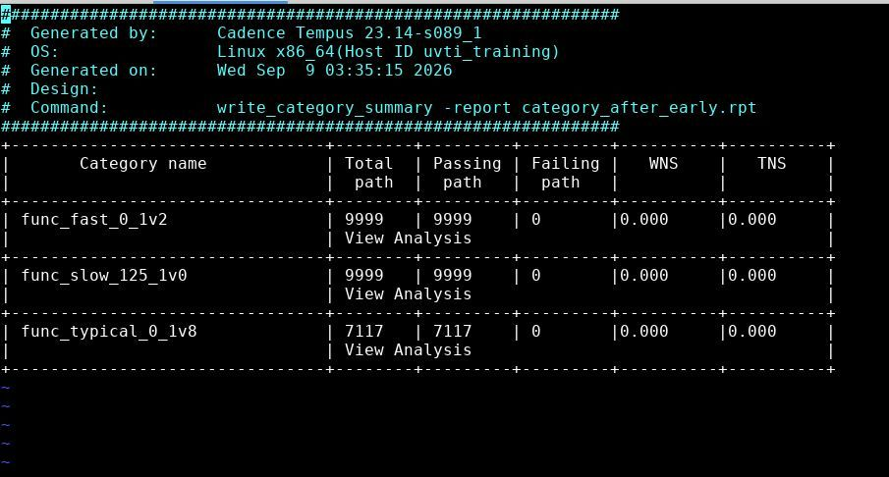
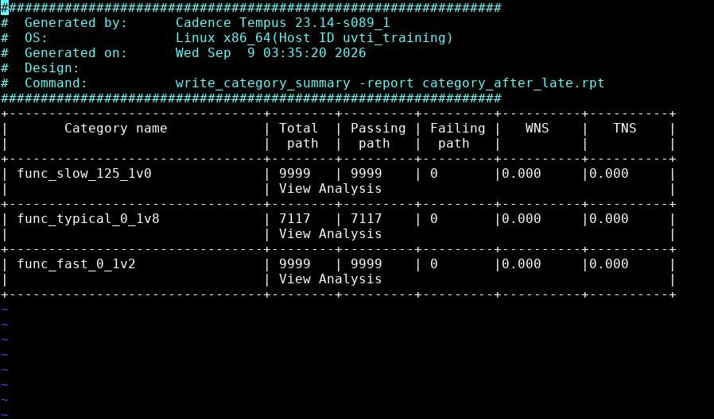
Tempus signoff – after fixes
All three corners, early and late
category_after_early.rpt
category_after_late.rpt
0 failing
0.000
0 failing
0.000
early / hold · 3 corners
WNS & TNS
late / setup · 3 corners
WNS & TNS
DarkSoCV · gpdk045 · PnR → Signoff
10

Slide 11
Timing closure summary
Violating categories, before → after
Analysis / corner | Before WNS / TNS (ns) | Before failing | After WNS / TNS | After failing
Early · func_typical_0_1v8 | −0.133 / −7.468 | 81 | 0.000 / 0.000 | 0
Early · func_slow_125_1v0 | −0.012 / −0.012 | 1 | 0.000 / 0.000 | 0
Late · func_slow_125_1v0 | −0.052 / −0.803 | 78 | 0.000 / 0.000 | 0
Early & late · func_fast_0_1v2 | 0.000 / 0.000 | 0 | 0.000 / 0.000 | 0
DarkSoCV · gpdk045 · PnR → Signoff
11

Slide 12
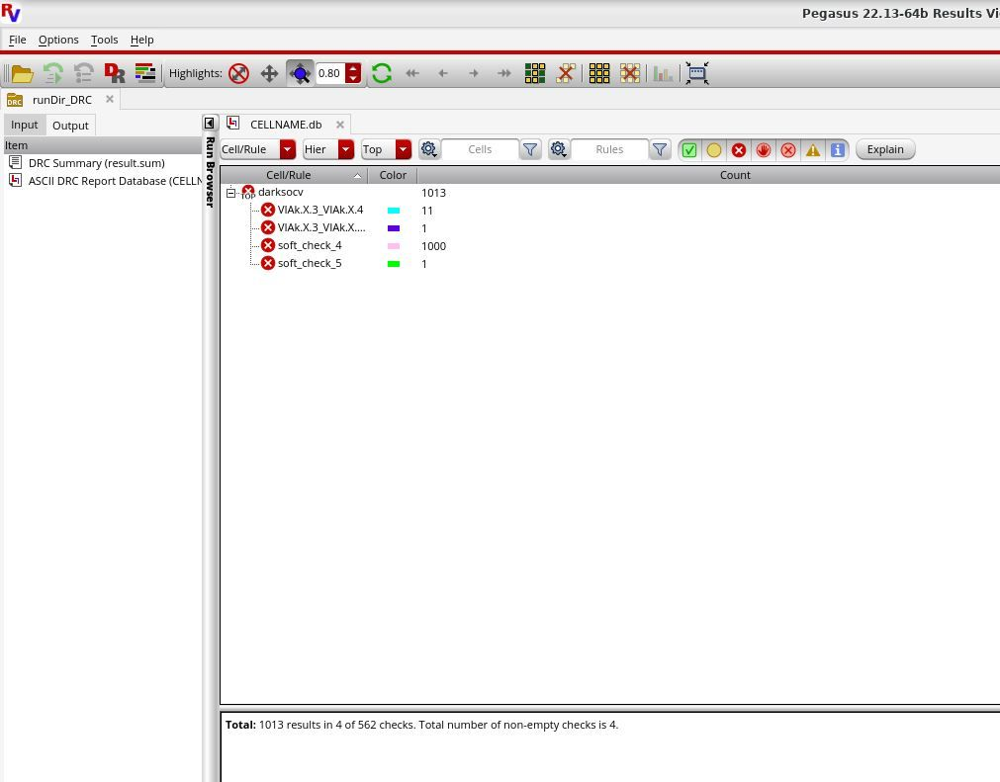
Physical verification – DRC
Pegasus 22.13 · runDir_DRC
1,013
results in 4 of 562 checks · PDK-related
soft_check_4: 1,000 (likely the result cap)
VIAk.X.3_VIAk.X.4: 11
VIAk.X.3_VIAk.X…: 1 · soft_check_5: 1
Root cause: PDK soft-check issues, outside the scope of the PnR flow and left as known PDK issues
DarkSoCV · gpdk045 · PnR → Signoff
12

Slide 13
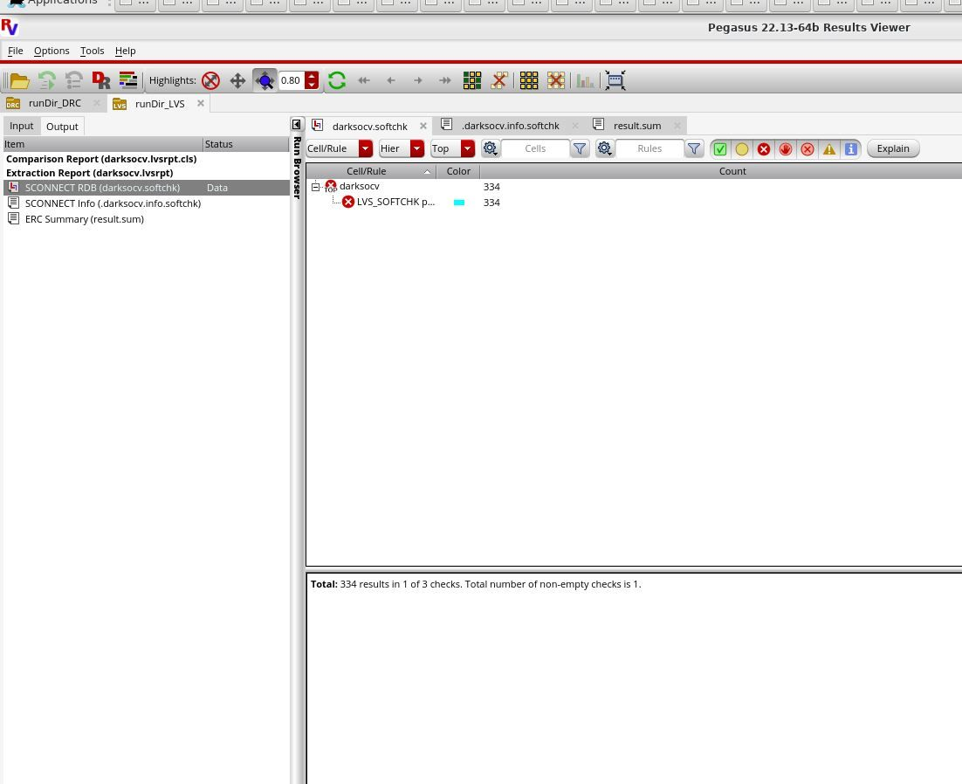
Physical verification – LVS
Pegasus 22.13 · runDir_LVS
334
LVS_SOFTCHK results · PDK-related
Soft-connect (SCONNECT) check: 334 results in 1 of 3 checks
Comparison and extraction reports are listed in the Output tab
Root cause: PDK soft-check issues, not fixable in the PnR flow; documented as known PDK issues
DarkSoCV · gpdk045 · PnR → Signoff
13

Slide 14
Signoff scorecard
Check | Status | Key result
Post-route timing (Innovus) | PASS | WNS +0.076 ns, 0 violating paths; 8 max_tran nets (worst −0.013)
STA signoff (Tempus) | PASS | 0 failing paths in all 3 corners, early and late
DRC (Pegasus) | PDK ISSUE | 1,013 results in 4 of 562 rules (1,000 in soft_check_4), from PDK soft checks
LVS (Pegasus) | PDK ISSUE | 334 soft-connect results, from PDK soft checks
Antenna (Innovus) | CLEAN | No antenna violations
DarkSoCV · gpdk045 · PnR → Signoff
14

