Slide 1
darkram on Sky130
A module of DarkSoCV, implemented separately
Floorplan → Place → CTS → Route → STA, antenna, DRC & LVS · Innovus · Tempus · Pegasus

Slide 2
Context & flow
Why darkram was implemented on its own
Standalone darkram
Reused in DarkSoCV
RAM module of DarkSoCV
Implemented, signed off separately
Rectilinear (L-shaped) core
Becomes the pre-implemented block (bram0)
Shortens the DarkSoCV top-level runs
Avoids re-implementing the RAM each iteration
Flow: floorplan and power plan, placement, pre-CTS opt, CTS, routing (Innovus 22.18); STA (Tempus 23.14); DRC and LVS (Pegasus 22.13). STA at the typical corner (typical_0_1v2).
darkram · sky130 · PnR → Signoff
2

Slide 3
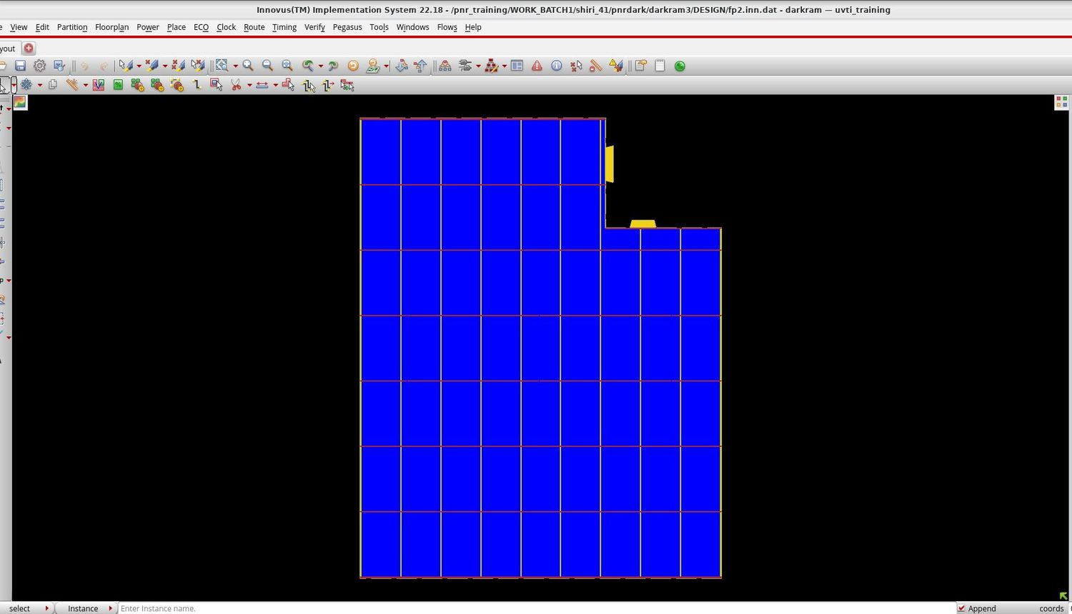
Floorplan & power plan
fp2.inn.dat · rectilinear core
L-shaped core with a notch at the top right
Power grid mesh of vertical and horizontal stripes
IO pins on the right edge, around the notch
Saved as the fp2 checkpoint before placement
darkram · sky130 · PnR → Signoff
3

Slide 4
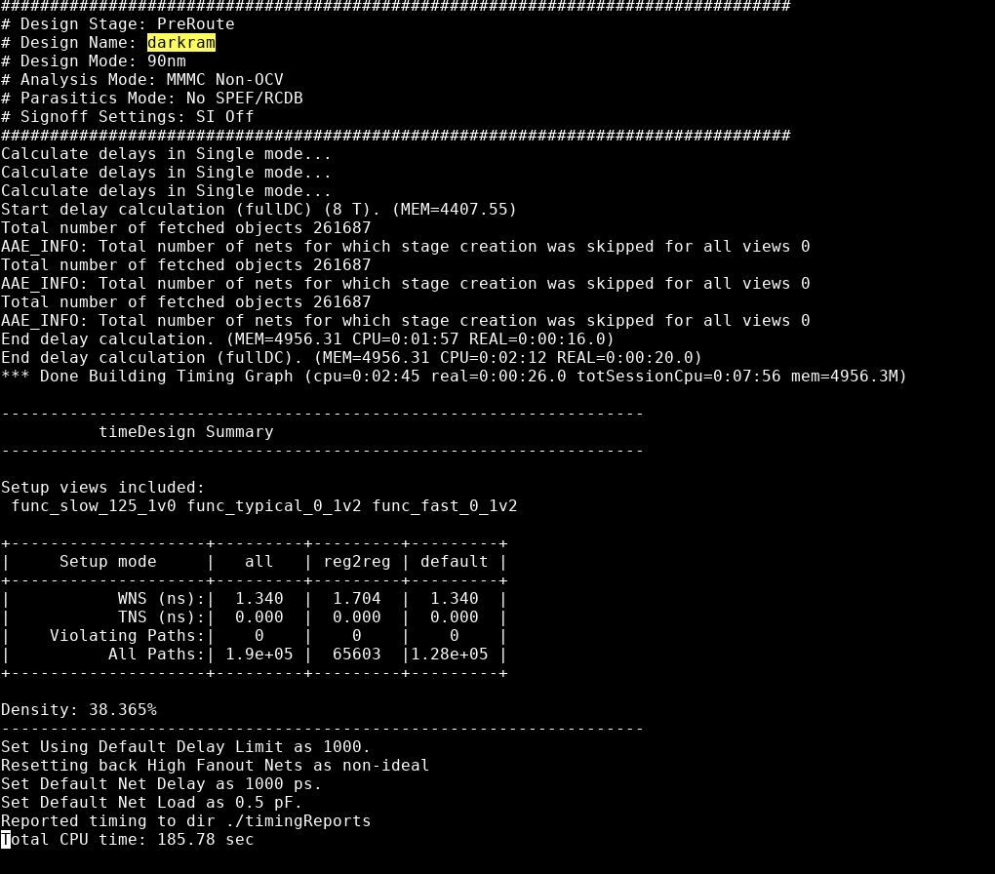
Placement timing
timeDesign after placement
+1.340 ns
WNS (all views)
0
violating paths
38.4%
placement density
Timing summary as reported by timeDesign
darkram · sky130 · PnR → Signoff
4

Slide 5
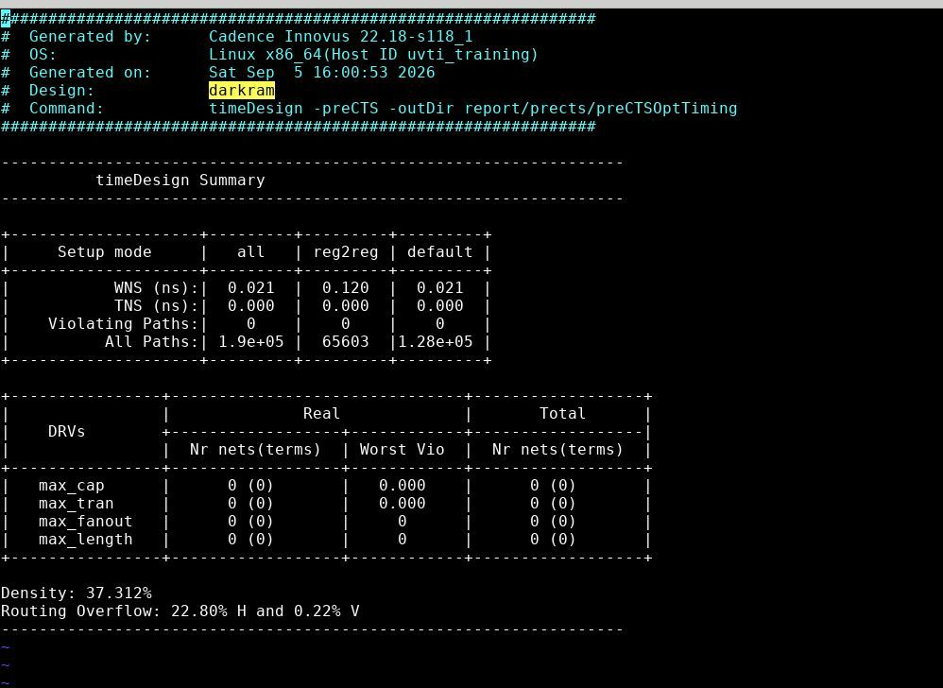
Pre-CTS optimisation
timeDesign -preCTS
+0.021 ns
WNS (reg2reg +0.120) · TNS 0.000
0
violating paths · 0 DRVs
37.3%
density
22.80% H / 0.22% V
routing overflow
darkram · sky130 · PnR → Signoff
5

Slide 6
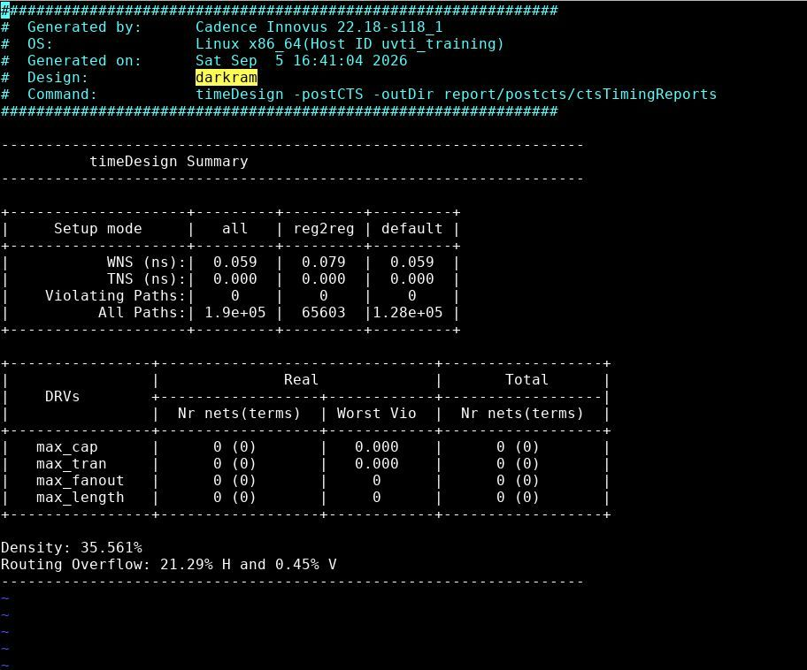
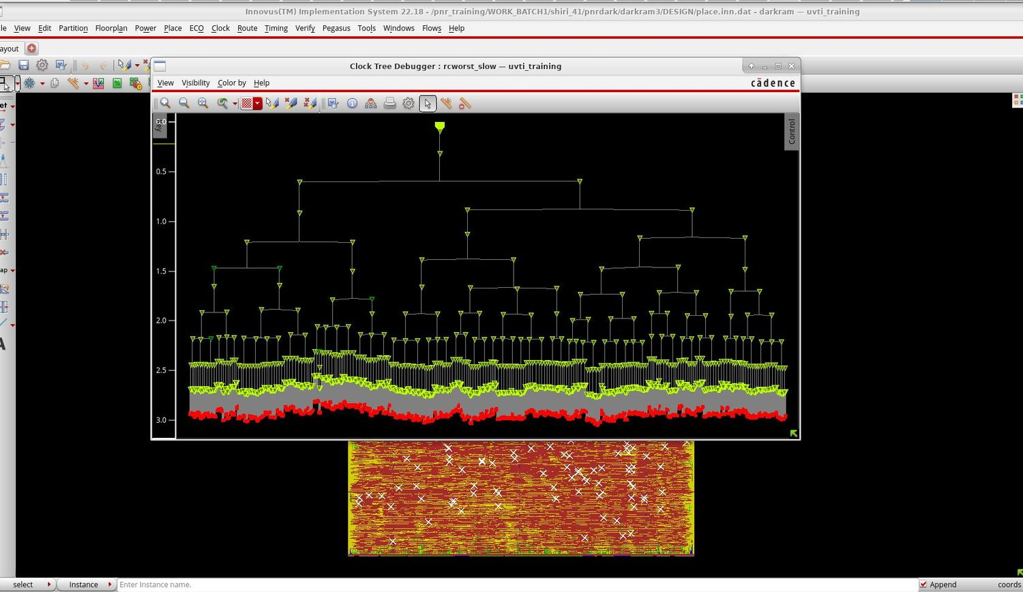
Clock tree & post-CTS timing
Clock Tree Debugger, rcworst_slow corner
timeDesign -postCTS
Post-CTS WNS +0.059 ns, 0 violating paths, 0 DRVs
Density 35.6%, overflow 21.29% H / 0.45% V
Sink insertion delay about 2.4–3.0 ns (read from plot)
darkram · sky130 · PnR → Signoff
6

Slide 7
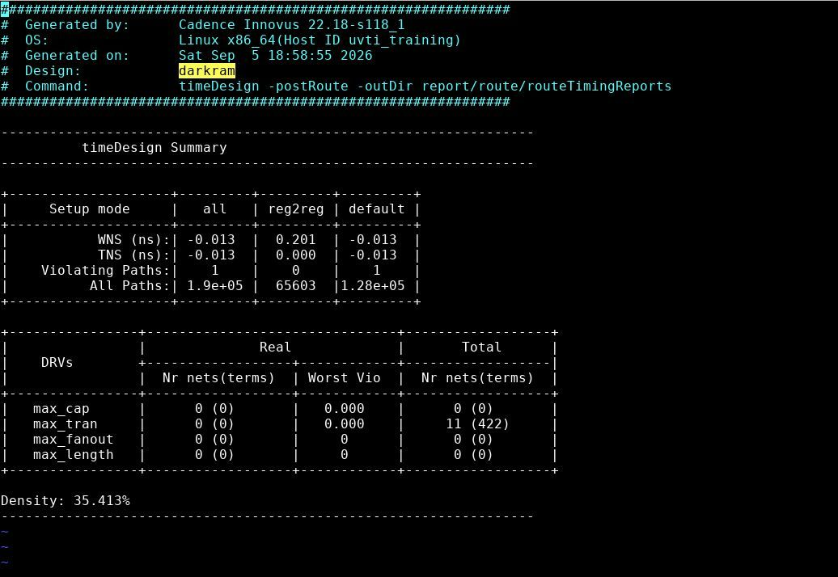
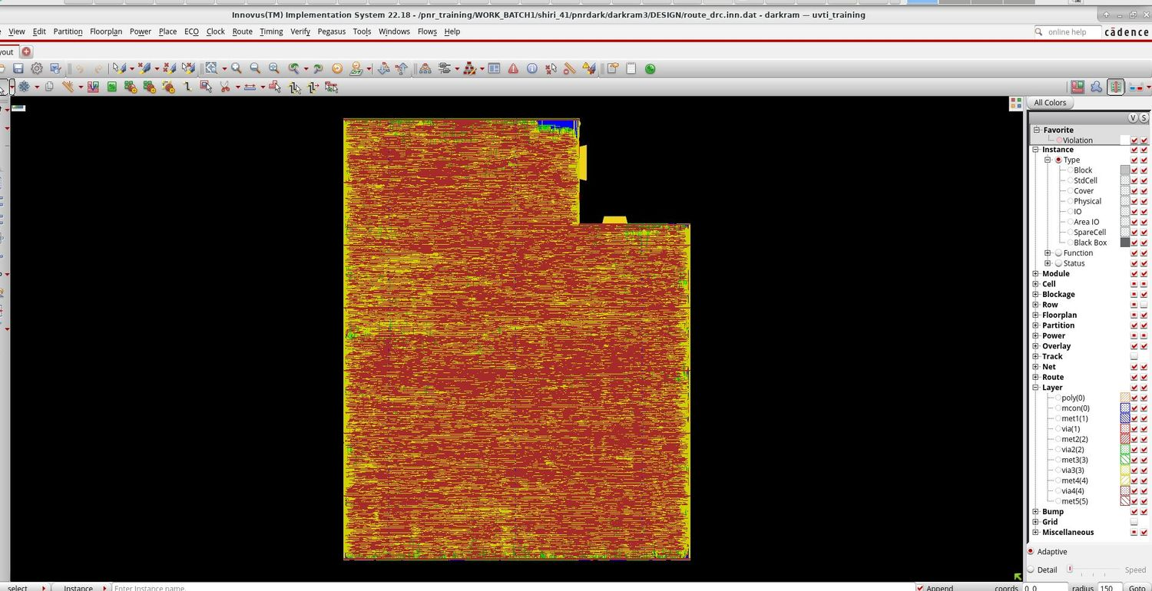
Routing & post-route timing
timeDesign -postRoute
Routed layout (route_drc.inn.dat)
Post-route timing summary
−0.013 ns
+0.201 ns
11 nets
35.4%
WNS · 1 violating path
reg2reg WNS
max_tran (total)
final density
darkram · sky130 · PnR → Signoff
7

Slide 8
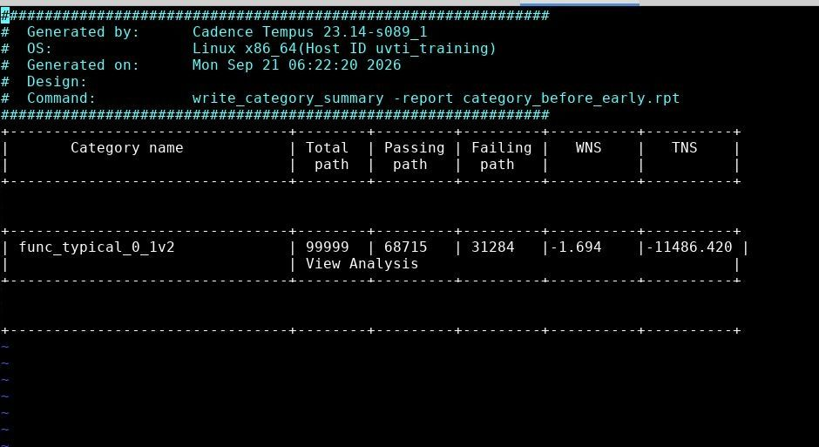
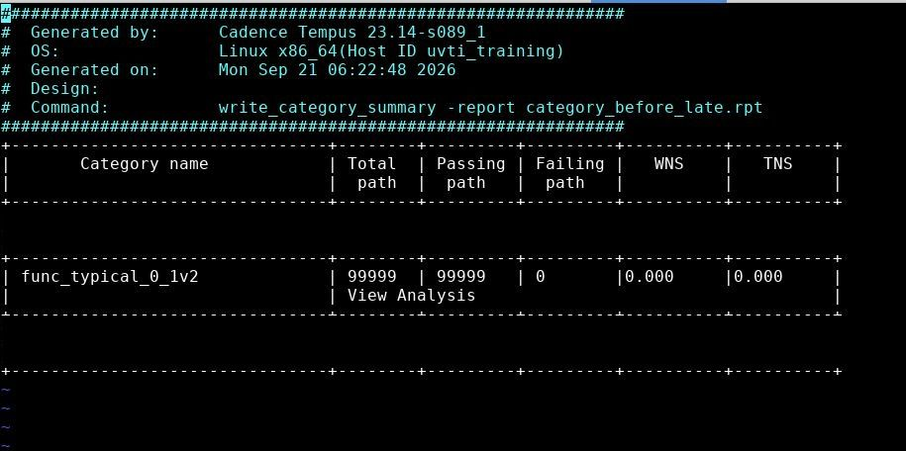
Tempus before fixes
Typical corner (typical_0_1v2): hold fails, setup clean
category_before_early.rpt
category_before_late.rpt
Early (hold): 31,284 failing paths, WNS −1.694 ns, TNS −11,486.420
Late (setup): 0 failing paths
darkram · sky130 · PnR → Signoff
8

Slide 9
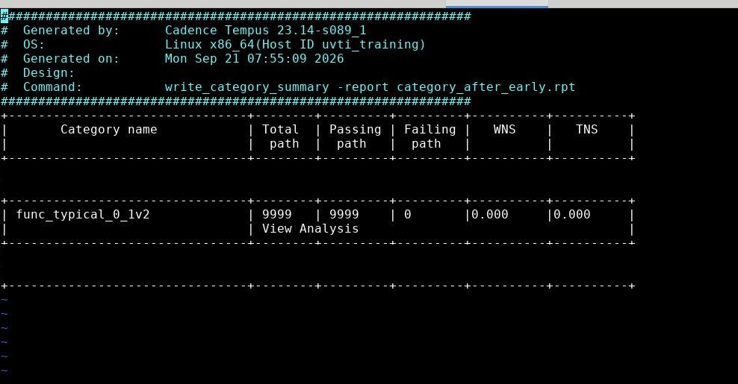
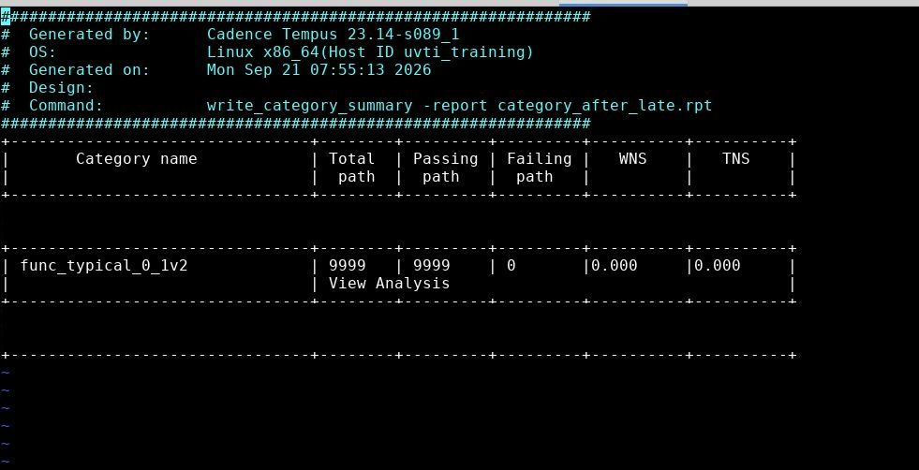
Tempus after fixes
Typical corner (typical_0_1v2), early and late
category_after_early.rpt
category_after_late.rpt
0 failing
0.000
0 failing
0.000
early / hold
WNS & TNS
late / setup
WNS & TNS
darkram · sky130 · PnR → Signoff
9

Slide 10
Timing closure summary
Typical corner, failing paths before → after fixes
Analysis | Before failing · WNS | After failing · WNS
Early (hold) | 31,284 · −1.694 ns | 0 · 0.000
Late (setup) | 0 · 0.000 | 0 · 0.000
At the typical corner, hold is fixed and setup stays clean: WNS and TNS 0.000 with 0 failing paths in both analyses.
darkram · sky130 · PnR → Signoff
10

Slide 11
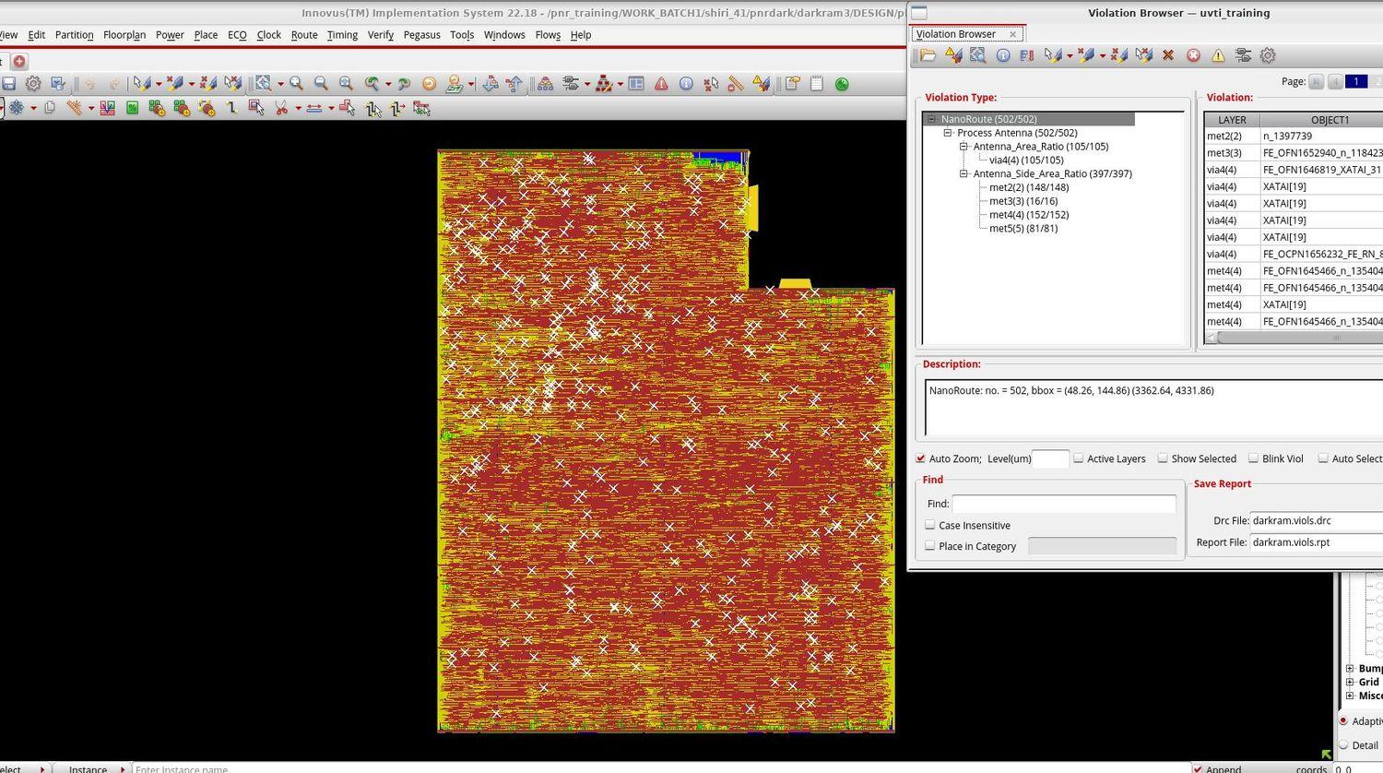
Process antenna violations
Innovus Violation Browser (NanoRoute)
502
antenna violations
Area ratio: 105 (all via4)
Side-area ratio: 397 – met4 152 · met2 148 · met5 81 · met3 16
Fix: insert antenna diodes, then re-route and re-verify
darkram · sky130 · PnR → Signoff
11

Slide 12
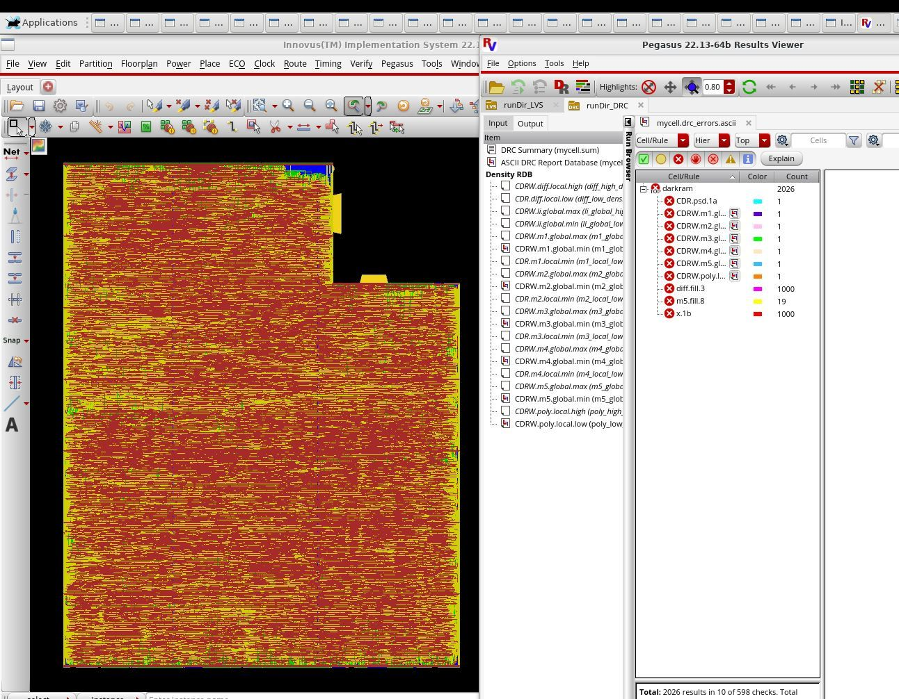
Physical verification – DRC
Pegasus 22.13 · runDir_DRC
2,026
results in 10 of 598 checks · PDK-related
diff.fill.3: 1,000 and x.1b: 1,000 (likely the result cap)
m5.fill.8: 19
CDR.psd.1a, CDRW.m1–m5, CDRW.poly: 1 each
Root cause: sky130 PDK rule set, left as a known PDK issue
darkram · sky130 · PnR → Signoff
12

Slide 13
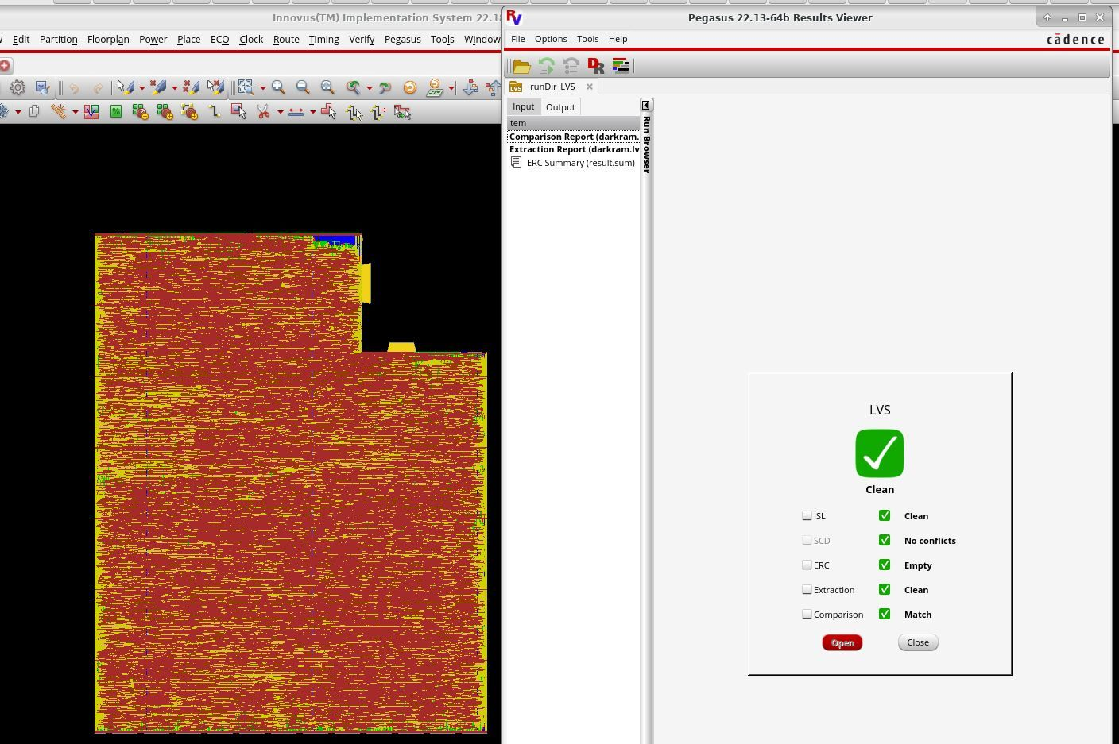
Physical verification – LVS
Pegasus 22.13 · runDir_LVS
CLEAN
overall LVS result
ISL: clean
SCD: no conflicts
ERC: empty
Extraction: clean
Comparison: layout and schematic match
darkram · sky130 · PnR → Signoff
13

Slide 14
Signoff scorecard
Check | Status | Key result
Post-route timing (Innovus) | OPEN | WNS −0.013 ns on 1 path; reg2reg +0.201 ns; 11 max_tran nets
STA hold / early (Tempus) | PASS | Typical corner: 0 failing paths after fixes
STA setup / late (Tempus) | PASS | Typical corner: 0 failing paths, WNS and TNS 0.000
Antenna (Innovus) | TO FIX | 502 violations; fix with antenna diodes
DRC (Pegasus) | PDK ISSUE | 2,026 results in 10 of 598 rules
LVS (Pegasus) | CLEAN | All five sub-checks pass
darkram · sky130 · PnR → Signoff
14

