Slide 1
DarkSoCV on GPDK045
55% vs 70% initial utilization
Same design, same flow and tools: placement through signoff compared side by side

Slide 2
Experiment setup
Only the initial utilization differs
55% initial utilization
70% initial utilization
Placement density 55.7%
Final density 54.6%
Cleaner pre-CTS and routing
Placement density 71.4%
Final density 69.8%
Smaller core for the same design
Common to both runs: GPDK045, 0.9 V supply, Innovus 22.18 (place, CTS, route), Tempus 23.14 (slow and fast corners), Pegasus 22.13 (DRC, LVS).
DarkSoCV · gpdk045 · PnR → Signoff
2

Slide 3
Density through the flow
Higher initial utilization carries through to the final layout
Density barely changes from placement to route in either run
The 70% run packs the design about 15 points tighter
Routing overflow at pre-CTS is 0.00% H / 0.00% V in both
DarkSoCV · gpdk045 · PnR → Signoff
3

Slide 4
Timing and DRVs
Pre-CTS and post-route setup WNS (ns)
Setup WNS is nearly identical at both stages
Post-route violating paths: 0 in both
Post-route DRVs: 55% has none; 70% has 8 nets with max_tran violations (worst −0.013)
Cap, fanout and length DRVs are 0 in both
DarkSoCV · gpdk045 · PnR → Signoff
4

Slide 5
Tempus violations before fixes
Failing paths per analysis, slow corner
Early: 1 failing path in both (−0.014 ns at 55%, −0.012 ns at 70%)
Late: 32 failing paths at 55% (WNS −0.034, TNS −0.113) vs 78 at 70% (WNS −0.052, TNS −0.803)
Fast corner is clean in both runs
DarkSoCV · gpdk045 · PnR → Signoff
5

Slide 6
Timing closure
Slow-corner failing paths, before → after fixes
Analysis | 55% before | 55% after | 70% before | 70% after
Early (hold) | 1 · −0.014 ns | 0 | 1 · −0.012 ns | 0
Late (setup) | 32 · −0.034 ns | 0 | 78 · −0.052 ns | 0
Fast corner | clean | clean | clean | clean
Both runs close timing completely: WNS and TNS 0.000 and 0 failing paths after fixes.
DarkSoCV · gpdk045 · PnR → Signoff
6

Slide 7
Physical verification
Pegasus DRC and LVS, antenna check
Check | 55% initial | 70% initial
DRC | 1,022 results · 4 of 562 rules | 1,013 results · 4 of 562 rules
LVS (soft check) | 370 results | 334 results
Antenna | No violations | No violations
DRC and LVS findings in both runs come from PDK soft checks (soft_check_4 alone is 1,000 results, likely the result cap) and are left as known PDK issues. They do not differ meaningfully with utilization.
DarkSoCV · gpdk045 · PnR → Signoff
7

Slide 8
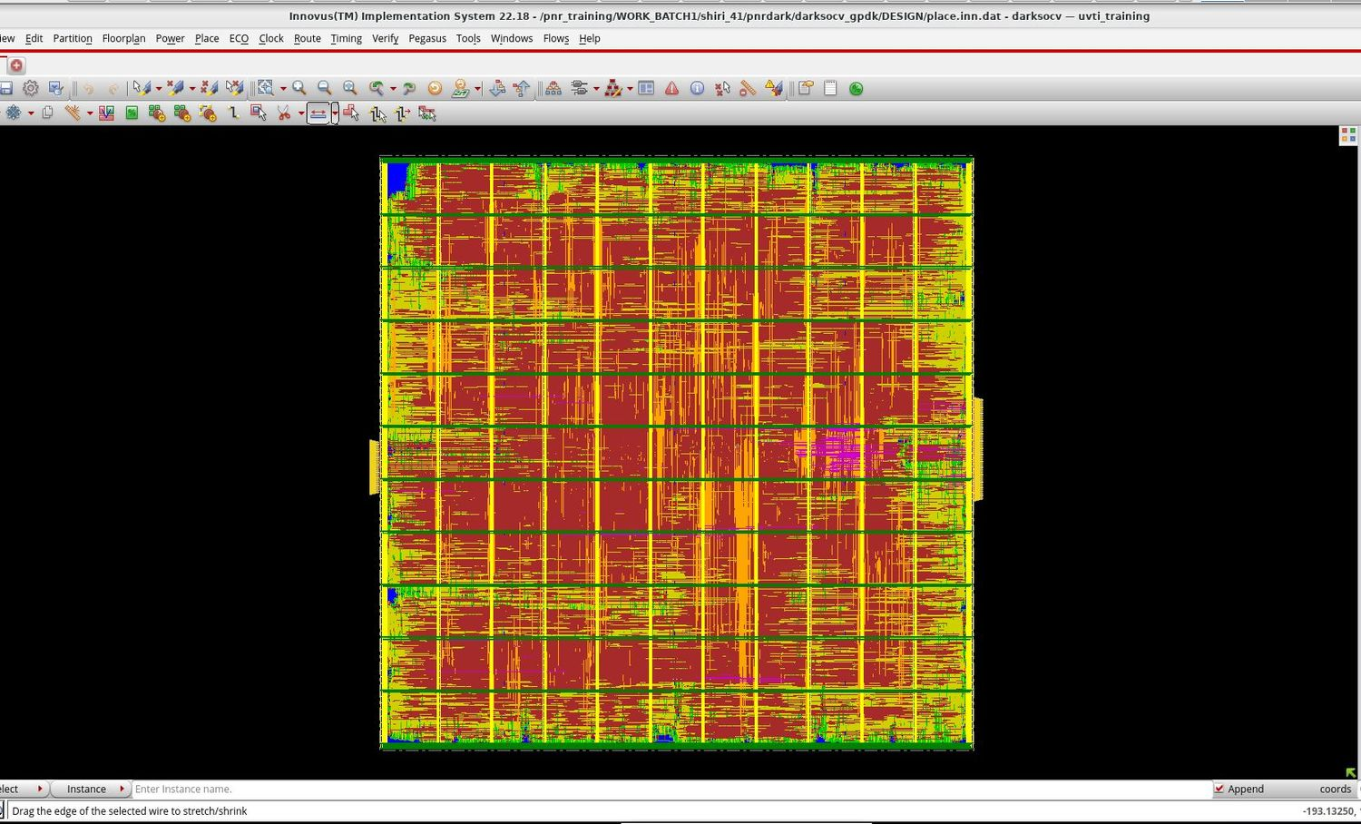
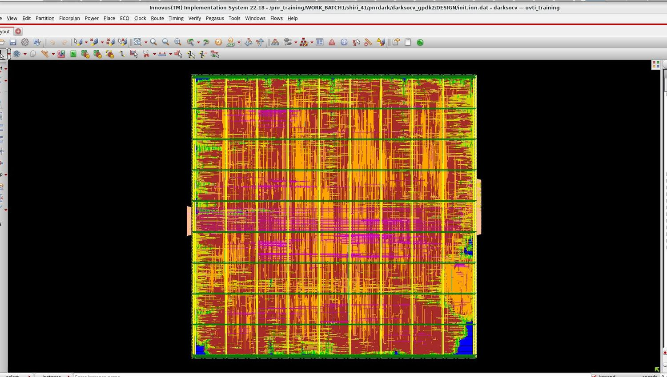
Routed layouts
Final routed design, same scale of view
55% initial utilization
70% initial utilization
DarkSoCV · gpdk045 · PnR → Signoff
8

Slide 9
Takeaways
Timing: both runs reach full closure; post-route WNS is +0.077 ns (55%) vs +0.076 ns (70%)
Density: 70% gives about 15 points higher utilization, a smaller core for the same design, at no setup-timing cost
Cost of 70%: more violations to fix before closure (78 vs 32 late paths, TNS −0.803 vs −0.113) and 8 max_tran violations at post-route
Verification: DRC and LVS results are PDK soft-check issues in both, independent of utilization
Choose 55% for the cleanest routing and fewest DRVs, or 70% when area matters and the max_tran nets are fixed
DarkSoCV · gpdk045 · PnR → Signoff
9

