Slide 1
DarkSoCV on GPDK045
RTL-to-signoff physical implementation: Innovus · Tempus · Voltus · Pegasus
45 nm generic PDK · 55% initial utilization · Floorplan → Place → CTS → Route → STA, IR-drop, DRC & LVS

Slide 2
Implementation flow
Tools and checkpoints used, in order
1
Floorplan & power plan
2
Placement
3
Pre-CTS opt
Innovus 22.18 · 55% utilization
Innovus
timeDesign -preCTS
4
Clock tree
5
Route
6
Signoff
CTS + CTD debug
timeDesign -postRoute
Tempus · Voltus · Pegasus
Signoff coverage: slow and fast corner STA (Tempus 23.14), static IR drop on VDD (Voltus 23.14), DRC and LVS (Pegasus 22.13).
DarkSoCV · gpdk045 · PnR → Signoff
2

Slide 3
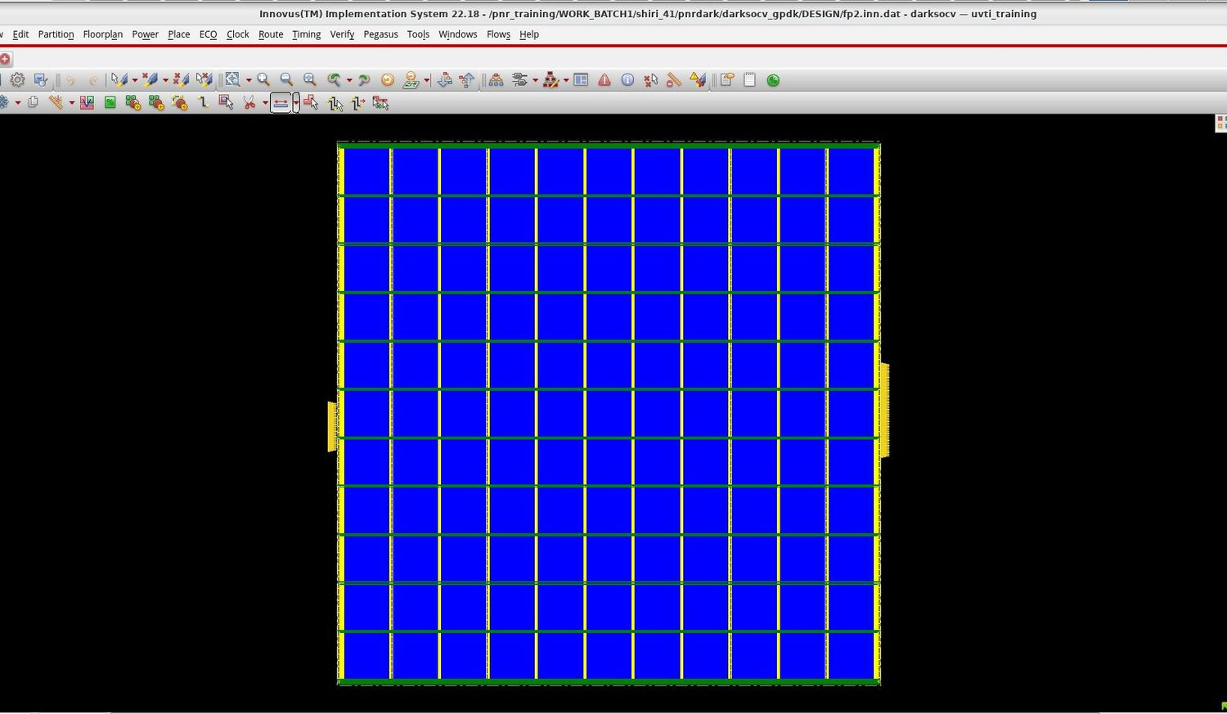
Floorplan & power plan
fp2.inn.dat · 55% initial utilization
Square core sized for 55% initial utilization
Power grid mesh: vertical stripes (yellow) crossed by horizontal stripes (green)
Power rings around the core edge
IO pins on the left and right edges
Saved as the fp2 checkpoint before placement
DarkSoCV · gpdk045 · PnR → Signoff
3

Slide 4
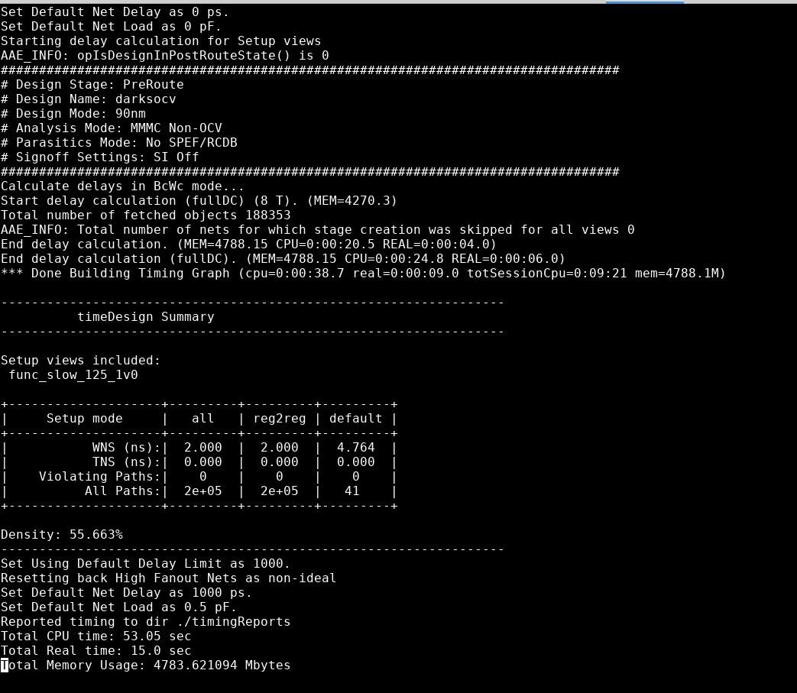
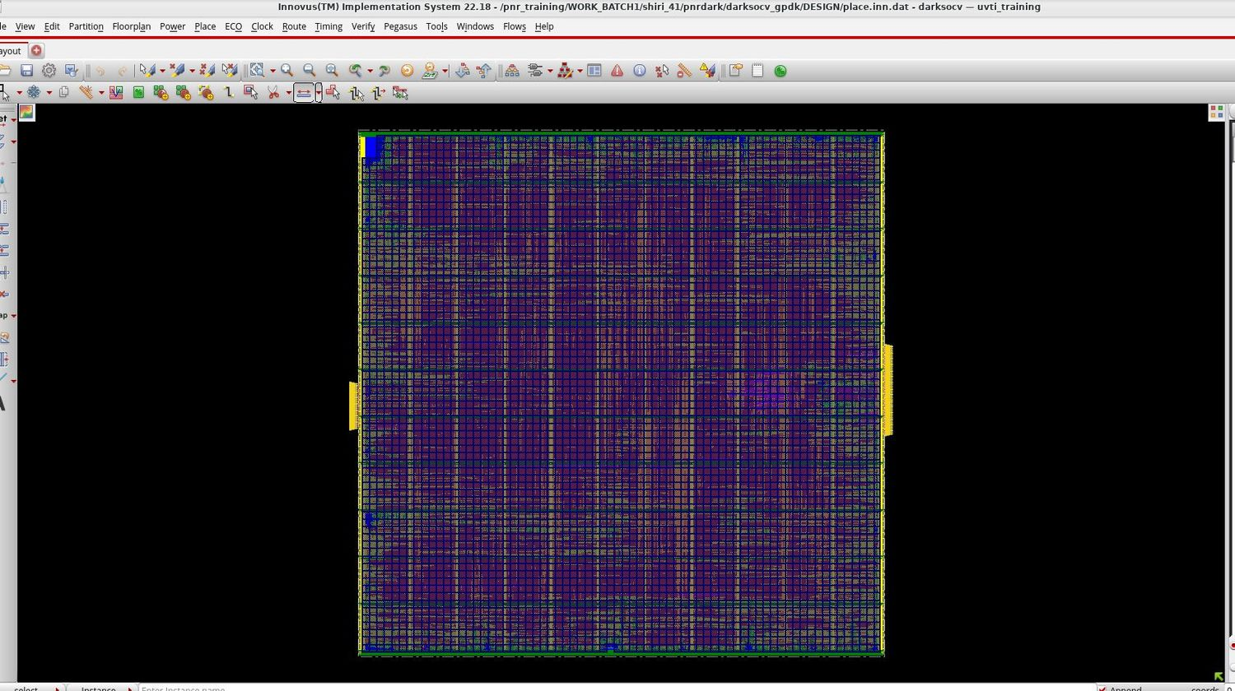
Placement & congestion
Initial utilization 55%
Post-placement timeDesign (func_slow_125_1v0)
Congestion map after placement
55.7%
+2.000 ns
Placement-stage timing is relaxed with large positive slack
Congestion map shows no concentrated hot spot
placement density
WNS · 0 violating
DarkSoCV · gpdk045 · PnR → Signoff
4

Slide 5
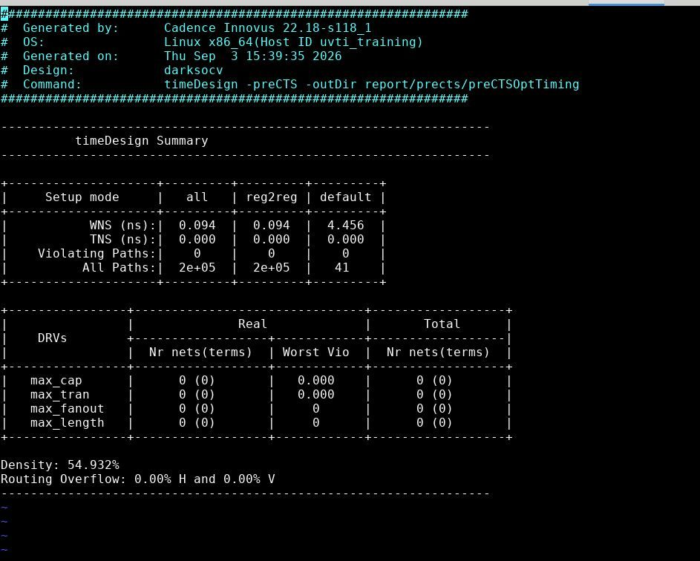
Pre-CTS optimisation
timeDesign -preCTS
+0.094 ns
WNS (reg2reg) · TNS 0.000
0
violating paths · 0 DRVs
54.9%
density
0.00% H / 0.00% V
routing overflow
DarkSoCV · gpdk045 · PnR → Signoff
5

Slide 6
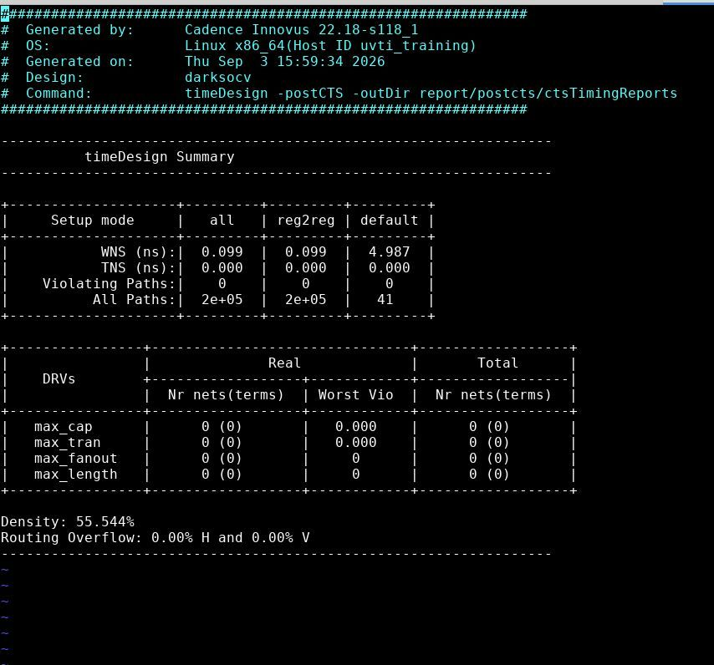
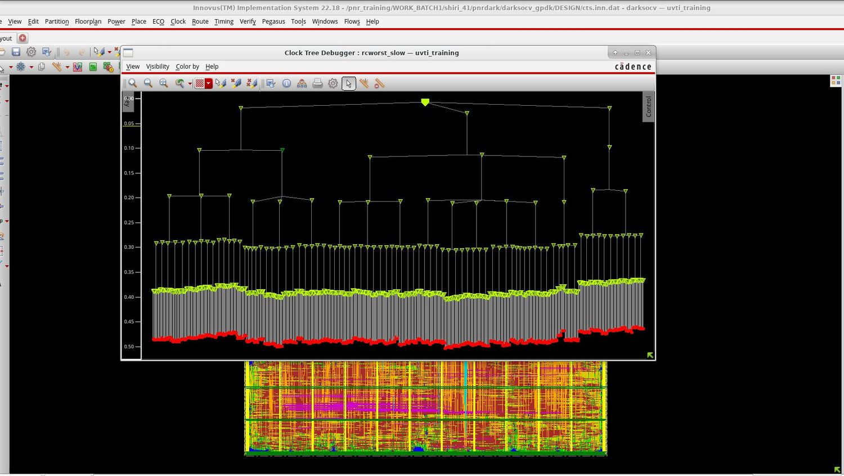
Clock tree
Clock Tree Debugger, rcworst_slow corner · cts.inn.dat
timeDesign -postCTS
Post-CTS WNS +0.099 ns, 0 violating paths, 0 DRVs
Density 55.5%, routing overflow 0.00%
Sink insertion delays about 0.37–0.50 ns (read from CTD plot)
DarkSoCV · gpdk045 · PnR → Signoff
6

Slide 7
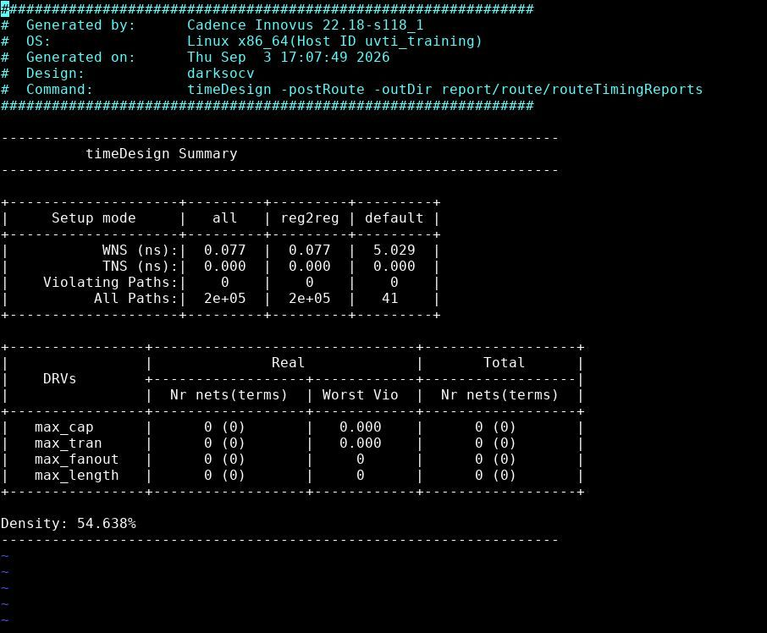
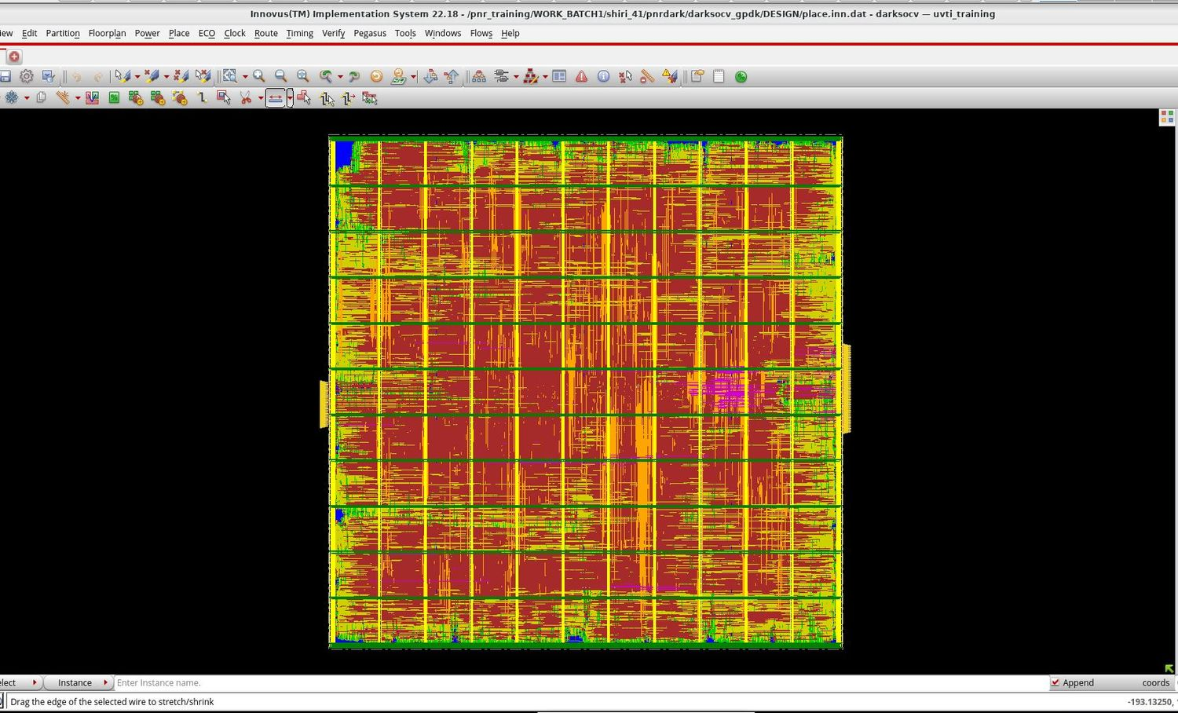
Routing & post-route timing
timeDesign -postRoute
Routed design
Post-route timing summary
+0.077 ns
0
0
54.6%
WNS · TNS 0.000
violating paths
max cap / tran / fanout / length
final density
DarkSoCV · gpdk045 · PnR → Signoff
7

Slide 8
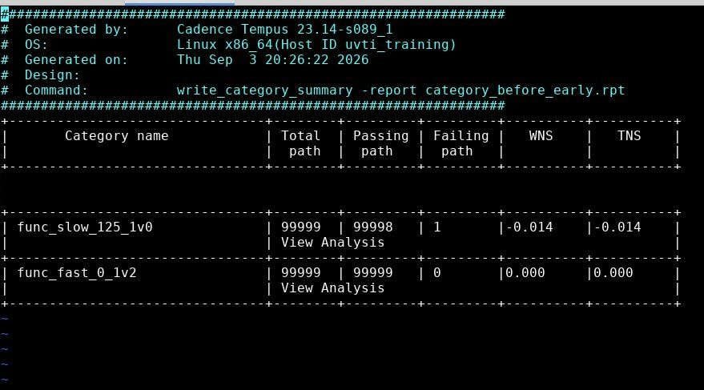
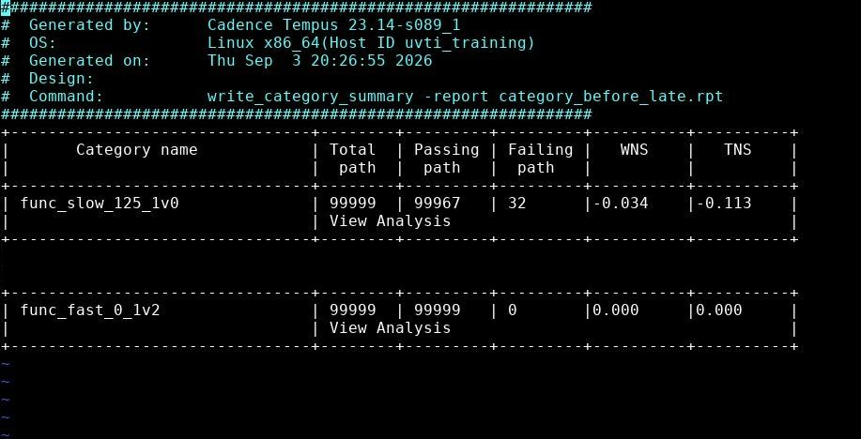
Tempus signoff – before fixes
write_category_summary, early (hold) and late (setup)
category_before_early.rpt
category_before_late.rpt
Early (hold): slow corner 1 failing path, WNS −0.014 ns
Late (setup): slow corner WNS −0.034 ns, TNS −0.113, 32 failing paths
Fast corner clean in both early and late
DarkSoCV · gpdk045 · PnR → Signoff
8

Slide 9
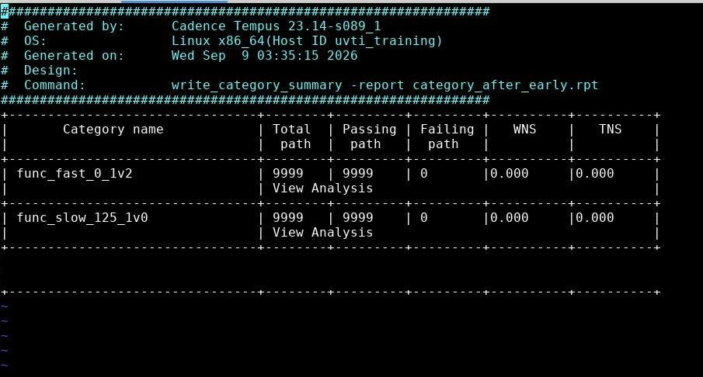
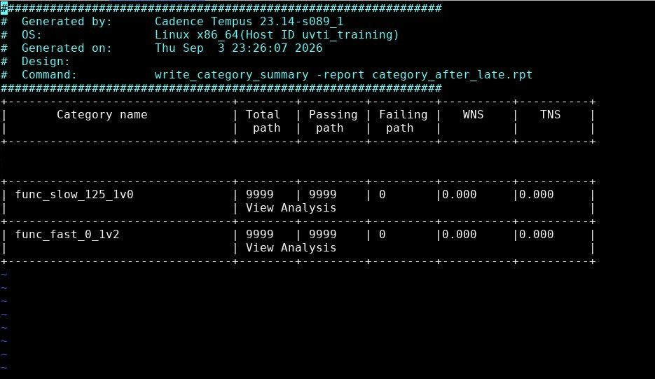
Tempus signoff – after fixes
Slow and fast corners, early and late
category_after_early.rpt
category_after_late.rpt
0 failing
0.000
0 failing
0.000
early / hold · slow & fast
WNS & TNS
late / setup · slow & fast
WNS & TNS
DarkSoCV · gpdk045 · PnR → Signoff
9

Slide 10
Timing closure summary
Violating categories, before → after
Analysis / corner | Before WNS / TNS (ns) | Before failing | After WNS / TNS | After failing
Early · func_slow_125_1v0 | −0.014 / −0.014 | 1 | 0.000 / 0.000 | 0
Late · func_slow_125_1v0 | −0.034 / −0.113 | 32 | 0.000 / 0.000 | 0
Early & late · func_fast_0_1v2 | 0.000 / 0.000 | 0 | 0.000 / 0.000 | 0
After fixes, setup and hold are clean in both corners: WNS and TNS 0.000, 0 failing paths.
DarkSoCV · gpdk045 · PnR → Signoff
10

Slide 11
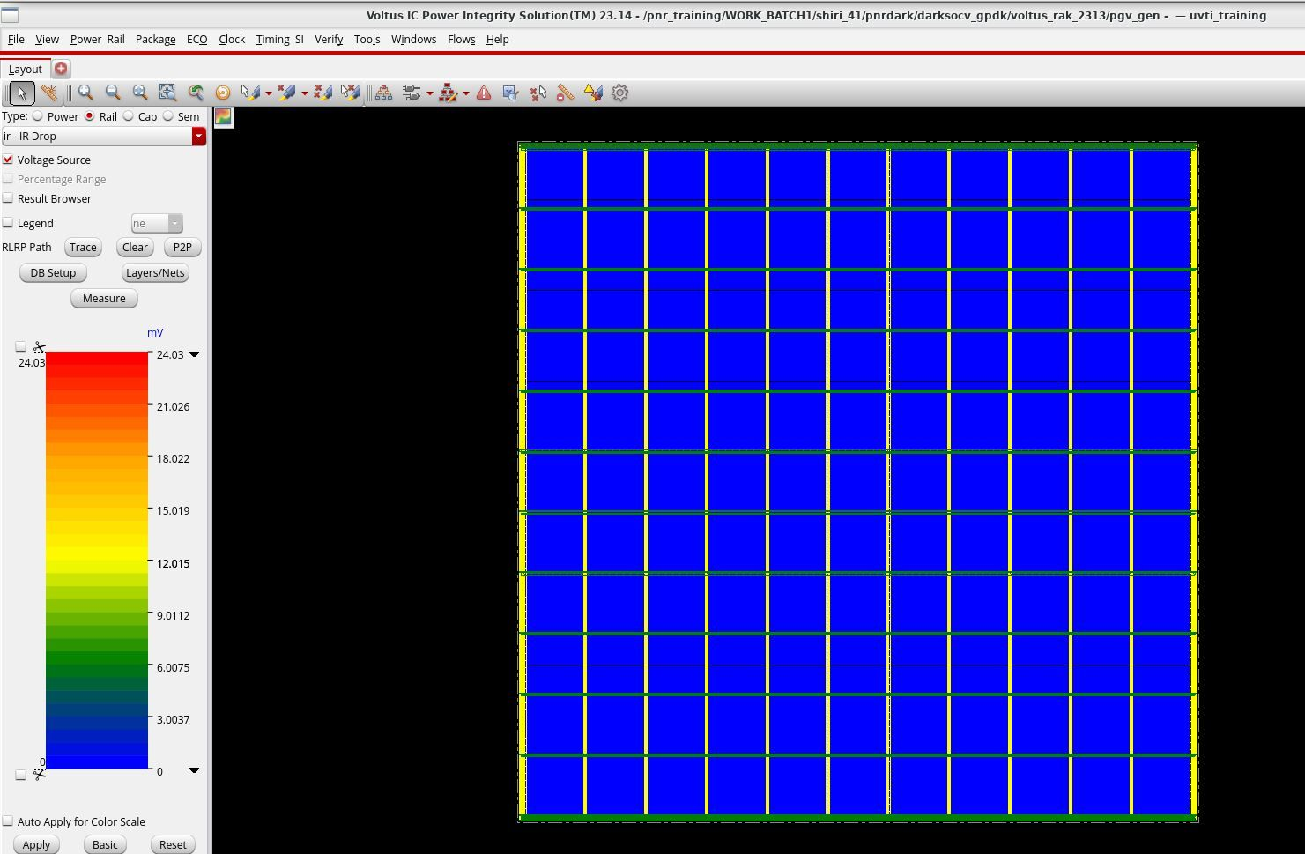
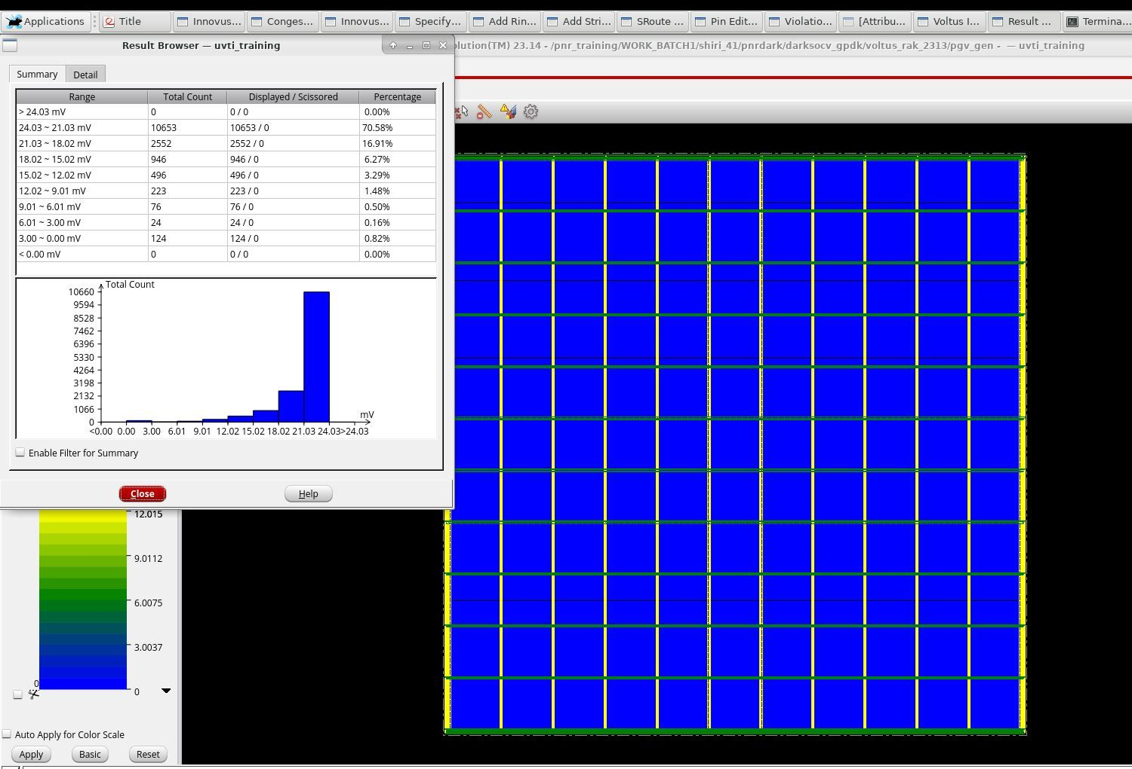
Static IR drop (Voltus)
VDD = 0.9 V · rail analysis, Result Browser
IR-drop colour scale (0–24.03 mV)
Instance voltage-drop distribution
24.03 mV
≈ 2.7%
70.6% of instances fall in the 21.03–24.03 mV bin
No instance above 24.03 mV
Only VDD results were captured
max drop bin
of 0.9 V supply
DarkSoCV · gpdk045 · PnR → Signoff
11

Slide 12
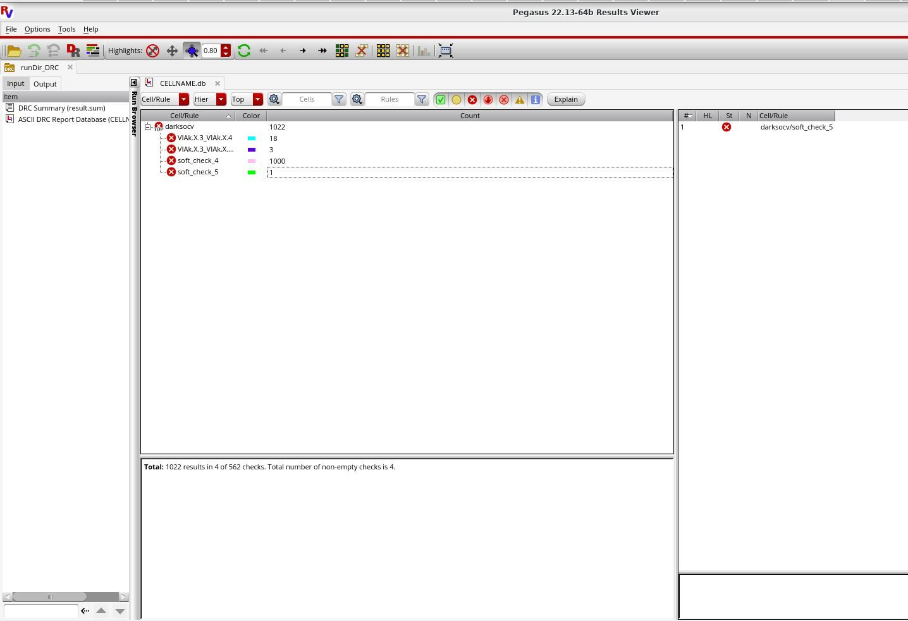
Physical verification – DRC
Pegasus 22.13 · runDir_DRC
1,022
results in 4 of 562 checks · PDK-related
soft_check_4: 1,000 (likely the result cap)
VIAk.X.3_VIAk.X.4: 18
VIAk.X.3_VIAk.X…: 3 · soft_check_5: 1
Root cause: PDK soft-check issues, outside the scope of the PnR flow and left as known PDK issues
DarkSoCV · gpdk045 · PnR → Signoff
12

Slide 13
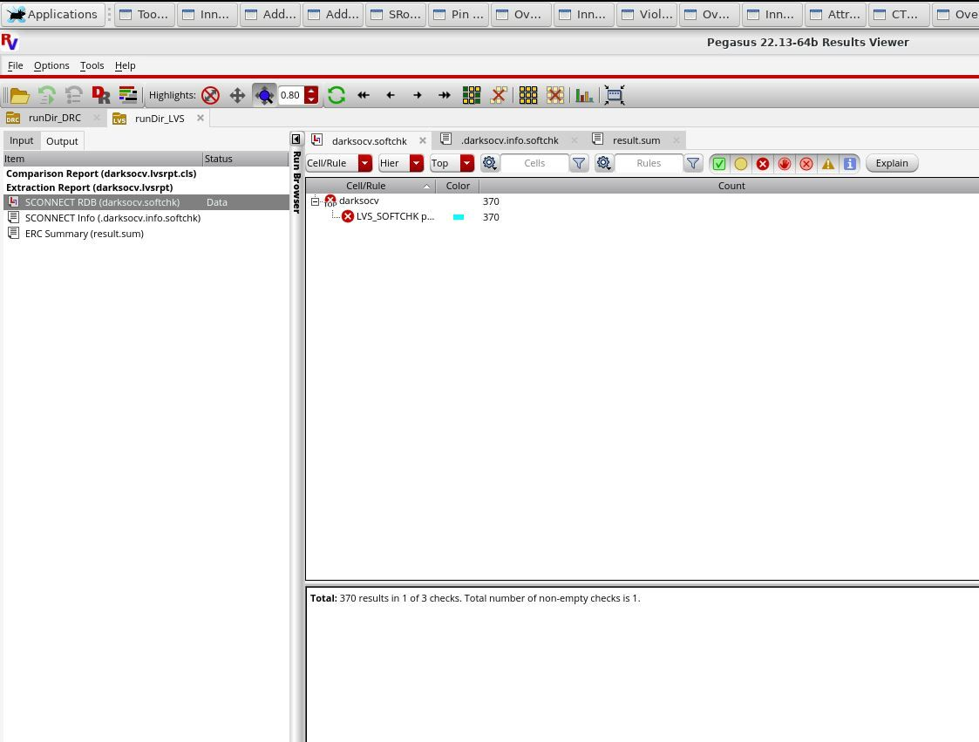
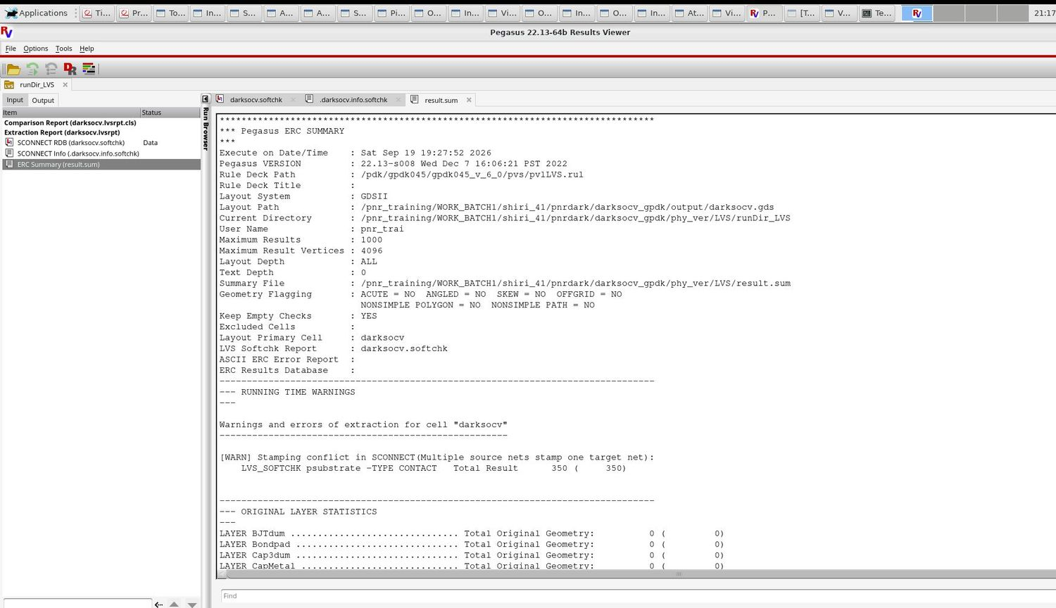
Physical verification – LVS
Pegasus 22.13 · rule deck gpdk045_v_6_0 pv1LVS.rul
SCONNECT soft-check database
ERC summary (result.sum)
370
PDK-related
1 of 3 checks non-empty: SCONNECT soft check
ERC summary: psubstrate contact stamping conflict (350 in the summary)
Root cause: PDK soft checks, left as a known PDK issue
LVS_SOFTCHK results
soft-check issue
DarkSoCV · gpdk045 · PnR → Signoff
13

Slide 14
Signoff scorecard
Check | Status | Key result
Post-route timing (Innovus) | PASS | WNS +0.077 ns, 0 violating paths, 0 DRVs
STA setup / late (Tempus) | PASS | 0 failing paths in slow and fast corners
STA hold / early (Tempus) | PASS | 0 failing paths in slow and fast corners
Static IR drop (Voltus) | REPORTED | Max 24.03 mV on VDD, about 2.7% of 0.9 V
DRC (Pegasus) | PDK ISSUE | 1,022 results in 4 of 562 rules, from PDK soft checks
LVS (Pegasus) | PDK ISSUE | 370 soft-check results, from PDK soft checks
Antenna (Innovus) | CLEAN | No antenna violations
DarkSoCV · gpdk045 · PnR → Signoff
14

