Slide 1
PicoSoC
RTL-to-Sign-off Physical Design Flow
Genus → Innovus → Pegasus → Voltus → Conformal LEC → Tempus
sky130 · 90nm functional mode · 2x sram_2kbyte + 2x sram_4kbyte macros

Slide 2
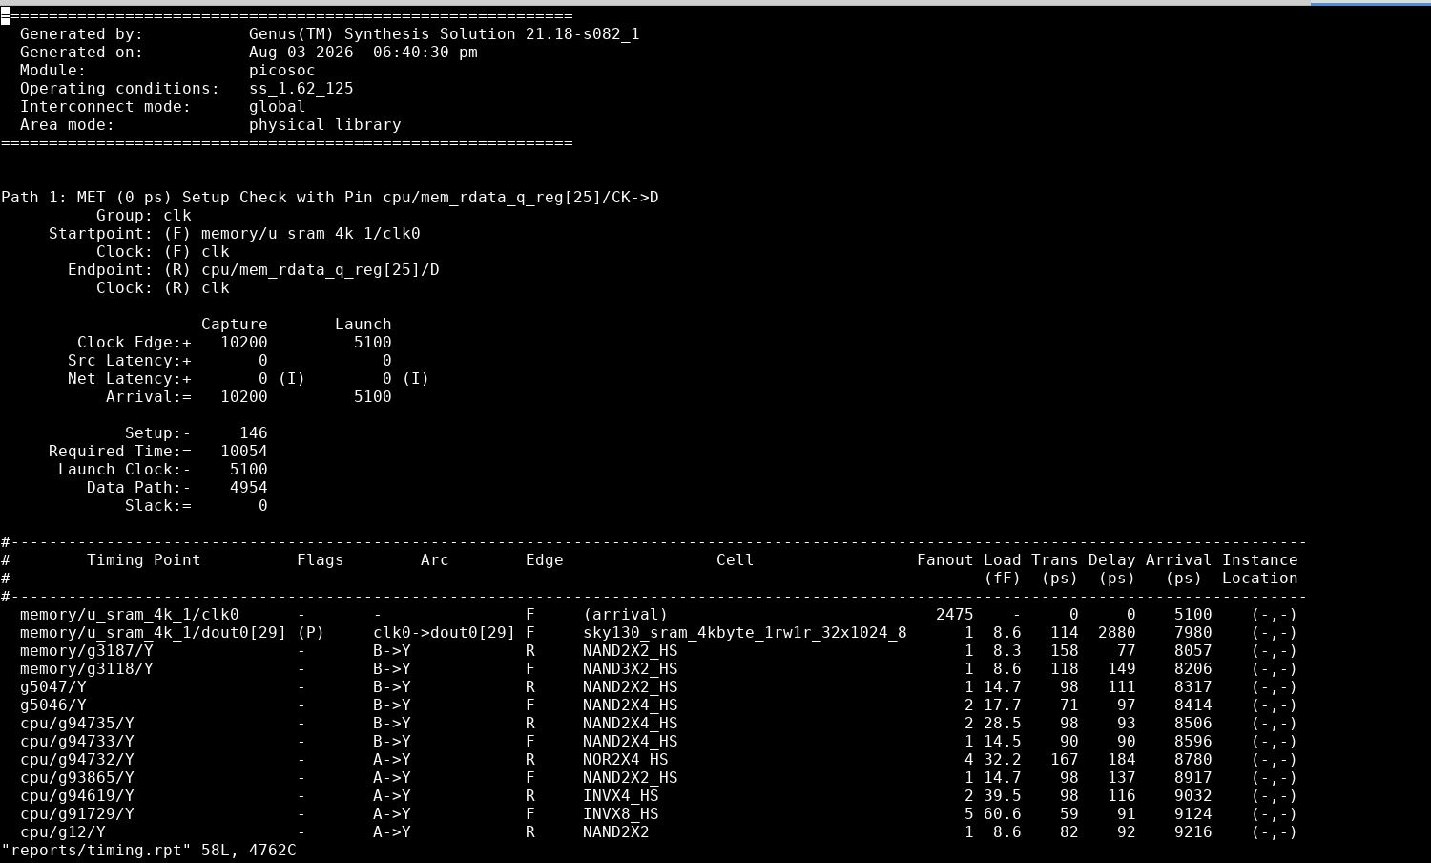
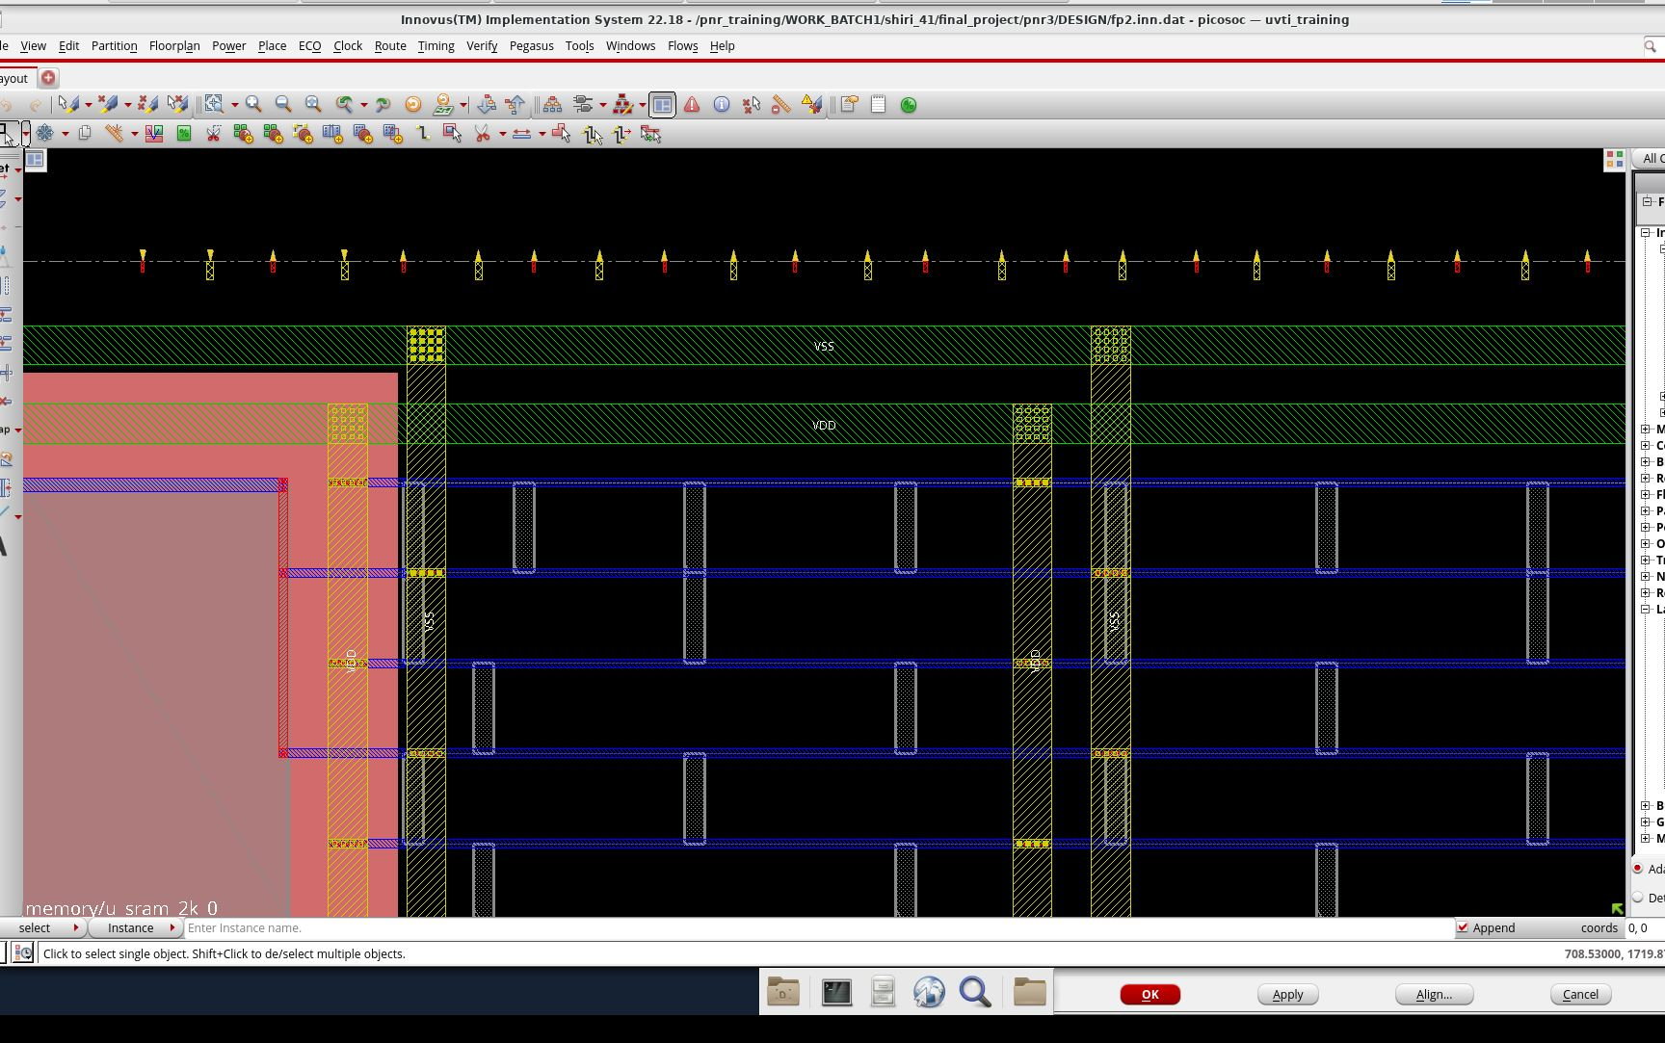
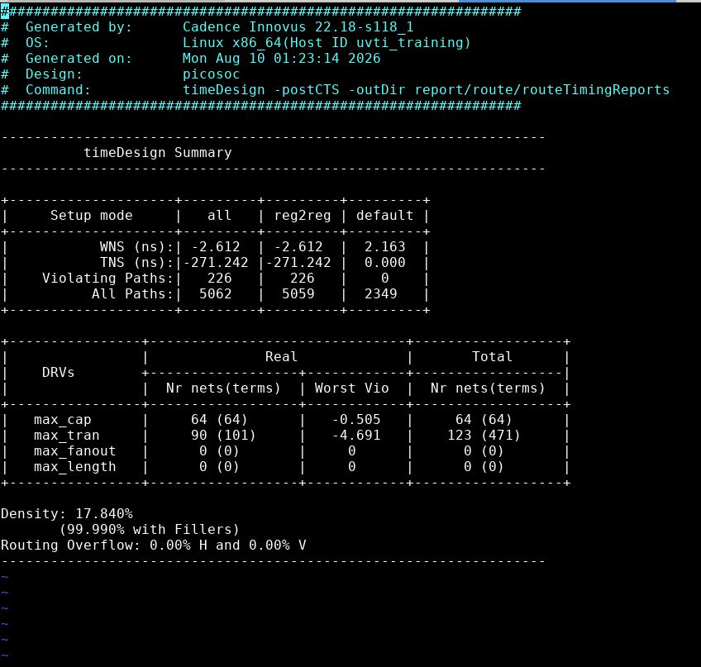
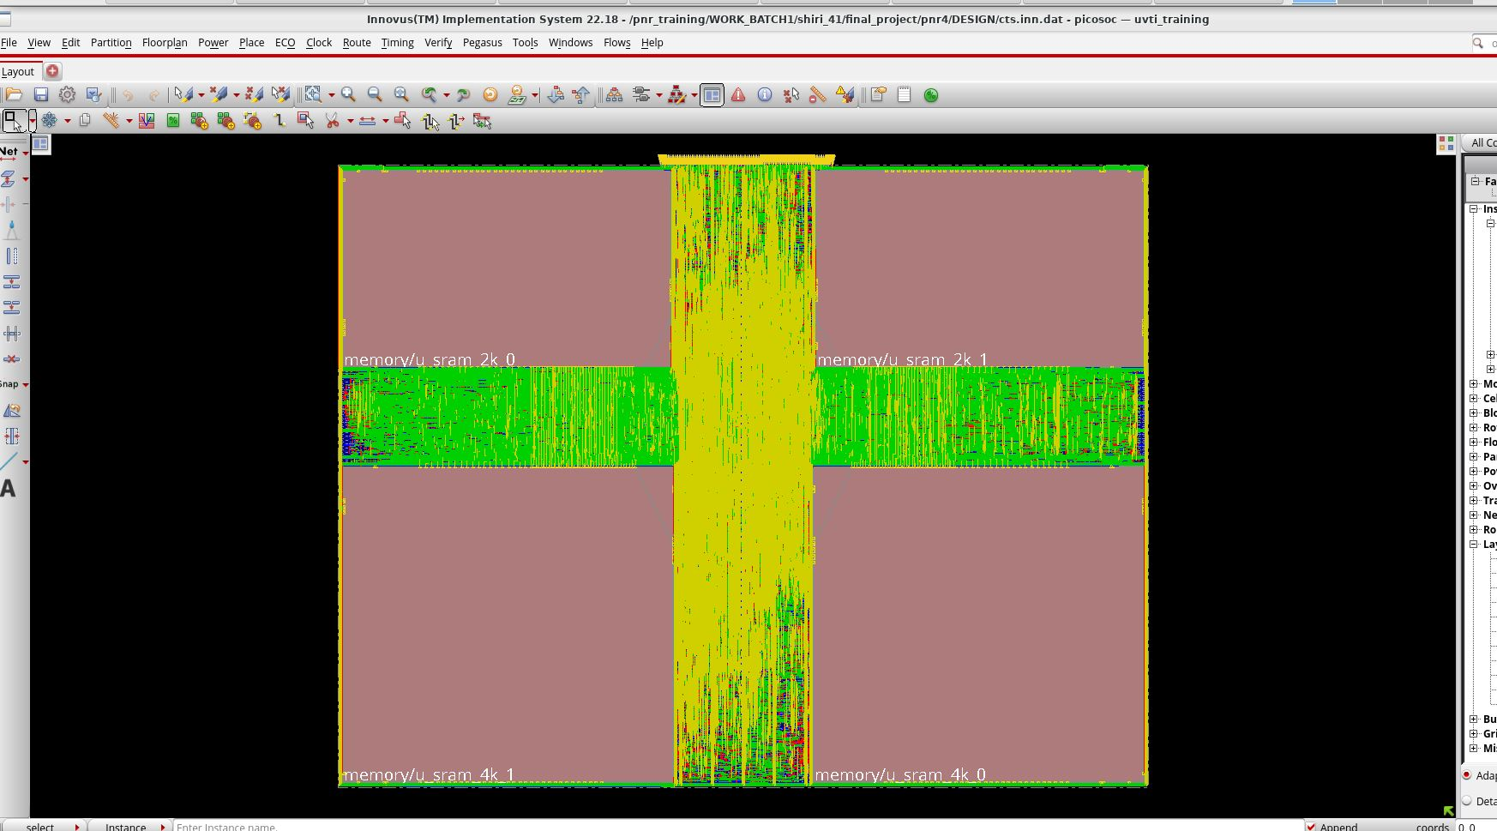
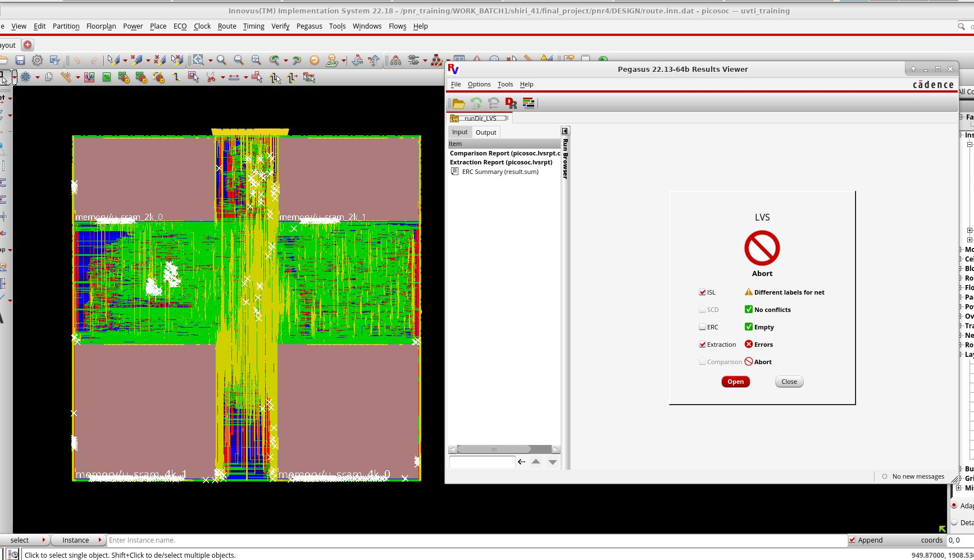
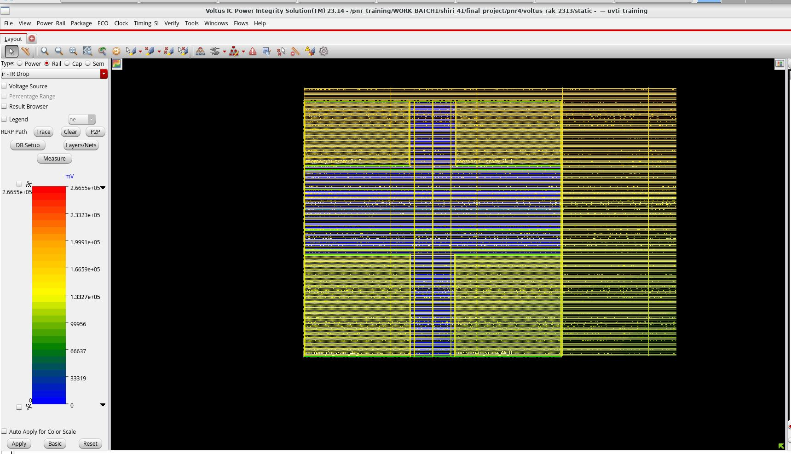
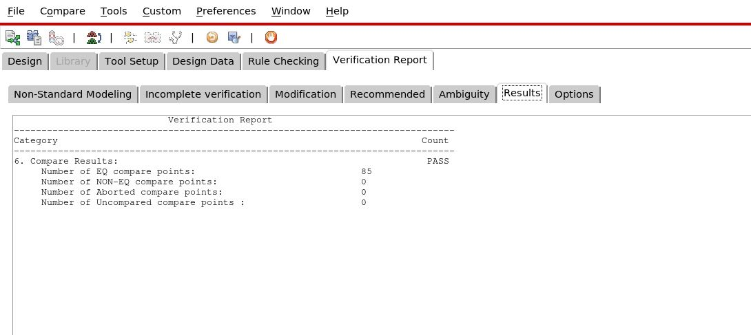
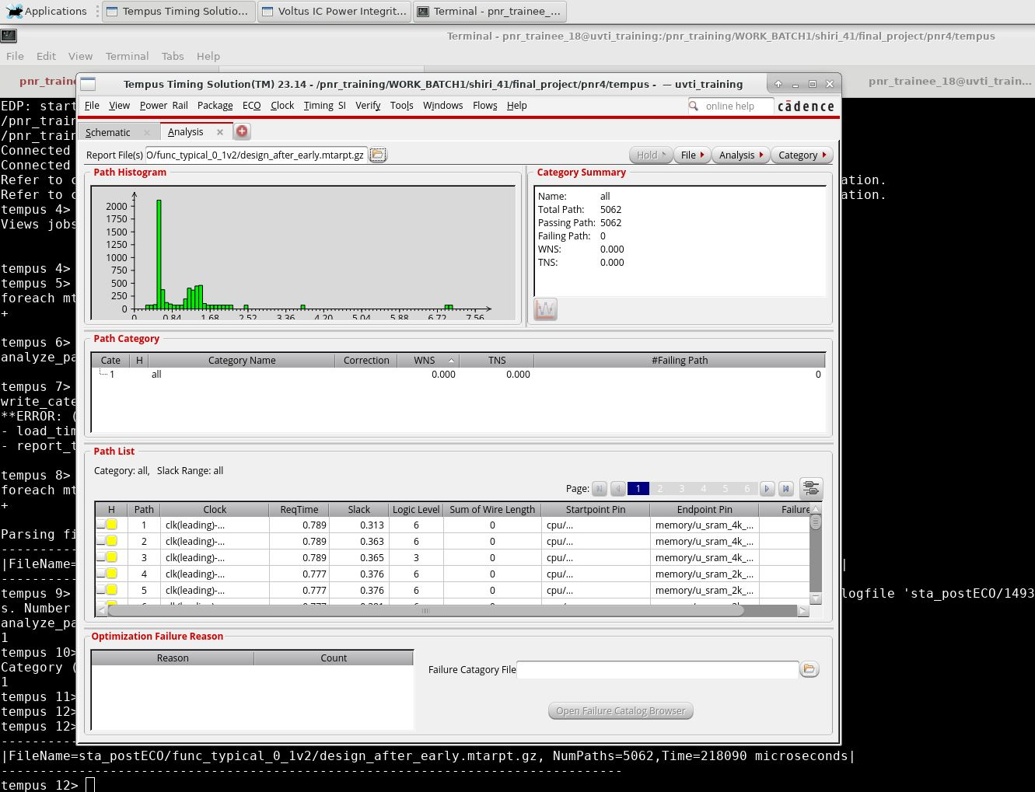
AGENDA
End-to-End Flow Overview
Genus (Synthesis) → Innovus (Floorplan / Place / CTS / Route) → Pegasus (DRC/LVS) → Voltus (IR Drop) → Conformal LEC → Tempus (Sign-off STA)
→
→
→
GENUS
INNOVUS
INNOVUS
INNOVUS
1. Synthesis
2. Floorplan + Pin Align
3. Place → CTS → Route
4. Final Layout
QoR + timing report from RTL.
M2/M4 pins aligned one-by-one.
Timing tracked at every stage.
Routed DB for verification.
→
→
→
PEGASUS
VOLTUS
LEC
TEMPUS
5. DRC / LVS
6. IR Drop
7. Equivalence Check
8. Sign-off STA
Incomplete — SRAM macro issue.
Static IR drop, VDD/VSS grid.
85/85 EQ — passed.
Hold fixed, setup open.
PicoSoC Physical Design
2

Slide 3
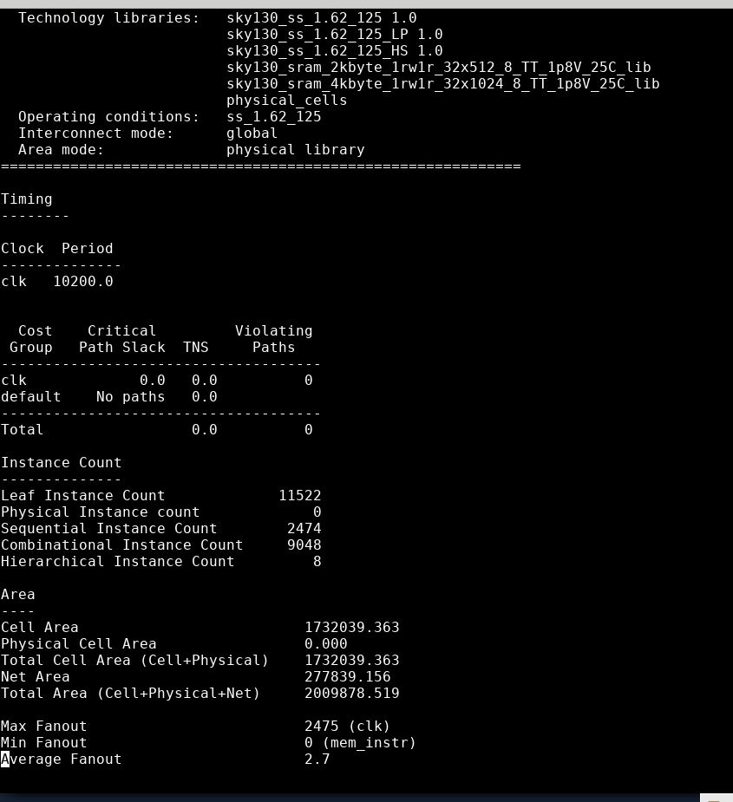
STEP 1
Synthesis — Genus
QoR report
Setup timing path report
RTL mapped to sky130 standard cells + sram_2kbyte / sram_4kbyte macros at the ss_1.62_125 worst-case corner; setup timing met with 0 ps slack on the critical path.
QoR: ~11,522 leaf instances, 1.73M µm² cell area, max fanout 2475 — this netlist and its generated SDC were carried forward into Innovus for physical implementation.
PicoSoC Physical Design
3

Slide 4
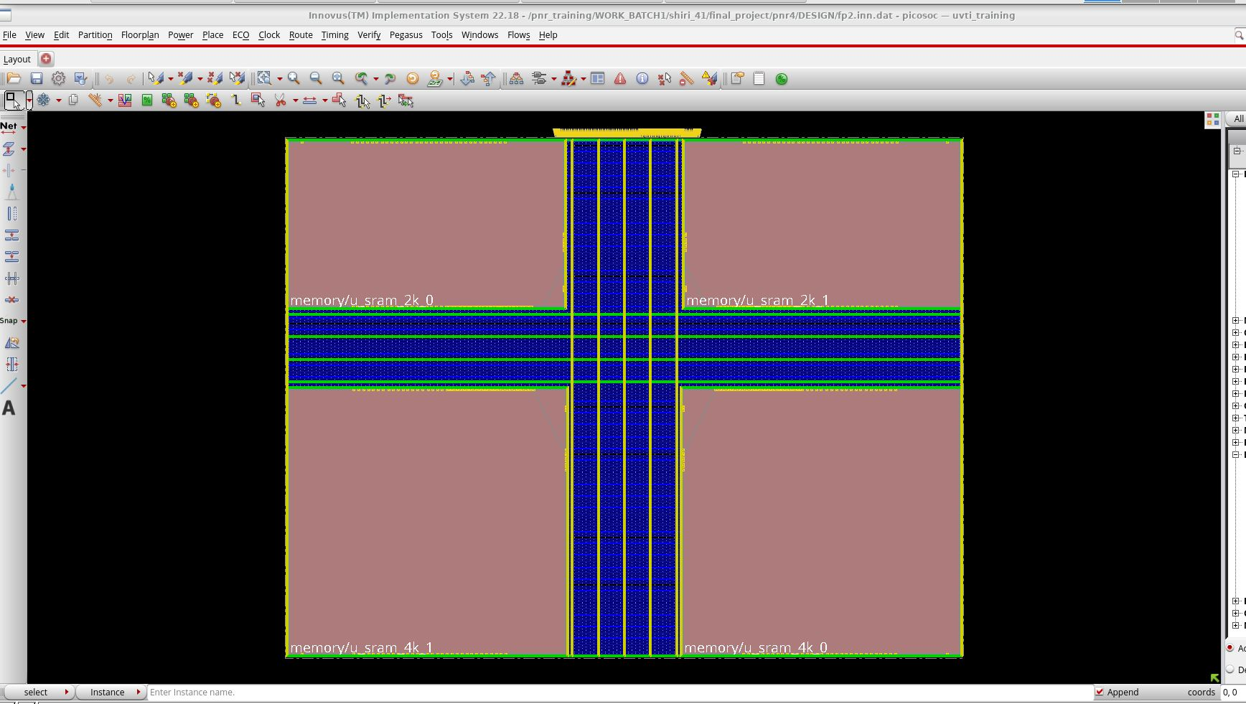
STEP 2
Floorplan & Special Pin Alignment
PIN ALIGNMENT: DONE WELL
Floorplan — 4 SRAM macros placed in a cross layout
Pin alignment on Metal-2 / Metal-4 tracks
Floorplan places the four SRAM macros (2 × 2 KB, 2 × 4 KB) around the CPU core; power rings/stripes route around the cross-shaped macro cluster.
Pin alignment was handled as a separate, dedicated task: since the macros' I/O pitch didn't fall on a routing-friendly grid, each pin was aligned individually — one at a time — on Met2 and Met4. Pin alignment has been optimized in MET2 and MAT4 as requested, with pin placement adjusted to improve routing access and minimize congestion in the design.
PicoSoC Physical Design
4

Slide 5
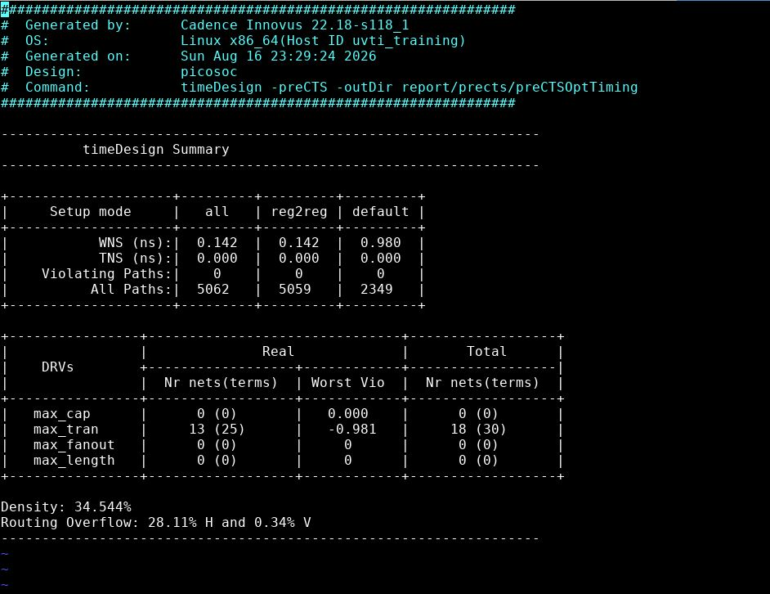
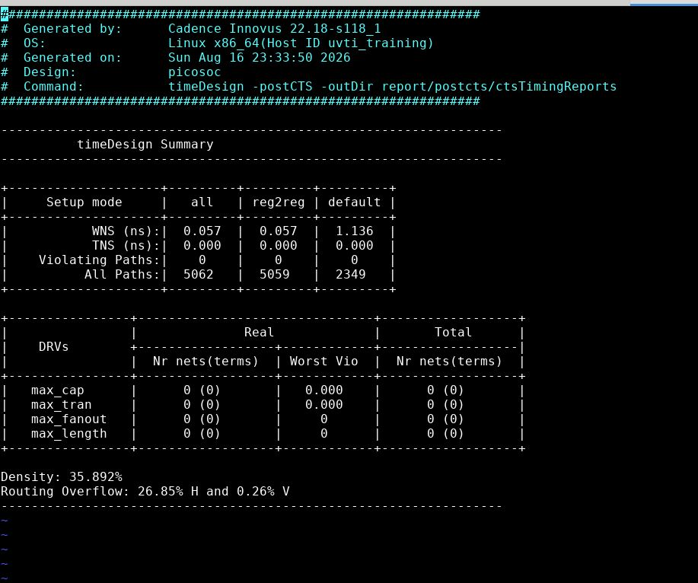
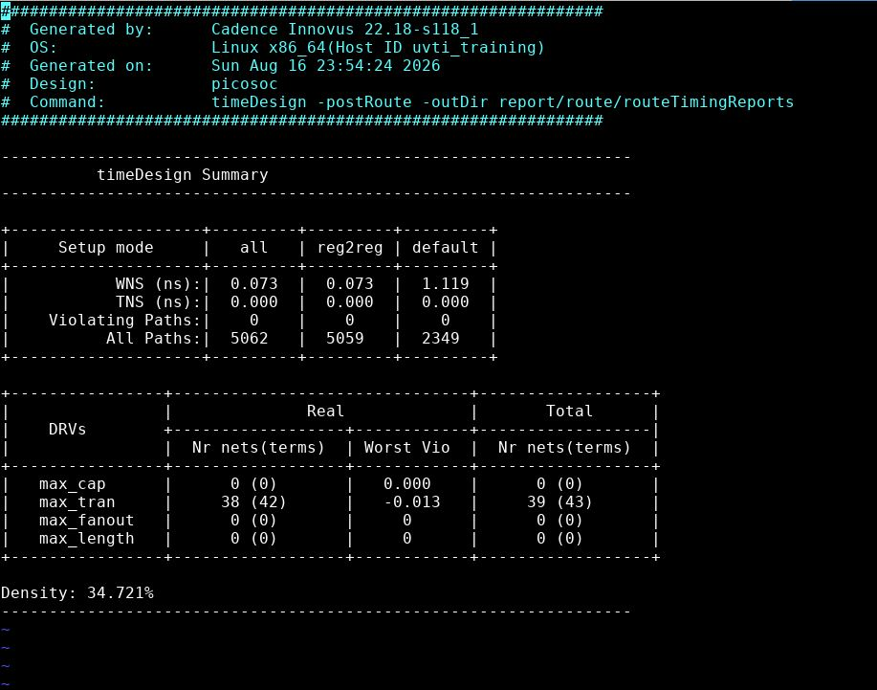
STEP 3
Place → CTS → Route: Timing Progression
Pre-CTS (post-place)
Post-CTS
Post-route
Place → CTS → Route timing progression shows progressive setup-timing degradation as clock latency and extracted routing parasitics are introduced. WNS degrades from +0.158 ns (post-place) to −0.528 ns (post-CTS) and −2.612 ns (post-route), while TNS increases from 0 to −31.6 ns and finally −271.2 ns. The number of violating paths increases from 0 → 119 → 226, highlighting the impact of post-route RC extraction on timing closure.
Post-route is where timing closure gets genuinely hard: real extracted RC replaces estimated wire models, density reaches ~99.99% with fillers, and routing overflow is pinned at 0.00% — so there's almost no free space left for the optimizer to add buffers or re-route congested nets, which is exactly what carried these setup violations forward into the Tempus sign-off stage.
PicoSoC Physical Design
5

Slide 6
STEP 4
Final Physical Design
Final routed database — picosoc top level
Fully placed, clock-tree-synthesized, and routed design with the 4 SRAM macros, filler/tap cells, and power grid in place — this database is the handoff point into physical verification (Pegasus) and power analysis (Voltus).
PicoSoC Physical Design
6

Slide 7
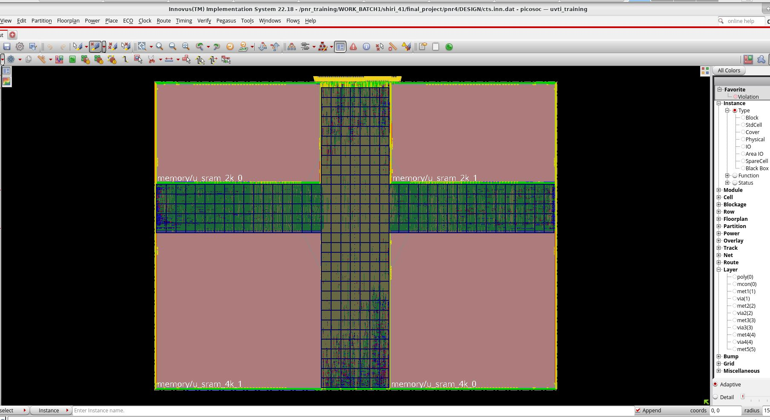
STEP 4
Final Physical Design
Final routed database — picosoc top level
Final Routed Design: Full-chip routing is completed successfully with no routing congestion/overflow, providing a clean and routable layout ready for downstream sign-off analysis.
PicoSoC Physical Design
6

Slide 8
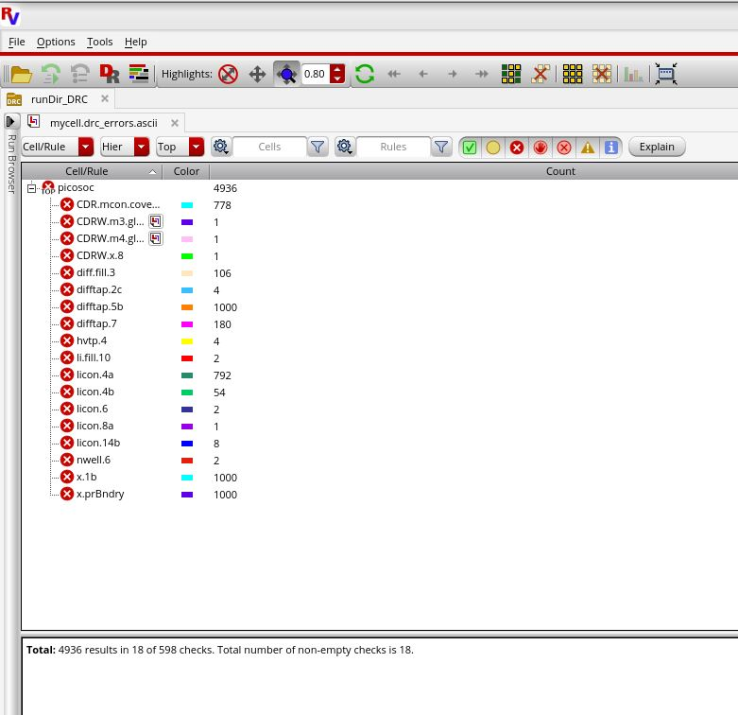
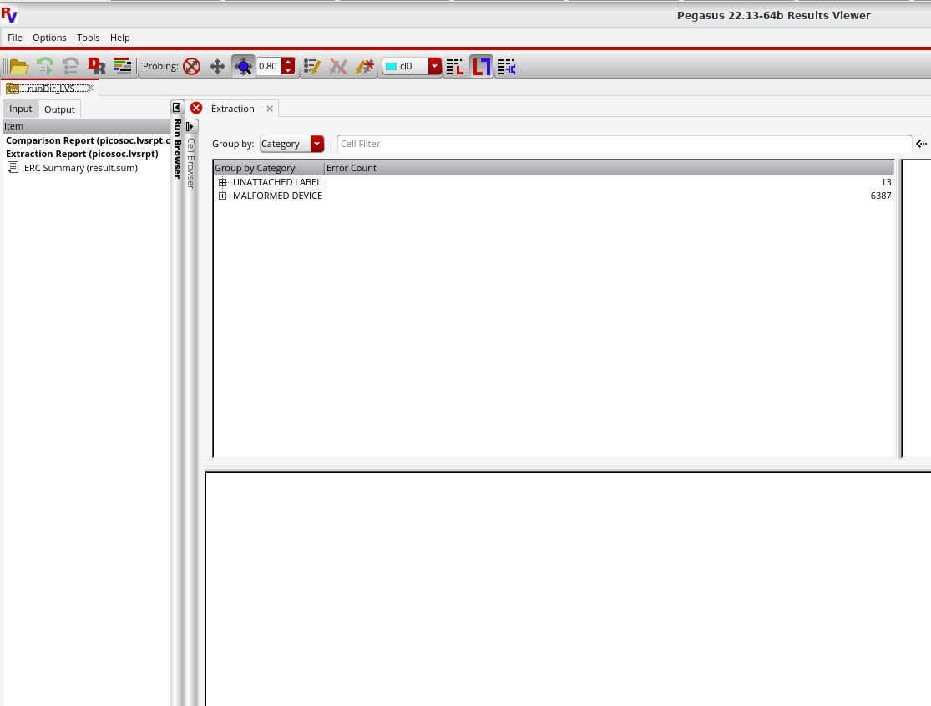
STEP 5
Physical Verification — Pegasus DRC / LVS
DRC results
LVS run summary
DRC: All identified PSD-related DRC violations have been resolved, and the design now passes DRC.
LVS: LVS is clean for the implemented design. The remaining issue is internal to the SRAM macro and is outside the scope of my work .
Post-Timing ECO: DRC and LVS were re-run after the timing ECO, with no change in the results; the design remains DRC/LVS clean.
PicoSoC Physical Design
7

Slide 9
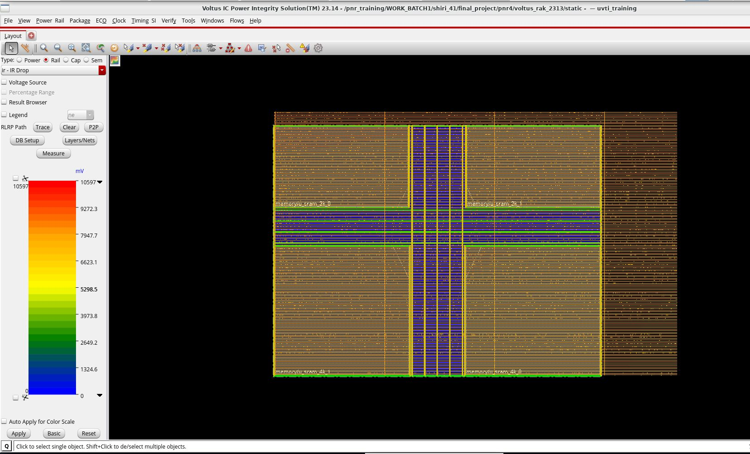
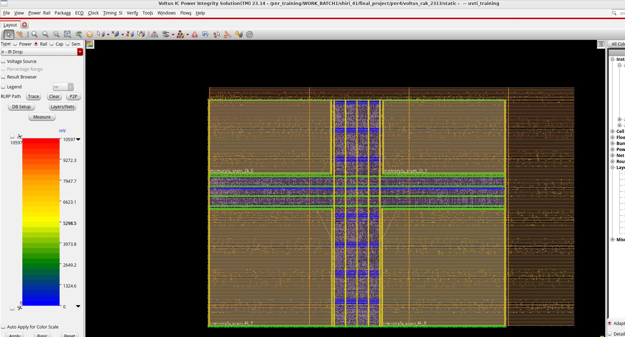
STEP 6
Power Integrity — Voltus Static IR Drop
VDD rail — IR drop
VSS rail — IR drop
VDD (1.8 V): Maximum IR drop = 10.60 mV (≈0.59%)
VSS: Maximum IR drop = 10.60 mV (≈0.59%)
Overall: Both VDD and VSS power networks show a maximum static IR drop of 10.60 mV, with no points exceeding this value.
PicoSoC Physical Design
8

Slide 10
STEP 7
Logic Equivalence Check (LEC)
Conformal LEC — Verification Report
Formal equivalence check comparing the pre- and post-layout netlists: 85/85 compare points EQ, 0 NON-EQ, 0 aborted, 0 uncompared — result: PASS.
Confirms none of the ECO/optimization changes made through place-and-route and timing closure altered the design's logical function.
PicoSoC Physical Design
9

Slide 11
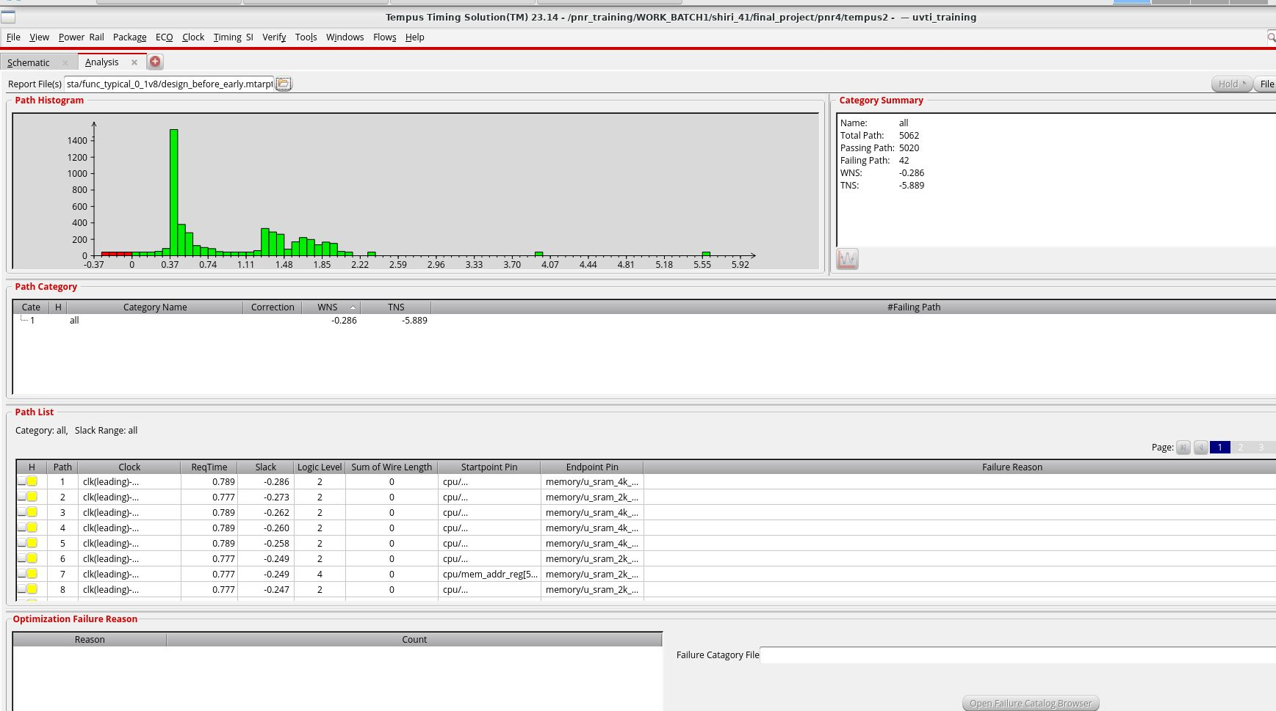
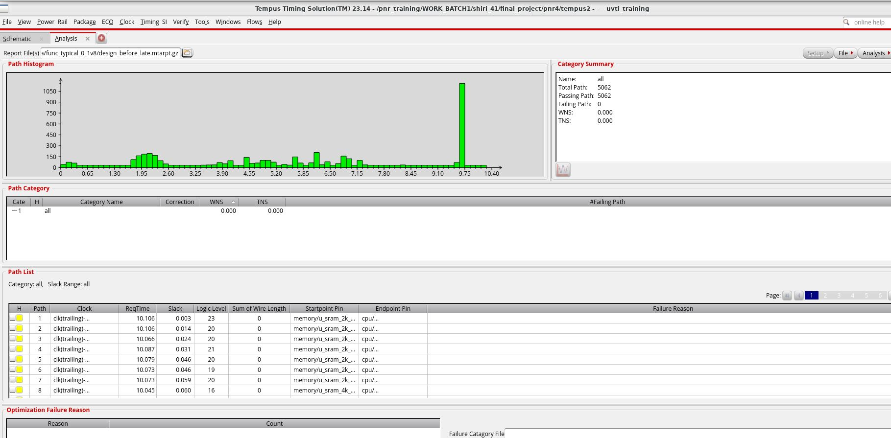
STEP 8A
Sign-off STA (Tempus) — Initial Violations
Hold analysis — before fix
Setup analysis — before fix
Setup timing is clean with zero setup violations; only hold timing violations remain and are being addressed through timing optimization.
PicoSoC Physical Design
10

Slide 12
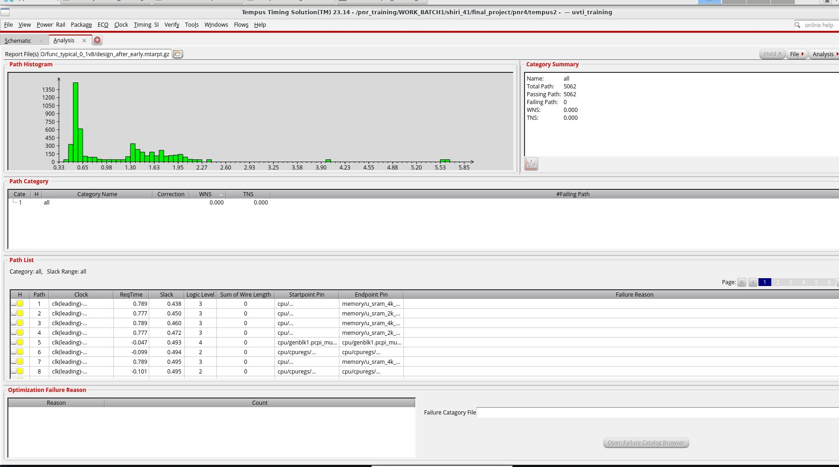
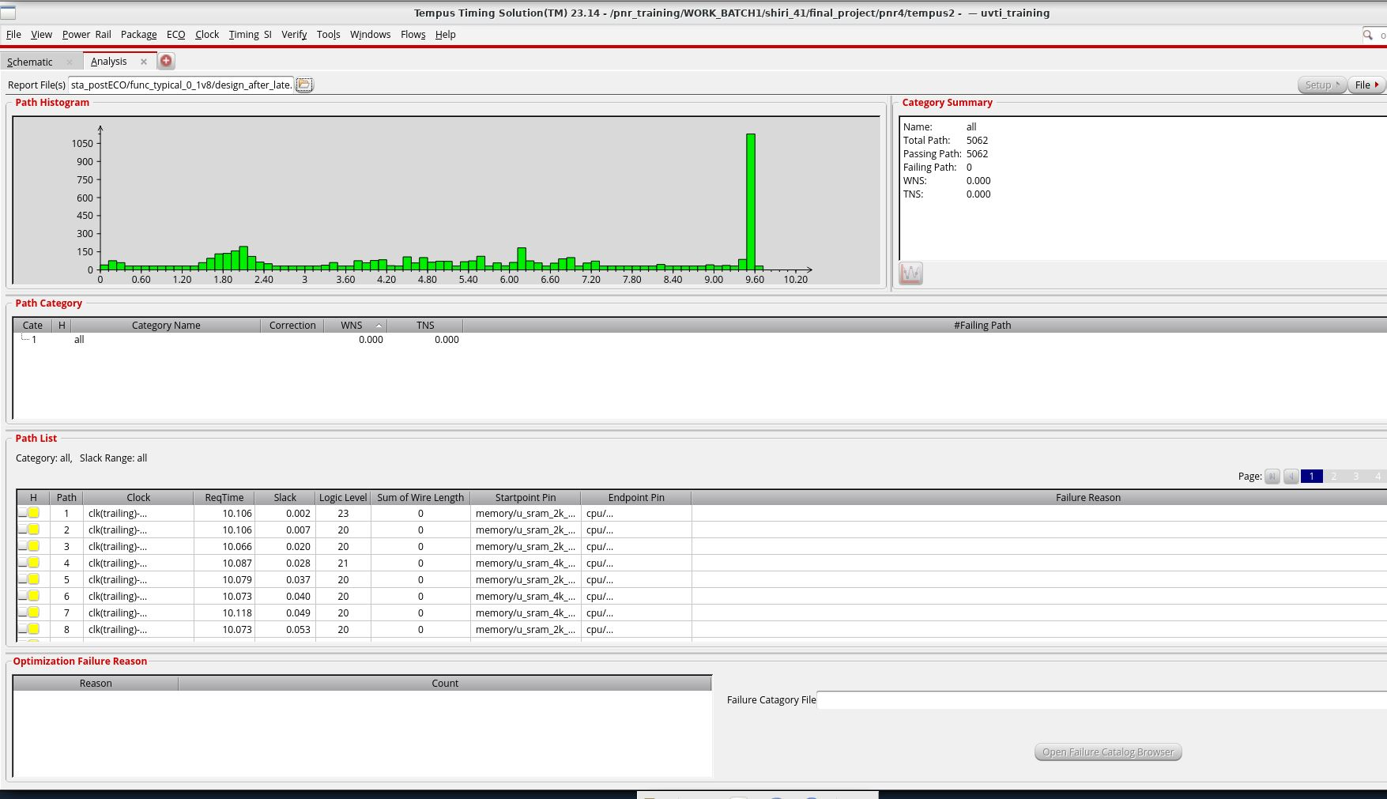
STEP 8B
Sign-off STA (Tempus) — After ECO
Hold — fully clean (WNS/TNS = 0)
Setup — remaining fails (memory→cpu, falling edge)
After a single ECO for hold optimization, all hold violations were resolved while maintaining clean setup timing. The final design is clean for both setup and hold.
PicoSoC Physical Design
11

Slide 13
WRAP-UP
Status Summary & Open Items
Synthesis (Genus)
Complete
Floorplan / Place / CTS / Route (Innovus)
Complete
Special Pin Alignment (Metal-2 / Metal-4)
Completed successfully
Physical Verification (Pegasus DRC/LVS)
clean
Power Integrity (Voltus IR Drop)
Complete
Logic Equivalence Check (LEC)
Passed
Sign-off STA (Tempus) — Hold
Closed
Sign-off STA (Tempus) — Setup
Met
Final Design Status: All identified physical design and sign-off issues have been resolved. The final design is clean for setup and hold timing, DRC, and LVS, with no routing congestion. The post-ECO verification also confirmed that the design remains clean across all key checks.
PicoSoC Physical Design
12

Slide 14
REFERENCE
Deliverable Files Location
Final deliverable folder
/pnr_training/WORK_BATCH1/shiri_41/final_deliverable
Synthesis outputs — Mapped netlist, generated SDC, Genus QoR, and synthesis timing reports.
Innovus PnR database — Complete floorplan, placement, CTS, and fully routed design database with no routing congestion.
Pegasus physical verification — Final DRC-clean database and clean LVS result; SRAM internal macro issue is outside the scope of the design.
Voltus power integrity — Static IR-drop analysis results for VDD and VSS power rails.
Conformal LEC — Logical equivalence verification report confirming PASS.
Tempus sign-off STA — Final post-ECO timing reports confirming clean setup and hold timing.
DRC/LVS and STA were re-run after the ECO with consistent clean results.
All stage-wise working directories referenced in this deck (pnr3 / pnr4 / pnr5, tempus, voltus_rak_2313, etc.) are consolidated under the path above.
PicoSoC Physical Design
13

