Slide 1
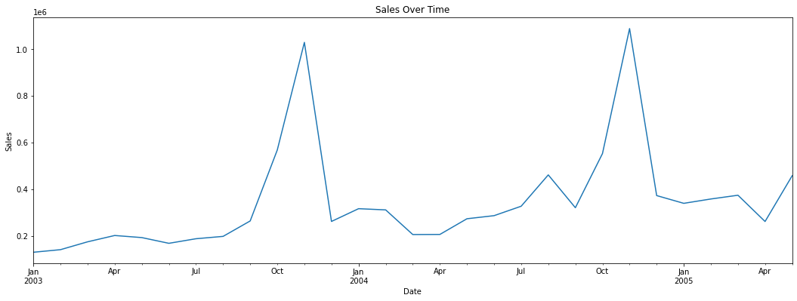
Sales Over Time
Sales Over Time
Observation:- The months of October and November exhibit higher sales compared to other months.
Observation:- The months of October and November exhibit higher sales compared to other months.

Slide 2
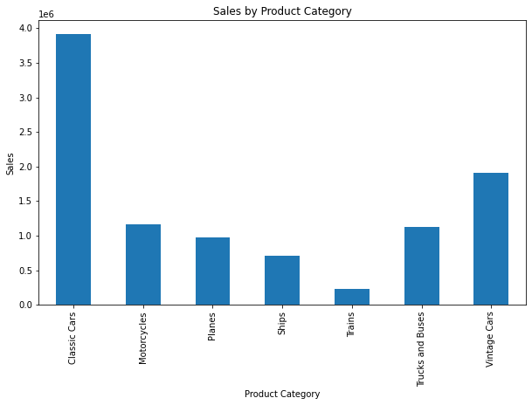
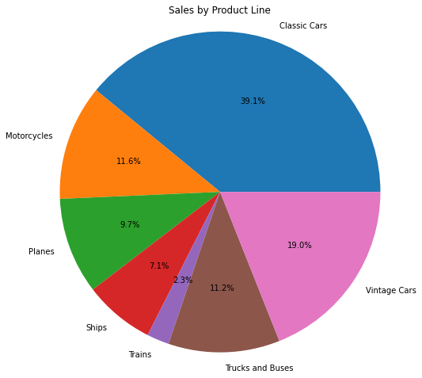
Sales Over Time
Sales by Product Category
Observation:- The months of October and November exhibit higher sales compared to other months.
Observation:- Classic cars have highest sales

Slide 3
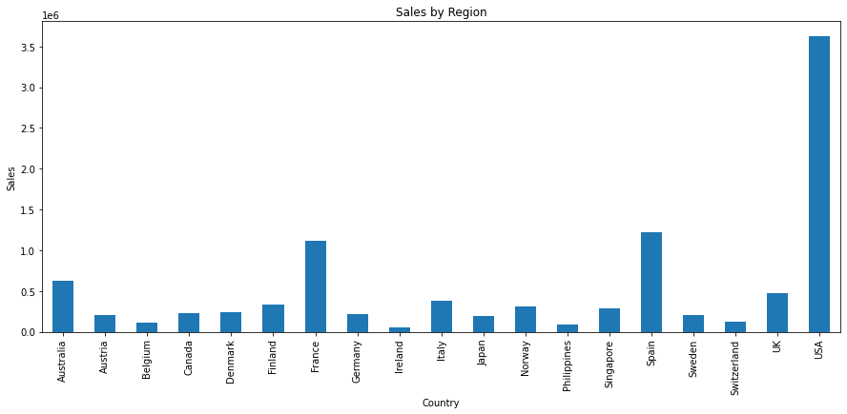
Sales Over Time
Sales by Country
Observation:- The months of October and November exhibit higher sales compared to other months.
Observation:- USA contribute in highest sales

Slide 4
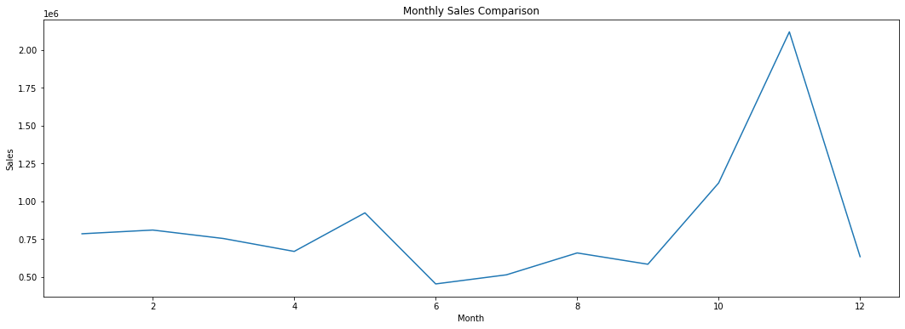
Sales Over Time
Monthly Sales Comparison
Observation:- The months of October and November exhibit higher sales compared to other months.
Observation:- Last two months contribute in most of the sales

Slide 5
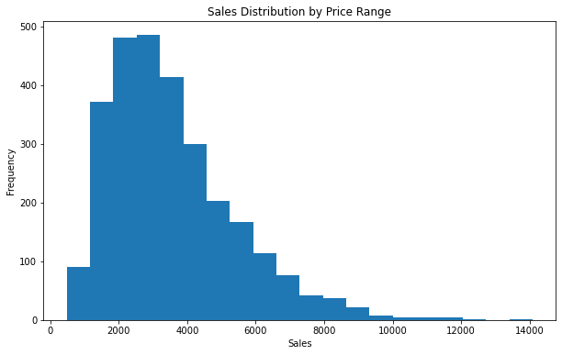
Sales Over Time
Sales Distribution by Price Range
Observation:- The months of October and November exhibit higher sales compared to other months.
Observation:- Most of the sales are in range of 2000-4000

Slide 6
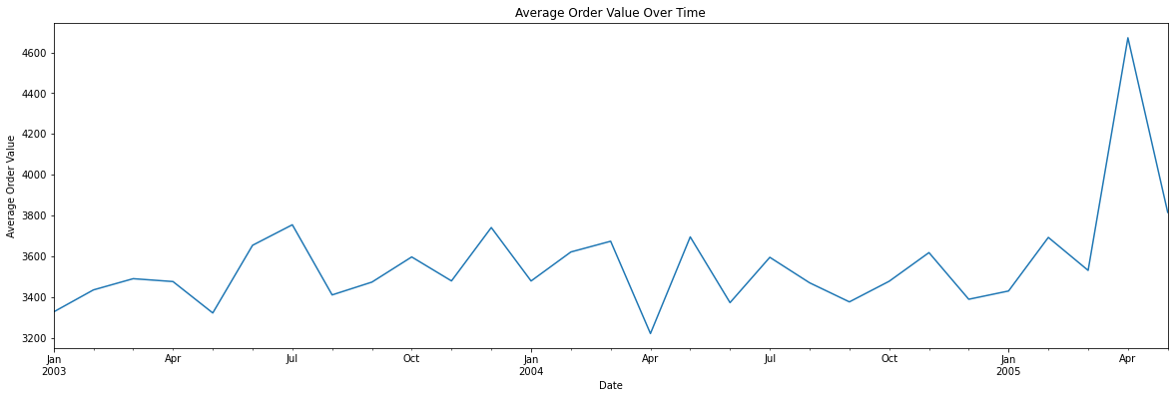
Sales Over Time
Average Order Value Over Time
Observation:- The months of October and November exhibit higher sales compared to other months.
Observation:- Most of the sales are in range of 2000-4000

Slide 7
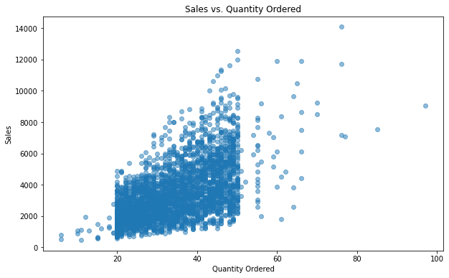
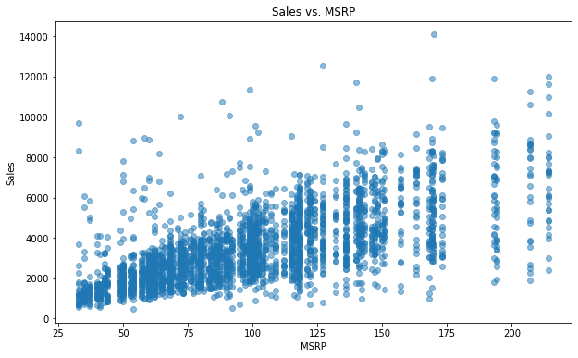
Sales Over Time
Sales vs. Quantity Ordered
Observation:- The months of October and November exhibit higher sales compared to other months.
Observation:- 20-40 quantity have most of the sales

Slide 8
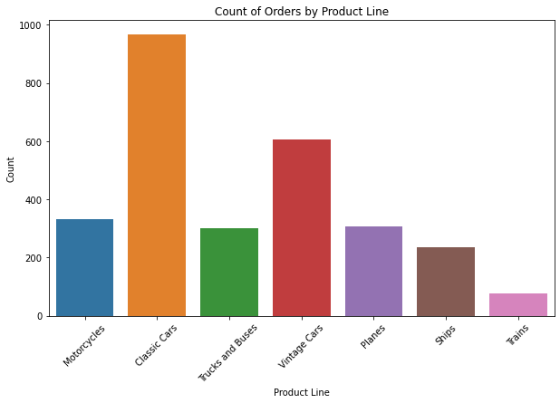
Sales Over Time
Count of Orders by Product Line
Observation:- The months of October and November exhibit higher sales compared to other months.

Slide 9
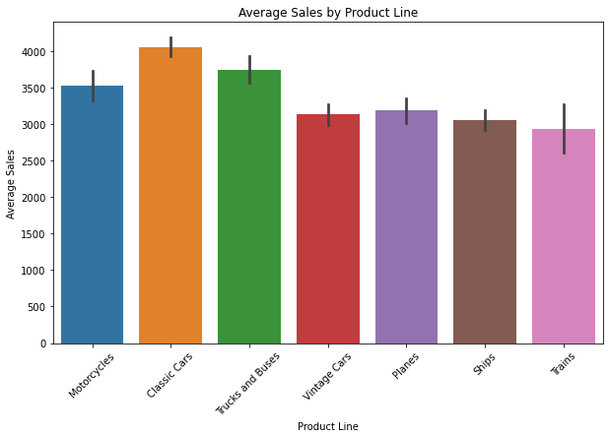
Sales Over Time
Average Sales by Product Line
Observation:- The months of October and November exhibit higher sales compared to other months.

Slide 10
Sales Over Time
Average Sales by Product Line
Observation:- The months of October and November exhibit higher sales compared to other months.

Slide 11
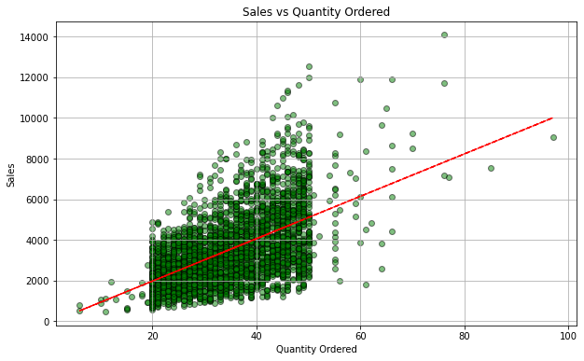
Sales Over Time
Sales vs Quantity Ordered
Observation:- The months of October and November exhibit higher sales compared to other months.

