Slide 1
A DATA VISUALIZATION FINAL PROJECT
The Shifting Landscape of
Global Clinical Trials
13,748 trials across 10 major pharmaceutical sponsors, 1984–2020 — what the record of the pre-AI era reveals about where digital health and AI-driven trial design need to go next.
Shirisha Shashidhar Reddy
Data Science Master's Program • Data Visualization, Final Project • July 2026

Slide 2
WHY THIS DATASET
Reading my own industry’s data, not a stranger’s
1
3 years at IQVIA
2
A career-defining direction
Worked directly with clinical trial operations data — this dataset speaks a language I already read fluently.
Pharma + data science + AI is where clinical development is heading; this project is a deliberate first step, not a class exercise.
3
A live industry question
4
Real, rich, and unresolved
AI and digital health promise faster, cheaper, more targeted trials. The historical record (1984–2020) is the baseline that promise has to beat.
No cleaned-up teaching dataset — messy sponsors, real terminations, real gaps. Exactly the kind of data a working data scientist inherits.
Dataset selection
Clinical Trials Explorer | Final Project

Slide 3
THE DATASET
A rich, multi-dimensional record of real drug development
ClinicalTrials.gov trial registrations, sourced via Kaggle (“A Quick Overview of Clinical Trials”)
13,748
10
1984–2020
4
trial records
major sponsors
years of history
trial phases tracked
Attribute types combined in the analysis
Categorical
Numerical
Temporal
Text
Sponsor, Phase, Status, Condition
Enrollment size
Start Year / Month, 36-year span
Trial Title, Summary (condition classification)
Dataset & scope
Clinical Trials Explorer | Final Project

Slide 4
METHODOLOGY
Being honest about what the data can and can’t say
1
No spatial column
The dataset has no country/site field, so no map-based view was possible. Every other attribute type (categorical, numerical, temporal, text) is combined instead — the brief asks to combine where possible, not force all four.
2
Zero-enrollment trials excluded
Records with Enrollment = 0 (never actually enrolled) are dropped from every enrollment-based analysis to avoid distorting medians and distributions.
3
Tiny-sample decades excluded
The 1980s (n=1) and 2020s (n=2) are excluded from phase-mix-by-decade comparisons — too few trials to support a percentage breakdown.
4
2019–2020 flagged, not hidden
Trial counts fall off a cliff in 2019–2020. This reads as a dataset extraction cutoff, not a real slowdown — flagged directly on the chart rather than silently shown as a trend.
Methodology & data quality notes
Clinical Trials Explorer | Final Project

Slide 5
TRENDS OVER TIME
Q1
Trial launches grew nearly 400× from 1990 to a 2006–’08 peak, then gradually declined
1984–1989 and 2019–2020 omitted — too few trials per year to plot meaningfully alongside the core trend; see methodology.
Insight 1 of 7
Clinical Trials Explorer | Final Project

Slide 6
TRENDS OVER TIME
Q2
Early-phase trials nearly tripled their share since the 1990s, as Phase 3’s dominance faded
Phase 1 share
4.1% → 25.4%
1990s to 2010s
Phase 3 share
65.5% → 35.3%
1990s to 2010s
Sponsors are testing more candidates earlier and cheaper, rather than betting everything on fewer Phase 3 mega-trials.
Insight 2 of 7
Clinical Trials Explorer | Final Project

Slide 7
SPONSOR COMPARISON
Q3
GSK completes 85.6% of its trials — 26 points ahead of AbbVie, the lowest of the ten
Insight 3 of 7 — Completion Rate (%) by sponsor
Clinical Trials Explorer | Final Project

Slide 8
SPONSOR COMPARISON
Q4
Pfizer halts nearly 1 in 5 trials before completion — three times AbbVie’s rate
Insight 4 of 7 — Terminated / Withdrawn rate (%) by sponsor
Clinical Trials Explorer | Final Project

Slide 9
TRIAL CHARACTERISTICS
Q5
Phase 3 trials enroll a median of 360 patients — 11× Phase 1’s 32
Why it matters
Phase 1 tests safety in a small cohort. Phase 3 has to prove efficacy at population scale before regulators will sign off — the enrollment curve is really the cost curve of de-risking a drug.
This is exactly the cost AI-assisted patient matching and adaptive trial design are aimed at compressing.
Insight 5 of 7 — Median Enrollment by Phase (patients with Enrollment > 0)
Clinical Trials Explorer | Final Project

Slide 10
SPONSOR COMPARISON
Q6
Gilead’s pipeline is 62% infectious disease — the most concentrated focus of any major sponsor
Sponsor | Leading therapeutic area | Share of sponsor’s trials
Gilead | Infectious Disease | 62.2%
Roche | Oncology | 52.2%
Bayer | Oncology | 49.3%
GSK | Infectious Disease | 37.3%
Novartis | Oncology | 33.8%
AbbVie | Oncology | 33.7%
JNJ | Neurological/Psychiatric | 33.7%
Sanofi | Oncology | 33.7%
Pfizer | Oncology | 30.1%
Merck | Infectious Disease | 25.1%
Rows with a leading specialty above 45% of the sponsor’s trial volume are highlighted — a strong single-therapeutic-area bet, not a diversified portfolio.
Insight 6 of 7 — Excludes conditions that don’t map to a defined therapeutic area
Clinical Trials Explorer | Final Project

Slide 11
TRENDS OVER TIME
Q7
Median trial size has nearly halved since the late 1990s — from ~300 to ~120 patients
Restricted to 1997–2018, where each year has ≥35 trials — enough for a stable median. Trials with Enrollment = 0 excluded.
Insight 7 of 7
Clinical Trials Explorer | Final Project

Slide 12
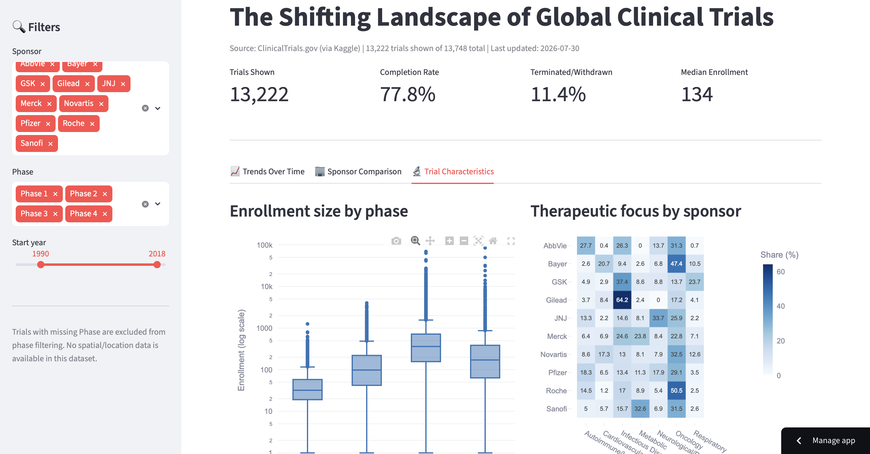
THE DASHBOARD
Explore it yourself: a live, filterable dashboard
Three tabs, one shared filter set
Trends Over Time
Trial volume by year, phase mix by decade
Sponsor Comparison
Completion & termination rates, side by side
Trial Characteristics
Enrollment by phase, therapeutic-area heatmap
Sponsor, phase, and year filters apply live across all three tabs — not a static chart dump.
Live dashboard: siris-clinical-trials.streamlit.app
Source: github.com/shirisha-shashidhar/clinical-trials-final-project
Interactive dashboard
Clinical Trials Explorer | Final Project

Slide 13
SO WHAT
An industry becoming more cautious, more fragmented —
and ready to be reshaped by AI
1
Trials are getting smaller and earlier-phase-heavy — sponsors are de-risking earlier rather than betting big on fewer Phase 3s.
2
Completion and termination rates vary 3× across sponsors doing the same kind of work — execution discipline, not just science, drives outcomes.
3
Sponsors are specializing (Gilead in infectious disease, Roche in oncology) rather than running generalist pipelines.
4
All of this is the pre-AI baseline. Digital health promises faster patient matching, adaptive designs, and leaner trials — the metrics on this deck are exactly what that promise needs to beat.
Conclusion
Clinical Trials Explorer | Final Project

Slide 14
THANK YOU
The Shifting Landscape of Global Clinical Trials
GitHub repository
github.com/shirisha-shashidhar/clinical-trials-final-project
Live dashboard
siris-clinical-trials.streamlit.app
Shirisha Shashidhar Reddy • Data Visualization, Final Project

