Slide 1

Learn with Shirisha
Lecture #1(Telugu)
Data Structures & Algorithms Course in Python
What are Data Structures?

Slide 2
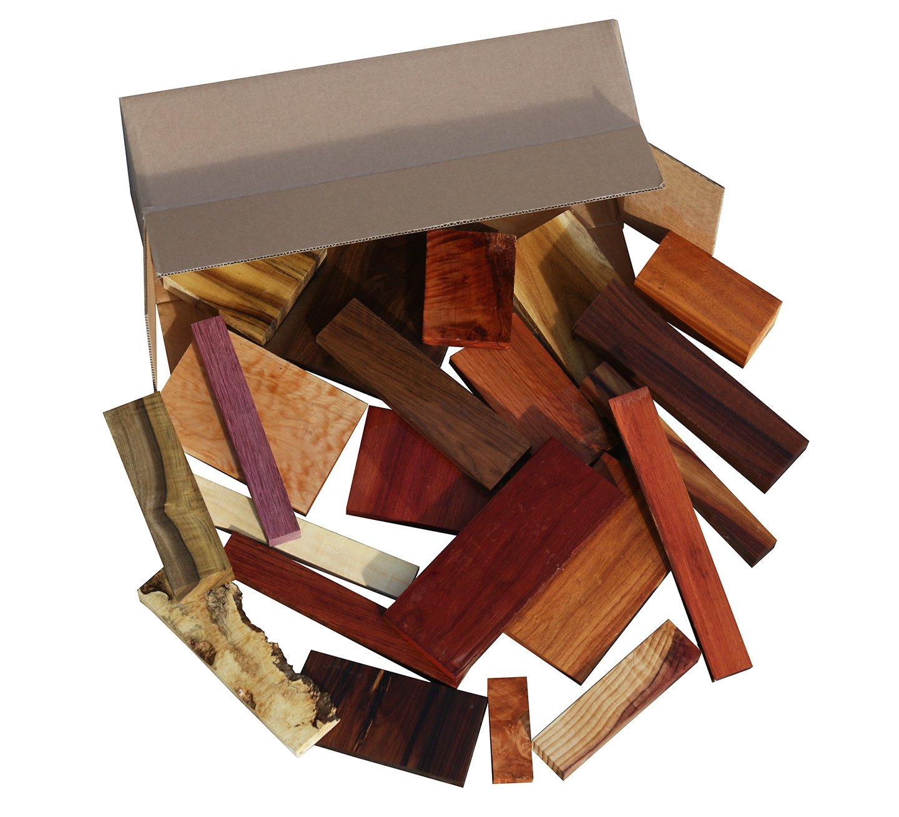

Learn with Shirisha
What are Data Structures?
Data Structures are different ways of organizing data on your computer, that can be used effectively.

Slide 3


Learn with Shirisha
What are Data Structures?
Data Structures are different ways of organizing data on your computer, that can be used effectively.

Slide 4
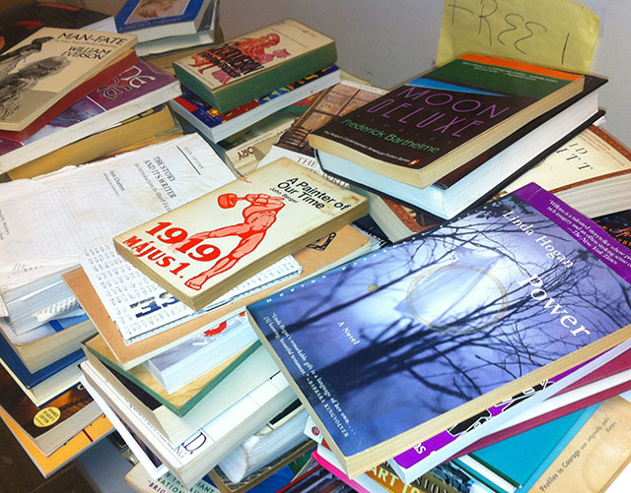

Learn with Shirisha
What are Data Structures?
Data Structures are different ways of organizing data on your computer, that can be used effectively.

Slide 5

Learn with Shirisha
Thank you

