Slide 1

SREENIDHI INSTITUTE OF SCIENCE AND TECHNOLOGY DEPARTMENT OF ELECTRONICS AND COMPUTER ENGINEERING
PROJECT TITLE: FACIAL EXPRESSION RECOGNITION
GROUP PROJECT: FINAL REVIEW
BATCH NO.-8
PROJECT GUIDE:
DR.MANU GUPTA
19311A1914: GANGADI SHIRISHA
19311A1927: AELA MANI CHANDANA
19311A1956: BELIDE ANKITHA

Slide 2
CONTENTS
Abstract
Objective
Existing System
Proposed System
Architecture Design
UML Diagrams
Tools and algorithm
Output and analysis
Future Scope
Conclusion
References

Slide 3
ABSTRACT
1. Facial expressions contribute highly in conveying the feelings of a person.
2. In this project we took the facial expression image dataset consists of 7 different basic emotions of the human beings for building a Deep Learning based model using computer vision model architectures for classification of facial expressions.
3. Preprocessed images using augmentation techniques were trained our custom built Convolutional Neural Network (CNN) layers of each image of all categories by passing their weights. Unlike using networks like VGG16, Xception and ResNet50, our custom sequential layered model gave the training accuracy and validation accuracy which are far better than other networks.

Slide 4
OBJECTIVE
Our objective is to develop various CNNs for a facial expression recognition problem and evaluated their performances using different pre and post-processing and visualization techniques.
To obtain the results demonstrated that deep CNNs are capable of learning facial characteristics and improving facial emotion detection.
Finally, to developed a model that can classify the basic emotion with image.

Slide 5
Existing System
Though the existing systems are computer based, they are not connected onto the Real world through applications i.e., classroom monitoring. Even if they are employed in the different usecases, they provide the significant accuracy on the real time hence accurate predictions are very less.
The following are the drawbacks of the existing manual System:
Scope for redundancy
Time Delay
No accuracy
Age old technique ie, Facial landmark detection and Haar features

Slide 6
Proposed System
Proposed system works with Convolutional Neural Network and custom build computer vision architecture.
The model is trained with augmentation methods and generate good accuracy among all transfer learning and predefined architectures.
We can make a web application to upload an image and predict the of emotion in it.

Slide 7
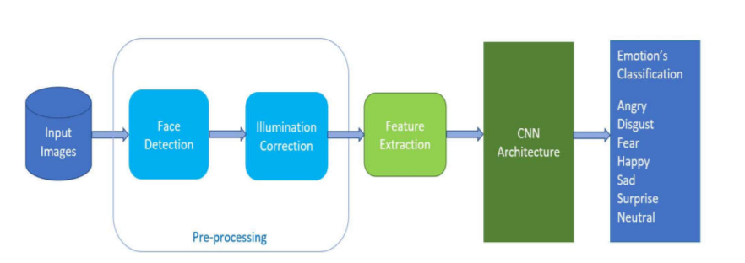
ARCHITECTURAL DESIGN

Slide 8
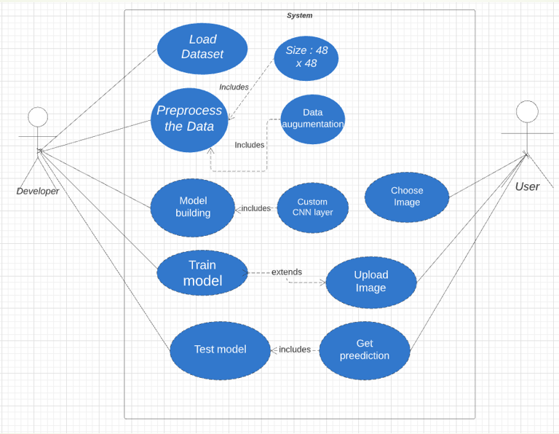
UML DIAGRAMS

Slide 9
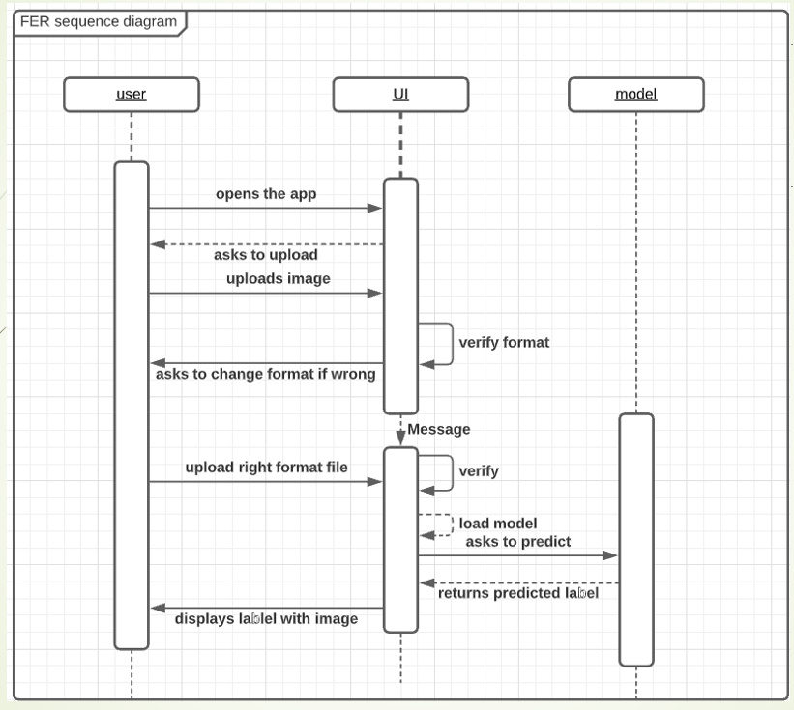

Slide 10
TOOLS AND REQUIREMENTS
Software Requirements:
Operating System: Microsoft Windows XP.
Language : Python
Frameworks : Tensorflow
Libraries : OpenCV, Scikit-Learn
IDE : Google Colab
Hardware Requirements:
Processor : Intel P-IV based system
RAM : Min. 512 MB

Slide 11
Algorithm used:CNN
CNN exploits the structure of images leading to a sparse connection between input and output neurons.
Each layer performs convolution on CNN. CNN takes input as an image volume for the RGB image. Basically, an image is taken as an input and we apply kernel/filter on the image to get the output.
CNN also enables parameter sharing between the output neurons which means that a feature detector (for example horizontal edge detector) that’s useful in one part of the image is probably useful in another part of the image.

Slide 12
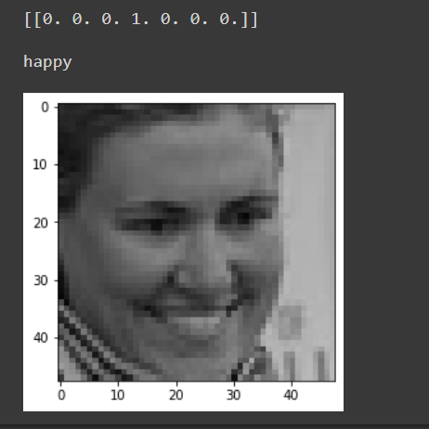
OUTPUT:

Slide 13
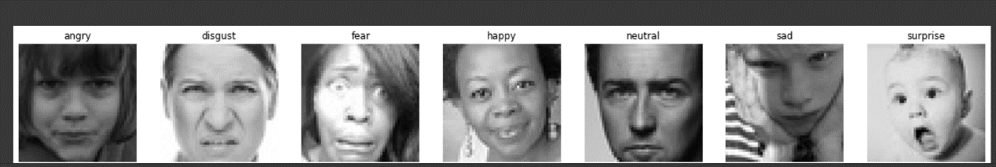
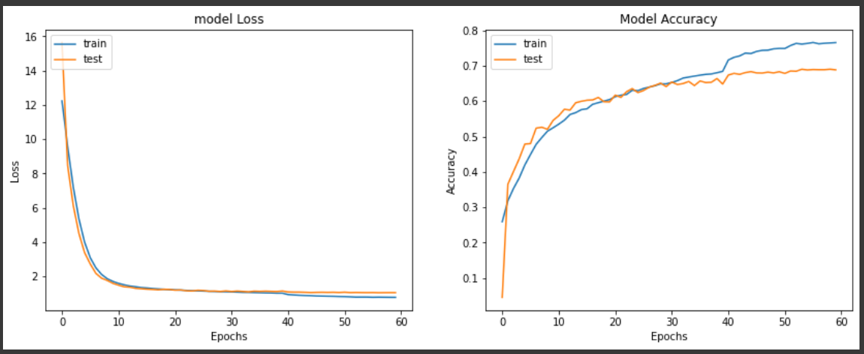
Analysis;

Slide 14
FUTURE SCOPE
It It is not possible to make a complete 100 percent accurate model but the present model can be enhanced with other different techniques.
can be used to know the emotions of dumb people.
It can be used to for pain detection in patients and alert as emergency.
We can use Haar Cascade classifier or DNN to detect the face in the image and crop the face part that useful for expression recognition.
The cropped image is well preprocessed inorder to classify it’s emotion.
Our proposed model will classify the image and gives output as the name of emotion.
We can use opencv library to get live web stream data to be processed and in this way we can classify emotion using webcam too.

Slide 15
CONCLUSION
We developed various CNNs for a facial expression recognition problem and evaluated their performances using different pre and post-processing and visualization techniques.
The results demonstrated that deep CNNs are capable of learning facial characteristics and improving facial emotion detection.
Hence, we developed a model that can classify the basic emotion with image.

Slide 16
REFERENCES
https://www.kaggle.com/msambare/fer2013
https://www.sciencedirect.com/science/article/pii/S1319157818303379
https://docs.streamlit.io/en/stable/
https://www.youtube.com/results?search_query=data+professor
https://www.youtube.com/results?search_query=krish+naik

