Slide 1

Hospitality Analytics
Tools: Excel | MySQL | Power BI | Tableau

Slide 2
Project Objective
Analyze Bookings & Revenue
Measure Performance
Segment Analysis
Temporal Patterns
Break down bookings by city, hotel, room class, and platform.
Deep-dive into hotel booking and revenue datasets to surface trends and drivers.
Quantify occupancy and cancellation performance across segments.
Identify weekday vs weekend booking behaviors.
Decision Support
Create dashboards to guide business decisions and recommend actions.

Slide 3
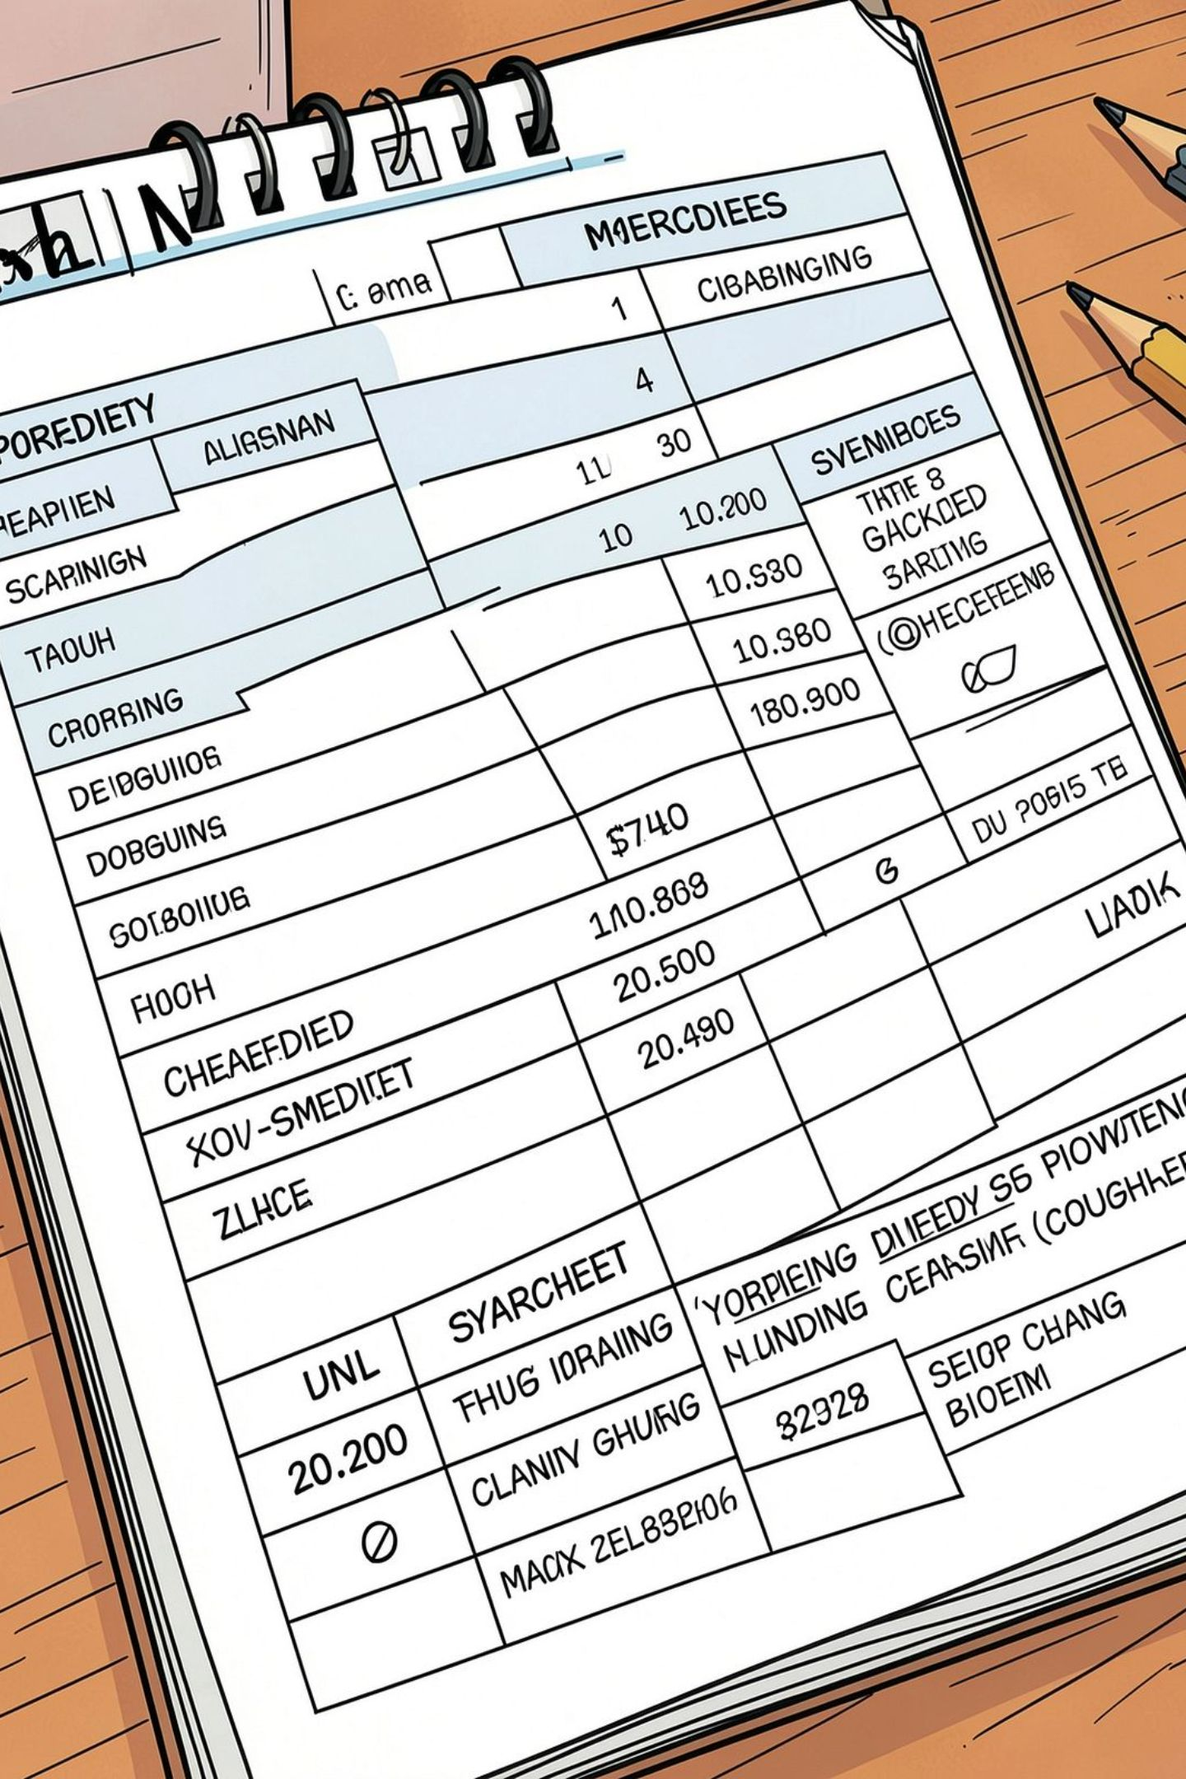
Dataset & Data Preparation
Dataset Overview
Data Preparation Steps
Hotel bookings, booking status, platform
City, property/hotel, room class
Revenue, capacity, rating, date fields
Removed duplicates and checked missing values
Standardized categorical fields
Validated revenue & booking fields
Calculated KPIs for analysis

Slide 4
Key KPIs
1
2
3
4
Total Revenue
Total Bookings
Total Capacity
Cancelled Bookings
$1,708,771,229
134,590
232,576
33,420
5
6
7
Occupancy Rate
Cancellation Rate
Average Rating
57.87% — (Occupied rooms ÷ Total capacity)
24.83% — (Cancelled bookings ÷ Total bookings)
3.62

Slide 5
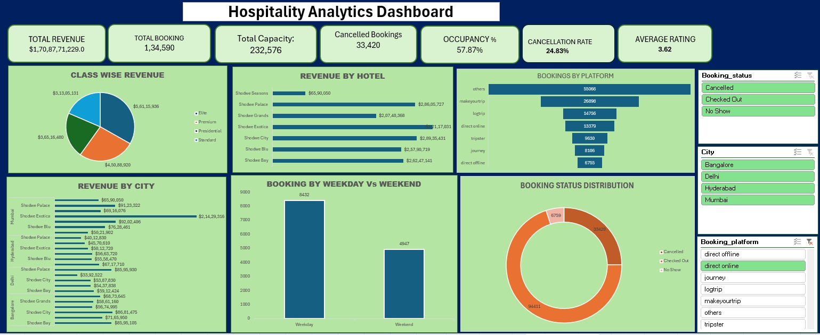
Excel Dashboard
Interactive Excel dashboard built to explore booking counts, revenue by city, and quick KPI filters for date ranges and room classes. Designed for rapid ad-hoc queries and spreadsheet-level validation before
BI ingestion.

Slide 6
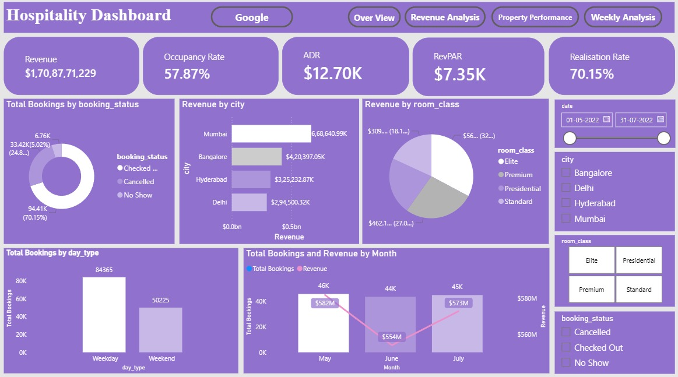
Power BI Dashboard
Power BI visualizations provide cross-filtered views: map of revenue by city, occupancy trendlines, and cancellation funnels. Ideal for executive summaries and operational monitoring with drill-through details.

Slide 7
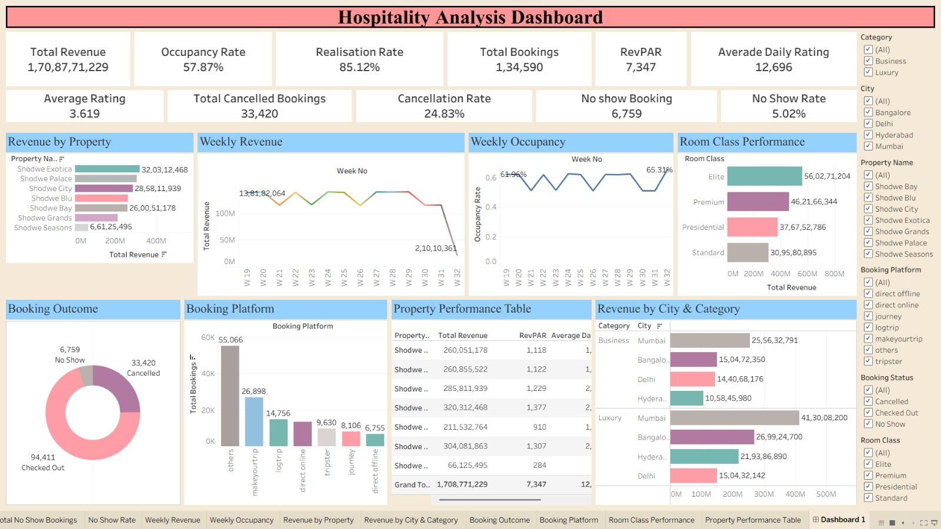
Tableau Dashboard
Tableau dashboards focus on exploratory analysis: booking sources, room-class performance, and weekday/weekend comparisons with rich interactive filters for property and platform segmentation.

Slide 8
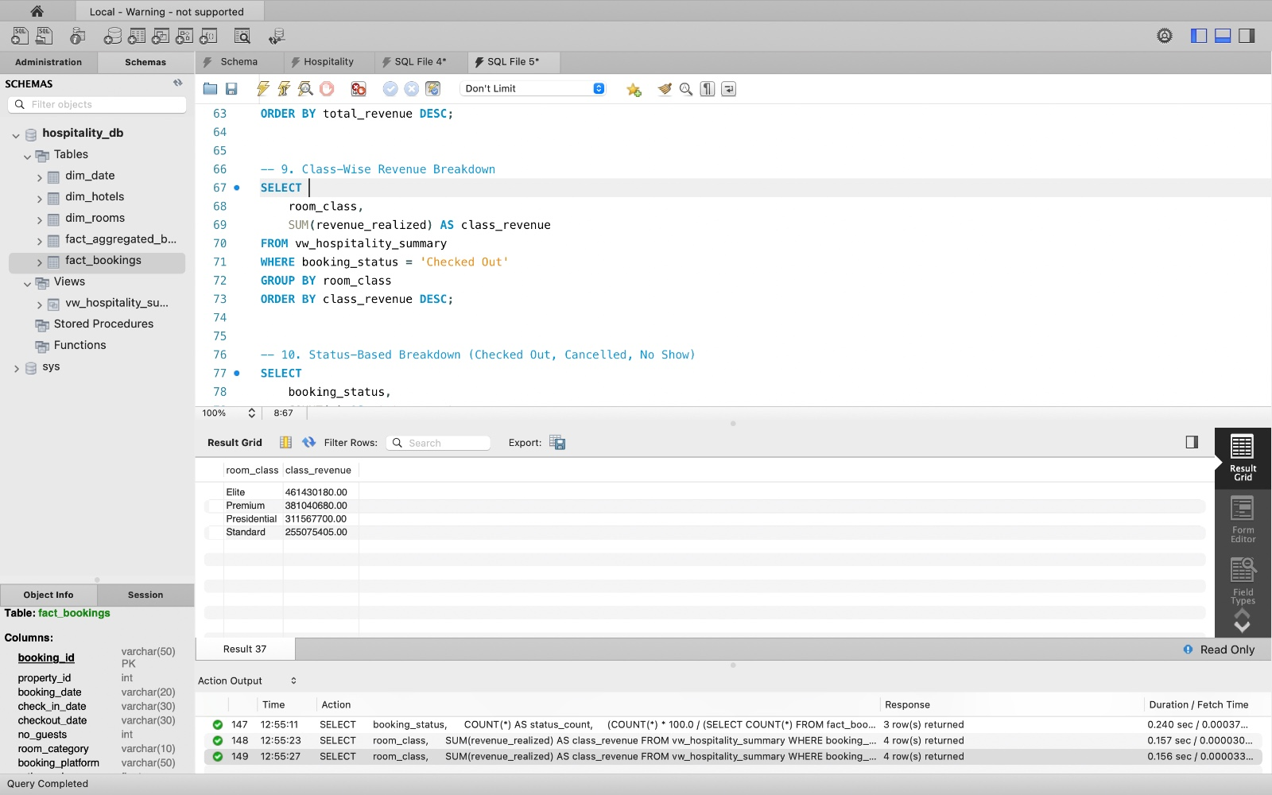
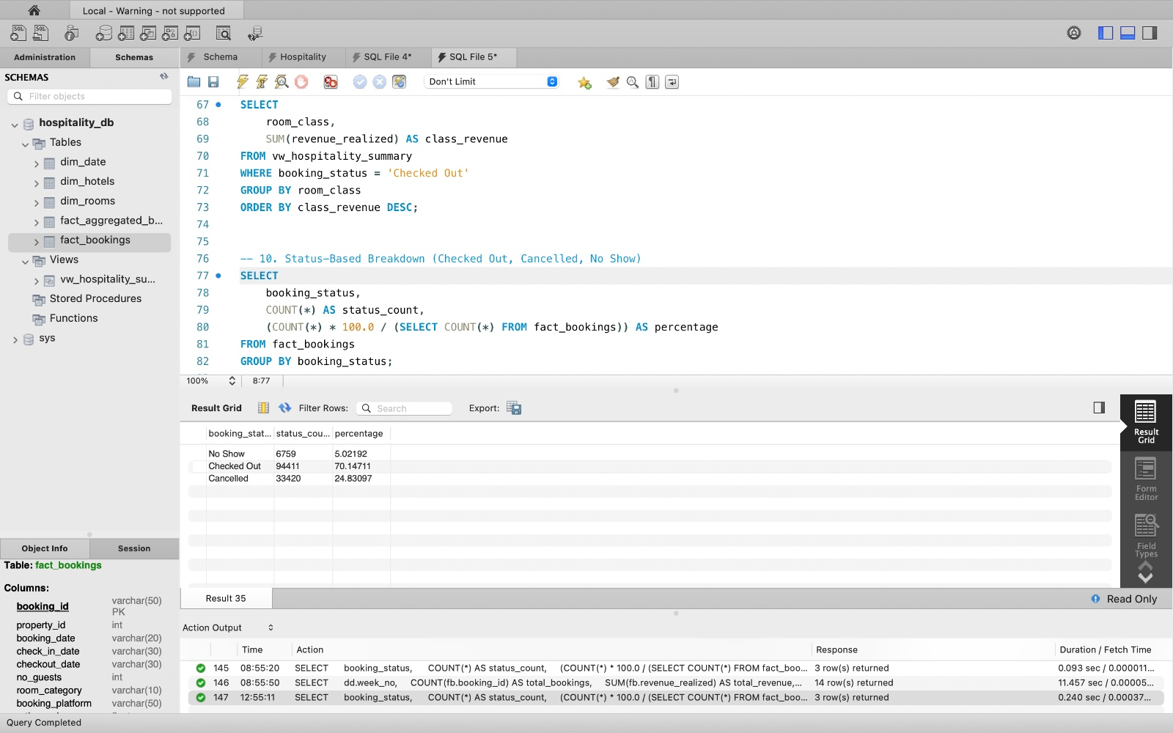
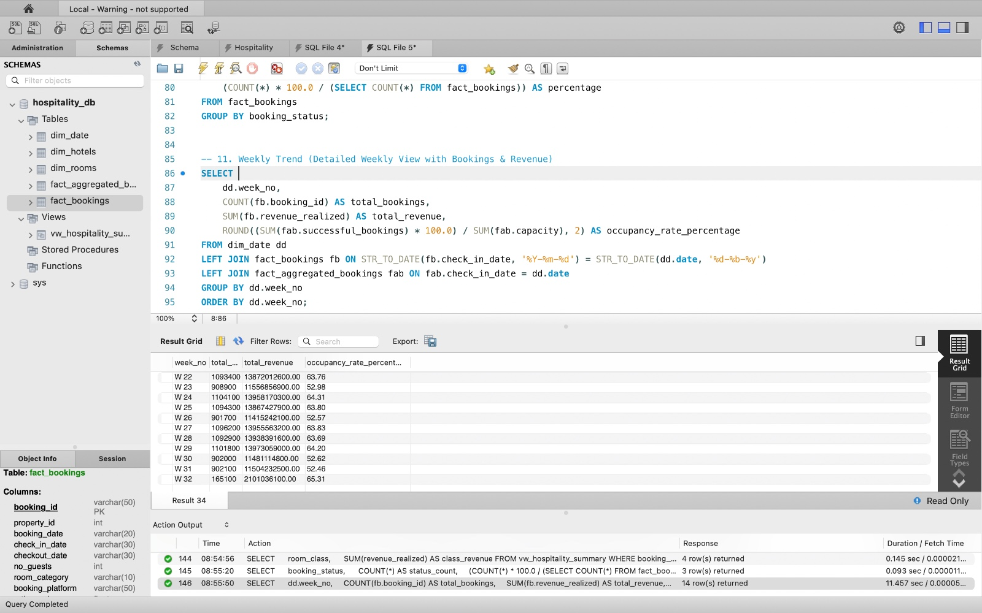
Class Wise Revenue Brekadown:
Status Based Breakdown:
Weekly Trend :

Slide 9
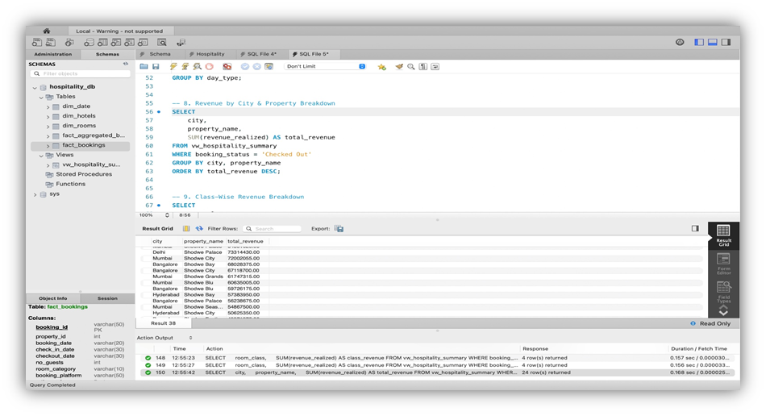
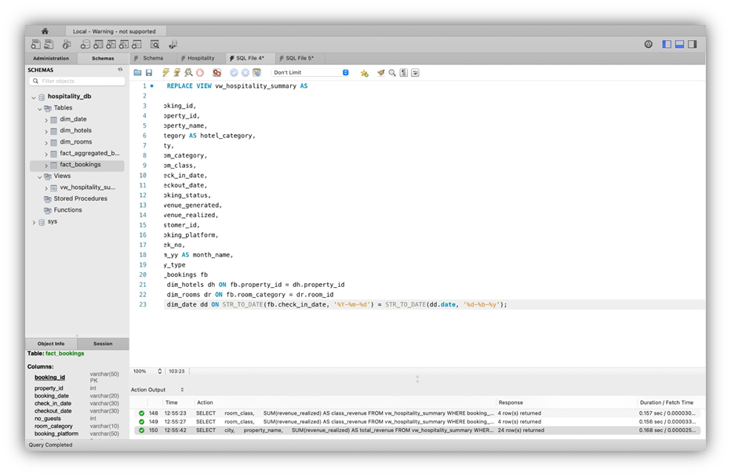
Revenue by City and Property Breakdown:

Slide 10






Key Insights
Total Revenue
Occupancy & Cancellations
Booking Patterns
Top City
Mumbai generates the highest revenue among analyzed cities.
Approximately $1.71 billion in analyzed period.
Weekday bookings: 84,365 vs Weekend: 50,225 — weekdays dominate demand.
Occupancy: 57.87%. Cancellation rate: 24.83%. ~70.15% of bookings checked out.
Platform Mix
Customer Rating
'Others' is the largest booking-platform category.
Average rating across properties: 3.62.

Slide 11


Recommendations
1 — Reduce Cancellations
Send booking reminders, analyze cancellation behavior by platform, and introduce suitable cancellation policies to lower the 24.83% rate.
2 — Increase Weekend Bookings
Develop weekend packages, offer targeted discounts, and market to leisure travelers to boost weaker weekend demand.
3 — Improve Customer Experience
Continuously monitor ratings, flag underperforming properties, and implement service improvements to raise the 3.62 average rating.
4 — Optimize Revenue
Prioritize high-performing cities/properties (e.g., Mumbai) and apply demand-based pricing to capture incremental revenue.
Recommendations are data-driven and align with KPI findings (revenue, occupancy, cancellations, ratings).

Slide 12

Conclusion & Next Steps
Hospitality Analytics transforms hotel booking data into actionable insights across bookings → revenue → occupancy → customer behavior, enabling better business decisions. The project shows an end-to-end workflow: Excel → MySQL → Power BI → Tableau for data preparation, analysis, visualization, and decision support.
Next steps: implement recommendation pilots (cancellation controls, weekend promotions), monitor KPI impact through dashboards, and iterate on pricing and experience improvements.
Thank you

