Slide 1


Slide 2
CAPSTONE PROJECT
EXPLORATORY DATA ANALYSIS ON HOTEL BOOKINGS
TEAM MEMBERS
NARAMALLAS SHIRISHA
BODDU YEMBAIAH

Slide 3

HOTEL BOOKING ANALYSIS
Defining the problem statement
Importing the Libraries
Missing Value Imputation
Descriptive Statistics
Graphical Representation

Slide 4
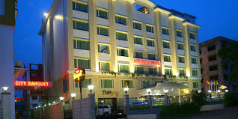

HOTEL BOOKING DATA INTRODUCTION
Have you ever wondered when the best time to book a hotel room is? What if you wanted to predict which hotel likely to receive high number of special requests?
This Dataset contains data that compares various booking information between two hotels, City Hotel and Resort Hotel. We will be using the data to analyze the factors affecting the hotel bookings. These factors can be used for reporting trends and predict the future bookings.
This dataset contains the booking data of hotels from year 2015-2017.

Slide 5

DATA ANALYSIS STEPS
1.IMPORT LIBRARIES : In this part , we had imported required libraries to perform Exploratory Data Analysis.
Libraries used are Pandas for Data manipulation and aggregation. Matplotlib and seaborn is for Visualization and Numpy is for computation effective operations.
2.DESCRIPTIVE STATISTICS : In this part we start by looking at descriptive statistic parameters for the dataset. We will use describe() for this. The dataset contains over 119,390 rows and 32 columns .Columns have data type object , integer, and float. Data had 31994 duplicates values so we removed it.
3.MISSING VALUE IMPUTATION: We will now check the missing values in our dataset. In case there are any missing entries , we will impute them with appropriate values.
There are 4 columns company , country agent and children with missing values
4.GRAPHICAL REPRESENTATION : We will start with the Univariate analysis where the data will be analyzed only one variable. Where as Bivariate analysis ,the data will be compared with two variables to study their relationships. Multivariate analysis is similar to bivariate analysis but comparing more than two variables.

Slide 6
POINTS FOR DISCUSSION
We have explored the following points while doing this analysis – The following steps are below:
What is the most preferred Hotel by the customers?
The most Customer type that contribute for the business.
Which month has the most peak customer flow or the bookings.
What is the most preferred meal by the customers in Hotel
What is the highest count in the reservation status.
Which deposit type contribute more to the business.
How many reservations are is canceled and not canceled?
Among three years which year has the peak customer flow?
Are there any outliers present in the lead time (which are taking lot of time from the day booking to arrival).
Checking the outliers in the Average daily rate
What is the effect of repeated and non repeated guest on hotel bookings?
Is there any potential for business in ‘excess car parking space’ ?
What is the status in terms of number of reservations which respective to city and resort hotel
What is the Average daily rate in city and resort hotel?
What is the minimum and maximum days of waiting days list with respective market segment?
Which month contributes the highest sales and customer flow in both city and resort hotel?
Which year contributes the year wise city and resort hotel?
Which deposit type impacted the business City hotel or Resort hotel?
From which country most customers came?
From which country has more number of cancelations?
Comparison between week and weekend nights
\ythe

Slide 7
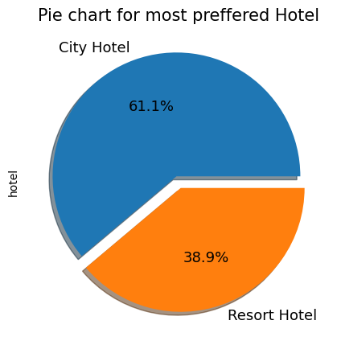
1.What is the most preferred Hotel by the customers?
From the pie chart, it seems like mostly people prefer city hotel type over resort hotel type. So, resort hotel type are more vacant then city hotel type. The percentage of city hotel is 61.1 % while the percentage of resort hotel is 38.9%

Slide 8
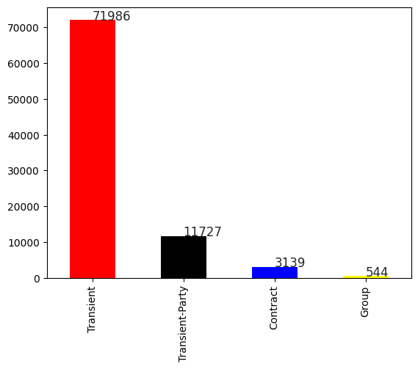
2.The most customer type that contributes the Business
From the Bar chart analyzed that there are 4 customer types ,Transient customers are more in count than all the parties.

Slide 9
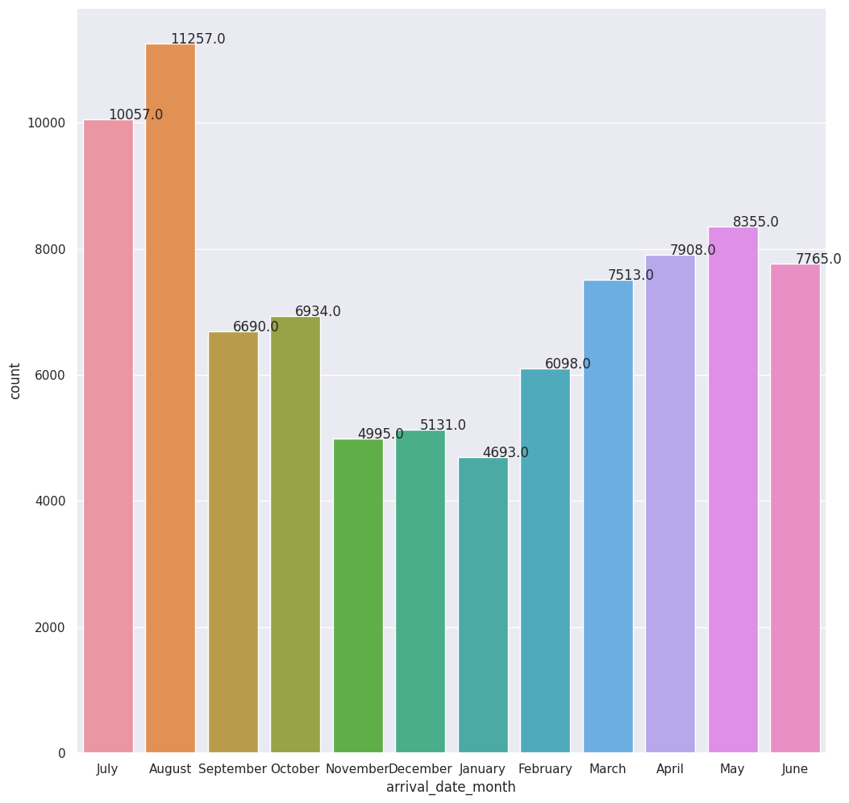
3.Which month has the most peak customer flow or the bookings?
There are more customers flow in the month of August and July from the above count plot. And January is the month in which hotel booking are least

Slide 10
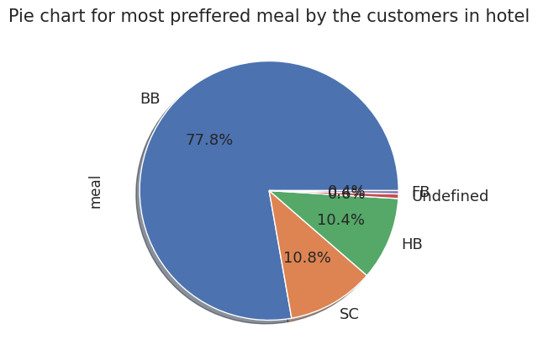
4.What is the most preferred meal by the customers in Hotel
From the pie chat ,the Most preferred meal by the customers is BB(bed and breakfast )which is around 77.8%.
FB is least preferred.
SC and HB are equally preferred.

Slide 11
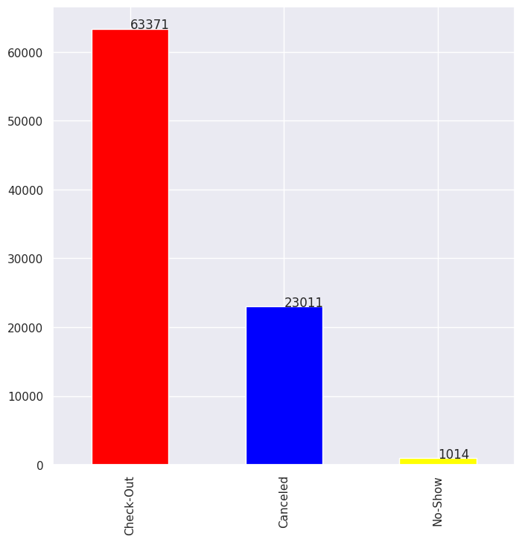
5.What is the highest count in the reservation status.
From the bar char, the count of the check-out(vacating of the room from the hotel) is more and No Show contributes least counts.

Slide 12
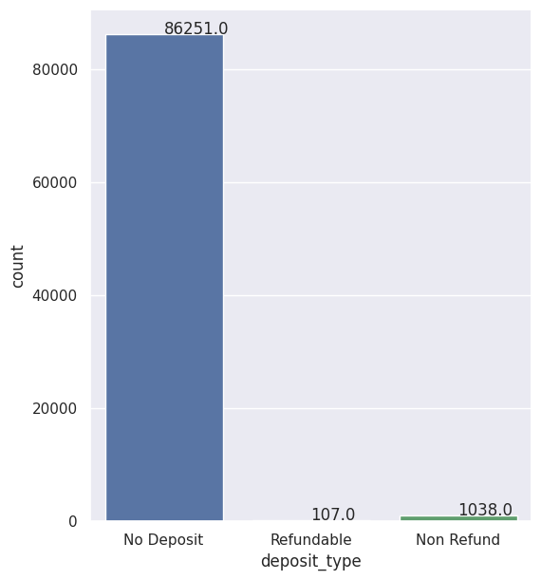
6.Which deposit type contribute more to the business
From the count plot we can get to know that ,No Deposit type is contributing more to the business than all other types.

Slide 13
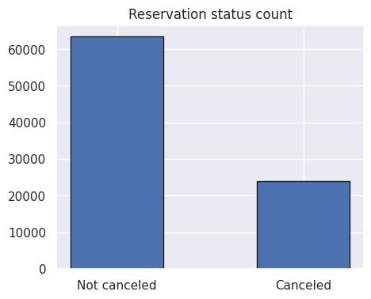
7.How many reservations are canceled and not canceled?
The cancelation is count is less then the not canceled data in the reservation status counts.

Slide 14
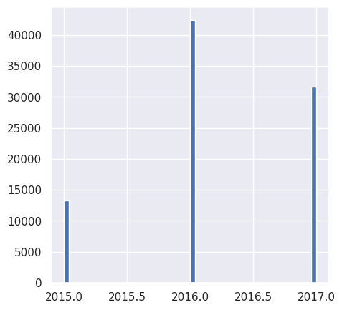
8.Among three years which year has the peak customer flow
From the histogram ,in the year 2016 has the more customer flow or the highest booking year than 2015 and 2017.

Slide 15
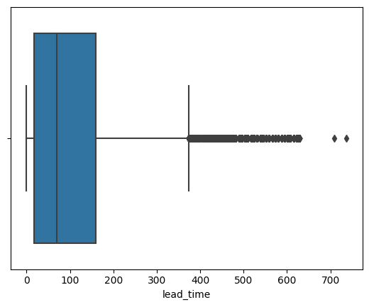
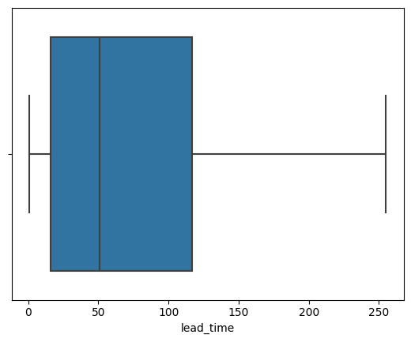
9.Are there any outliers present in the lead time (which are taking lot of time from the day booking to arrival).
The maximum lead time is 737 and minimum is 0 , which means the number of days elapsed between the entering date of the booking into the PMS and the arrival date .

Slide 16
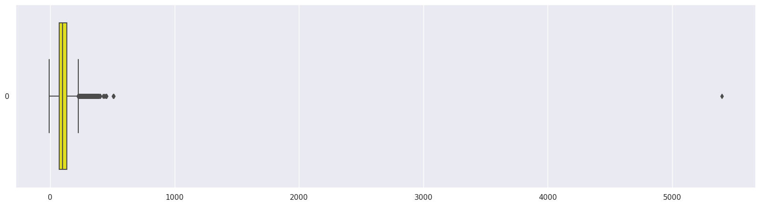
10.Checking the outliers in the Average daily rate
From the box plot, we can say that the outliers are present in the ADR(Average Daily Rate). Hence there is a price variation from customer to customer , time to time.

Slide 17
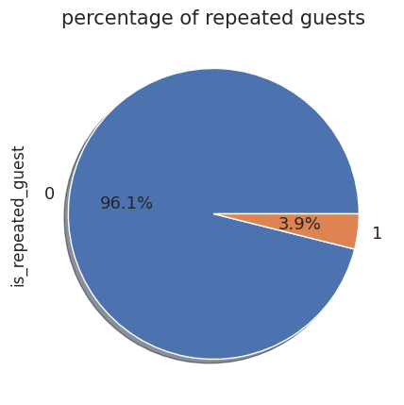
11.What is the effect of repeated and non repeated guest on hotel bookings ?
Repeated guests are very few which are around 3.9 % , and the non repeated customers with 96.1 percentage.

Slide 18
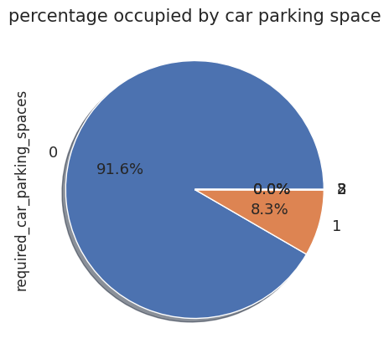
12.The car parking space for customers by hotels
From the pie chat , most of the customers required no parking space ,only less then 10 percentage people required car parking space

Slide 19
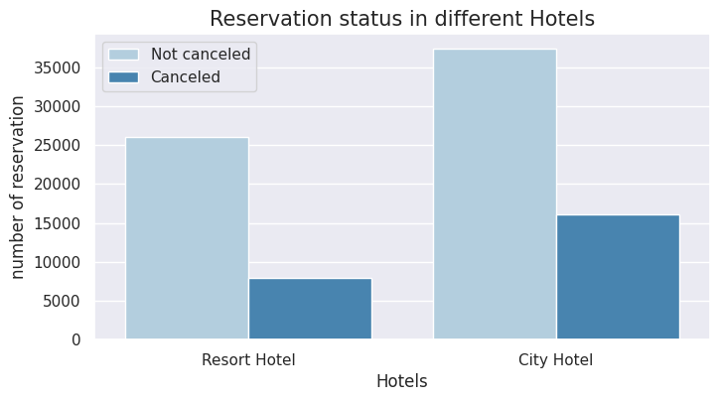
13.What is the status in terms of number of reservations with respective to city and resort hotel?
From the above count plot, the more number of canceled and not canceled in City Hotel is more than the Resort Hotel.

Slide 20
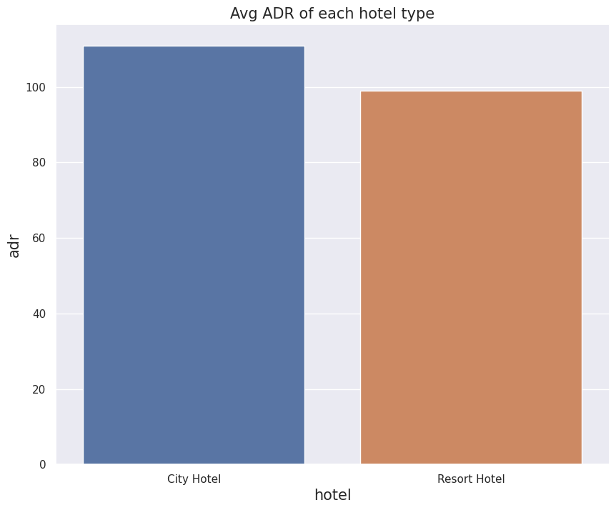
14.What is the Average daily rate in city and resort hotel?
From the bar plot we can see that the City Hotel has the more number of count in the Average Daily Rate then Resort Hotel.

Slide 21
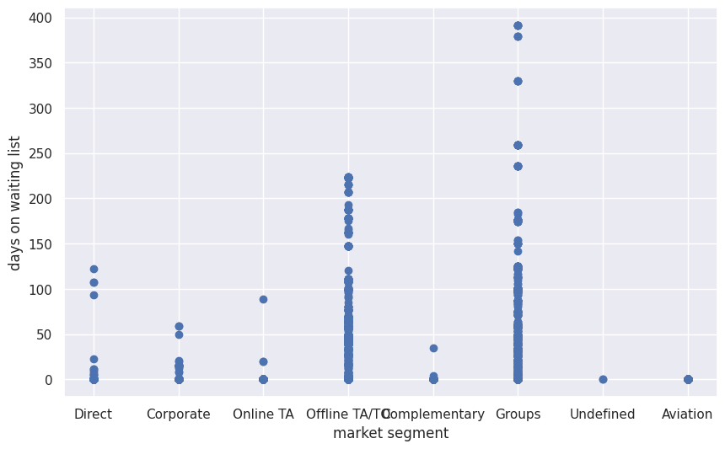
15.What is the minimum and maximum days of waiting days list with respective market segment?
Here we can see that Aviation Market Segment has the minimum number of days on the waiting list . In order to increase the business the number of waiting list should be minimized.

Slide 22
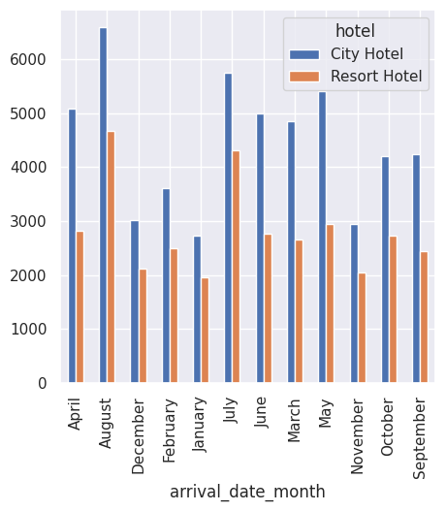
16.Which month has more number of Bookings?
In the July and August the number of bookings increased and from the bar graph City hotel got most number of bookings in all the months .

Slide 23
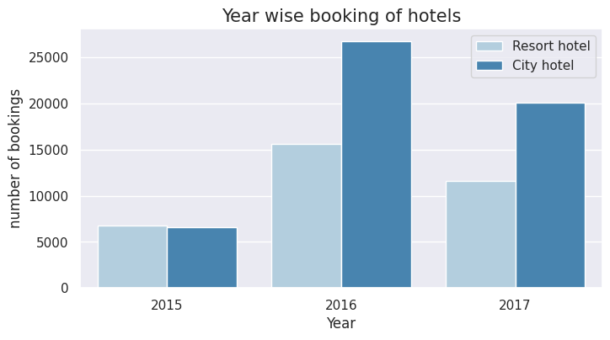
17.Which year has more number of bookings?
In the year 2016 we can see in the graph that number of bookings are more in the hotels City and Resort.

Slide 24
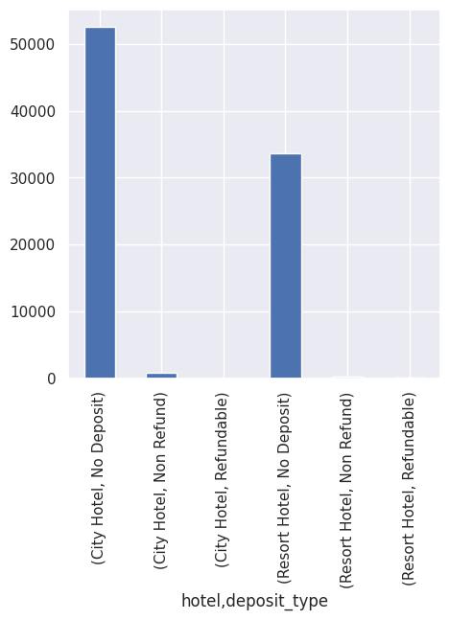
18.Which deposit type impacted the business City hotel or Resort hotel?
From both the hotels City and Resort , No Deposit type is more in count which means it contributes more value and percentage to get the revenue for the business.

Slide 25
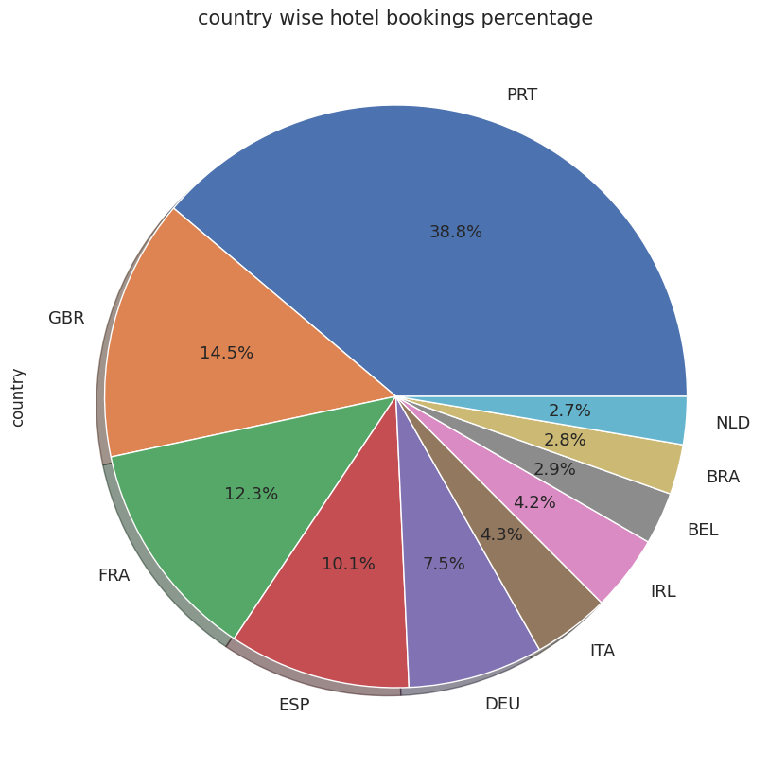
19.From which country most guests came?
From the country PRT(Portugal) have the more number of bookings or the booking percentage followed by GBR ,FRA, ESP.

Slide 26
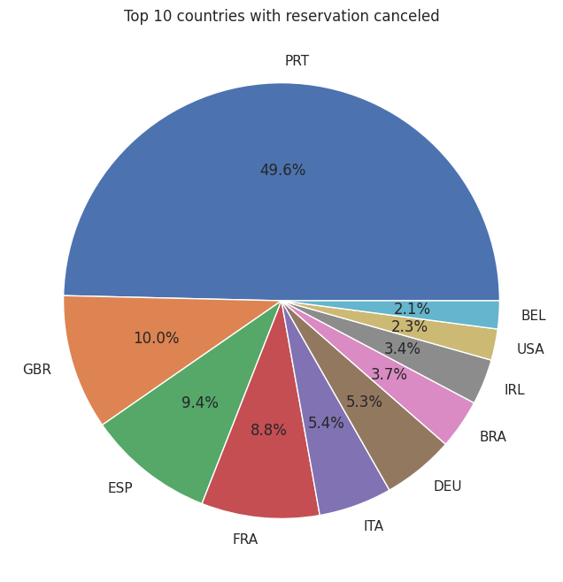
20.From which country has more number of cancelations?
From the Country PRT (Portugal) has the more number of cancelations when compared to all the countries.

Slide 27
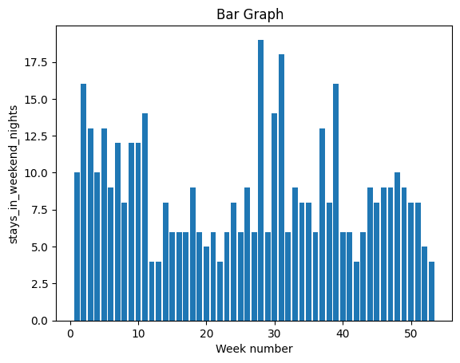
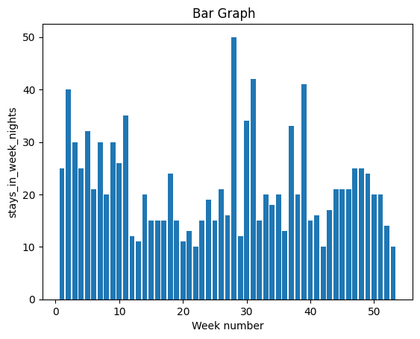
21.Comparison between week and weekend nights
Stays in the week nights is more than weekend nights as per the week number counts.

Slide 28
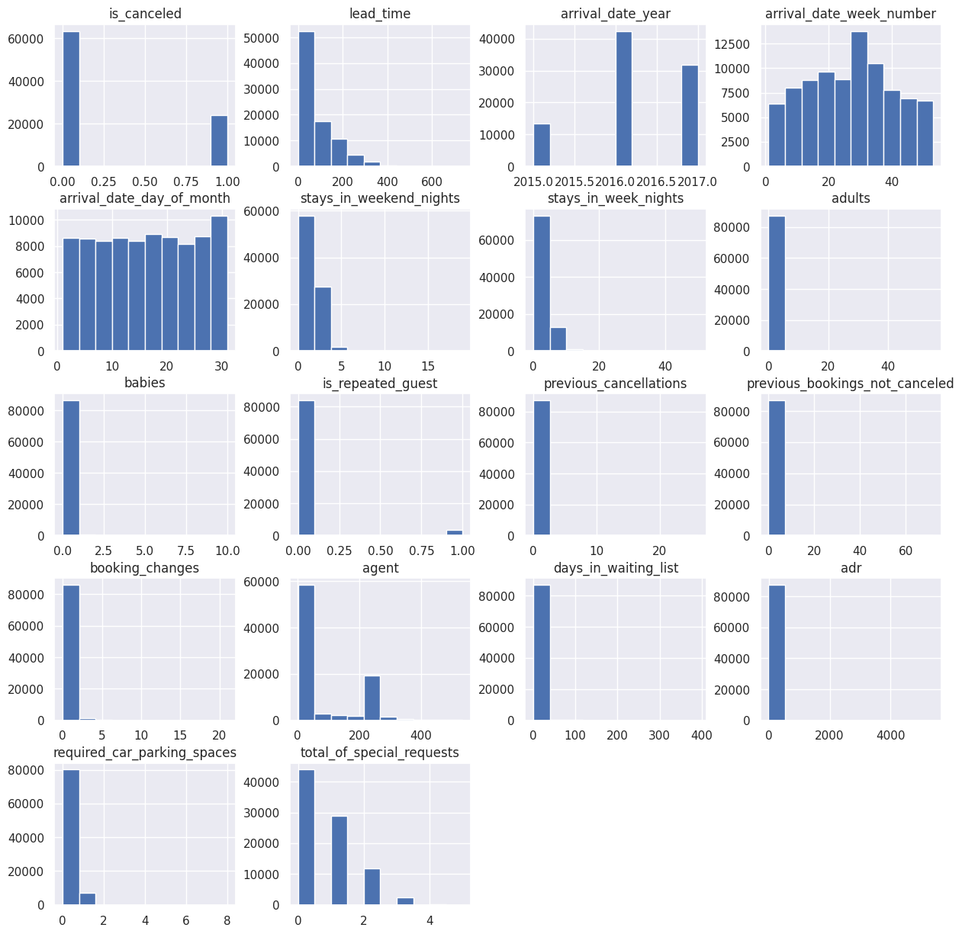

Slide 29
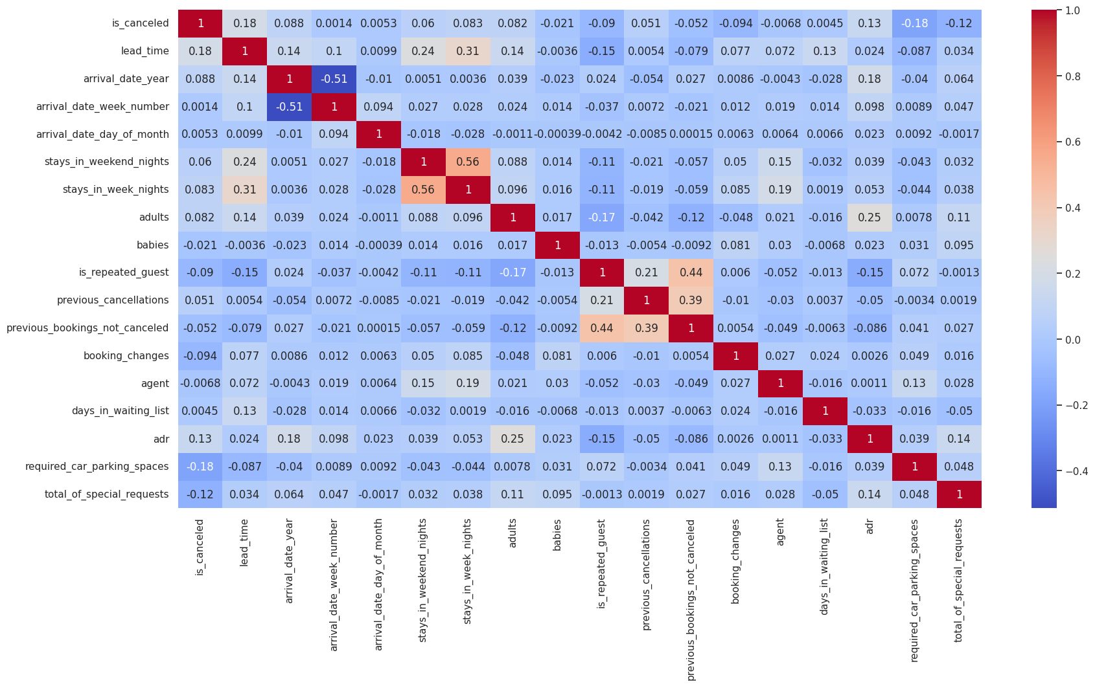

Slide 30
CONCLUSIONS
City Hotel is the most preferred hotel by the customers.
City Hotel seems to be more preferred among travelers and it also generates more revenue and profit.
Year 2016 is highest booking year with total booking of 56,707 then booking decreased to 40,687.
The percentage of City hotel is 66.45% while the percentage of Resort Hotel is 33.55% is used to stay.
August is the month or we can say that the time of the year in which hotel booking is at its peak. And January is the month in which hotel bookings are least
Weekdays have more number of bookings than Weekends.
From both the hotels City and Resort , No Deposit type is more in count which means it contributes more value and percentage to get the revenue for the business.
the City Hotel has the more number of count in the Average Daily Rate than Resort Hotel.
The more number of canceled and not canceled in City Hotel is more than the Resort Hotel.
Most of the customers required no parking space ,only less then 10 percentage people required car parking space
The Most preferred meal by the customers is BB(bed and breakfast )which is around 77.8%. FB is least preferred.
The people of Portugal(PRT) id doing maximum numbers of bookings .

Slide 31
Solutions to Business Objectives
1. To attain high growth and more success , hotel business need to flourish and for that few things which we need to consider is high revenue generation , customers satisfaction and employee retention.
2. We found that performance in different categories like most liked meal type, facilities required by customers like car parking spaces etc. So , all these insights ultimately add to have a better planning for growth and higher revenue.
3. Periodically throw offers to attract old customers so as to increase the number of repeated guests.
4. To introduce system of getting feedback often from the guests visiting the hotels so that the quality can be upgraded to the next level to increase more guests.

Slide 32


Slide 33


