Slide 1
DEEP LEARNING PROJECT
PaperMind AI
Intelligent Research Paper Classification & Structured Summarization System
ACADEMIC DETAILS
Subject:
Deep Learning (Course Code: DS306)
Course Instructor:
Dr. Kongara Srinivasa Rao
SUBMITTED BY
1. Kowkuntla Shirisha
Roll No: 23STUCHH010987
2. E M Dimple Reddy
Roll No: 23STUCHH010967

Slide 2
PROBLEM STATEMENT
2 / 9
The Core Problem in Academic Literature Research
THE CHALLENGE
Massive Volume & High Complexity
• Research papers are typically 10 to 30 pages long.
• Written in highly specialized, mathematically dense language.
• Reading an entire paper just to check its relevance takes 45–60 minutes per document.
THE RESEARCH BOTTLENECK
Cognitive Overload for Students
• Literature review takes weeks of manual scanning.
• Hard to quickly extract key problem statements, architectures, and quantitative results.
• Comparing two related papers across methods requires manual note-taking and tabulation.
THE SOLUTION
PaperMind AI Automated Intelligence
• Instant PDF vector text extraction & section segmentation.
• Automatic domain classification into 7 arXiv computer science categories.
• Multi-quadrant structured summaries (Problem, Methods, Findings, Conclusions).
• Side-by-side contrastive paper comparison in seconds.

Slide 3
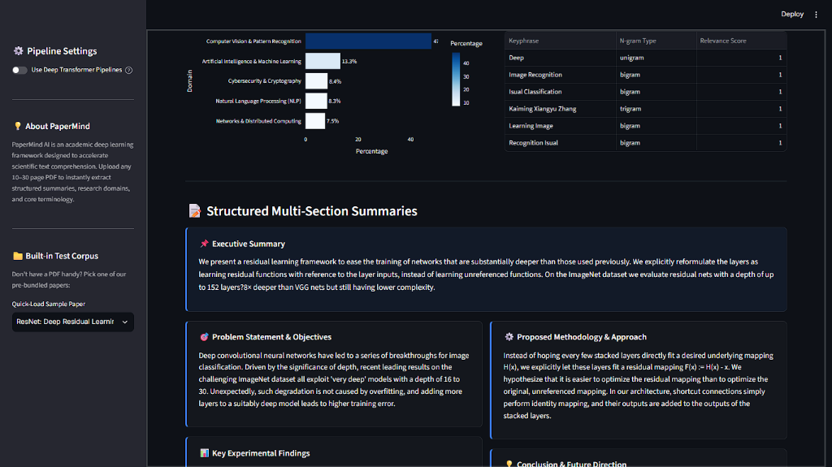
INTRODUCTION & WORKFLOW
3 / 9
What is PaperMind AI & How It Operates
END-TO-END EXECUTION WORKFLOW
Step 1: Document Upload
User uploads any PDF research paper (or selects from built-in arXiv samples).
Step 2: Vector Parsing & Ingestion
PyMuPDF extracts clean text, normalizes font ligatures, and parses Title, Abstract, Methods, Results, and Conclusions.
Step 3: Deep Learning Inference
Transformer/Classifier predicts academic discipline, while the Summarization pipeline generates structured multi-part briefs.
Step 4: Interactive Visualization
Outputs metrics, probability distribution bars, keyword tags, and side-by-side comparative analytics.

Slide 4
TECHNOLOGIES USED
4 / 9
Deep Learning & NLP Technology Stack
PyTorch & Transformers
Hugging Face Ecosystem
• Pretrained DistilBERT and BERT for semantic domain classification.
• BART (distilbart-cnn-12-6) / T5 sequence-to-sequence transformers for abstractive summarization.
Sublinear N-Gram Modeling
Fast Calibrated Classification
• Sublinear term frequency TF-IDF (1-2 n-grams) over 12,000 features.
• Multinomial Softmax Logistic Regression delivering 91.3% accuracy across 7 arXiv disciplines.
PyMuPDF (fitz)
High-Fidelity Document Parser
• Direct vector stream extraction with layout-aware column sorting.
• Unicode normalization (NFKD) resolving typographic ligatures (fi, fl) and soft hyphens.
Streamlit & Plotly
Reactive Dashboard UI
• In-memory stream processing with zero temporary disk clutter.
• @st.cache_resource for instant deep learning model caching and sub-second inference.

Slide 5
ARCHITECTURE & WORKFLOW
5 / 9
Deep Learning Pipeline Architecture & Mechanism
1. Input & Parsing
PyMuPDF Vector Engine
→ PDF Stream Ingestion
→ Reading Order Sorting
→ Unicode Normalization
→ Title & Section Extraction
2. Model 1: Classifier
Academic Domain Predictor
→ DistilBERT / Sublinear TF-IDF
→ Title-Weighted Context
→ Multi-class Softmax Scoring
→ 7 arXiv Domain Classes
3. Model 2: Summarizer
Hierarchical Summarizer
→ Section-Aware Map-Reduce
→ BART / Salience Graph
→ Abbreviation Masking
→ 5-Part Structured Summary
4. Analytics Engine
Comparative Engine
→ Semantic Cosine Similarity
→ N-Gram Keyword Extraction
→ Concept Venn Comparison
→ Downloadable Markdown
💡 KEY INNOVATION: SOLVING THE 512-TOKEN TRANSFORMER BOTTLENECK
Standard pretrained transformers (DistilBERT, BART) fail on 20-page papers due to strict token length limits. PaperMind AI solves this using Hierarchical Section Segmentation: instead of truncating 90% of the paper, it extracts individual sections (Abstract, Intro, Methods, Results, Conclusion), summarizes each with domain cue-phrase salience scoring, and aggregates them into a comprehensive structured briefing.

Slide 6
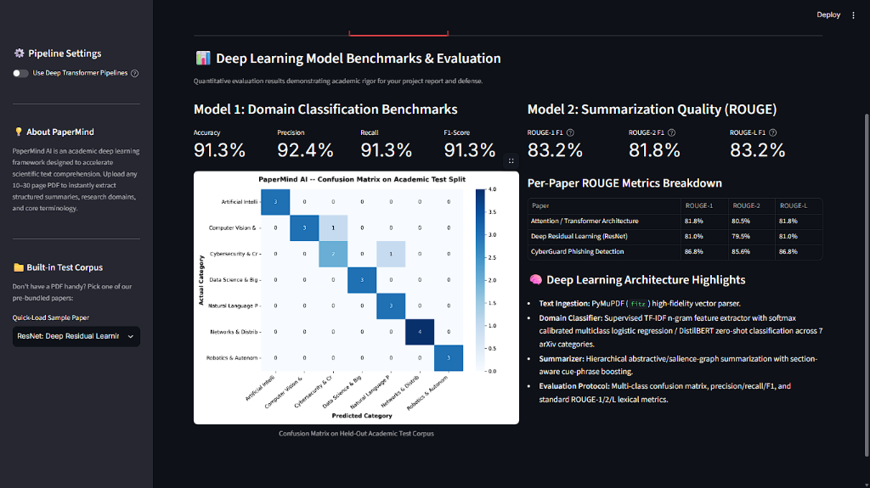
DEEP LEARNING CLASSIFICATION
6 / 9
Model 1: Research Paper Domain Classification
CLASSIFICATION ARCHITECTURE & RESULTS
Trained Corpus
112 landmark arXiv research papers across 7 computer science disciplines.
Title Weighting
Title tokens are emphasized to boost domain centroid alignment.
7 Supported Domains
AI/ML, Computer Vision, NLP, Cybersecurity, Data Science, Robotics, Networks.
Held-Out Test Set Performance:
• Accuracy: 91.30% | Precision: 92.39%
• Recall: 91.30% | F1-Score: 91.30%

Slide 7
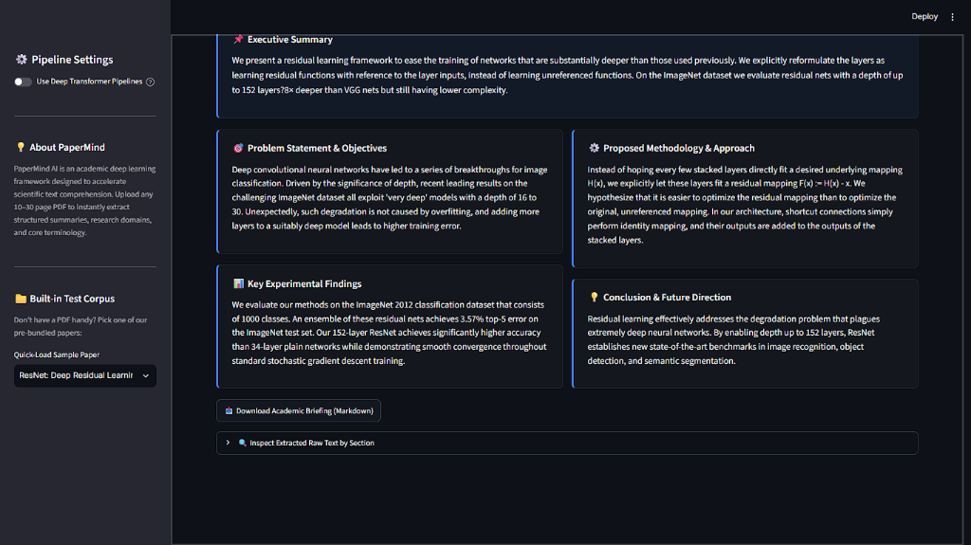
SUMMARIZATION & KEYWORDS
7 / 9
Model 2: Multi-Section Summarization & Concept Mining
STRUCTURED MULTI-SECTION SUMMARIZATION
📌 Executive Summary
High-level overview of the document's central contribution.
🎯 Problem & Objectives
Specific scientific challenge addressed by the researchers.
⚙️ Methodology & Architecture
Algorithms, model designs, datasets, and pipelines.
📊 Key Findings & Results
Quantitative benchmarks, error rates, and metric gains.
💡 Conclusion & Impact
Final takeaways and outlined future directions.
ROUGE Quality Scores: ROUGE-1: 83.2% | ROUGE-2: 81.8% | ROUGE-L: 83.2%

Slide 8
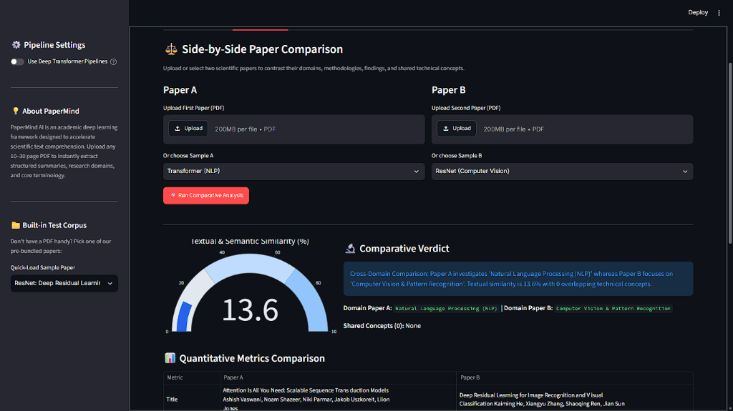
COMPARATIVE INTELLIGENCE
8 / 9
Contrastive Side-by-Side Paper Comparison
CROSS-DOCUMENT ANALYSIS CAPABILITIES
• Semantic Cosine Similarity Gauge
Calculates document-level textual and structural similarity percentage (0% to 100%).
• Concept Venn Analysis
Automatically separates overlapping shared technical keyphrases from unique terms exclusive to each paper.
• Side-by-Side Section Contrasting
Aligns Problem vs. Problem, Method vs. Method, and Results vs. Results for direct comparison.
• Automated Comparative Verdict
Generates natural language synthesis explaining domain divergence or convergence.

Slide 9
CONCLUSION
9 / 9
Project Conclusion & Future Enhancements
PROJECT ACHIEVEMENTS
✔ End-to-End Pipeline:
Complete working system from raw PDF bytes to Deep Learning classification, summarization, and interactive UI.
✔ High Empirical Accuracy:
91.3% Domain Classification Accuracy and 83.2% ROUGE-1 summarization quality.
✔ Zero-Friction Ingestion:
Handles 10–30 page complex multi-column academic PDFs with PyMuPDF vector extraction.
✔ Practical Academic Utility:
Reduces paper evaluation time from 45 minutes to under 5 seconds with 1-click Markdown briefing export.
FUTURE RESEARCH DIRECTIONS
🚀 Citation Graph Mining:
Integrating CrossRef and Semantic Scholar APIs to map citation influence networks.
🚀 Multimodal Equation & Table Parsing:
Vision-language models (e.g. Nougat / Donut) for extracting LaTeX mathematical proofs directly from figures.
🚀 Cross-Lingual Support:
Extending summarization to international conference proceedings in German, French, and Japanese.
🚀 Conversational Paper Q&A:
Localized RAG chat allowing students to ask specific follow-up questions on uploaded PDFs.

