Slide 1
JOB PORTAL
M.K.SHIRISHA
43111204

Slide 2
ABSTARCT
The Job Portal System is an integrated web-based platform designed to bridge the gap between job seekers and employers. This system automates the recruitment process by enabling candidates to create comprehensive profiles, specify preferences including location and role, and discover positions matching their criteria. Administrators can efficiently post and manage job listings with detailed abstracts and requirements. The platform leverages intelligent matching algorithms to enhance hiring efficiency whilst providing users with a seamless, intuitive experience throughout their employment journey.

Slide 3
EXISTING SYSTEM
Current recruitment methods remain largely manual and fragmented. Job seekers navigate multiple websites, rely on email notifications, and struggle with unstructured application processes. Employers face challenges managing high application volumes without sophisticated tracking systems. Communication between parties is inefficient, leading to prolonged hiring cycles and missed opportunities for qualified candidates.
Fragmented Job Boards
Candidates search across multiple platforms without centralised access
Manual Application Processing
Employers manually review applications without structured evaluation tools
Limited Visibility
Poor application status tracking and communication gaps between stakeholders
Time-Consuming Coordination
Extended hiring cycles reduce employer competitiveness and candidate satisfaction

Slide 4
PROPOSED SYSTEM
Our solution introduces a unified, user-centric platform transforming recruitment. Candidates register, complete detailed profiles, specify location and role preferences, then access intelligently filtered job opportunities. Administrators maintain control through a dedicated panel for posting job abstracts and managing listings. The system automates matching, reduces administrative overhead, and creates a transparent, efficient pathway connecting qualified talent with appropriate roles.
User Registration & Authentication
Secure account creation with verification
Profile Development
Comprehensive candidate information and experience
Preference Configuration
Location, role, and specialisation selection
Intelligent Job Discovery
Filtered opportunities matching criteria
Admin Control Panel
Job posting and listing management dashboard

Slide 5
ADVANTAGES
The Job Portal delivers transformative benefits across all user segments, streamlining workflows whilst enhancing user experience and market reach.
Time Efficiency
Precision Matching
Increased Conversions
Cost Reduction
Transparency

Slide 6
DISADVANTAGES
Learning Curve
Data Quality Dependencies
Scalability Challenges
Geographic Constraints
Integration Requirements
Maintenance Overhead

Slide 7
HARDWARE REQUIREMENTS
Robust infrastructure ensures reliable platform performance and seamless user experience across concurrent sessions and data volumes.
Server Infrastructure
Multi-core processor (Intel Xeon or equivalent)
Minimum 16 GB RAM (32 GB recommended)
SSD storage: 500 GB+ for database and applications
Redundant power supplies and cooling systems
Client Systems
Standard desktop or laptop computers
Modern web browsers (Chrome, Firefox, Safari, Edge)
Minimum 4 GB RAM, dual-core processor
Stable internet connection (broadband minimum)

Slide 8
SOFTWARE REQUIREMENTS
The platform utilises modern, scalable technologies ensuring security, performance, and maintainability throughout the system lifecycle.
Backend Stack
Java Spring Boot framework
Apache Tomcat application server
MySQL or PostgreSQL database
RESTful API architecture
Frontend Stack
HTML5, CSS3 responsive design
JavaScript with modern frameworks
Bootstrap for UI components
AJAX for dynamic interactions

Slide 9
MODULES AND MODEL DESCRIPTION
Authentication Module
Secure registration, login, and session management for all user types
User Profile Module
Comprehensive candidate profiles with skills, experience, and preferences
Job Search & Matching Module
Advanced filtering by location, role, experience level, and specialisation
Admin Dashboard Module
Job posting interface, listing management, and recruitment analytics
Application & Notification Module
Application submission tracking, status updates, and real-time notifications

Slide 10
MODULE DESCRIPTION
User Authentication: Uses JWT or session-based login to restrict access, with separate admin and user roles.
Product Management: Admins can add new mobiles, edit details, upload images, and remove outdated items.
Product Catalog: Displays products with filters and search features; fetches data from backend REST APIs.
Shopping Cart: Maintains selected items, manages quantities, and calculates real-time totals for checkouts.
Order Management: Enables users to finalize purchases, view past orders, and handle cancellations. Admins can update shipping status.
Admin Dashboard: Provides analytics and full control over the product lifecycle and order pipeline.

Slide 11
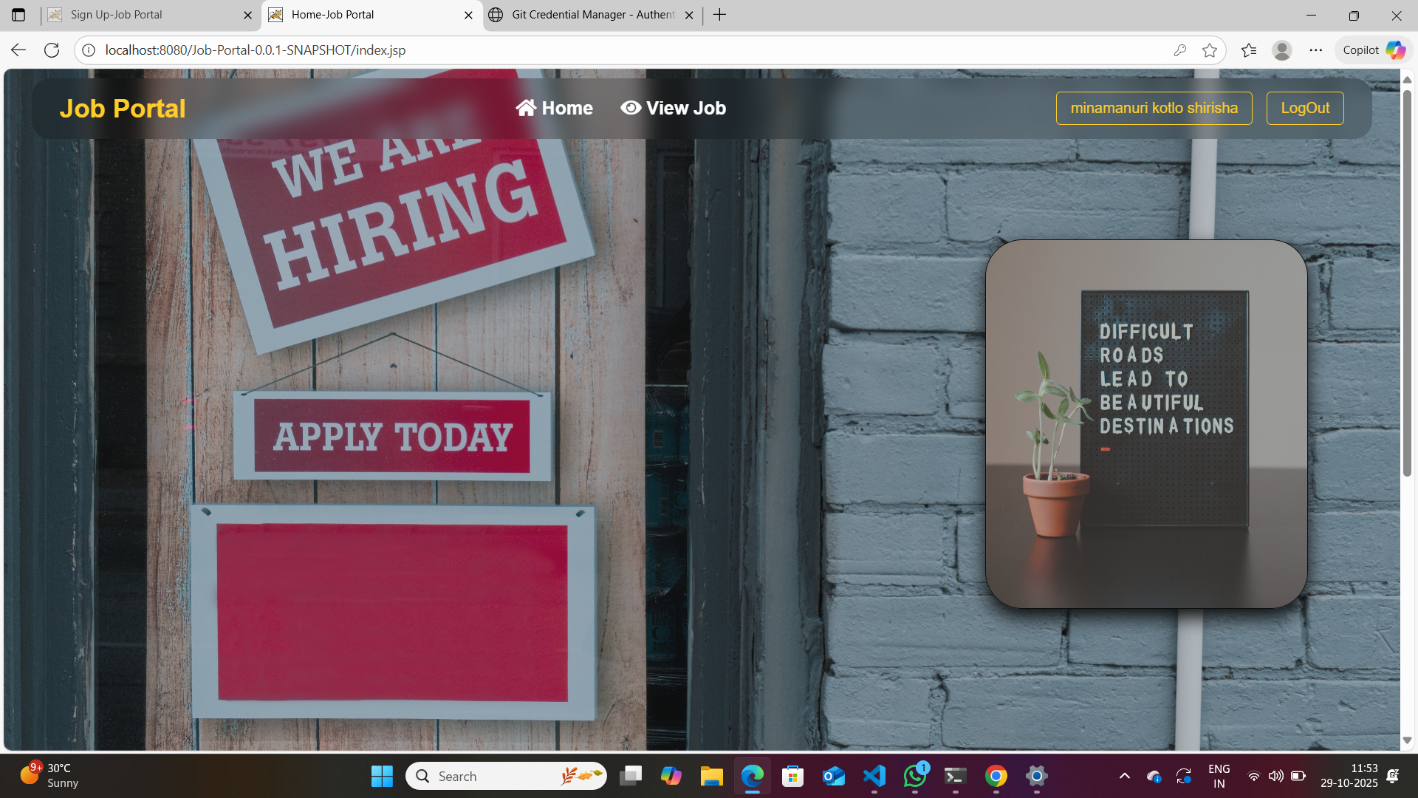
SAMPLE OUTPUT

Slide 12
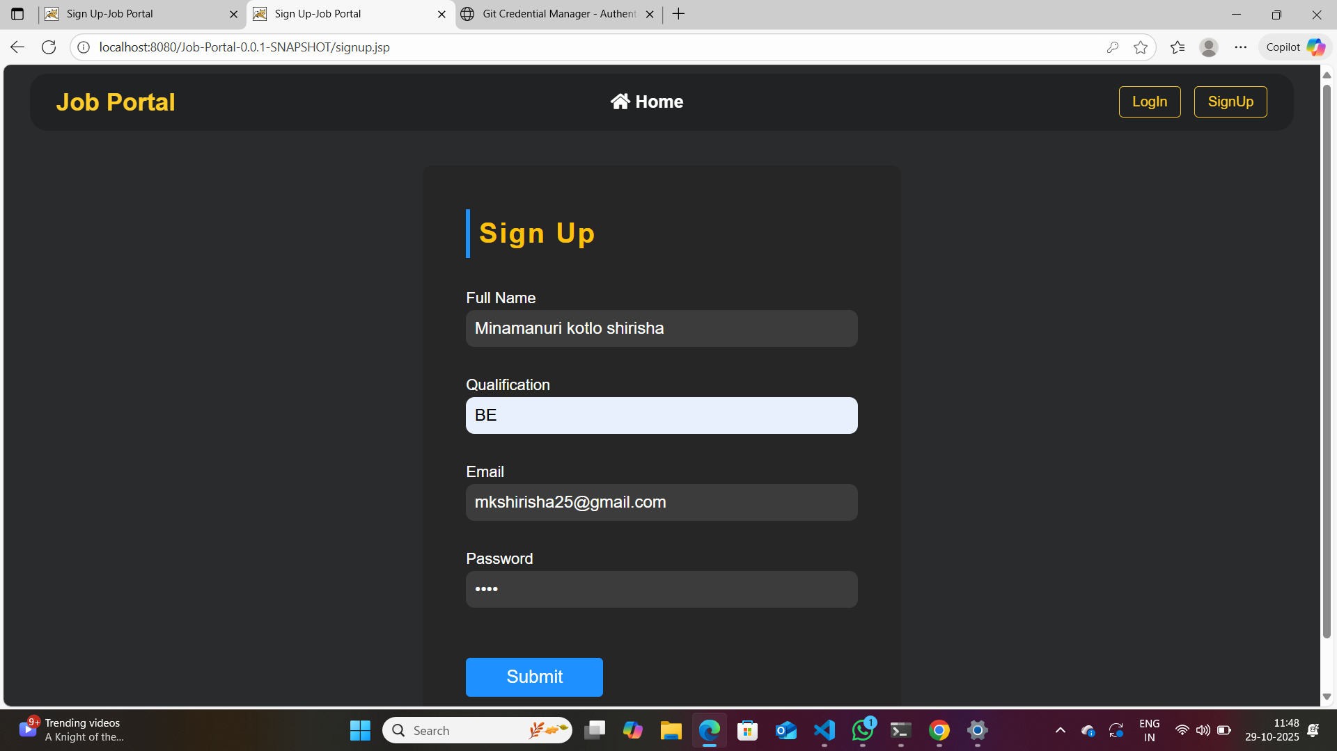
SAMPLE OUTPUT

Slide 13
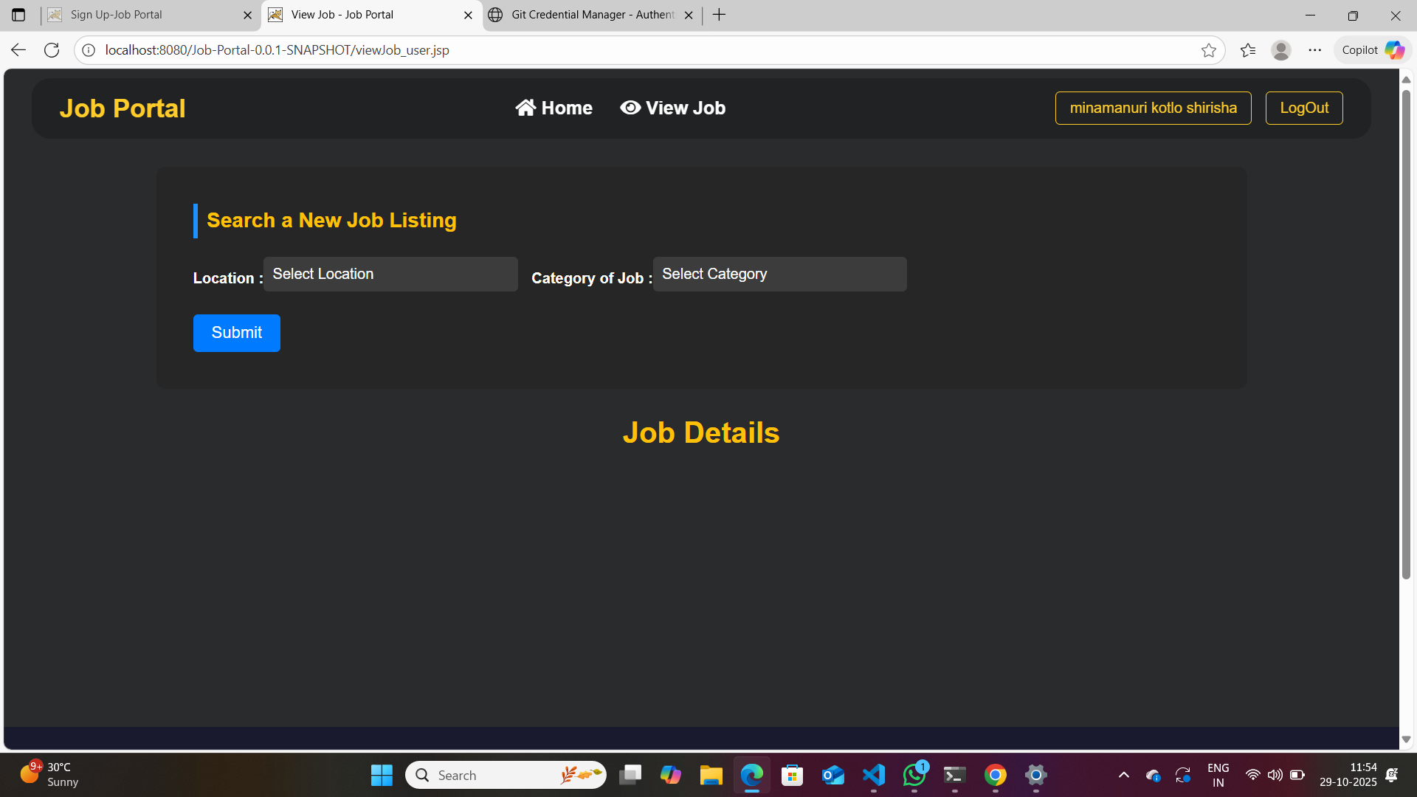
SAMPLE OUTPUT

Slide 14
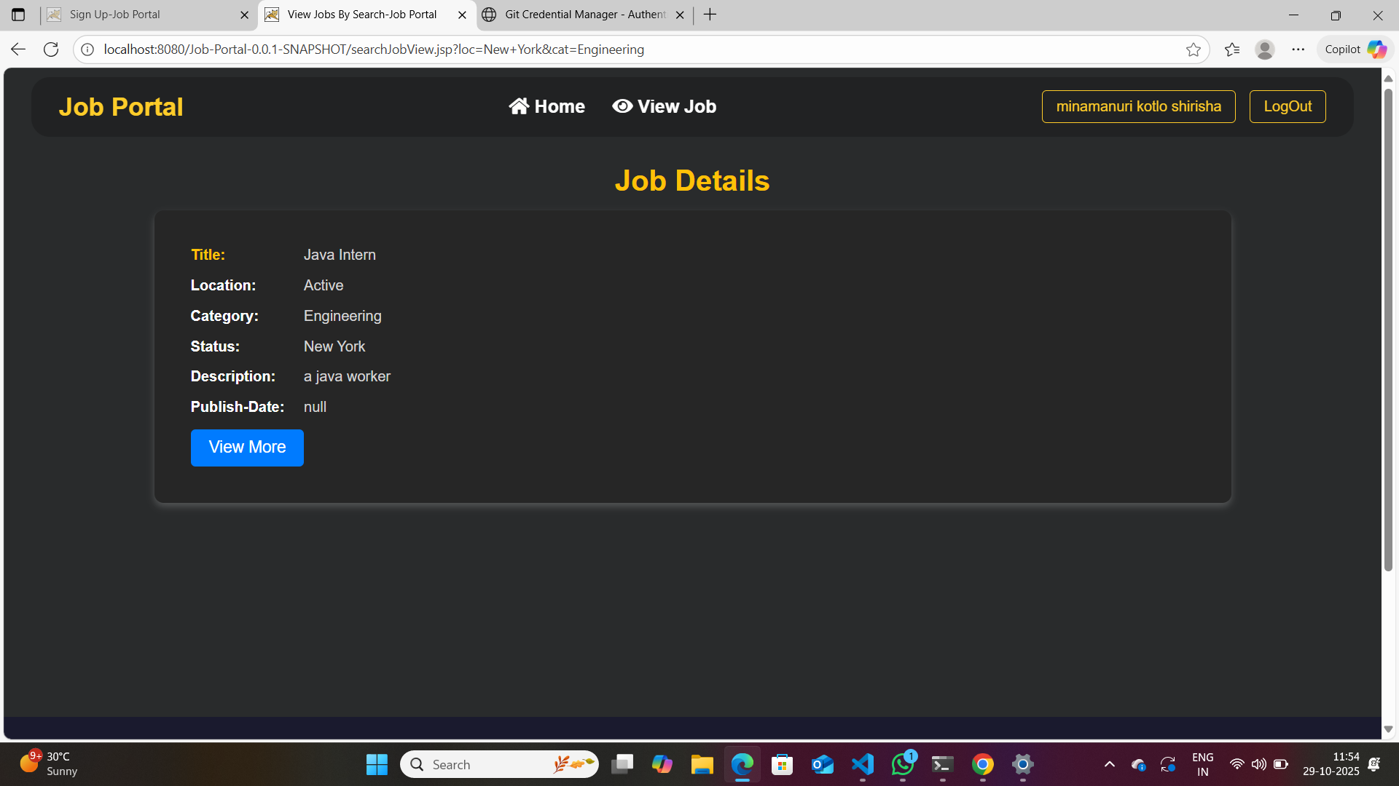
SAMPLE OUTPUT

Slide 15
CONCLUSION
The Job Portal represents a comprehensive solution addressing modern recruitment challenges. By streamlining candidate discovery, automating matching processes, and providing administrative control, the system delivers tangible value to all stakeholders whilst maintaining user-centric design principles.

