Slide 1
Table of Contents
Arrays
Array Lists and Common methods
Linked Lists
Linked List Operations
Linked List Types

Slide 2

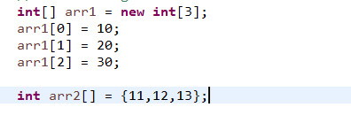
Array Data Structure
An array is a collection of items stored at contiguous memory locations. The idea is to store multiple items of the same type together. This makes it easier to calculate the position of each element by simply adding an offset to a base value, i.e., the memory location of the first element of the array
How to Initialize an Array?

Slide 3
Common Methods in Array
equals – indicates whether some object is “equal to” this one
length – returns the length of the Array
Arrays.toString(arr) – Converts the array into String format.

Slide 4
ArrayList Data Structure
ArrayList is Dynamic which means array can be maximized, minimized and elements can be added, deleted and modified in the Array.
Initializing ArrayList
Import ArrayList from Collection class import java.util.ArrayList
Create an ArrayList using the new keyword
Example : ArrayList <Integer> al = new ArrayList <Integer>();

Slide 5
Common Methods in ArrayList
add(data) – To add the element to the ArrayList
add(index, data) – To insert element at specified index
contains(Object) – Checks if Array contains a specific Object
get(index) – Returns the element at the specified position (Throws IndexOutOfBoundsException if index is beyond size of list)
indexOf(data) – Returns the first occurrence of specified element in the list.
Remove(index) – Removes the element at specified position in the list
Remove(Object) – Removes the first occurrence of specified element
Set(index,data) – Sets the element at the specified index in the list.
Size() – Returns the number of elements in the list

Slide 6

Linked List Data Structure
A linked list is a linear data structure that includes a series of connected nodes. Here, each node stores the data and the address of the next node. Below is the example if Singly Linked List.

Slide 7
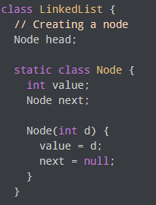
Representation of Linked List
Each node consists:
- A data item
An address of another node

Slide 8
Linked List operations
List of Basic Linked List operations :
Traversal
Insertion
Deletion
Search
Sort

Slide 9
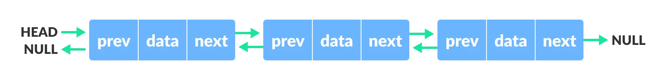

Types of Linked List
There are three common types of Linked List.
Singly Linked List
Doubly Linked List
Circular Linked List

