Slide 1
Online News Popularity
Lynell Amanna, Bhuvana Bellala, Shirish Dhar, Jeanie Oh, Pratibha Rathore

Slide 2


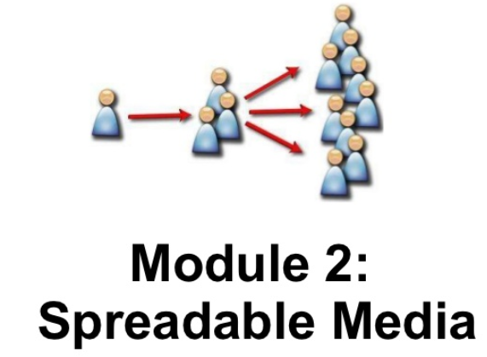
What makes articles “viral”? Let’s Analyse!
= Participatory circulation
Notes:
Jeanie

Slide 3
Research Question?
Can we predict an article’s popularity?
How - determine particular features that influence how many times an article will be shared
Why - indicator of what is more likely to go viral or which articles catch readers attention
Implications in new media studies, culture and marketing
Notes:
Jeanie

Slide 4
Data
Characteristics of an article and their relevance to ‘popularity’
UCI Machine Learning Repository
39797 rows
61 attributes
All articles published on Mashable
Notes:
Shirish

Slide 5
Columns/Potential Features
Content-based:
n_tokens_content
num_hrefs
num_videos
num_images
day_published
num_keywords
Category
Business
Tech
Lifestyle
Sentiment-based:
positive_polarity
negative_polarity
global_rate_positive_words
global_rate_negative words
LDA
title_polarity
Output:
Shares - Number of shares received by an article (An indicator of popularity)
Notes:
Shirish

Slide 6
Approach
Data exploration
Data distributions & feature correlations
Output label processing
Models and their performance indicators
Ensembling
Results
Inference and Conclusion
Notes:
Shirish

Slide 7
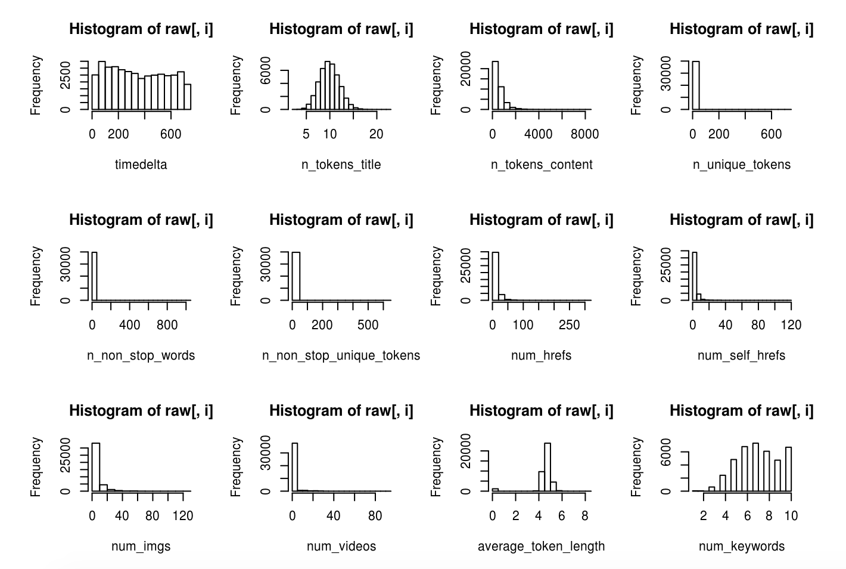
Data Distribution
Notes:
Pratibha to add stuff
Plotted histogram using R
Some data skewed so took log of it

Slide 8
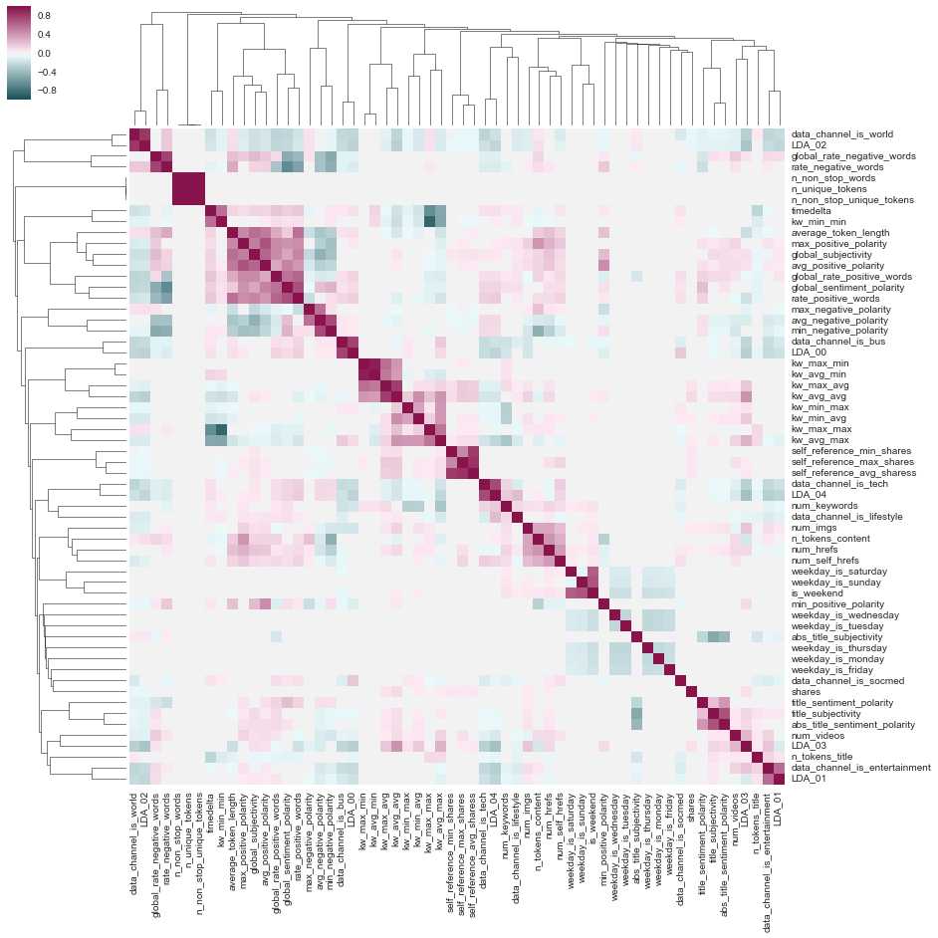
Cluster Grid
Notes:
Pratibha
Used Seaborn library for visualization in python to plot: ClusterGrid/Heatmap
Pair-wise distance
Plot a hierarchically clustered heatmap of a pandas DataFrame
https://stanford.edu/~mwaskom/software/seaborn/
seaborn.clustermap() function

Slide 9
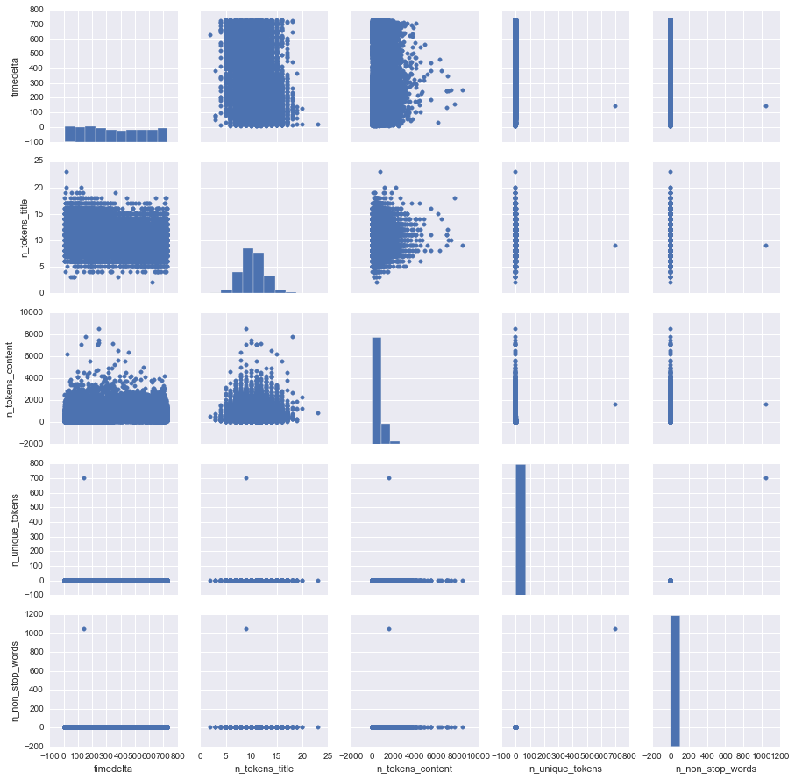
Pair Plots
Notes:
Pair plot:Using Seaborn pair plot function
Plot pairwise relationships in a dataset

Slide 10
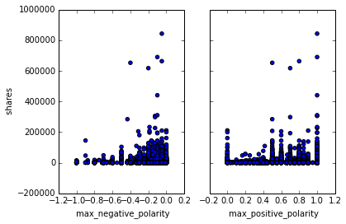
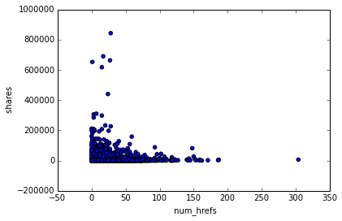
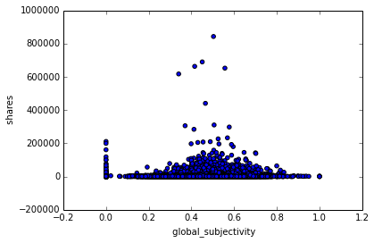
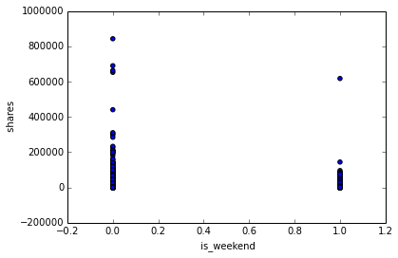
Correlations with output
shares
shares
max_negative_polarity
max_positive_polarity
Number of links in the article
shares
shares
Global subjectivity of article
Article (business) published on weekend (0-No, 1-Yes)

Slide 11
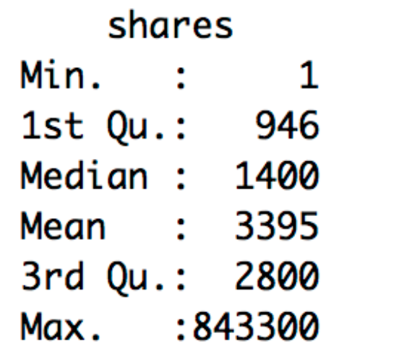
Output Processing
Highly dispersed output - ranging from min of 1 to max of 843300.
Much more effective and sensible to make the output binary - Unpopular articles vs. Popular articles.
The median 1400 was used as a threshold to judge popularity.
Articles with less than 1400 shares were taken to be ‘unpopular’. Article with more than 1400 shares were taken to be ‘popular’.
Notes:
Bhuvana

Slide 12
Models
Prediction Accuracy
Combining the models using ensembling techniques like blending, boosting and Random Forests increased the Prediction Accuracy to 85.5%.
Logistic Regression 77.3%
Random Forest 77.2%
Decision Trees 75.7%
SVM 73%
Naive Bayes 73%
Notes:
Bhuvana

Slide 13
Ensembling
Blending: Combined three models with the aim of creating an improved classification model
The models with the highest accuracy were considered - Random Forest, Logistic Regression, Decision Trees
Naive Bayes and SVM were not included in the final prediction due to lower accuracy
With each model assigned equal weight a vote on each row was taken to obtain the final accuracy
This technique improved the accuracy by 1.5%
Notes:
Lynell

Slide 14
Results
Features related to sentiment, type of article, and day of publishing had pronounced impact on the popularity- “Maximum positive polarity”, “maximum negative polarity”, “is weekend”, “is entertainment”, “is business”.
Despite the correlation of these features with the output, the predictive accuracy was still limited to 68%.
Notes:
Lynell

Slide 15
Inference and Conclusion
THE IMPORTANCE OF ‘CONTEXT’
The features in this dataset, although relevant, are also too generic with no information about the environment and context of the media. People like to share different news at different times based on events occurring around the world.
As an example, political articles would be shared more during election season.
Thus, content-based and sentiment-based features are not enough to predict ‘popularity’ of an article. Data related to the environment and context of the media can help predict ‘popularity’ of online articles better.
Notes:
Lynell

Slide 16
Questions ??

