Slide 1
Gradle
An Automated Build Management Tool

Slide 2
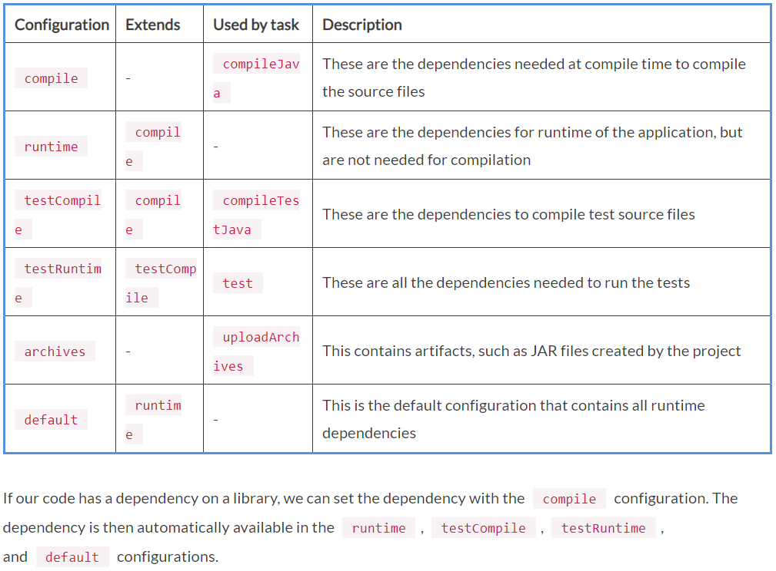
Configurations

Slide 3
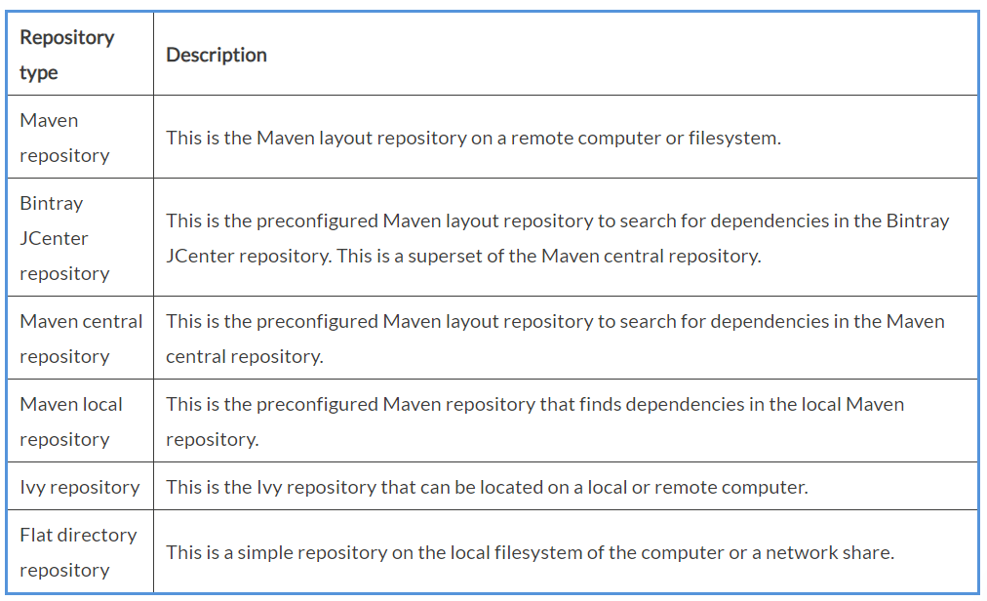
Repositories

Slide 4
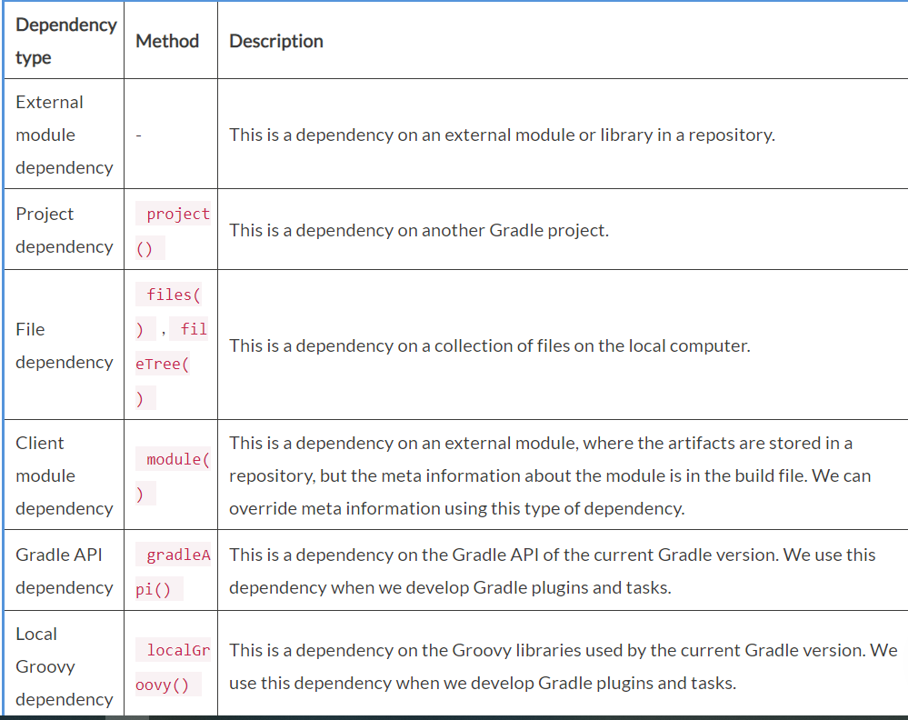
Dependency types

Slide 5
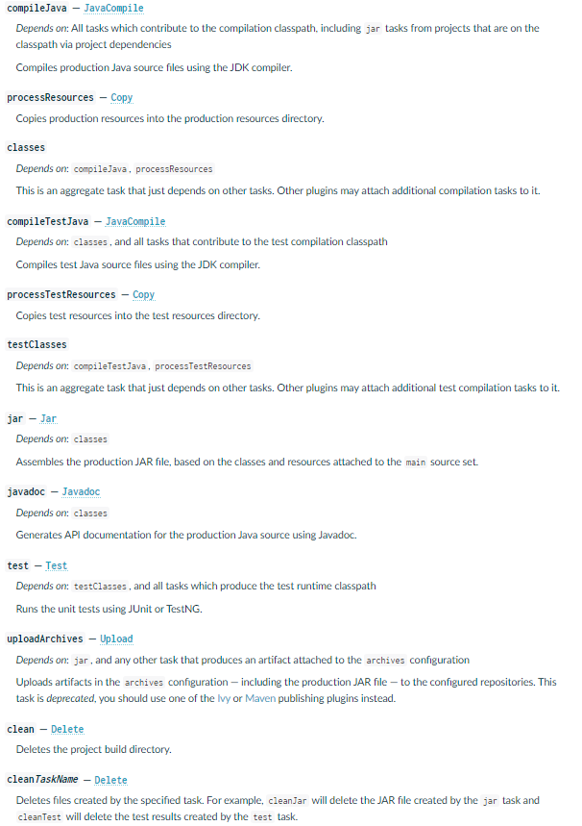
Java Plugin - Tasks

Slide 6
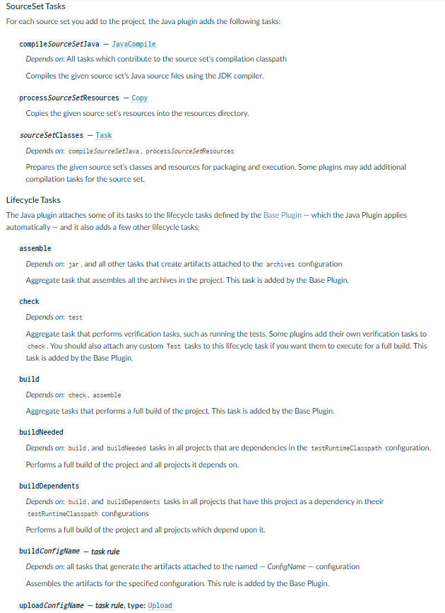
Java Plugin -Tasks

Slide 7
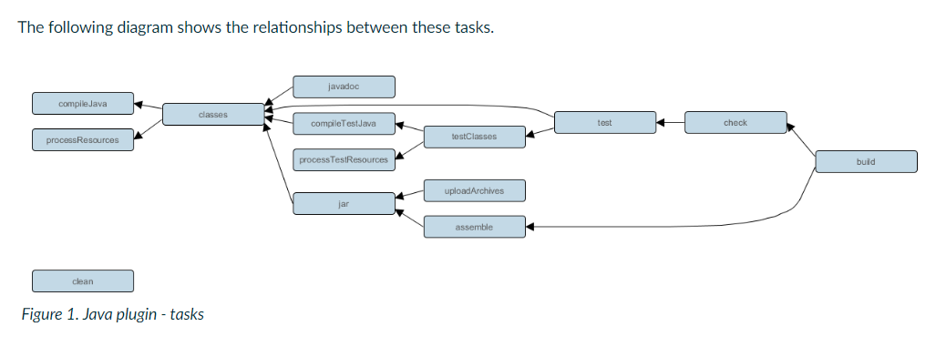
Java Plugin Task Relationships

Slide 8
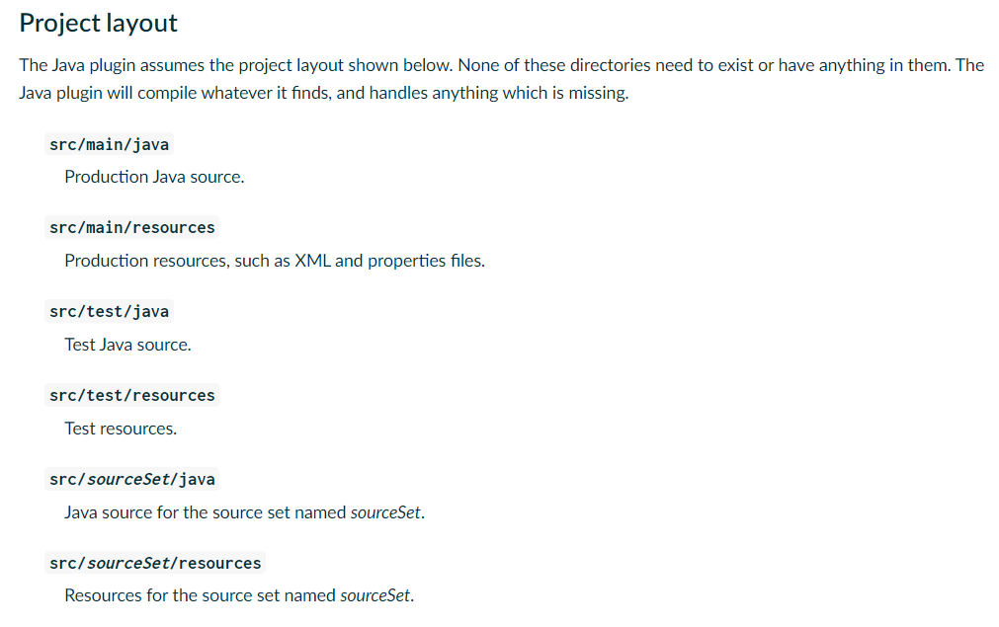
Java Plugin - Project Layout

