Slide 1

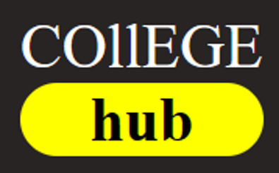
By Illuminati: Sirish Shrestha Prashant Bista Satkrit Bhandari Salina Timilsina

Slide 2
Introduction
Project Title: College Hub Blog Website
Project aims to develop a user-friendly blog website for college information.
Empowers users to make informed decisions about their education,as well ass college
Objectives:
Create user-Friendly Interface
Provide Comprehensive College Infomation
Provide detailed course information
Providing accurate information
Trustworthy website

Slide 3
Identifying the Problem
Issue:students confused after +2 about course selection, suitable colleges, and post-selection guidance, Existing websites lack comprehensive college information.
Challenges:
Limited Course Details:
Other platforms offer only superficial information about college courses, causing confusion.
Unclear Criteria:
Lack of clarity on how to choose the best college and the criteria for selection.
Post-Selection Dilemma:
Students face uncertainty about the next steps after choosing a course and college.

Slide 4

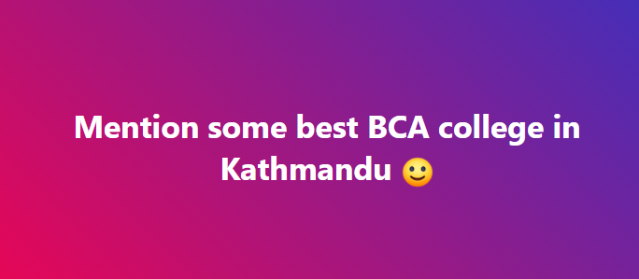
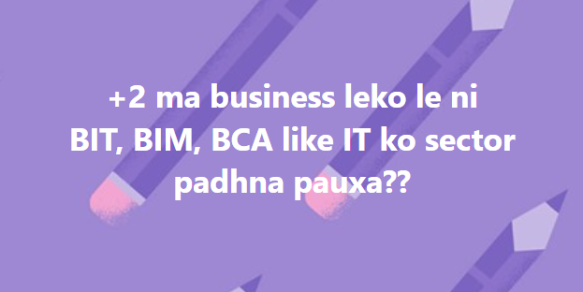
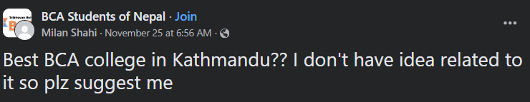


Problem Evidence:

Slide 5
Our Solution
Introduce our website as a remedy to these challenges, providing detailed course information, clear selection criteria, and guidance post-course selection,mind mapping about course and college selection.
Key Features:
Comprehensive Course Information:
details about each course, aiding students in understanding their academic choices.
Transparent Selection Criteria:
Clearly defined criteria for choosing a college, promoting confident decision-making.
Post-Selection Guidance:
Guidance on what steps to take after choosing a course, easing the transition into college life.
True information:
we provide true information with the aim of providing guidance to the +2 passed students and don’t provide brainwashing information to promote advertisement of the college.

Slide 6
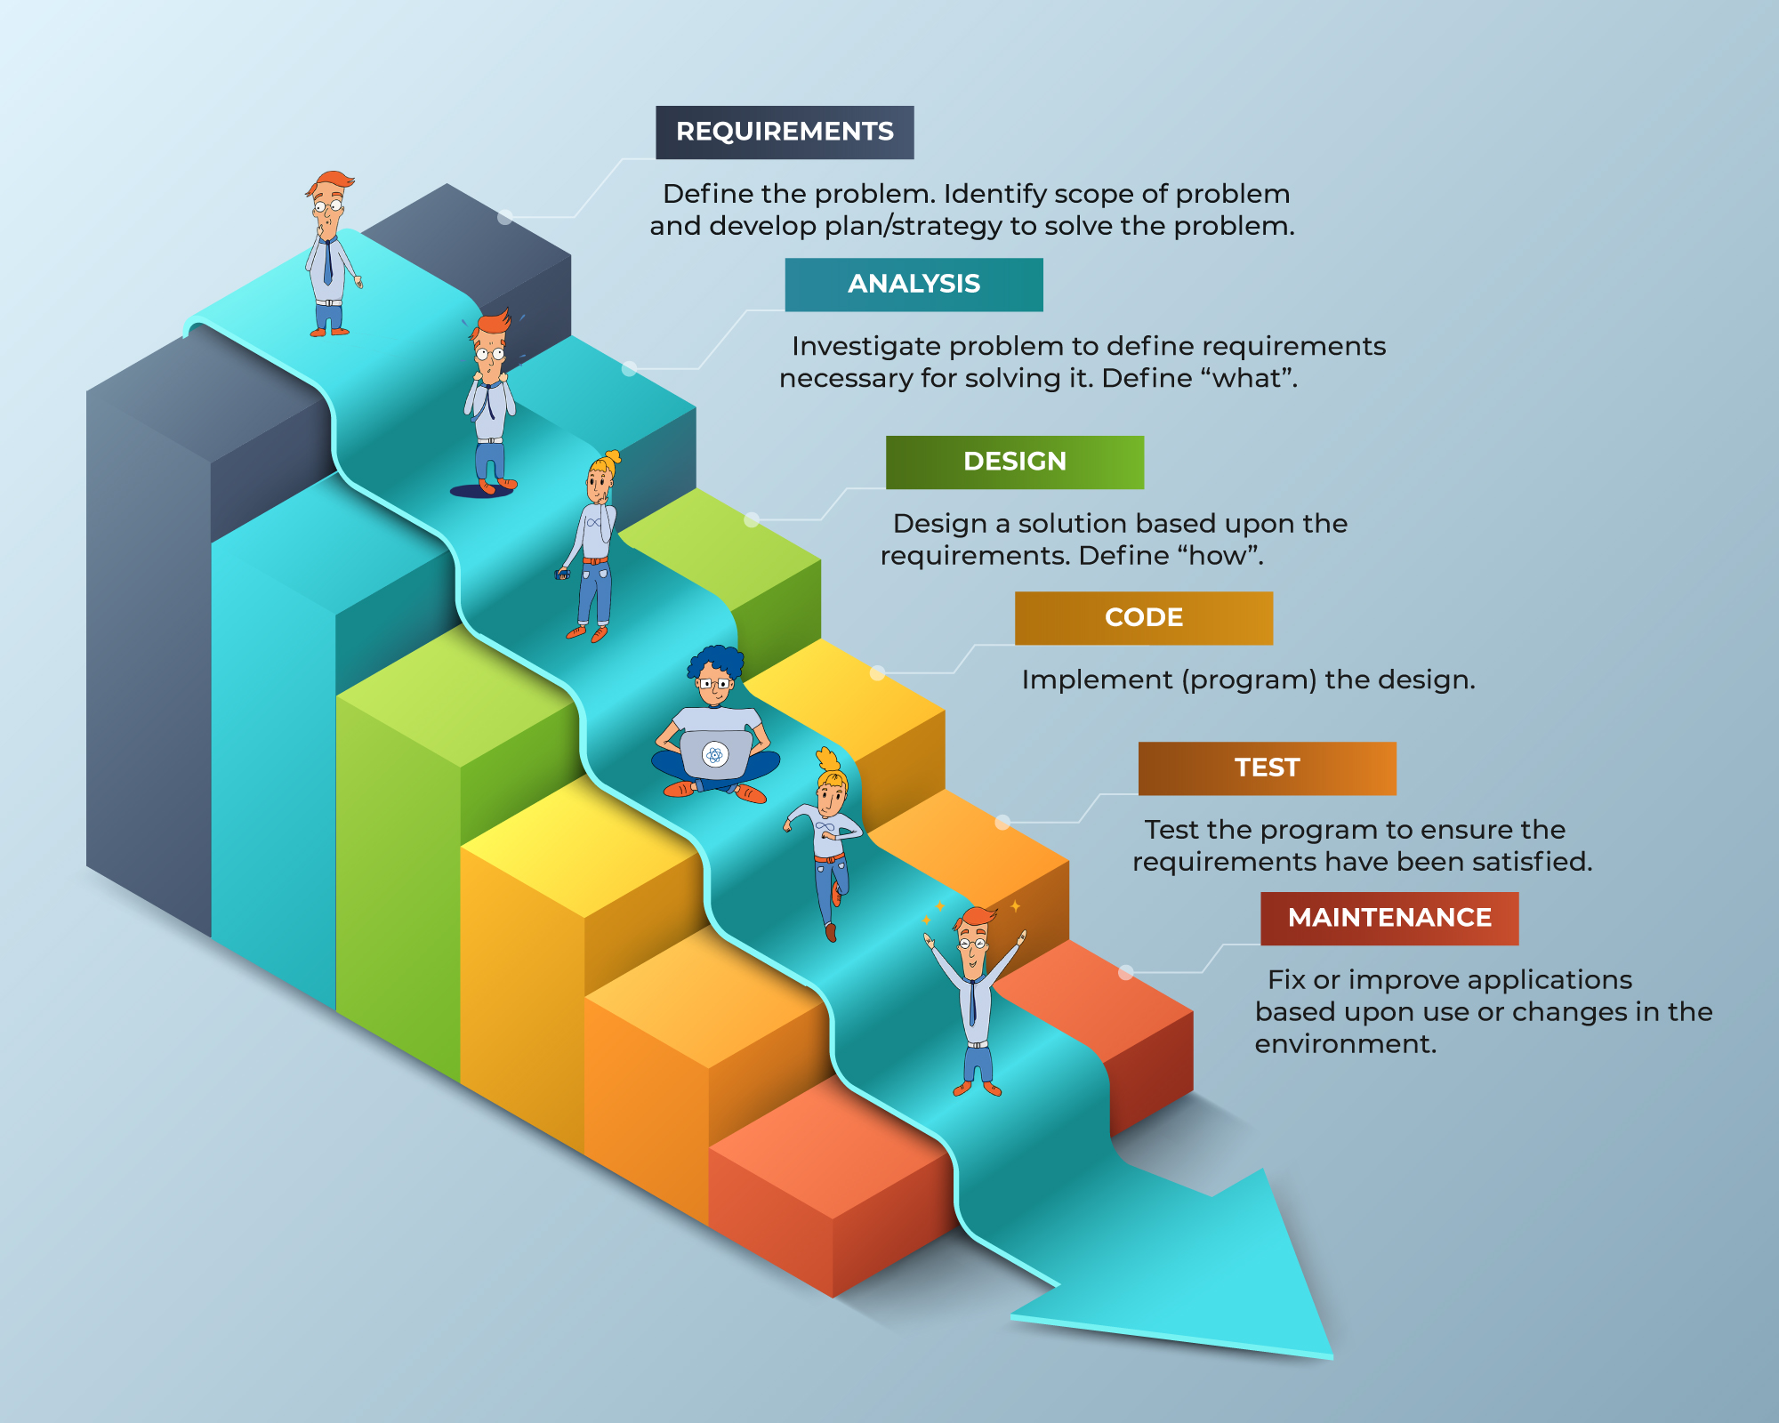
Development Methodology Overview
Our website development follows the structured Waterfall Model.

Slide 7
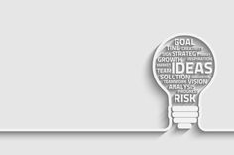
Future Plans
Responsive Design
User Engagement
Use of Database
Advanced Search and Filtering Options
Feedback Mechanism and many more..

Slide 8

Conclusion
Our website, guided by the Waterfall Model, ensures a seamless user experience.Acommitment to continuous improvement, we are dedicated to providing a comprehensive platform for informed educational decisions.
“Join us in shaping the future of education exploration!"

Slide 9
Refrences:
Diffrent college websites
Diffrent educational websites

