Slide 1


Forecasting future sales for a retail store chain
Using
Machine Learning
- Shirish Wate
Oct 2025

Slide 2
What are we solving?
In the retail world, competition is fierce, and profitability is as important as quality of product and service. This means the following things matter:
Staying ahead of the competition
Optimizing store operation and inventory
Optimize Operations: Streamline store operations & inventory
Focus on Winners: Prioritize top-selling products/services
Smart Marketing: Run targeted, effective campaigns
Right Staffing: Ensure stores are optimally staffed

Slide 3
Why does it matter?
Due to lack of sales forecast
📦 Inventory may not match actual demand, leading to stockouts or overstock
👥 Staffing levels may be misaligned, causing overstaffing or understaffing
📢 Marketing campaigns may miss the market pulse and reduce effectiveness
💰 Budget allocation becomes challenging and less efficient
📈 Future investment planning relies on guesswork instead of data
🏆 Staying competitive becomes difficult without actionable insights

Slide 4
What are the benefits?
Accurate sales forecasting enables better planning across key business areas:
Inventory Management: Ensure product availability aligns with demand
Workforce Planning: Optimize store staffing levels
Budgeting: Allocate financial resources efficiently
Growth Strategy: Identify high-potential areas for expansion
Sales Targets: Set realistic and achievable goals
Marketing Impact: Evaluate campaign effectiveness
Financial Planning: Manage cash flow and plan future investments
Investor Confidence: Support funding and expansion decisions
Risk Mitigation: Take proactive measures against sales decline
Customer Insights: Understand trends, preferences, and competitive positioning

Slide 5
How we achieved this?
🧹 Data Preparation
Data cleanup, integration, and visualization.
Created a time-series matrix to capture monthly trends.
🧩 Feature Engineering
Extracted hidden insights from existing features such as city, category type, first sold month, and monthly transaction count.
Added lag variables (e.g., previous 3 months’ sales).
Computed aggregated metrics (e.g., average sales per shop or item).
🤖 Modeling Techniques
Polynomial Regression
ARIMA (Time-Series Model)
Ensemble Methods:
XGBoost and LightGBM

Slide 6
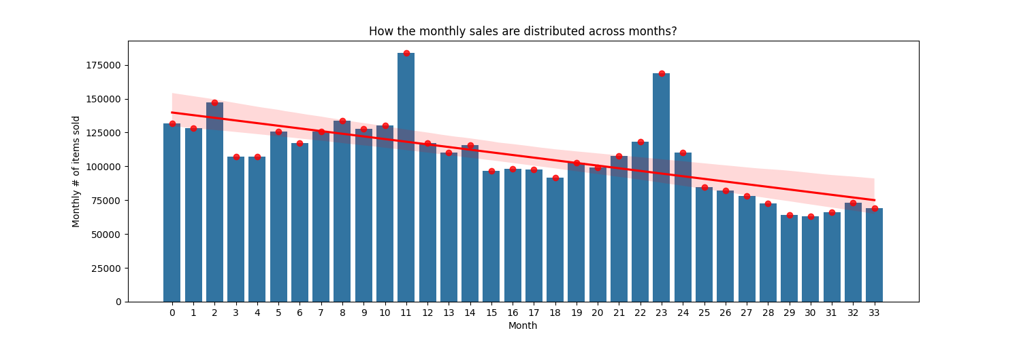
Data Insights
There seems to be an overall declining trend in the number of items sold.
Sales volumes show noticeable spikes in certain months, likely corresponding to promotional activities or special events.

Slide 7
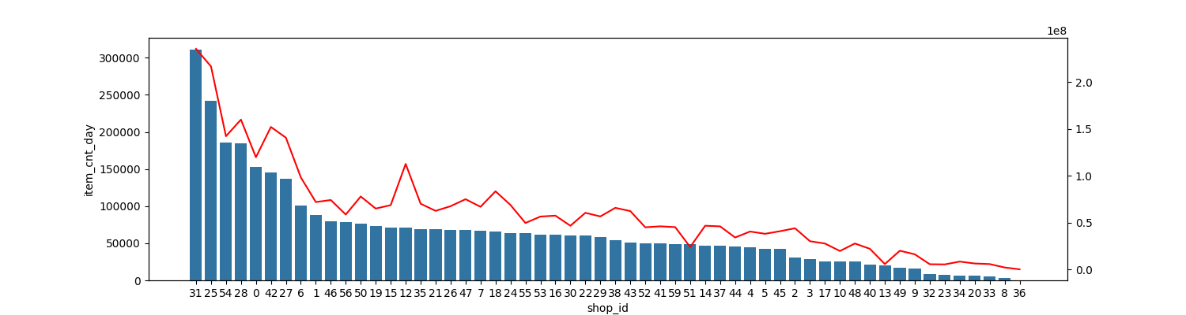
Data Insights
Overall, most shops maintain comparable sales performance.
A few shops consistently underperform relative to the average.
Several shops — notably Shop IDs 25, 28, 31, 42, and 54 — demonstrate outstanding performance and can be considered top sellers.
The total sales amount across shops generally mirrors the trend in the number of items sold, though some exceptions indicate a focus on higher-priced items.

Slide 8
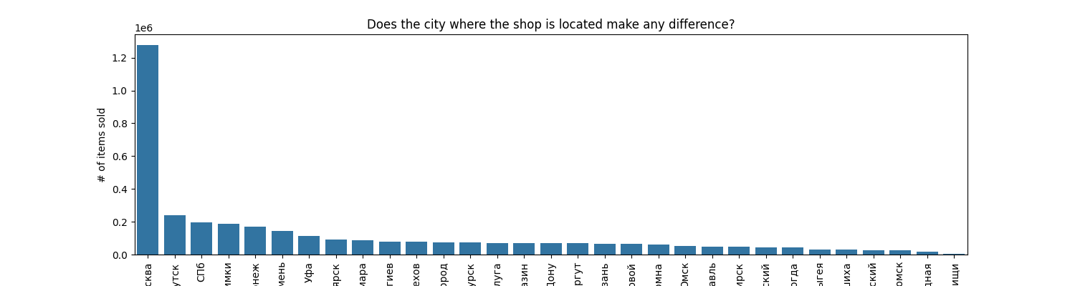
Data Insights
Moscow (“Москва”) emerges as the leading city in terms of total sales volume.
Other cities report substantially lower sales, though their performance remains relatively consistent, with a few showing moderate strength.
This suggests that a significant portion of total sales is concentrated in Moscow, highlighting its dominance as a primary market.

Slide 9
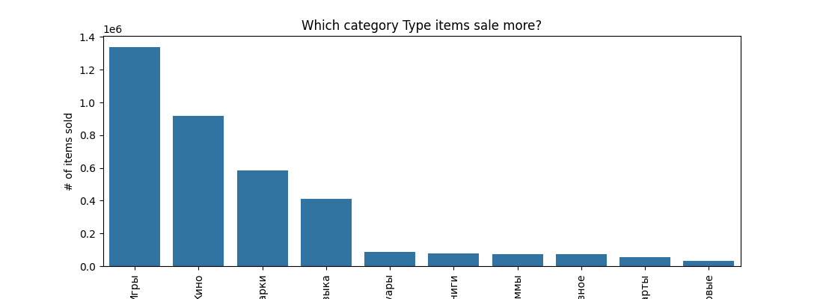
Data Insights
Among all product categories, four stand out prominently: Игры (Games), Кино (Movies), Музыка (Music), and Подарки (Gifts).

Slide 10
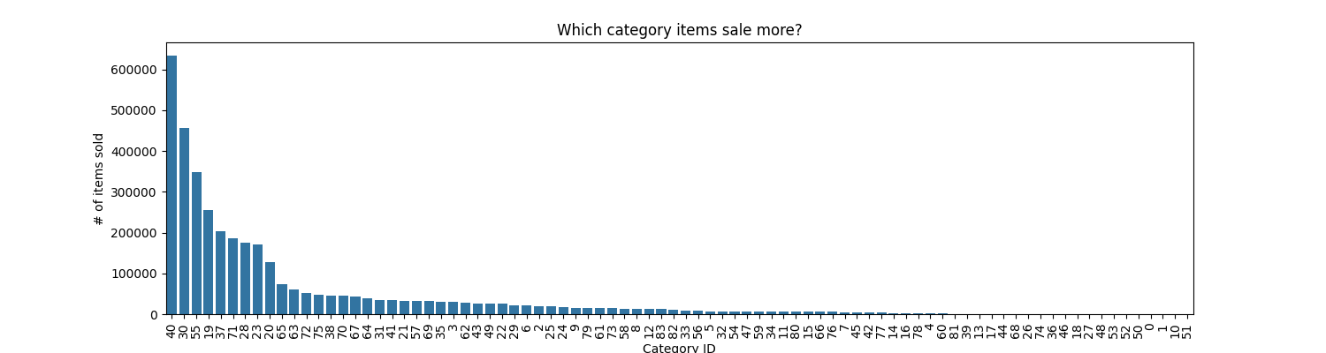
Data Insights
Most product categories record relatively low sales, with only a few achieving notably higher figures.
This pattern indicates that a limited number of categories account for a disproportionately large share of total sales.

Slide 11
Methodology
📘 Methodology Overview
Built upon the feature engineering detailed in Slide 3.
Applied GridSearchCV for systematic hyperparameter tuning and model selection.
📊 Data Split Strategy
Training Set: Months 1–31
Validation Set: Months 32–33
Test Set: Month 34 (held-out test data)
📈 Evaluation Metric
Used Root Mean Square Error (RMSE) to measure and compare model performance across all experiments.

Slide 12
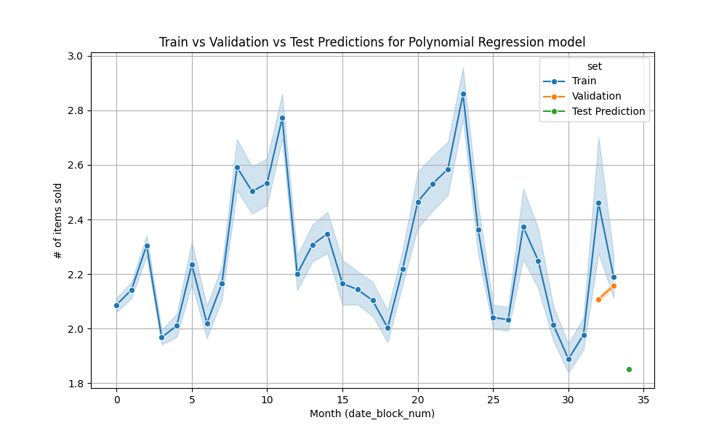
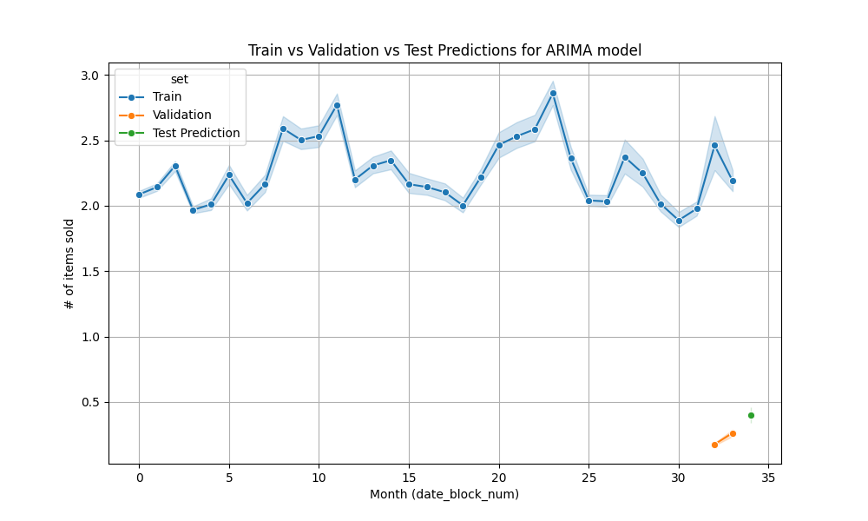
Outcome
Polynomial Regression
ARIMA
RMSE : 13.810
Mean RMSE : 0.705

Slide 13
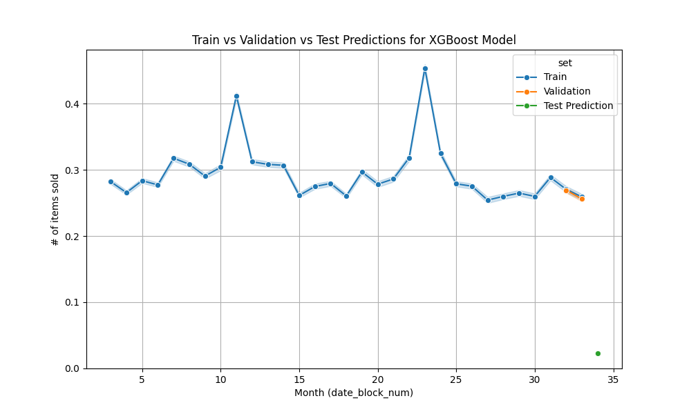
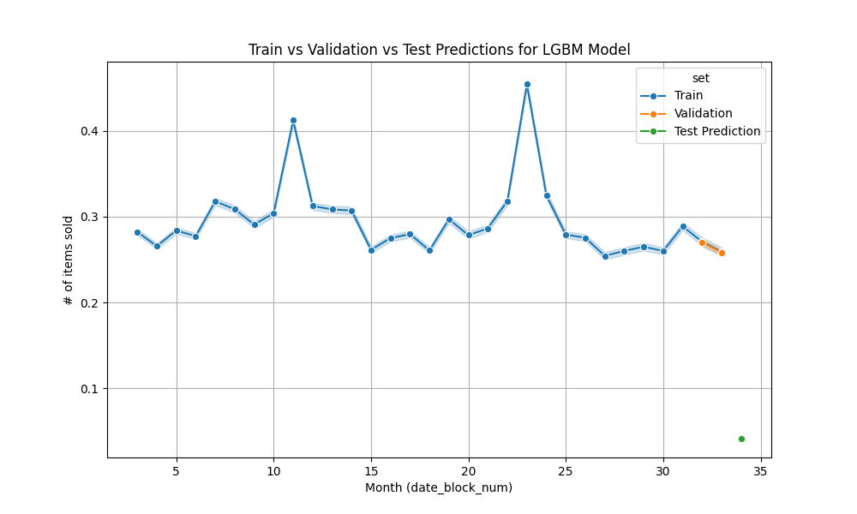
Outcome
eXtreme Gradient Boosting
Light Gradient Boosting Machine
RMSE : 0.687
RMSE : 0.679

Slide 14
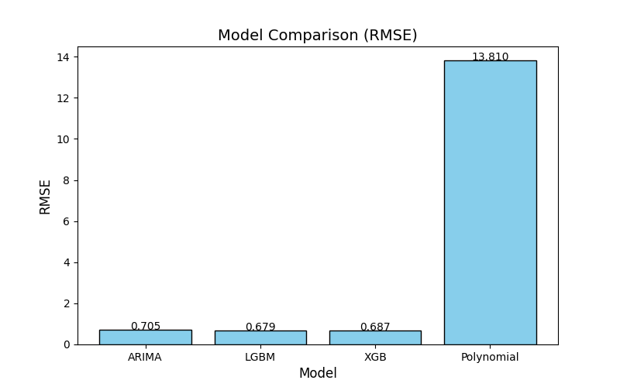
Model Comparison
Conclusion:
ARIMA, LGBM and XGB, all have similar validation error scores.
LGBM model’s error score is the least.
LGBM was faster to train than XGBM.
ARIMA model was the slowest to train.
The recommended model is LGBM

