Slide 1

AWS DMS Workshop
Core Concepts
AWS ASEAN Team
Revised 2017.10.24

Slide 2
About
This workshop is composed of three parts:
Part 1: Introduction to core concepts of AWS Database Migration Services (AWS DMS) and the AWS Schema Conversion Tool (AWS SCT)
Part 2: Lab providing hands-on with a SQL use case, specifically migrating Oracle DB -> Postgres DB
Part 3: Lab providing hands-on with a NoSQL use case, specifically migrating MongoDB -> Amazon DynamoDB

Slide 3
Agenda
Challenges of Database Migration
AWS Database Migration Service (AWS DMS)
AWS Schema Conversion Tool (AWS SCT)

Slide 4
Challenges of Database Migration

Slide 5
Customers Want to Migrate to AWS, but…
Migrations create long periods of application downtime
Migration tools that minimize downtime are expensive
Migrations seem too complex and expensive, especially across two different platforms
Migrations still require a copy of data on-premise
Migrations require skills outside their organization

Slide 6
Traditional Approach to Migrate to AWS
Create your AWS account
Setup your Virtual Private Cloud (VPC) in AWS
Connect to AWS with a VPN or Direct Connect
Shutdown and backup your database
Transmit the backup to S3
Configure an EC2 instance with the DB software
Restore the backup
Configure EC2 instances for the application
Switch the users to use AWS

Slide 7
Traditional Approach to Migrate to AWS
Steps 4-9 could take weeks!
Create your AWS account
Setup your Virtual Private Cloud (VPC) in AWS
Connect to AWS with a VPN or Direct Connect
Shutdown and backup your database
Transmit the backup to S3
Configure an EC2 instance with the DB software
Restore the backup
Configure EC2 instances for the application
Switch the users to use AWS

Slide 8
AWS Database Migration Service (AWS DMS)

Slide 9





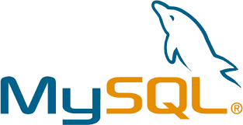


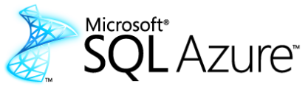
AWS Database Migration Service (AWS DMS)
DMS migrates databases to AWS easily and securely with minimal downtime. It can migrate your data to and from most widely used commercial and open-source databases.
Amazon Aurora
Notes:
And then we introduce the service….
So it was with all these factors in mind that we developed the database migration service. We designed it to be simple - you can get started in less than ten minutes. We designed it to enable near-zero-downtime migration. And we designed it to be a kind of replication Swiss army knife. To replicate data between on-premises systems, RDS, EC2, and across database engine type.
Reiterate what engines are supported + CDC

Slide 10



AWS DMS Support for NoSQL
Migrate to AWS
Move between NoSQL and SQL
Move from MongoDB to Amazon DynamoDB
Move from MongoDB to relational DBs
Re-platform database technology
DynamoDB
DynamoDB
RDS
Amazon Aurora
Notes:
Recently added support for NoSQL databases using DMS
For Mongo Two modes:
Document mode > JSON data becomes a single column in a target table
Table mode > DMS scans the Mongo documents and creates a set of all the keys and types to use a columns in a target table
For Dynamo:
DMS supports the scalar data types in Dynamo
Use mapping rules to define record to record or record to document mappings for relational sources
Also mention S3

Slide 11
AWS DMS Support for S3 (as Source or Target)
Extract Data from any supported DMS source to S3 and to any DMS target
Amazon Aurora
S3 Bucket
DynamoDB
S3 Bucket
Amazon Aurora

Slide 12

Keep Your Apps Running During the Migration
AWS
Database Migration Service
Customer
Premises
VPN
AWS
Internet
Start a replication instance
Connect to source and target databases
Select tables, schemas, or databases
Let AWS DMS create tables, load data, and keep them in sync
Switch applications over to the target at your convenience
Application Users
Notes:
Using the AWS Database Migration Service to migrate data to AWS is simple.
Start by spinning up a replication instance in your AWS environment
Next, from within DMS, connect to both your source and target databases
Choose what data you want to migrate. DMS lets you migrate tables, schemas, or whole databases
Then sit back and let DMS do the rest. It creates the tables, loads the data, and best of all, keeps them synchronized for as long as you need
That replication capability, which keeps the source and target data in sync, allows customers to switch applications over to point to the AWS database at their leisure. DMS eliminates the need for high-stakes extended outages to migrate production data into the cloud. DMS provides a graceful switchover capability.
Additional Flow Information
Customer creates a replication instance in the AWS Management Console
Customer enters source and target database connection info (“endpoints”)
Customer creates a task to migrate data from source to target
Data from the source is copied to tables on the target (“bulk load”)
Changes to data on source are captured while the tables are loaded
Once bulk load is complete, buffered changes are applied to the target
Additional changes captured on the source are applied to the target until the task stopped or terminated

Slide 13
AWS DMS Key Concepts
Replication instances are EC2 instances that provide the processing engine for data migrations
Endpoints are wrappers around the source and target databases, used by the the replication instances during data migration
Tasks oversee the data migration process, provide source filters and/or data transforms, and determine if data will continue to be replicated after the initial transfer is performed

Slide 14
AWS Schema Conversion Tool (AWS SCT)

Slide 15
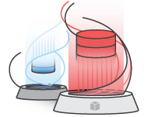
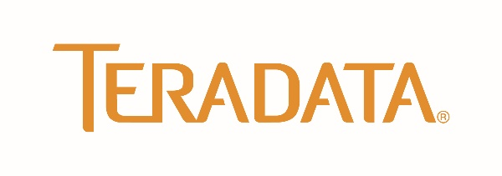


AWS Schema Conversion Tool (AWS SCT)
AWS SCT is a desktop application that helps automate many database schema and code conversion tasks when migrating between database engines or data warehouse engines
Amazon Aurora
Notes:
We used to talk about SCT as more of an afterthought than anything, but we are finding more and more people are looking to switch database engine and the link between the two products was not always clear
So what happens if you are converting from one database engine to another? Where does the magic happen? This is where the AWS Schema Conversion Tool steps in.
Relational and Data Warehouse schema conversion
Database Migration Assessment report for choosing the best target engine
Code browser that highlights places where manual edits are required
Secure connections to your databases with SSL
Cloud native code optimization
Start a DMS migration from SCT

Slide 16
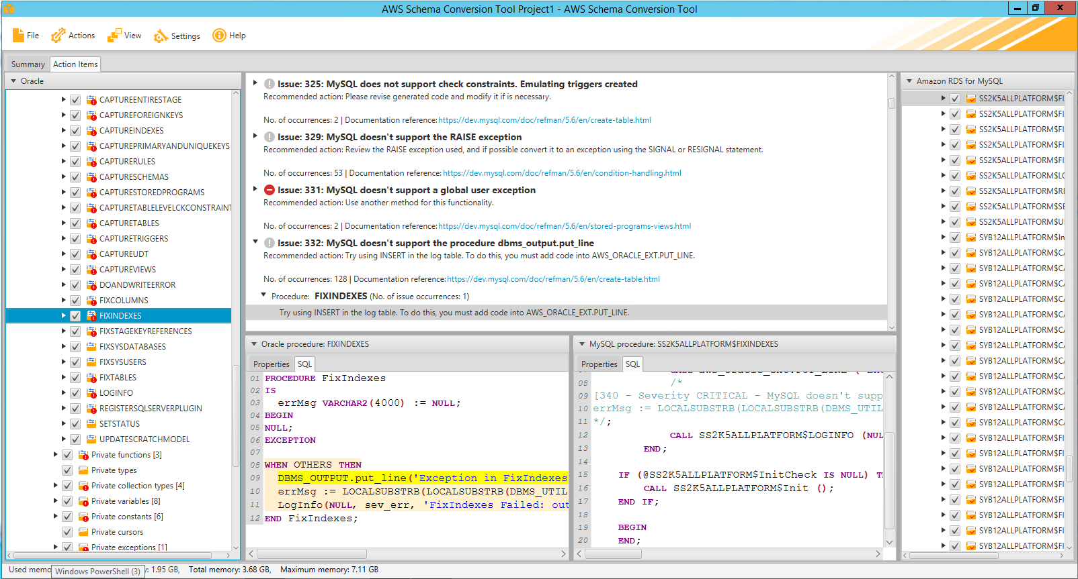
AWS SCT Helps Convert Tables, Views & Code
Sequences
User-Defined Types
Synonyms
Packages
Stored Procedures
Functions
Triggers
Schemas
Tables
Indexes
Views
Sort and distribution keys
Notes:
- Embedded SQL conversion
- Cloud native code optimization

Slide 17
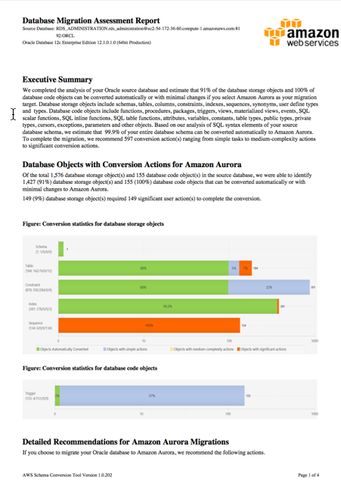
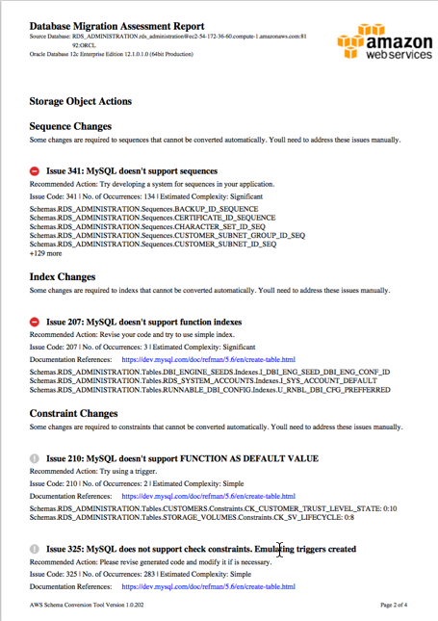
AWS SCT Assessment Report
AWS SCT provides an Assessment Report to help you plan for any potential conflicts in your planned migration
Connect AWS SCT to Source and Target DBs
Run Assessment Report
Read Executive Summary
Follow detailed guidance
Database Migration Assessment Report (Sample)

Slide 18
AWS SCT Pricing and Permitted Use
$0
for software license
Pricing
Free software license
For active AWS customers with accounts in good standing
Permitted Use
Use AWS SCT to migrate database schemas to Amazon RDS, Amazon Redshift, or Amazon EC2-based databases
To use AWS SCT to migrate schemas to other destinations, contact for special pricing

Slide 19
Next: SQL Lab: Oracle to PostgreSQL

