Slide 1
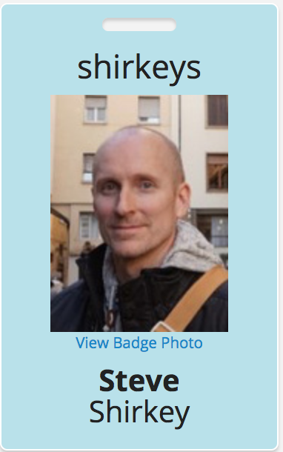
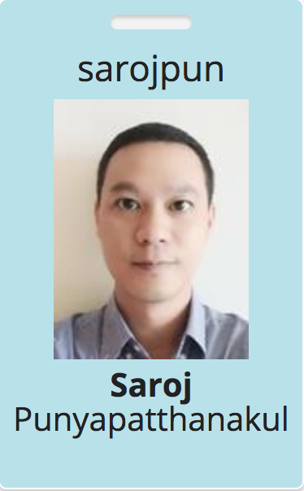
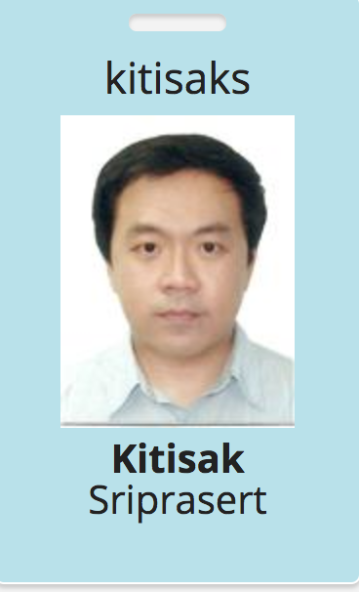
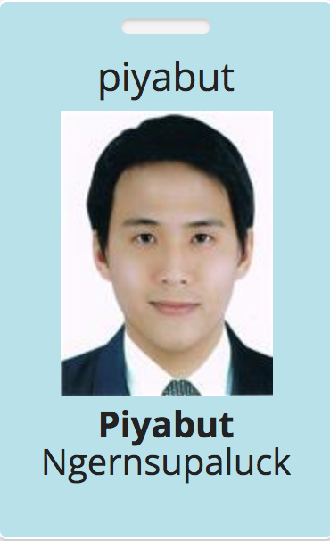
SSID: S31-Ballroom
Username/Password: {ask AWS staff}
User: shirkeydev@gmail.com Password: W0rksh0p
WIFI
Solutions Architect ASEAN
Solutions Architect Thailand
Solutions Architect Thailand
Inside Sales, Thailand

