Slide 1
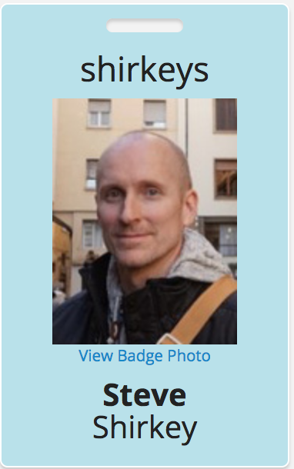
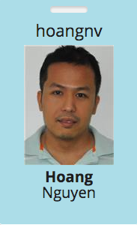
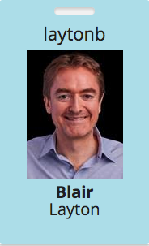
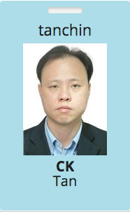
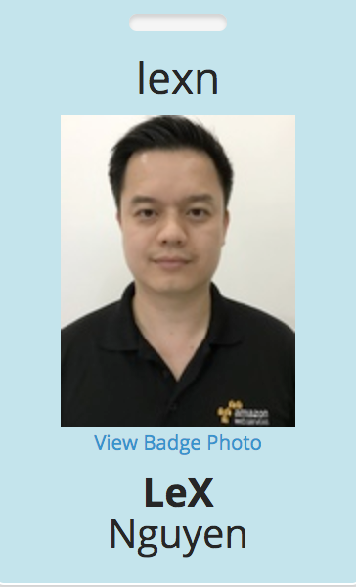
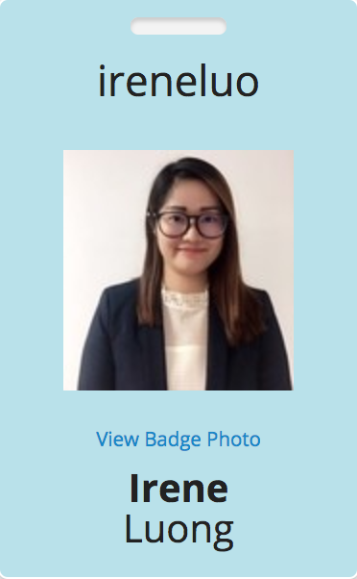
Solutions Architect ASEAN
Solutions Architect Việt Nam
BDM APAC - Database, Singapore
Enterprise Migration Architect
Territory Manager- Việt Nam
Inside Sales
Emerging Markets
Runbook 1: http://amzn.to/aws-dms-runbook-sql
Runbook 2: http://amzn.to/aws-dms-runbook-nosql
Github: https://github.com/shirkeyaws/aws-dms-workshop
SSID: AWS / Password: aws@2017
Notes:
User: shirkeydev@gmail.com Password: W0rksh0p
Housekeeping
AWS Account
Credit Code
AppStream 2.0 account
USB drive for local installations

Slide 2
Workshop Requirements
You will need:
AWS Account
Credit Code
AppStream 2.0 account (via email)
USB drive for local installations

