Slide 1
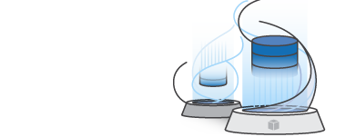
AWS DMS Workshop
NoSQL Lab: MongoDB to DynamoDB
AWS ASEAN Team
Revised 2017.10.26

Slide 2
About
This workshop is composed of three parts:
Part 1: Introduction to core concepts of AWS Database Migration Services (AWS DMS) and the AWS Schema Conversion Tool (AWS SCT)
Part 2: Lab providing hands-on with a SQL use case, specifically migrating Oracle DB -> Postgres DB
Part 3: Lab providing hands-on with a NoSQL use case, specifically migrating MongoDB -> Amazon DynamoDB

Slide 3
Agenda
MongoDB
Amazon DynamoDB
Lab Activities

Slide 4
MongoDB

Slide 5
What is MongoDB?
MongoDB is a document database with the scalability and flexibility that you want with the querying and indexing that you need
MongoDB stores data in flexible, JSON-like documents, meaning fields can vary from document to document and data structure can be changed over time (ie. schemaless)
Documents are stored within separate databases on a MongoDB server, and are further subdivided into Collections
Users can directly access both document as a whole or as a part (accessing individual elements and attributes nested within the objects)
* See https://www.mongodb.com/what-is-mongodb for more information

Slide 6
AWS DMS Support for MongoDB
MongoDB as Source only (Target not supported)
MongoDB versions supported:
2.6.x
3.x
Two migration modes:
Document Mode (default)
the MongoDB document is migrated “as is,” meaning that its JSON data becomes a single column in a target table named “_doc”
Table Mode
the MongoDB is automatically parsed for fields
See http://docs.aws.amazon.com/dms/latest/userguide/CHAP_Source.MongoDB.html for more details

Slide 7
Amazon DynamoDB

Slide 8
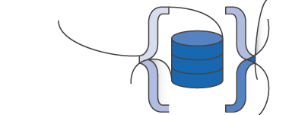
What is Amazon DynamoDB?
a fast and flexible NoSQL database service for all applications that need consistent, single-digit millisecond latency at any scale
a fully managed cloud database and supports both document and key-value store models
priced based on both storage and throughput, where throughput is measured in read capacity and write capacity, and can be scaled independently of each other

Slide 9
Lab Activities

Slide 10
Lab Setup: Bootstrapping Your Account
Create new EC2 key within ap-northeast-1 region
Name: workshop
Not necessary if already completed previous SQL lab
Launch CloudFormation template:
Stack Name: workshop-cfn-nosql
Creates MongoDB source instance
Provisions a DynamoDB target table
Once launched, all resources will be provisioned in your account, immediately incurring cost!

Slide 11
Lab Steps: AWS DMS & DynamoDB
AWS DMS always provisions the DynamoDB tables
Creates 1:1 mapping between source MongoDB tables and DynamoDB tables
Provisions each table with 200 read + 200 write capacity units
After provisioning/loading, AWS DMS does not reduce that initial throughput, which could result in excessive costs
Notes:
(=$132.50/table/month)
2100 total read/writes (approximately $1400/month)

Slide 12
Lab Steps: AWS DMS & MongoDB
MongoDB defaults
Runs with localhost bindings
Need to change MongoDB config file to permit binding on external ports
Runs with no user account for access
Create a MongoDB privileged user to securely access specific databases
AWS DMS with incremental change (CDC) requires a MongoDB cluster

Slide 13
Lab Teardown
Always destroy your Lab Resources after lab completion
First, teardown AWS DMS resources
Destroy in reverse order of creation
Tasks, then Endpoints, then Replication Instances
Next, teardown CloudFormation stack
Finally, delete workshop key pairs

Slide 14
Thank You For Attending! Please complete your survey ☺

