Slide 1
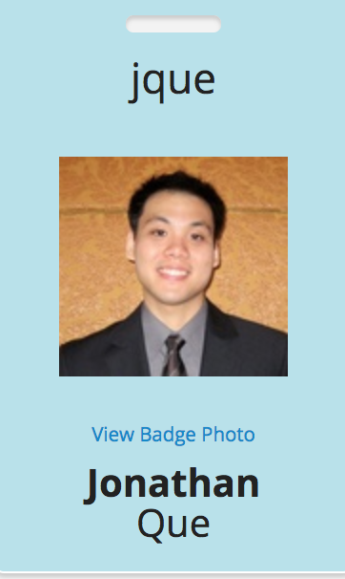
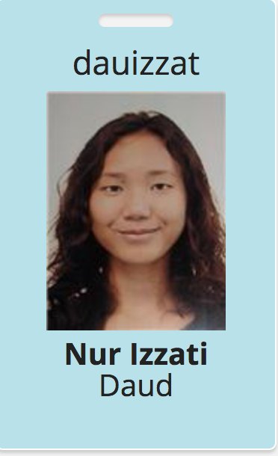
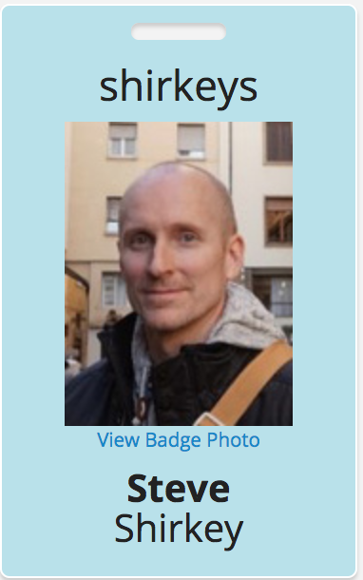
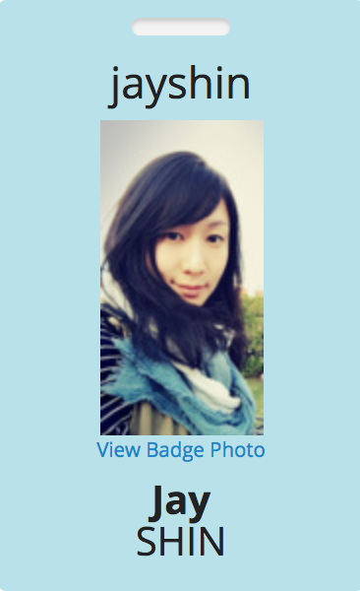
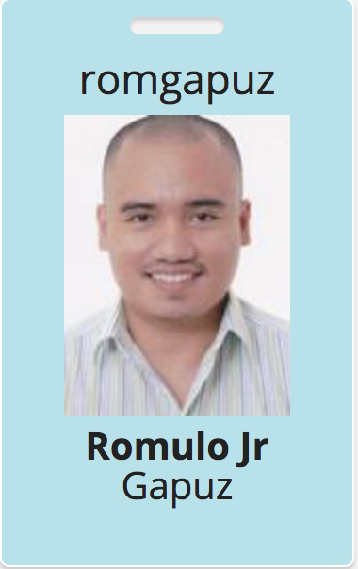
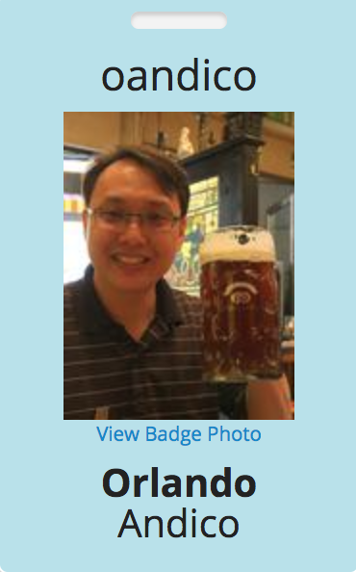
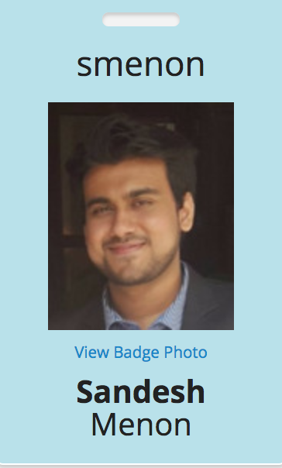
WIFI
SSID: AWS Workshop
Password: @AWS2017
Enterprise Sales, Philippines
Marketing Specialist - SG
Solutions Architect ASEAN
Cloud Architecture Consultant
Solutions Architect, Philippines
Solutions Architect ASEAN
Inside Sales, Philippines

