Slide 1
Predicting car collision severity

Slide 2
Predicting car collision severity helps prevent accidents
Traffic and road departments can use the tool to improve the future development and give more effective warnings to the drivers in time.
Drivers can use the tool in the mobile device to inform them to drive in a safer way.

Slide 3
Data acquisition and cleaning
The collision dataset is collected by SDOT Traffic Management Division, Traffic Records Group in Seattle, which includes all collisions provided by SPD and recorded by Traffic Records from 2004/01/01 to 2020/05/20.
The dataset is well prepared and all the record has its value (severity code) in the target variable column without missing value.

Slide 4
Feature Selected
After considering the relevance of features to the project and exploring the correlations between the features
We finally select 3 features to build the model
ADDRTYPE Collision address type
ROADCOND The condition of the road
LIGHTCOND The light conditions

Slide 5
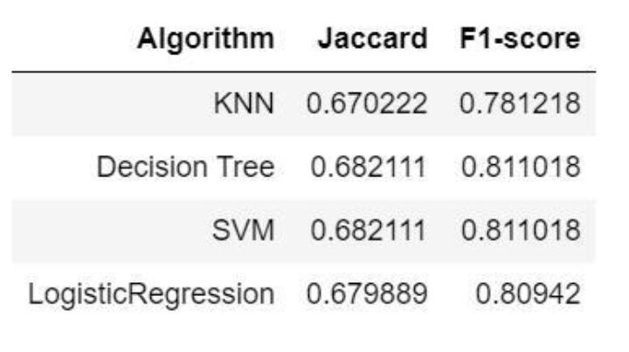
Classification models
We build the models of different algorithms including K-Nearest Neighbor(KNN), Decision Tree, SVM and Logistic Regression. Their performances show as follows.
However, with the best performance, the optimal depth of decision tree is only 1.
The model simply adheres to predict the level 1 severity and sacrifice the accuracy in predicting level 2 severity involving injury.

Slide 6
Conclusion and future direction
It seems the features in the imbalanced dataset are inadequate to distinguish car collisions involving injury from these only having property damage in the prediction.
As more features to be developed and collected, it may be possible to forecast serious collisions with injury more accurately in the future.

