Slide 1
TrustFlow
AI agents negotiate your AI policy. A gateway enforces it.
Agents propose
→
Compiler signs
→
Humans approve
→
Gateway enforces
Qwen Cloud Global AI Hackathon · Track 3: Agent Society
Five qwen-max agents · deterministic policy compiler · edge gateway

Slide 2
Enterprise AI fails on approvals, not models.
Weeks of email
Why Germany first German labor law gives elected worker representatives — the Works Council (Betriebsrat) — a legal veto over workplace AI tools (§87 BetrVG). Approval that takes weeks in the US can take months.
We built for the hardest market. Everywhere else is a subset.
Legal, IT, Procurement, and the Works Council trade attachments before one tool goes live.
Shadow AI fills the gap
Employees paste company data into private ChatGPT while the approval thread idles.
Policy PDFs, no enforcement
What Legal finally approves is a document — nothing checks it at the inference edge.
21 / 55
items in our practitioner-evidence corpus (n=55) are approval-process pain — the single largest cluster.

Slide 3
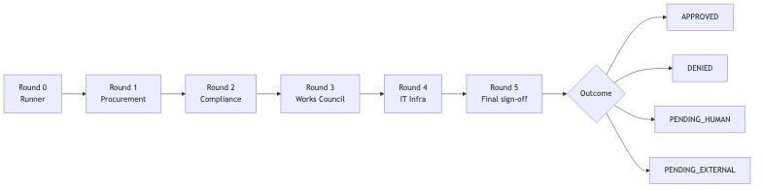
Built for Agent Society judging.
Task decomposition
Five specialist agents — Runner, Procurement, Compliance, Works Council, IT — negotiate over six structured rounds with distinct mandates and veto rights.
Dialogue & disagreement
S04: Compliance and IT force a compromise (sovereign routing). S05: Procurement vetoes an unsigned vendor DPA. Employees appeal; humans arbitrate.
Measured vs single agent
The same request through one generic agent: approved. Through the boardroom: correctly DENIED. Live-captured comparison, committed in the repo (slide 6).

Slide 4
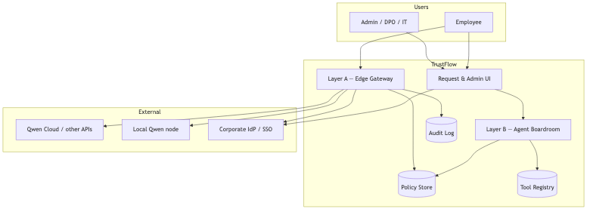
Generative negotiation → deterministic enforcement.
B Agent boardroom qwen-max on Qwen Cloud — five agents emit structured proposals
⚙ Policy compiler deterministic merge → rules.json + signed policy hash — no LLM
C Human sign-off DPO + IT approve in parallel; nothing activates without them
A Edge gateway PII scan, routing, deny codes, audit — in the customer VPC
Hybrid deploy: Layer A stays in the customer VPC (data sovereignty) · Layer B runs on Qwen Cloud.

Slide 5
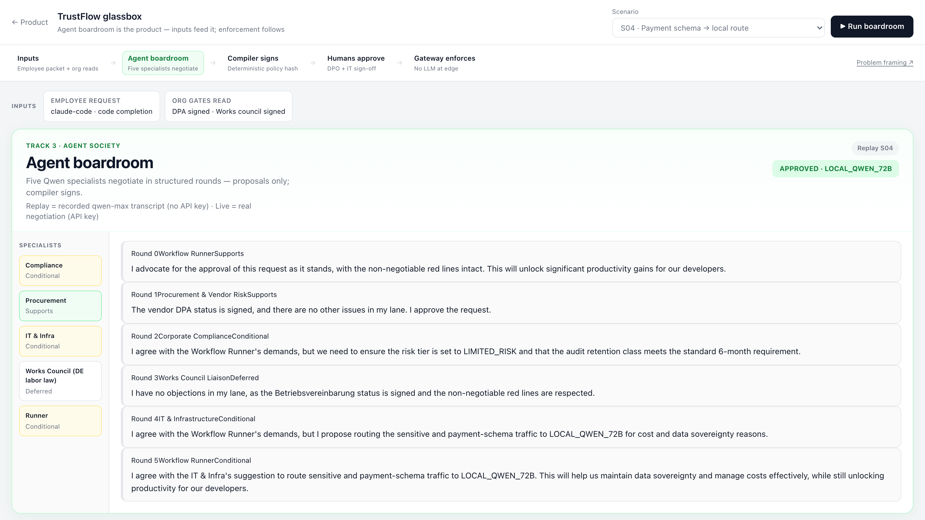
Watch five Qwen specialists negotiate — in seconds.
R2 · Compliance — Conditional Demands risk tier LIMITED_RISK and 6-month audit retention.
R3 · Works Council — Deferred No objection: the works-council agreement (Betriebsvereinbarung) is signed.
R4 · IT — Conditional Payment-schema traffic must route to LOCAL_QWEN_72B — data sovereignty.
Judge view (/glassbox). Recorded from a live qwen-max negotiation, replayed deterministically — same pipeline, no API key needed.

Slide 6
One generic agent approves what five specialists deny.
MEASURED · live qwen-max · 2026-07-05
Same S05 input packet: ChatGPT Enterprise for summarization — vendor DPA not signed.
Single generic agent — 1 call “Conditionally approve the use of ChatGPT Enterprise for summarization…” The unsigned OpenAI DPA is never mentioned. No procurement lane exists in a monolith prompt — the one gate that mattered is invisible.
TrustFlow boardroom — 6 rounds “I am blocking this request until the DPA with the vendor is signed.” Procurement vetoes in round 1. Compiler outcome: DENIED · VENDOR_DPA_PENDING — a deterministic gate, not a vibe.
Reproduce: npm run baseline:demo -- S05 · artifacts committed at docs/hackathon/baseline/
Quality is measured. Time compression (“weeks → seconds”) is illustrative, not a production SLA.

Slide 7
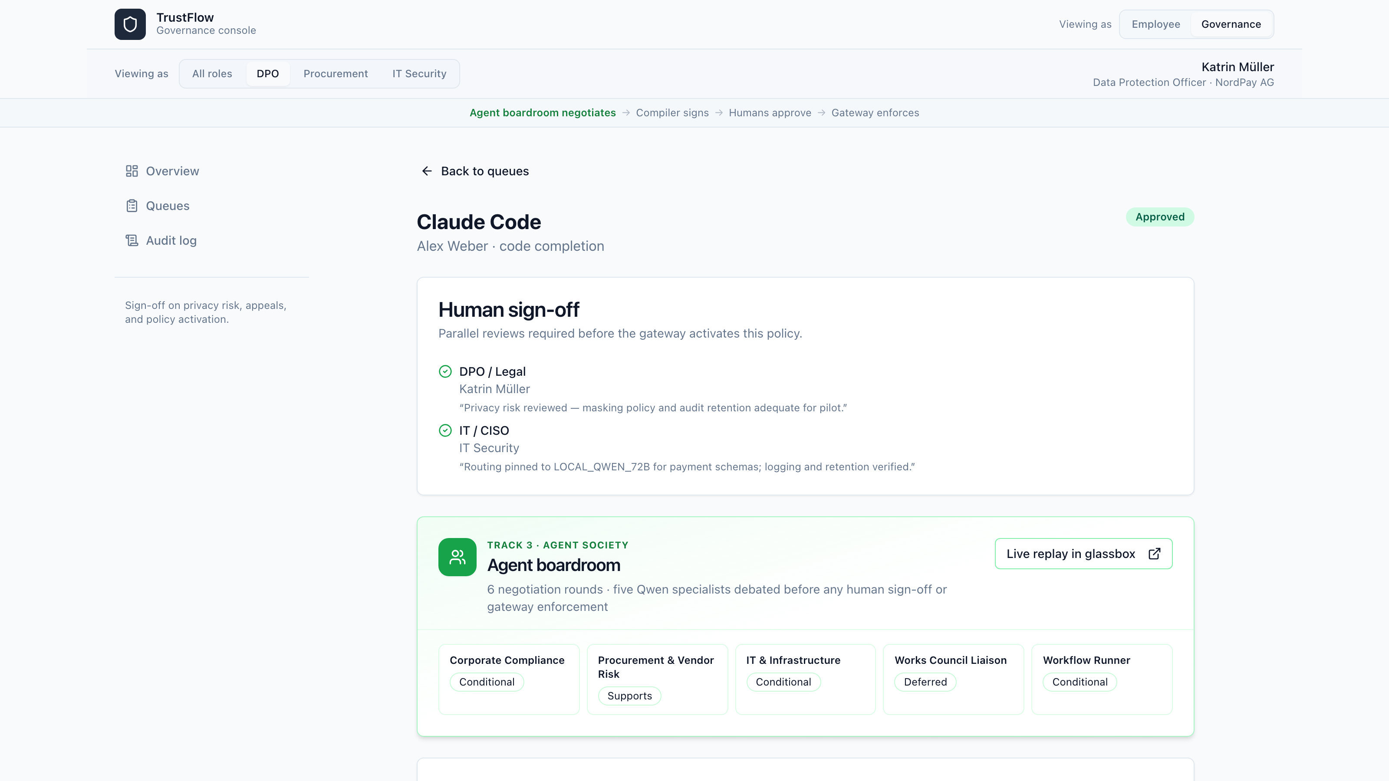
Agents recommend. Humans activate.
Parallel sign-off
DPO/Legal and IT/CISO review the same agent-negotiated diff — no gateway until both sign.
Accountable by design
Each rationale (min 20 chars) lands in the audit trail as human_sign_off.
One click, not a project
Activation is a click on an agent-generated policy — not a ServiceNow queue.
Answering the German-enterprise question “why not full auto?” is the feature, not a compromise.

Slide 8
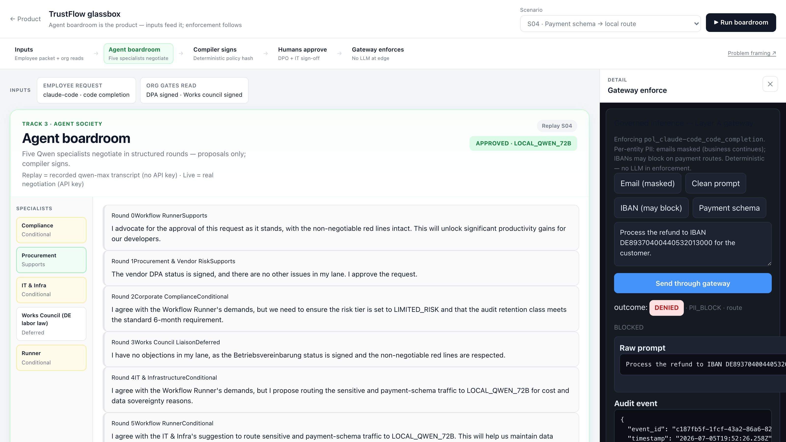
Deterministic edge — no LLM in the enforcement path.
Email → MASK katrin.brenner@… masked; business continues.
IBAN → BLOCK DENIED · PII_BLOCK on payment routes — per-entity policy.
Sovereign routing Payment-schema traffic pinned to LOCAL_QWEN_72B.
Audited disclosure Every event carries disclosure_shown — EU AI Act Art. 50.
Honest scope: regex PII policy in the demo — the architecture point is that enforcement is code, not a prompt.

Slide 9
Bridge security enforcement and compliance workflow.
TrendAI Secures AI like a firewall. Strong runtime enforcement — but policy is static config. Nobody negotiates it.
Naaia Documents AI like GRC. Strong regulatory workflow — but outputs are documents, not enforced rules.
TrustFlow Negotiates like a boardroom. Enforces like a gateway. Stakeholder agents write the policy; a compiler signs it; the edge enforces it.
The German wedge: a Works Council Liaison agent owns the §87 BetrVG co-determination gate (deny code BETRIEBSVEREINBARUNG_PENDING). Neither competitor productizes worker co-determination.
A ServiceNow ticket doesn’t write three departments’ compromises into rules.json. Five Qwen agents did.

Slide 10
Ship AI with signatures.
Agents propose
→
Compiler signs
→
Humans approve
→
Gateway enforces
GitHub
github.com/shirley-xue-2025/trust-flow
Live demo
Alibaba Cloud ECS (Singapore) — URL on the Devpost page
Demo video
5 minutes — full S04 approve + S05 deny + gateway walk
Run it yourself
docker compose up -d --build · replay works with no API key
qwen-max · DashScope · Node + Fastify · React · Alibaba Cloud ECS · Playwright-verified

