Slide 1
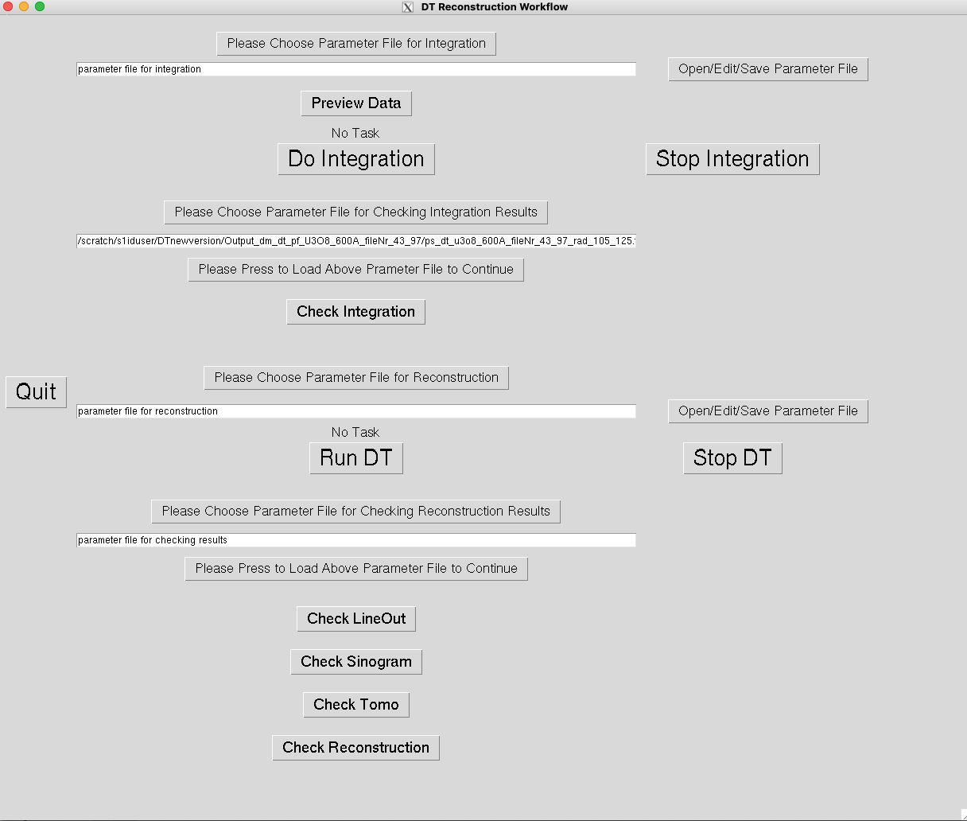
Login Haydn
anapy /scratch/s1iduser/DTnewversion/dt_gui.py

Slide 2
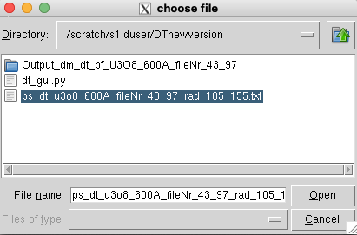

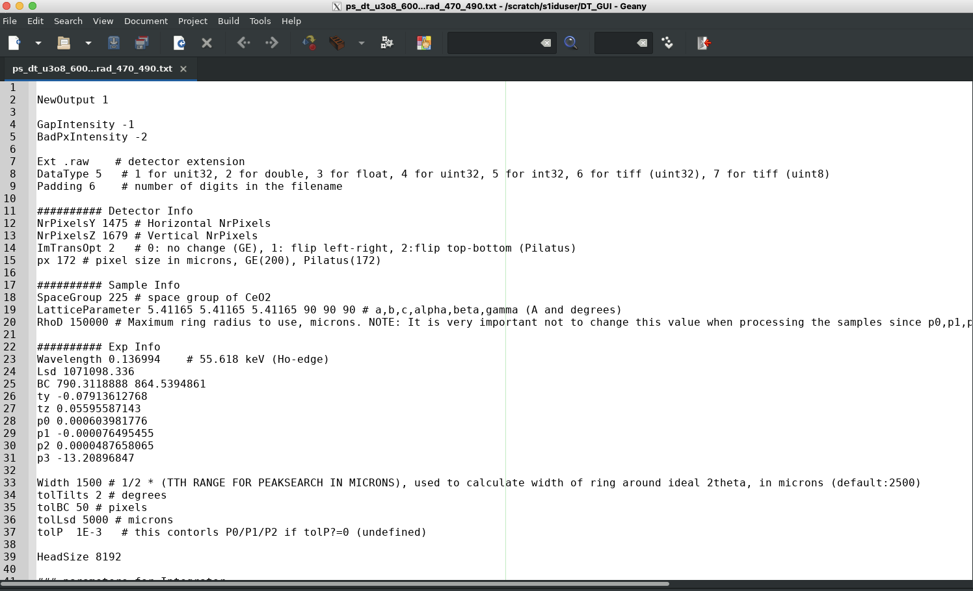
For Doing Integration:
Click:
Step 1:
Step 2:
Click this to choose parameter file
After step 1 and 2, you will get:
Click this you will go to the Geany interface

Slide 3
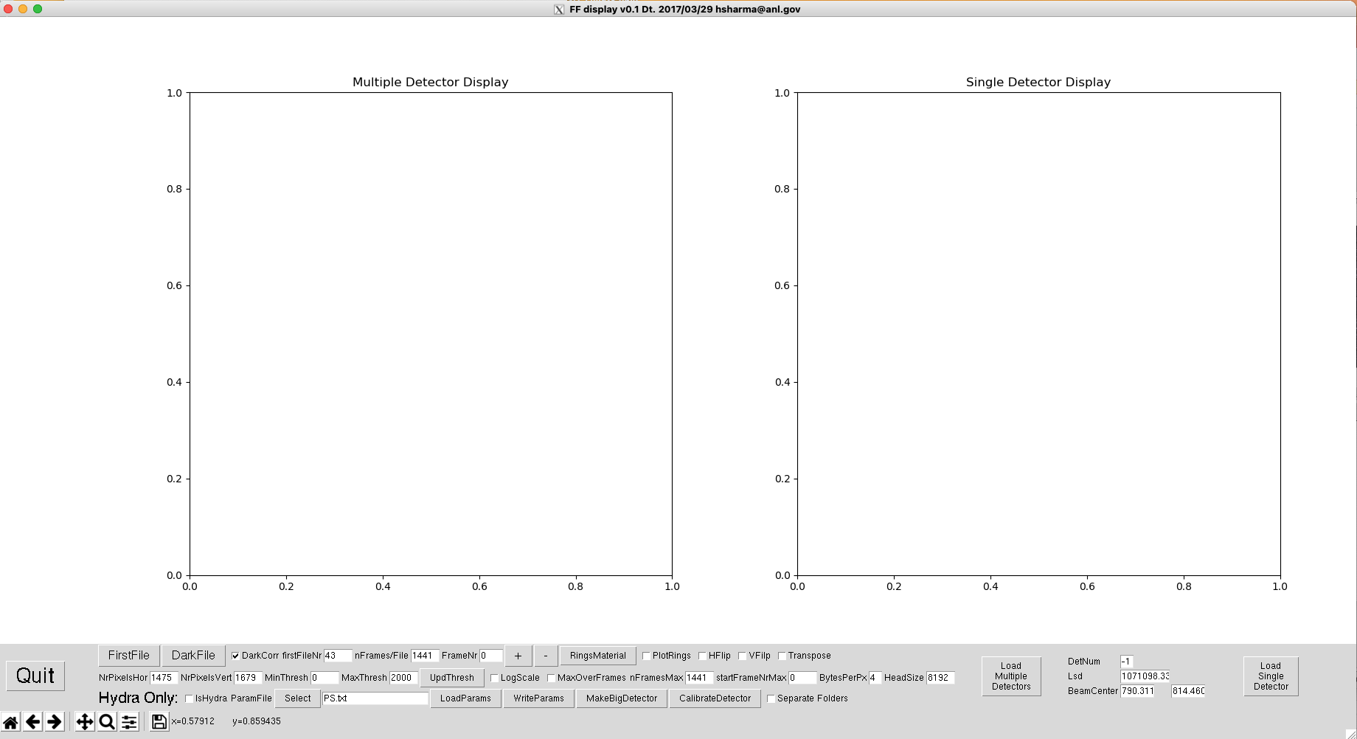

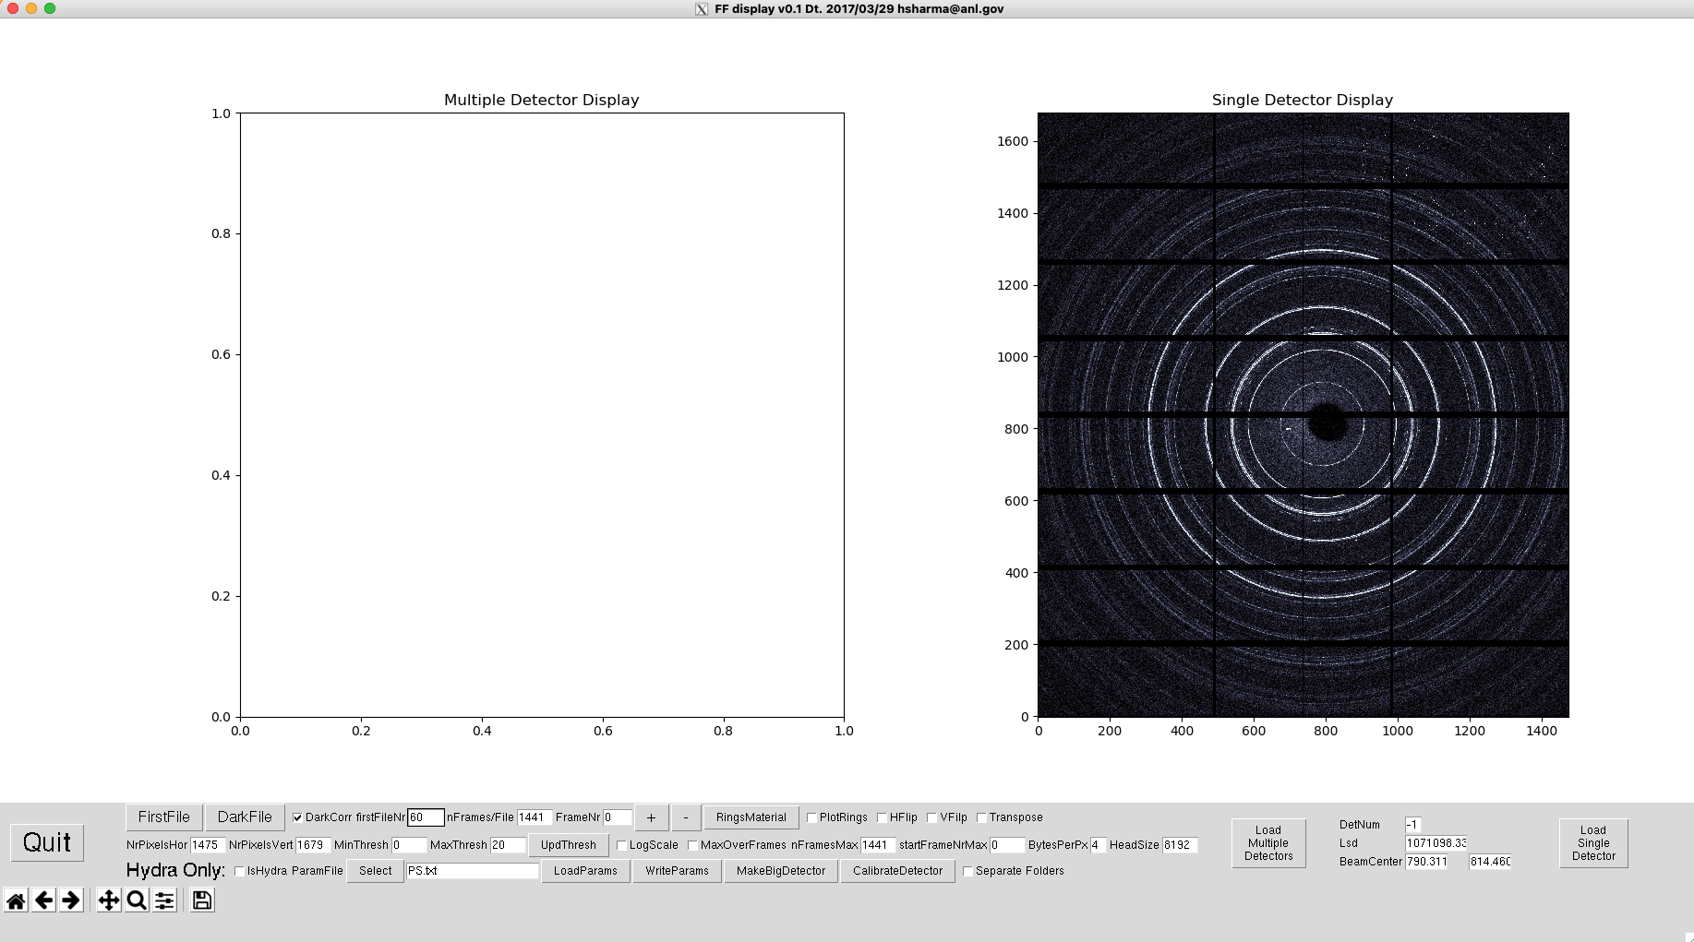
For Doing Integration:
Step 3: Click:
This step can be skipped, if you know the parameters you want to use
Click

Slide 4
For Doing Integration:
Step 4:
Click
Click
Once finished:
However, if you use all the processors to run the integration, click this button may not give you response; you can use the “Control+C” to terminate

Slide 5

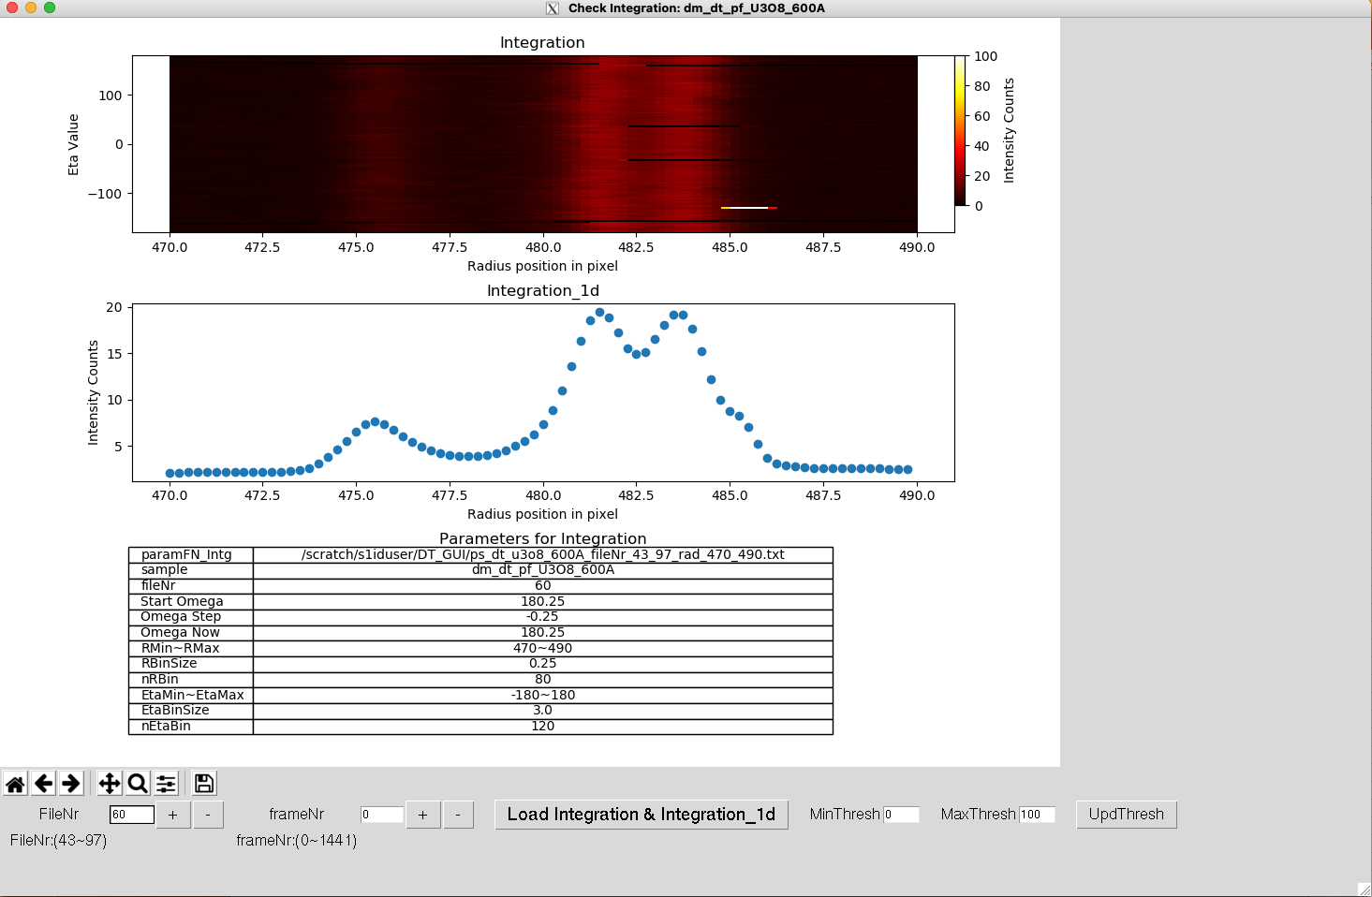
For checking
Integration:
! Click this button to load the parameter file
Step 5:
Click
Show the value range

Slide 6
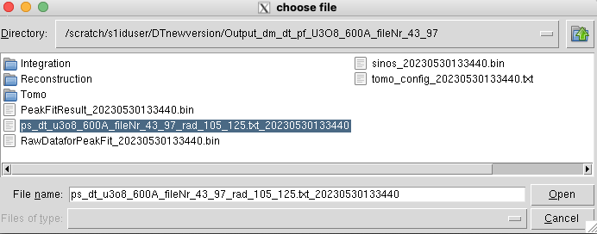


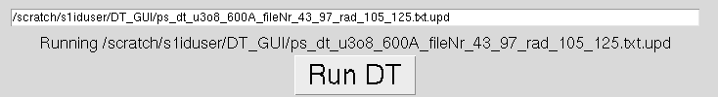
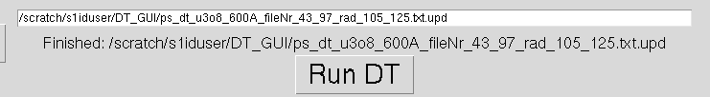
For doing reconstruction:
Step 1: Click:
Step 2: Click
! Choose the reconstruction parameter file, which is located under the output folder, the suffix is the time string
After step 1 and 2, you will get:
Click
Once finished:

Slide 7
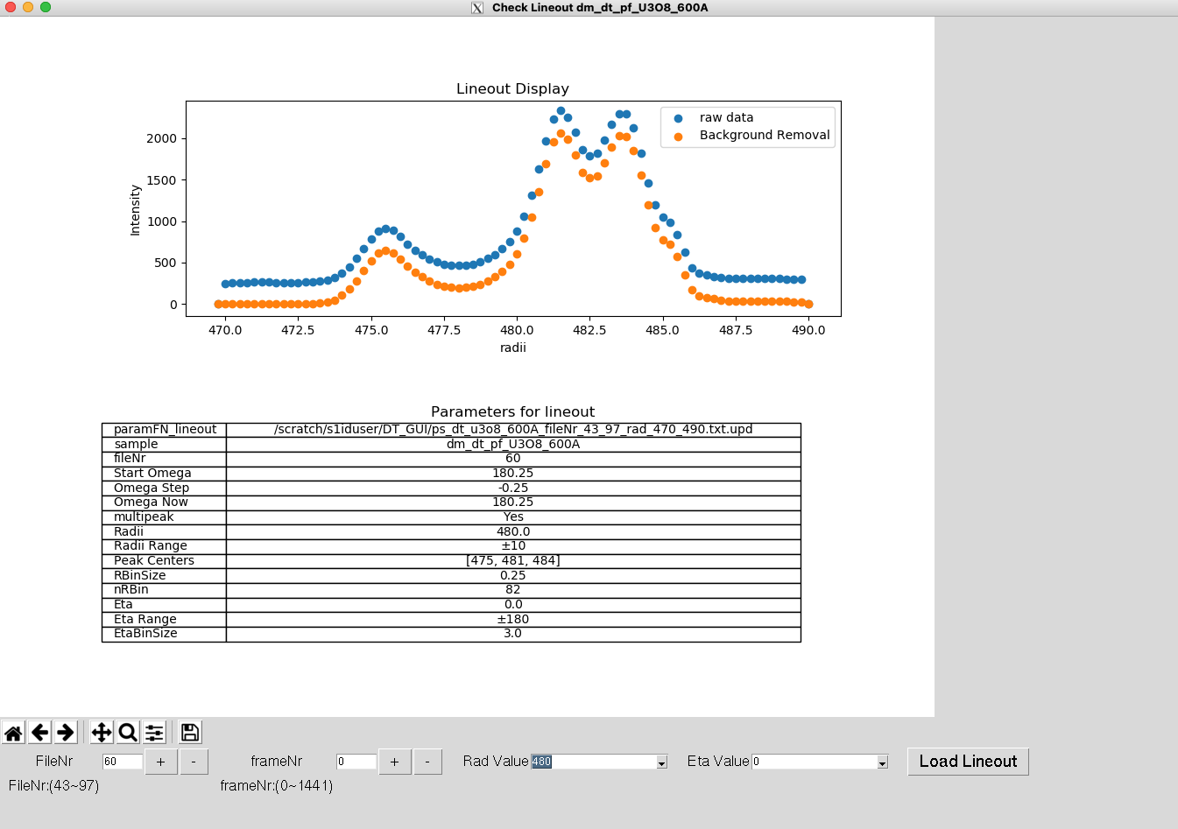


For checking reconstruction results:
Step 3 Click:
Get:
Click:
Then click:

Slide 8
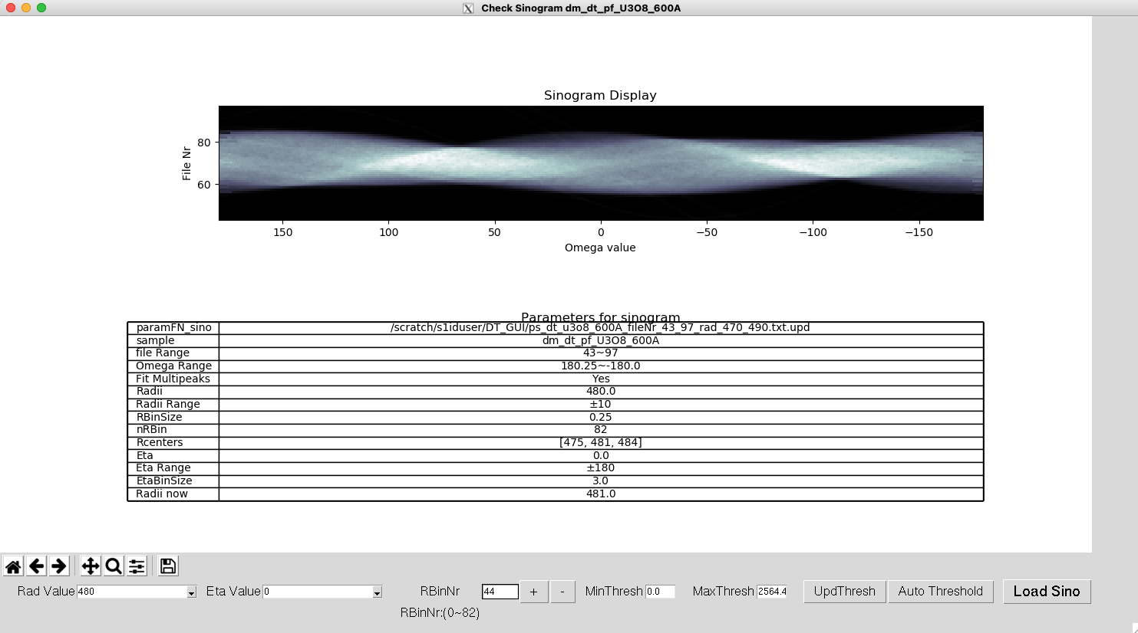

For checking reconstruction results:
Click:
Click this will change the threshold automatically

Slide 9
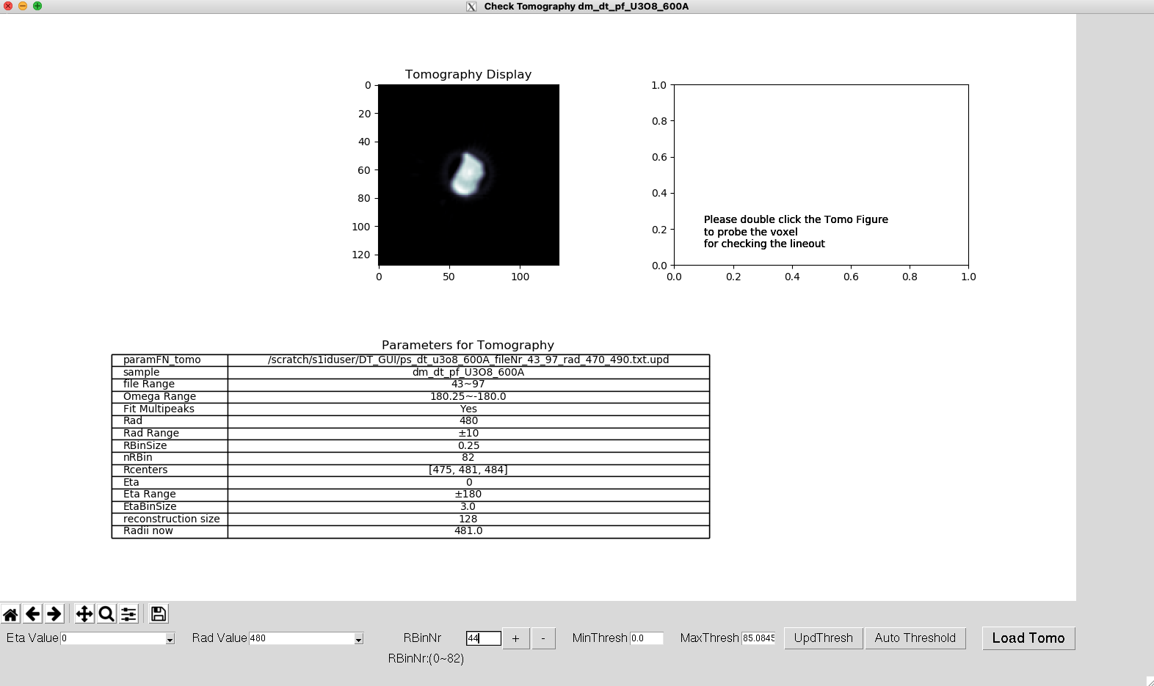

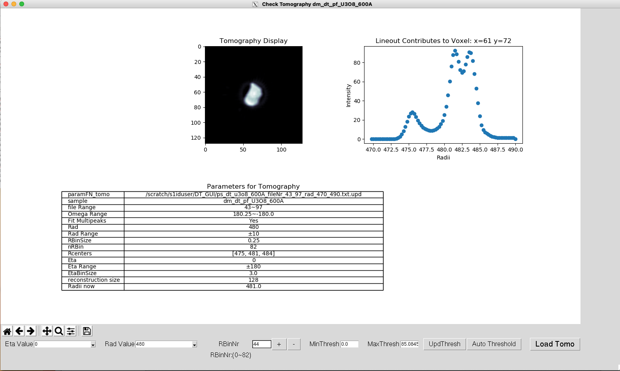
For checking reconstruction results:
Click:

Slide 10

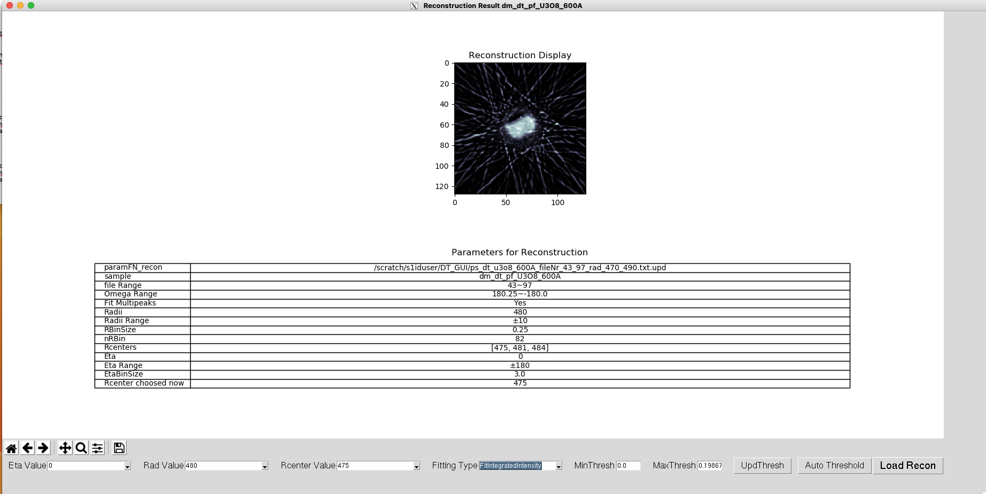
For checking reconstruction results:
Click:

Slide 11

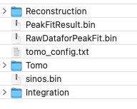
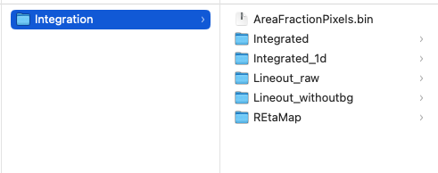
Storage Hierarchy:
These files better to open with DT_GUI.py

Slide 12
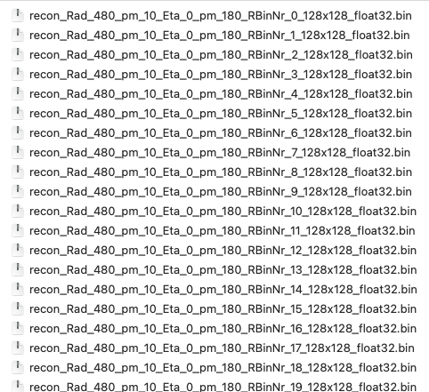
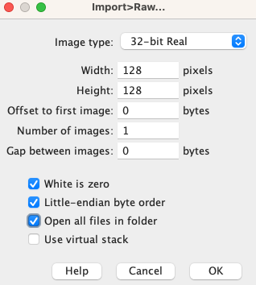
If you want to open this file in image J, use import -> raw
the suffix 128x128 is the width and height, respectively, data type 32-bit real

Slide 13
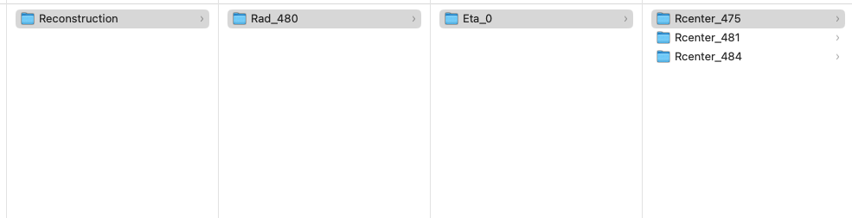
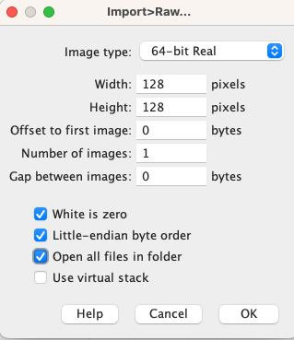
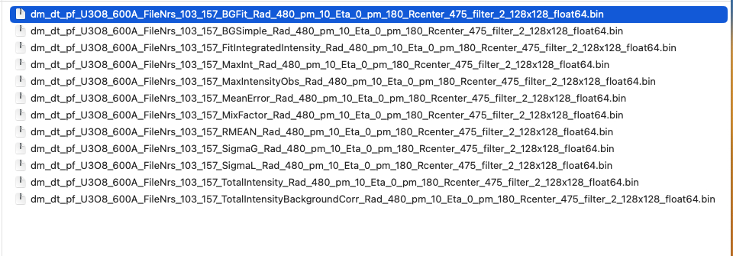
If you want to open this file in image J, use import->raw
the suffix 128x128 is the width and height, respectively, data type 64-bit real

