Slide 1

07.April.2025
ML MarshMallow
SeungJu Paek
Shirley Lau
Pia Rosebelle Dela Paz
Yaren Durgun

Slide 2
Problem Statement
“ To design end-to-end RAG pipeline using a real-world dataset composed of unstructured text ”
Transform messy web data into structured knowledge
Build an intelligent agent on top of it

Slide 3

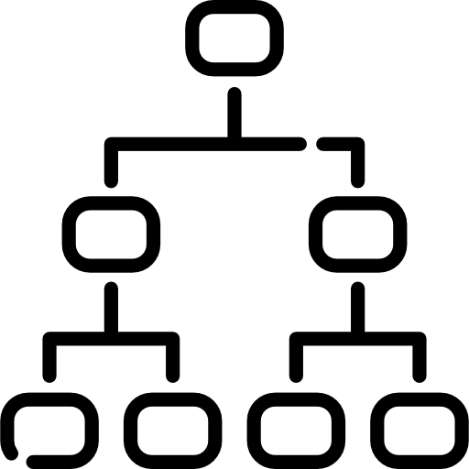




Overall Architecture
Load JSON Chunking the data Embedding Store in ChromaDB
LLM to summarize the result Perform similarity search & retrieve result

Slide 4
Embedding Logics
Cluster Semantic Chunking
Splits text into sentences
Each sentence is passed to a pretrained embedding model
→ obtain the vector representation
The vectors are grouped into clusters using KMeans
→ forming semantically coherent chunks
Embedding Model
all-MiniLM-L6-v2 was used → provides good balance between speed and performance

Slide 5
VectorDB
Why we chose VectorDB ?
HTML text in each json file was not structured, and context of each file was inconsistent → relational databases is not usable
Structure of query was also inconsistent, relationships between entities was also inconsistent → Graph embeddings using triples would not be effective
⇒ We decided to use VectorDB to store the semantic meaning of the text which can be matched to semantic meaning of the query.

Slide 6
VectorDB
1,0,1
Match query embedding
2,1,0
0,5,1
2,2,2
2,1,2
Create embeddings
Store in Vector DB
Chunking data
QUERY

Slide 7
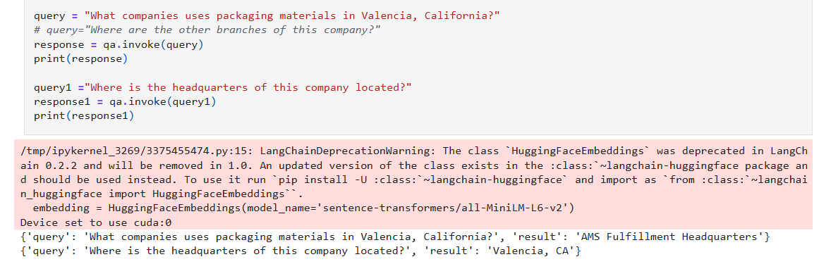

Slide 8
Learning curves
Handling large amount of unstructured data is a complex and time-consuming process → cleaning and preprocessing is a very crucial step
Scraping the internet for data has no consistent patterns, and information is all over the place
It is indeed challenging to build agents that can retrieve, reason and generate output that matches user’s intent

