Slide 1
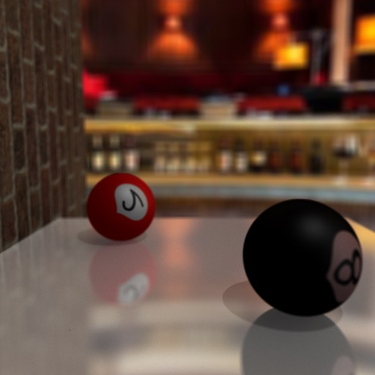
Zhen Ma, Jing Li Graphics Demo
Notes:
----- Meeting Notes (6/1/15 12:39) -----
Hi, everyone,
this picture shows a newly created scene that combines, cool effect, enviromental illumination, depth of field, blurry refelction and normal mapping. We will show the process of removing each of the effect in the next slide and you could easily see the difference.

Slide 2
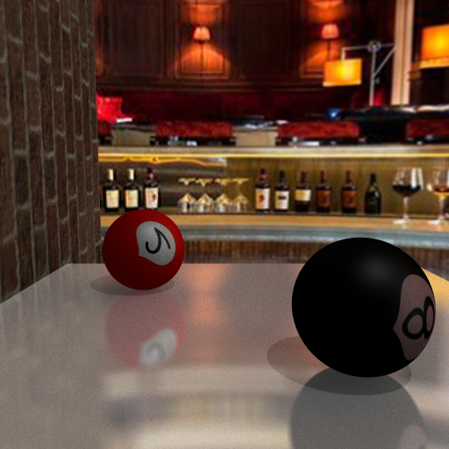
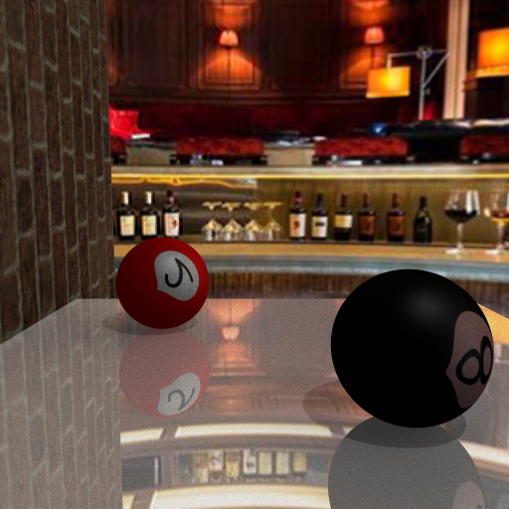
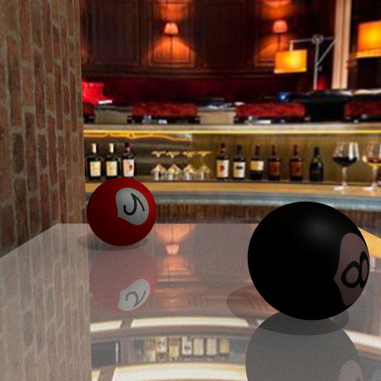
Environment illumination
Remove
Depth of field
Remove
Blurry Reflection
Remove
Normal Mapping
Zhen Ma, Jing Li Demo

