Slide 1

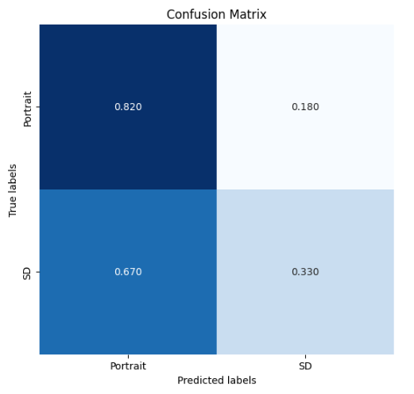

Battle of Deepfake Diffusion vs. Recognition
Members: YuYung Yeh, TingYen Wang, PeiYin Li, HungYang Yeh Mentor: Jerry Liao
Introduction
Methodology and Results
Discussion and Conclusion
Previous poster session ‘The Turing Eye’(SC201 Oct2023) used ResNet model to recognize AI images and real people images. They found out AI images from ‘Stable Diffusion’ were the hardest to recognize.
Our team is divided into two groups: the generation team, which uses 'Stable Diffusion' to generate test data and attempts to decrease accuracy by adjusting the images, and the recognition team, which uses the real images and 'Stable Diffusion’ image datasets to build an ensemble model with ResNet and EfficientNet.
We aim to find out which team performs better through adversarial learning.
We have tried many model to build recognition model and got some best results as below:
Our battle is like GAN process. At first generation team created test data by ‘Stable Diffusion’, recognition team then made model to defend, finally generated team decrease the accuracy by making new test data.
 | Model | Resize | LR | Batch Size | Epochs | Val Acc | Test Acc (Turing) | Test Acc
1 | ResNeXt | 224 | 1e-4 | 16 | 30 | 90% | 86.25% | 74%
2 | ResNet50 | 224 | 1e-4 | 16 | 10 | 87.5% | 88.75% | 82%
3 | DenseNet121 | 224 | 1e-4 | 16 | 20 | 88.75% | 90% | 81.75%
4 | VisionTrans | 224 | 1e-4 | 16 | 20 | 76.4% | 75.0% | 71.5%
5 | ResNet50(avg) | 224 | 1e-3 | 16 | 200 | <70% | <70% | <50%
6 | VisionTrans | 224 | 1e-4 | 16 | 40 | 74.3% | 77.9% | 67.0%
7 | EfficientNet_B0 | 224 | 1e-4 | 16 | 20 | 95% | 88.75% | 83.25%
8 | EfficientNet_B4 | 224 | 1e-4 | 16 | 20 | 93% | 88.75% | 84%
Future Work
Recognition team could do more data pre-processing based on the result and keep improving the model.
Generation team could create more test data by image-to-image in ‘Stable Diffusion’ or customize the de-noise model to make more high-qualified images.
Dataset
We chose ResNet50, EfficientNet-B4, EfficuenfNetB0 to build ensemble model and got the best final test accuracy 86.75%.
To resist this result, we use confusion matrix and saliency map to find out how to decrease accuracy by adjusting test images. We have tired some effective ways below:
References
The training dataset used in our project comes from 'The Turing Eye' (SC201 Oct2023) and was created by the generation team using 'Stable Diffusion,' consisting of 560 AI-generated images and 560 real images.
The test dataset are 200 images generated by Stable Diffusion Model and 200 real images.
We do data pre-processing below:
[1] The Turing Eye, SC201 Oct2023, https://github.com/stanCodeTW/AI-Projects/tree/main/SC201Oct2023Projects/GroupB
[2] Stable Diffusion Masterclass - Theory, Code & Application, https://deeplizard.com/lesson/did2ziladr
[3] Pytorch ResNet implementation from Scratch, https://www.youtube.com/watch?v=DkNIBBBvcPs
[4] Variational Autoencoder from scratch in PyTorch
https://www.youtube.com/watch?v=VELQT1-hILo
[5] Stable Diffusion Clearly Explained!
https://medium.com/@steinsfu/stable-diffusion-clearly-explained-ed008044e07e#3212
Low down contrast, highlight &
shadow, color and blur real images.
Light up contrast, highlight & shadow,
color and sharpen generated images.
(2) Save images for 45% quality.
(3) Hance edge, gray scale, mirror up
for generated images.
(4) Remove background for real images.
85.5%
↓
0.820
(1) T.RandomHorizontalFlip(p=0.5)
(2) T.RandomAutocontrast()
(3) T.ColorJitter(brightness=0.2, contrast=0.2,saturation=0.2, hue=0.1)
(4) T.RandomRotation(10)
(5) T.RandomCrop
88.5%
↓
0.330
Finally, we succussed to decrease
total accuracy to 57.5%.

