Slide 1
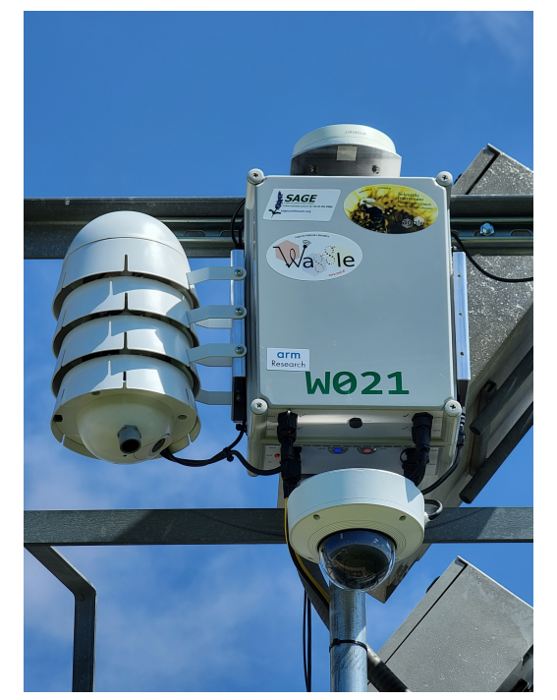
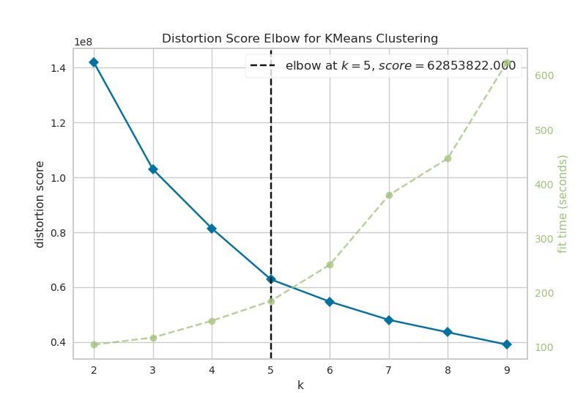
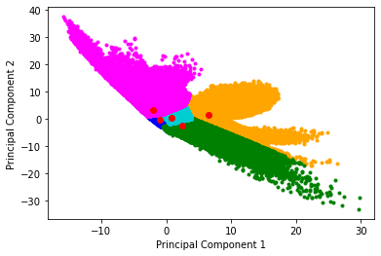
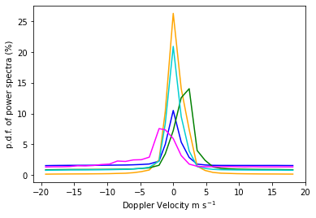
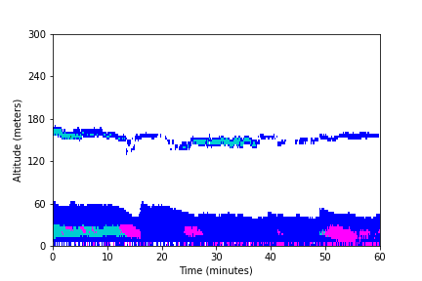
Classification of atmospheric lidar data for edge computing
Daniel Zetterberg, University of Tennessee, Environmental Science Division Mentor: Bobby Jackson, Argonne National Lab, Environmental Science Division
MOTIVATION
Doppler lidar is used at the DOE Atmospheric Radiation Measurement in Southern Great Plains, Oklahoma (Matthew and Voyles 2013)
Waggle Nodes, part of Argonne’s Sage Project, are deployed at SGP in order to process Doppler lidar in real time using Edge computing (Beckman, et al. 2016)
The Doppler lidar spectra are too large to store, so there is a need to be able to pick out which data is interesting enough to store.
The goal of the project is to develop an algorithm to be used by the Waggle nodes to classify and interpret the physical meaning of the lidar spectra in real time. (Newsom and Krishnamurthy 2020).
METHODOLOGY
The method used to classify the data is k-means clustering, an unsupervised naïve machine learning method.
Principal component analysis was first done to reduce the 5 variables to 2 dimensions, while retaining most of the information.
The data variables used are: doppler velocity, signal to noise ratio, skewness, kurtosis, and spectral width.
Each Waggle node includes environmental sensors as well as Edge computing capabilities
In order to find the optimal number of clusters, the elbow method was used. (Bholowia and Kumar 2014).
RESULTS
DATA CLUSTERS
The data points are plotted and clustered in principal component space.
The red points are the cluster centers.
Most of the data points are concentrated near the center, so the blue and cyan clusters are smaller
POWER SPECTRA
Plot shows how likely it is to find a data point from a certain cluster inside a certain doppler velocity bin.
Peaks skewed right show general upward movement, and peaks skewed left show general downward movement.
CLOUD FORMATIONS
By plotting data points in the time-range domain, aerosols and clouds can be visualized.
In this timeframe, low altitude cloud formations and precipitation are shown.
Time Period shown is from 08/01/2017
Color | Physical Interpretation
Blue | Thin cloud/aerosol
Orange | Cloud/aerosol in the presence of weak updrafts
Cyan | Stratiform cloud or aerosol
Magenta | Rain or precipitation
Green | Cloud/aerosol in the presence of strong updraft
CONCLUSIONS AND FUTURE DIRECTIONS
WORKS CITED
Beckman, P., R. Sankaran, C. Catlett, N. Ferrier, R. Jacob, and M. Papka, 2016: Waggle: An open sensor platform for edge computing. 2016 IEEE SENSORS, 1–3, https://doi.org/10.1109/ ICSENS.2016.7808975.
Bholowalia, P., and A. Kumar, 2014: Article: Ebk-means: A clustering technique based on elbow method and k-means in wsn. International Journal of Computer Applications, 105 (9), 17–24, full text available.
Mather, J. H., and J. W. Voyles, 2013: The arm climate research facility: A review of structure and capabilities. Bulletin of the American Meteorological Society, 94 (3), 377 – 392, https://doi.org/10.1175/BAMS-D-11-00218.1, URL https://journals.ametsoc.org/view/journals/bams/94/3/bams-d-11-00218.1.xml.
Newsom, R., and R. Krishnamurthy, 2020: Doppler lidar (dl) instrument handbook. https://doi.org/10.2172/1034640, URL https://www.osti.gov/biblio/1034640.
Wei, T., H. Xia, B. Yue, Y. Wu, and Q. Liu, 2021: Remote sensing of raindrop size distribution using the coherent doppler lidar. Opt. Express, 29 (11), 17 246–17 257, https://doi.org/10.1364/OE.426326, URL http://www.osapublishing.org/oe/abstract.cfm?URI=oe-29-11-17246.
Consistent clusters with physical meaning were defined.
The algorithm developed in this project will improve long term observation of aerosol and cloud properties. This will aid in improving climate models.
The cluster data will need to be implemented into the Waggle nodes so that each incoming data point can be classified in real time.
Going forward, the power spectra will be further investigated to gain further physical meaning into the clusters

