Slide 1


Comprehensive Analysis of
Breast Cancer Prediction
Final project:
Cloud Computing & Big Data Analytics Course
(Azure ML Sudio)
By Shirmila Hewapathirana
Metro College of Technology
Professor: Ms. Mahnaz F Nia
Submitted on May 12, 2025
Toronto

Slide 2
Introduction
What causes Breast cancer?
Breast cancer is always caused by a genetic abnormality (a "mistake" in the genetic material).However, only 5-10% of cancers are due to an abnormality inherited from your mother or father. About 90% of breast cancers are due to genetic abnormalities that happen as a result of the aging process and the "wear and tear" of life in general.
Breast cancer is one of the most common types of cancer, with rising cases reported worldwide in recent years. In healthcare discussions, breast cancer is a critical issue, partly due to factors such as modern lifestyle and genetic predisposition.
Although breast cancer can occur in both men and women, scientific studies indicate that women are approximately twice as susceptible to developing breast cancer. Early diagnosis plays a vital role in improving survival rates, as timely treatment can significantly enhance outcomes.

Slide 3
Executive Summary
The project leverages the BreastCancer.csv dataset, containing 569 records with 31 features including tumor radius, texture, perimeter, area, smoothness, and diagnosis labels (Malignant or Benign), to develop a classification machine learning model using Azure ML Studio. The model aims to accurately predict the diagnosis, enabling early detection of malignant cases to improve patient outcomes. Through data preprocessing, feature selection, and model training with algorithms such as Two-Class Logistic Regression, the solution demonstrates robust performance with a focus on precision and recall. Implementation in Azure ML Studio ensures scalability, integration with clinical workflows, and actionable insights for healthcare professionals, positioning this as a valuable tool for diagnostic support.
Objective
To develop a machine learning classification model in Azure ML Studio that accurately predicts breast cancer diagnosis, categorizing tumors as Malignant (M) or Benign (B) based on key morphological and statistical features, thereby enhancing diagnostic accuracy and supporting timely medical interventions.

Slide 4
Summary of Dataset
# | Variable | Type | # | Variable | Type
1 | id | Num | 17 | compactness_se | Num
2 | radius_mean | Num | 18 | concavity_se | Num
3 | texture_mean | Num | 19 | concave_points_se | Num
4 | perimeter_mean | Num | 20 | symmetry_se | Num
5 | area_mean | Num | 21 | fractal_dimension_se | Num
6 | smoothness_mean | Num | 22 | radius_worst | Num
7 | compactness_mean | Num | 23 | texture_worst | Num
8 | concavity_mean | Num | 24 | perimeter_worst | Num
9 | concave_points_mean | Num | 25 | area_worst | Num
10 | symmetry_mean | Num | 26 | smoothness_worst | Num
11 | fractal_dimension_mean | Num | 27 | compactness_worst | Num
12 | radius_se | Num | 28 | concavity_worst | Num
13 | texture_se | Num | 29 | concave_points_worst | Num
14 | perimeter_se | Num | 30 | symmetry_worst | Num
15 | area_se | Num | 31 | fractal_dimension_worst | Num
16 | smoothness_se | Num | 32 | Diagnosis (M/B) * | Char
Notes: (M: Malignant B: Benign)
File type : csv Total records: 569 Total features: 31 (29 numerical, 2 categorical) Target feature: ‘diagnosis’
No missing values found

Slide 5
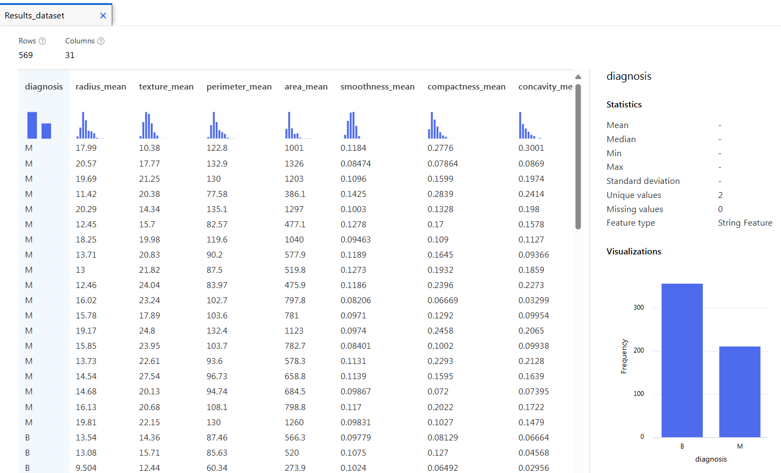
Preview of Dataset

Slide 6
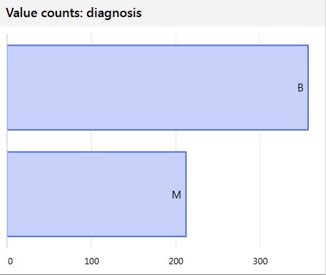
Target Feature : ‘diagnosis’
357
Most common | : B
# Most common | : 357
# Unique values | : 2
Total count | : 569
Not missing count | : 569
Missing count | : 0
Empty count | : 0
Error count | : 0
212

Slide 7
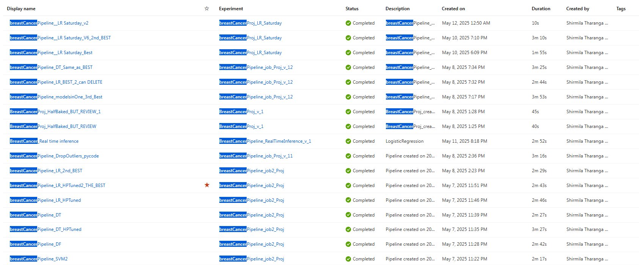
Experiments Done

Slide 8
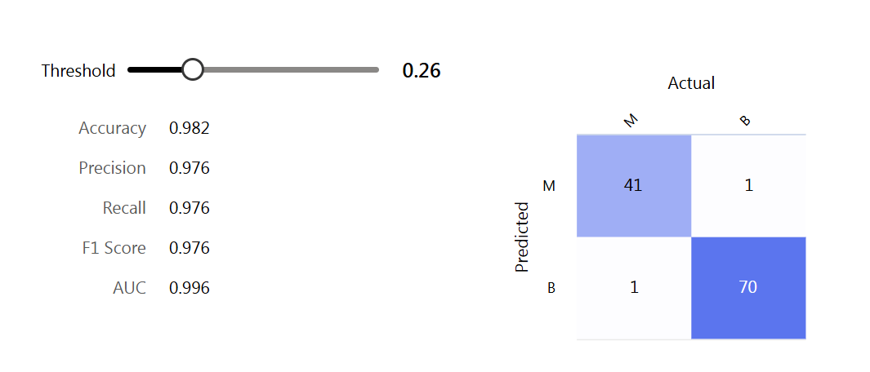
Model Expectation

Slide 9

Two-Class Boosted Decision Tree
(The Best Model)

Slide 10
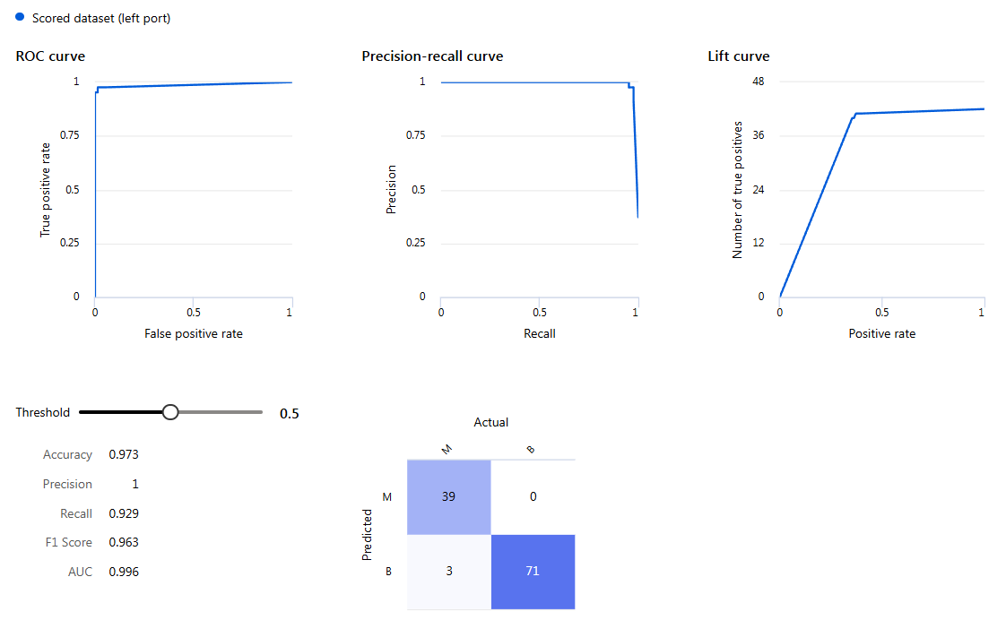
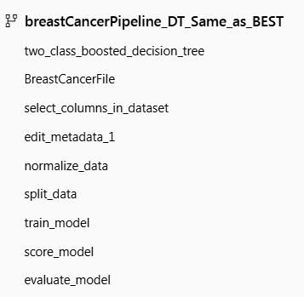

Slide 11
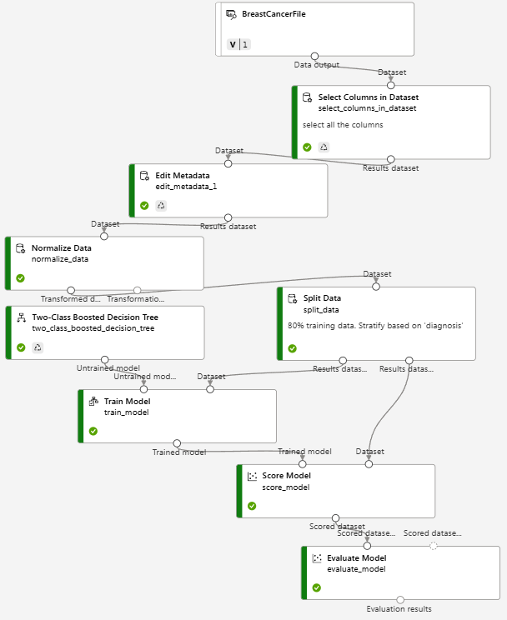
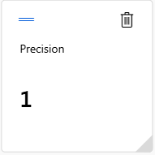
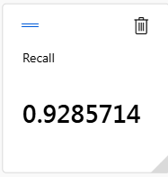
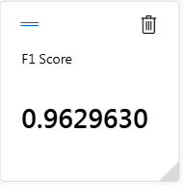
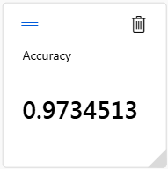


Slide 12
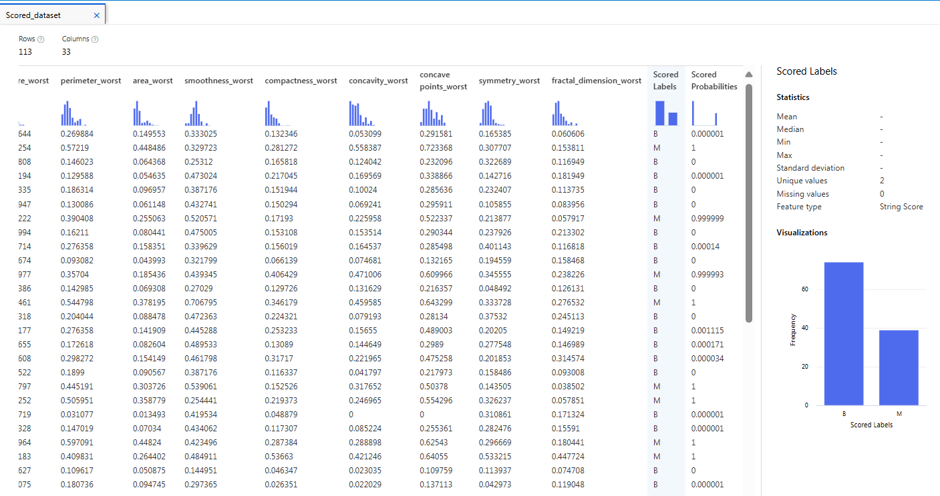
Preview of Scored Dataset

Slide 13
Two-Class Logistic Regression
(The 2nd Best Model)

Slide 14
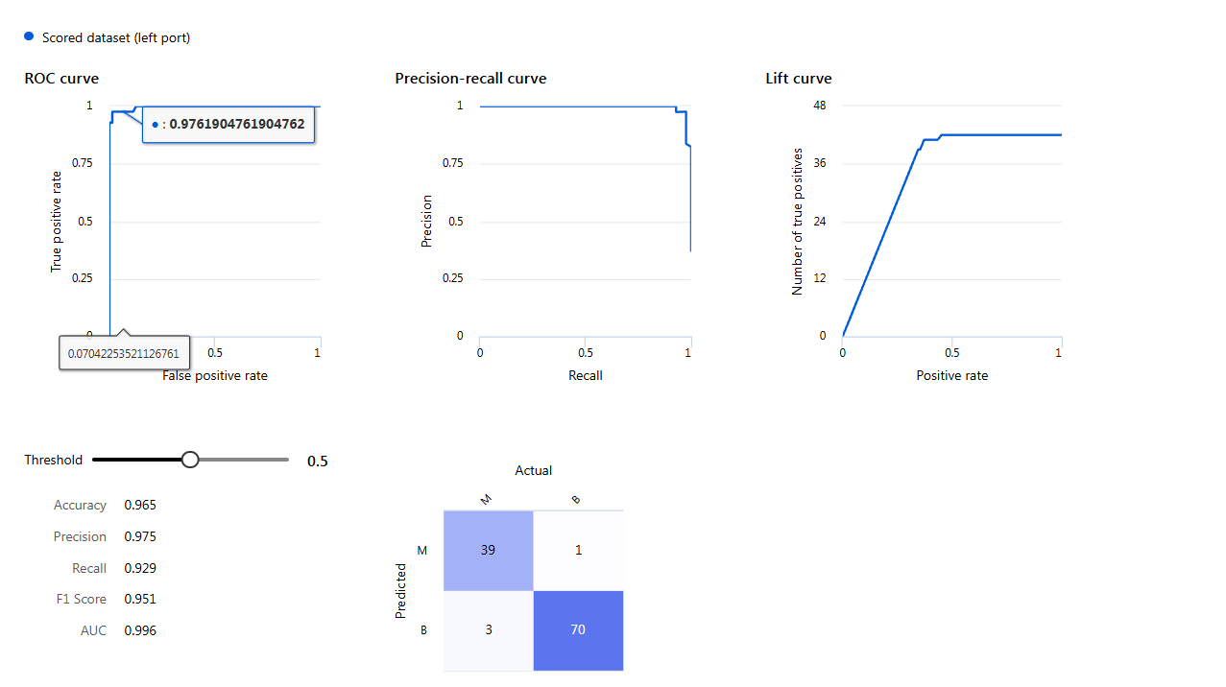
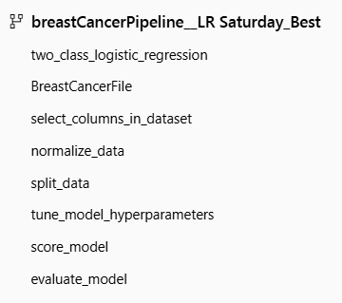
Two-Class Logistic Regression

Slide 15
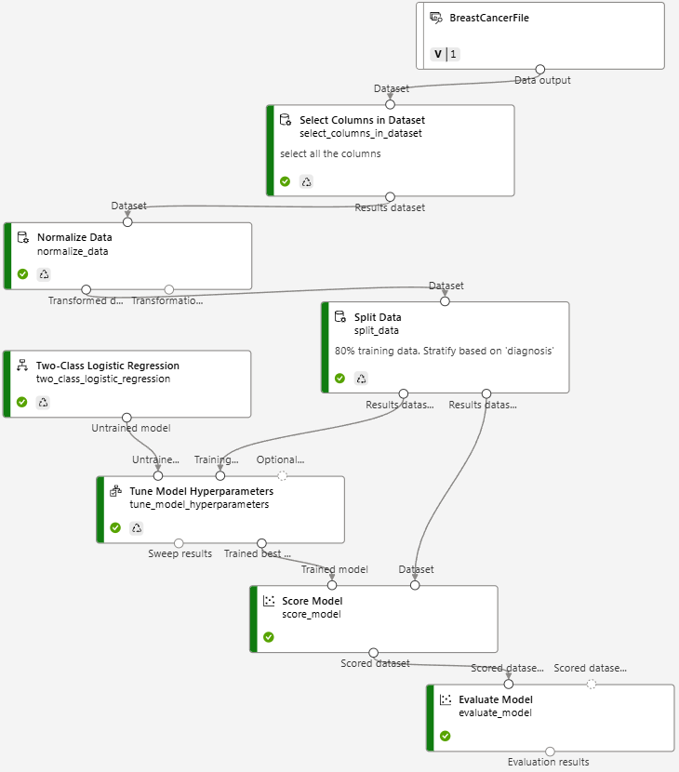
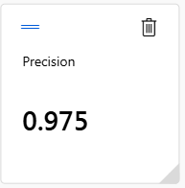
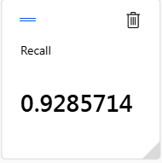
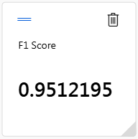
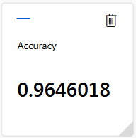
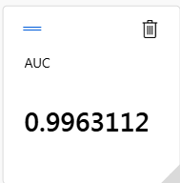

Slide 16
Real Time Inference
(of Best Model)

Slide 17
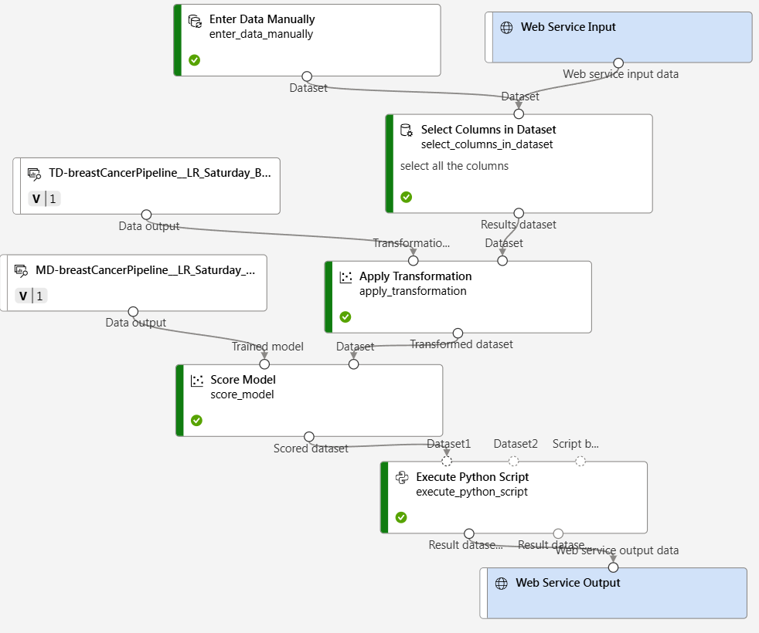
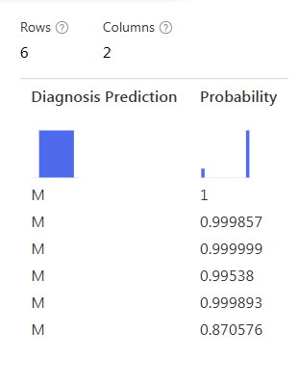

Slide 18
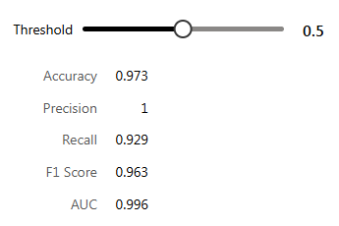
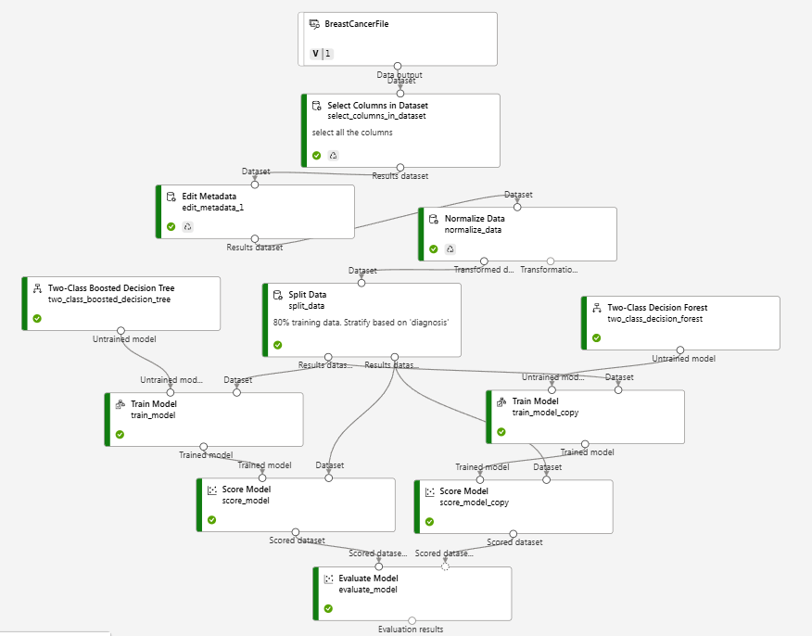
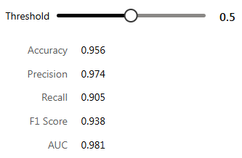
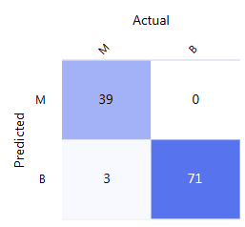
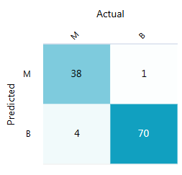
Other Experiments

Slide 19
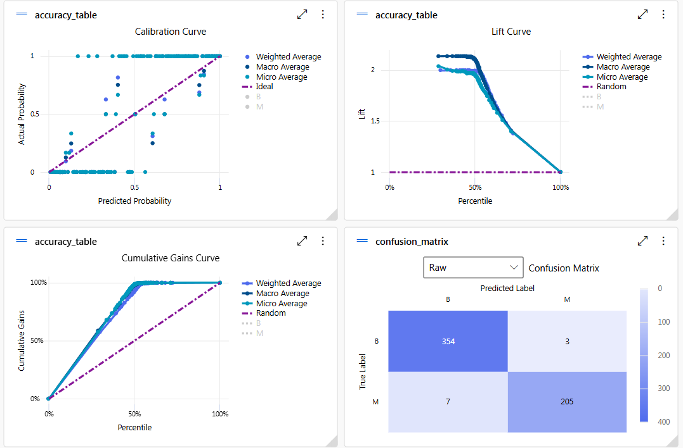
Automated ML

Slide 20
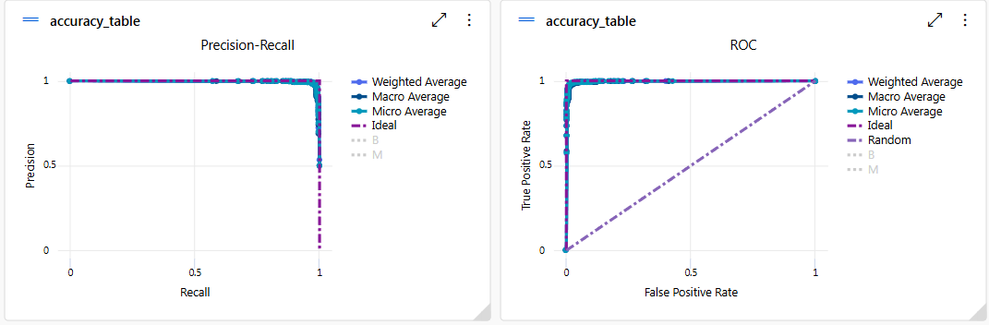
Automated ML

Slide 21
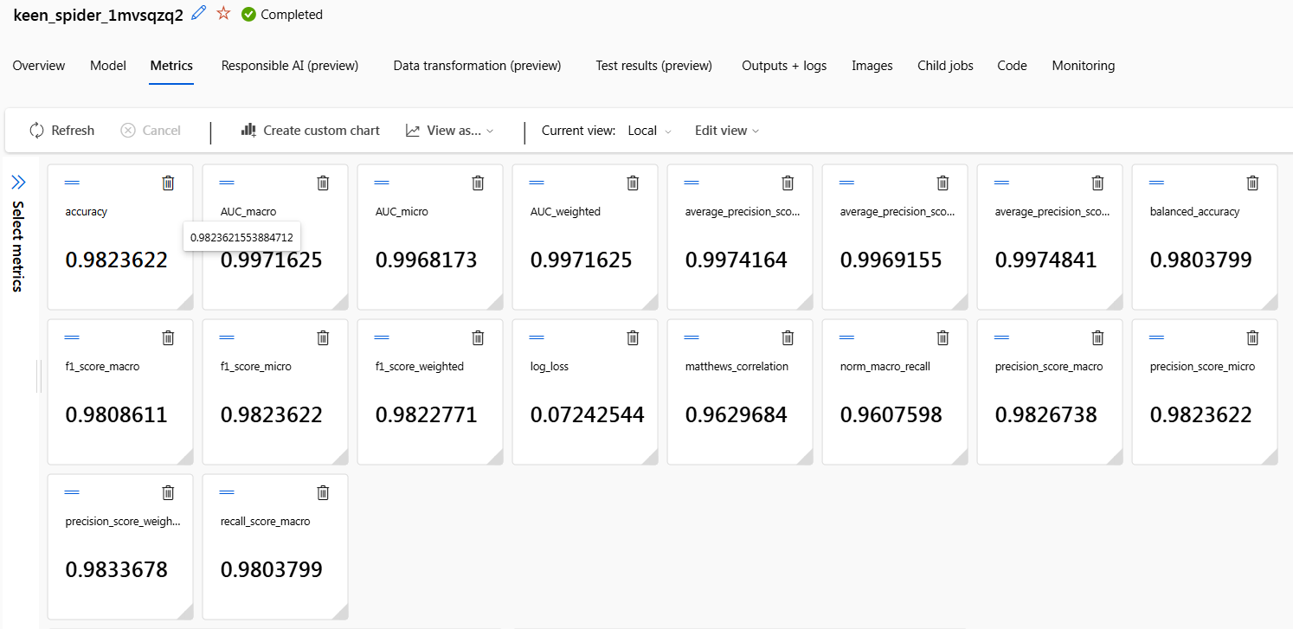
Metrics

Slide 22
Conclusion
The development and implementation of the breast cancer classification model using Azure ML Studio have successfully demonstrated the ability to predict Malignant and Benign diagnoses with high recall and accuracy, leveraging the ‘BreastCancer.csv’ dataset.
This solution enhances diagnostic support by providing reliable insights based on tumor characteristics, offering a scalable and integrable tool for healthcare professionals.
Future enhancements, including model optimization and real-time deployment, will further improve its efficacy, solidifying its potential as a critical asset in early cancer detection and patient care.

Slide 23

Q&A
Q & A

Slide 24

Thank you!

Slide 25
Q & A

