Slide 1

Metro College of Technology
Toronto
Comprehensive Analysis of
Global Energy Indicators
and Economic Trends
Final project - PDA Course
By Shirmila Hewapathirana
Professor: Mr. Amit Kukreja
Submitted on January 21, 2025

Slide 2
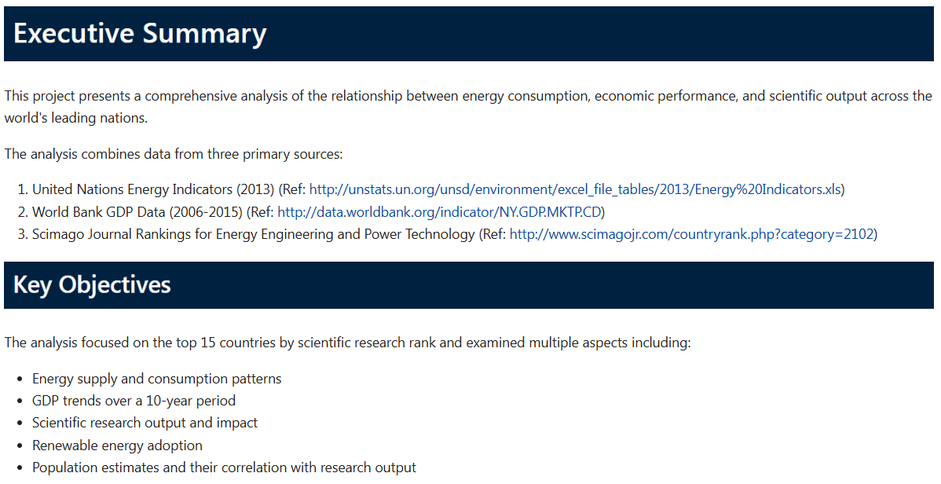

Slide 3
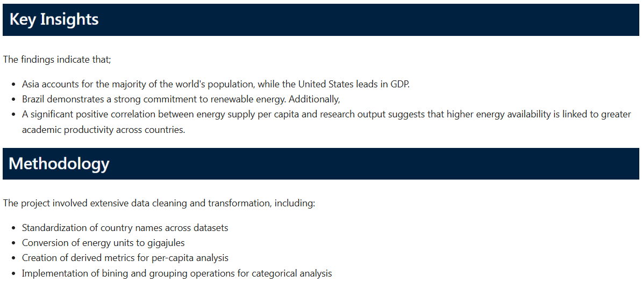

Slide 4
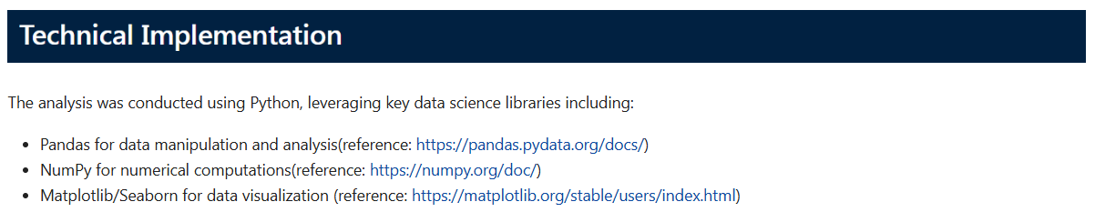

Slide 5
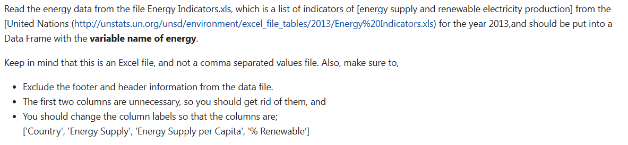
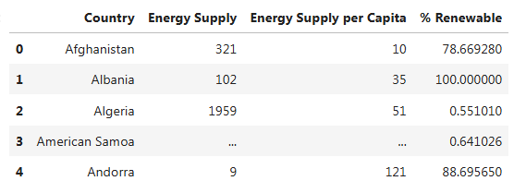
Q1. a)
Output:

Slide 6
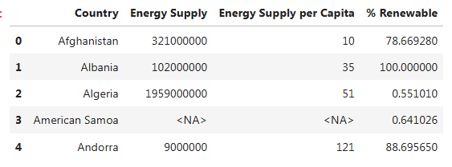
Q1. b)
Output:

Slide 7


Q1. c)
Slice of the output:

Slide 8
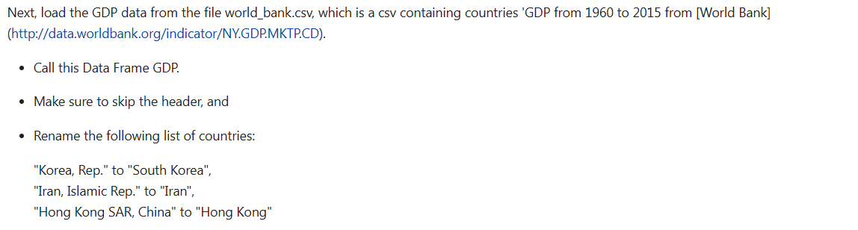
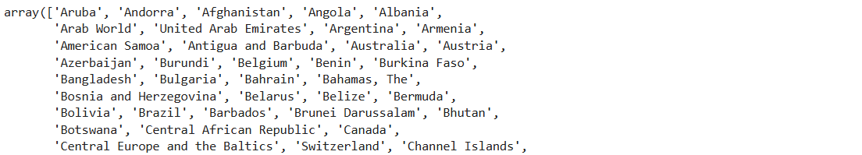
Q1. d)
Slice of the output:

Slide 9
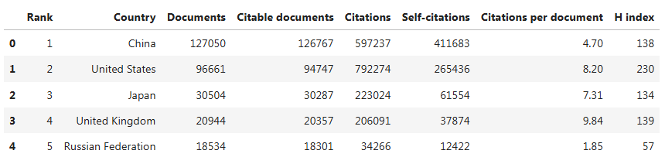
Q1. e)
Output:

Slide 10
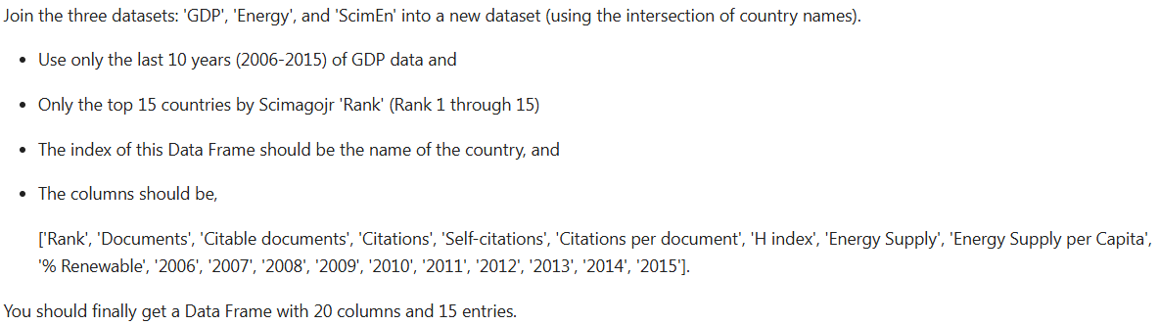
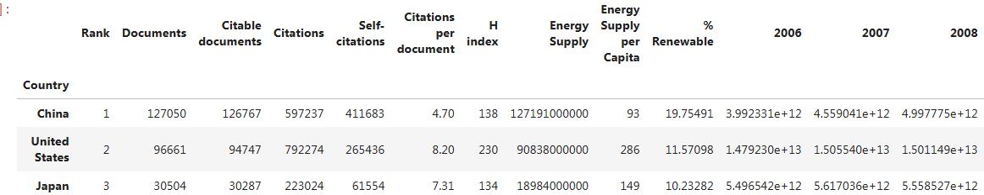
Q1. f)
Output:

Slide 11
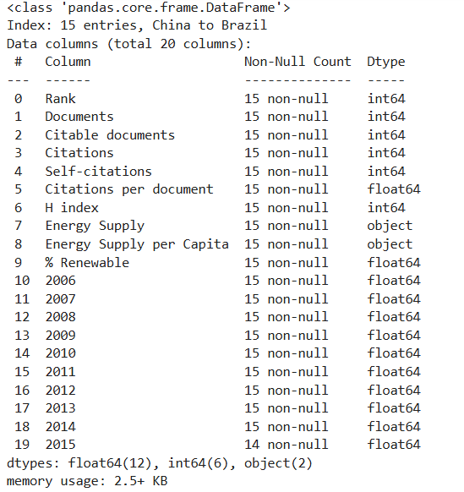
Q1. f)
Output:

Slide 12
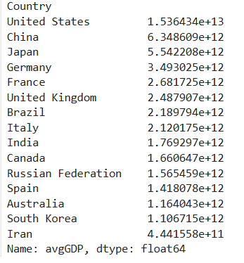
Q2.
Output:

Slide 13
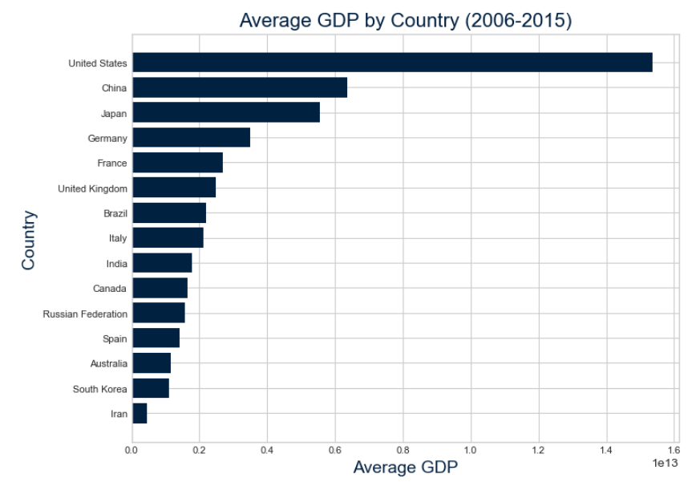
Q2.
Bar Plot:

Slide 14



Q3.
Output:
Q4.
Output:
Q5.
Output:

Slide 15
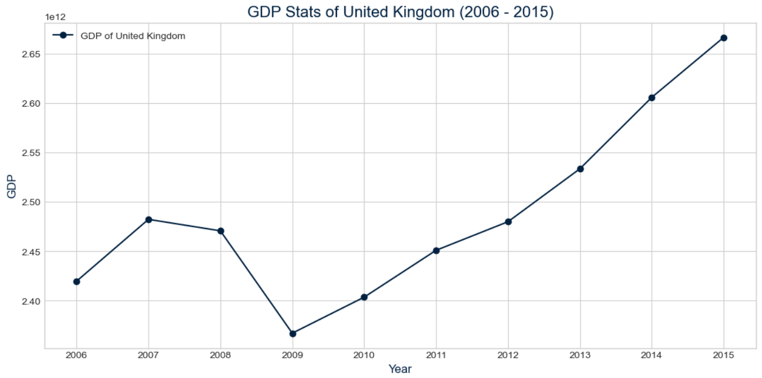
Q3.
Line Chart:

Slide 16
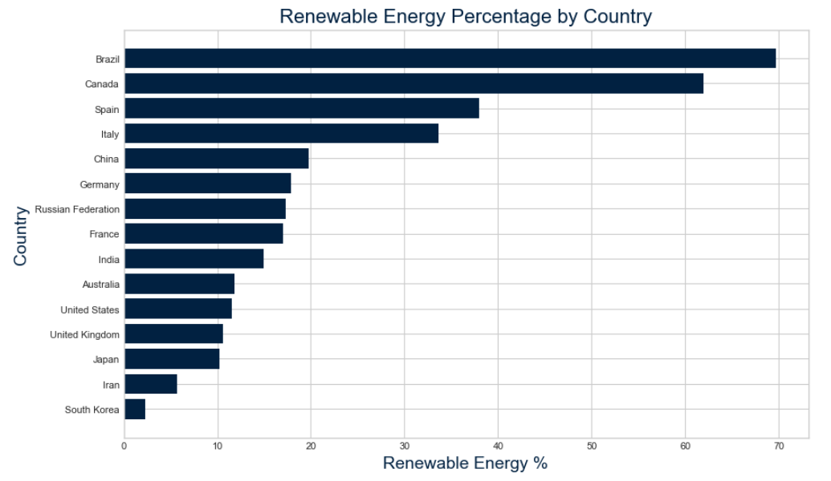
Q5.
Bar Plot:

Slide 17


Q6.
Output:

Slide 18
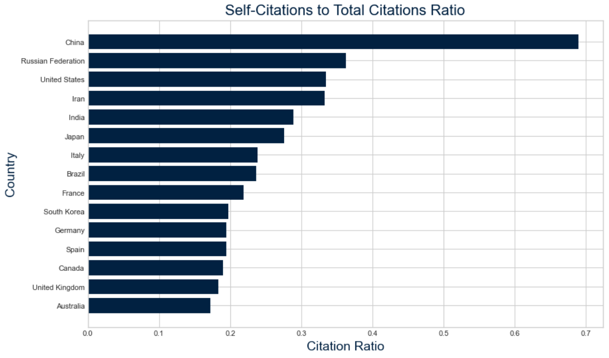
Q6.
Bar Plot:

Slide 19


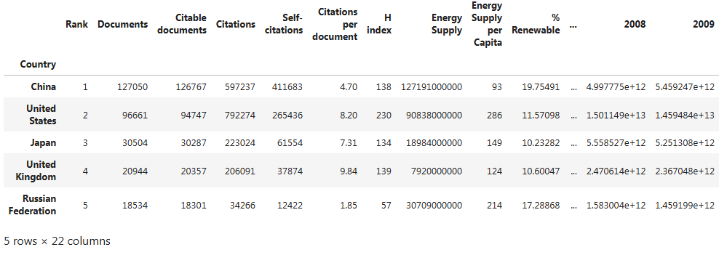
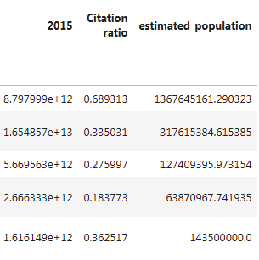
Q7.
Output:

Slide 20
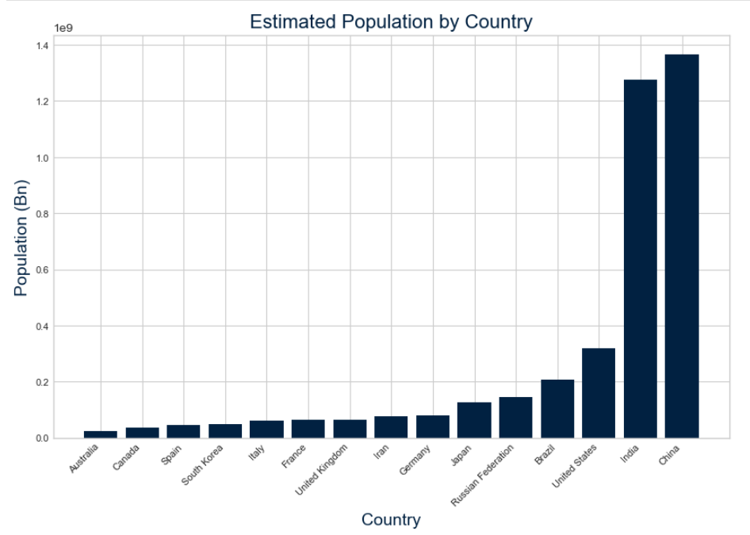
Q7.
Bar Plot:

Slide 21
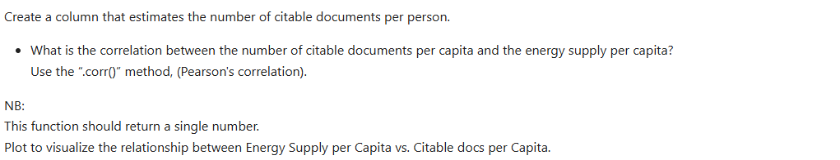

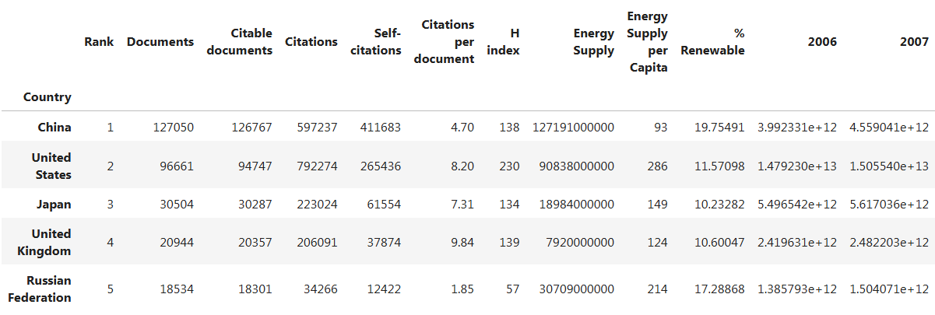
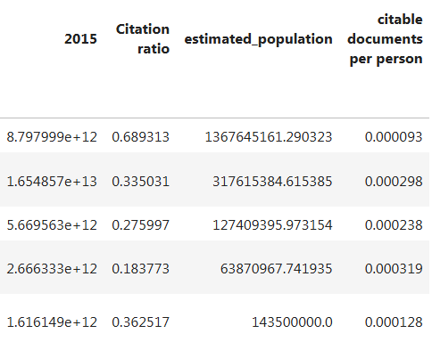
Q8.
Output:

Slide 22
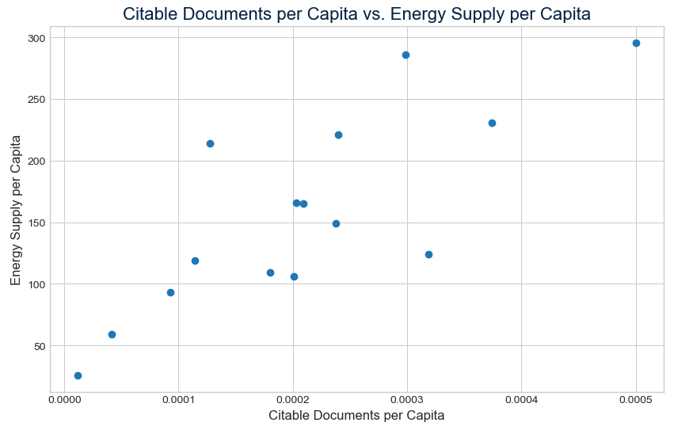
Q8.
Scatter Plot:
Findings:
A significant positive correlation between energy supply per capita and research output suggests that higher energy availability is linked to greater academic productivity across countries

Slide 23
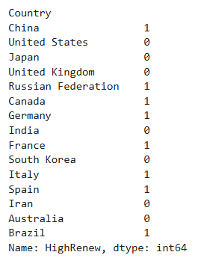
Q9.
Output:

Slide 24
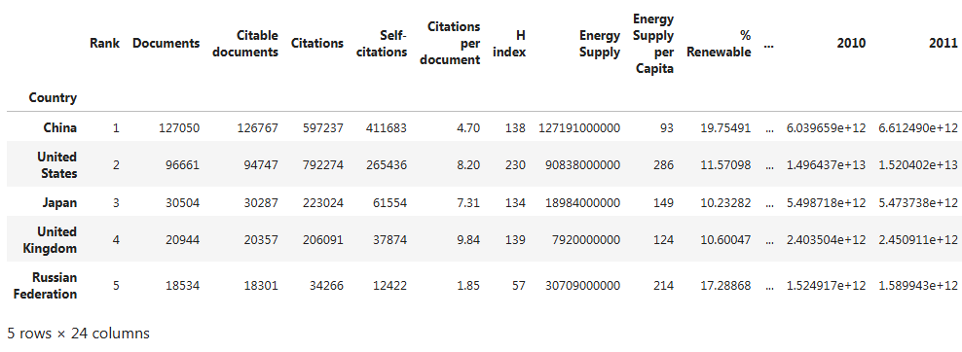
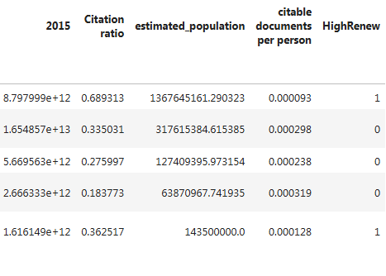
Q9.
Slice of the Data frame:

Slide 25
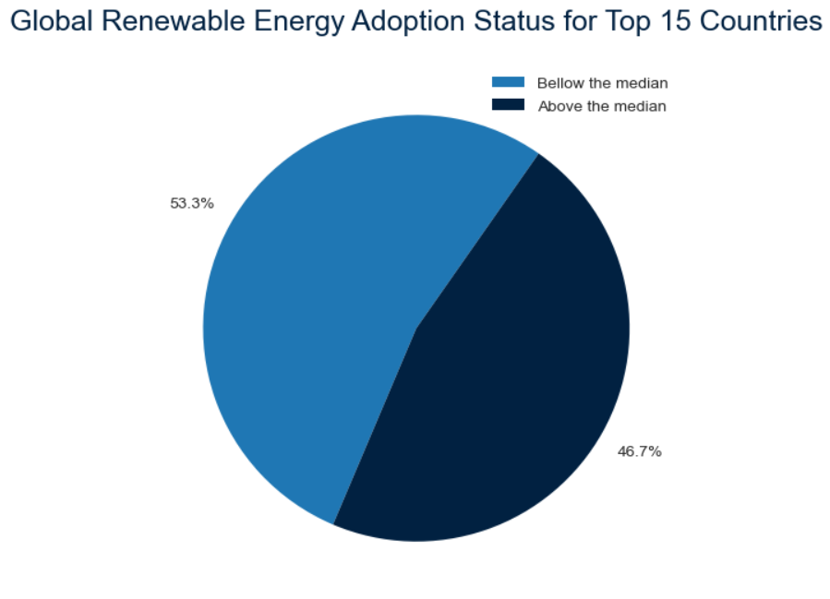
Q9.
Pie Chart:

Slide 26
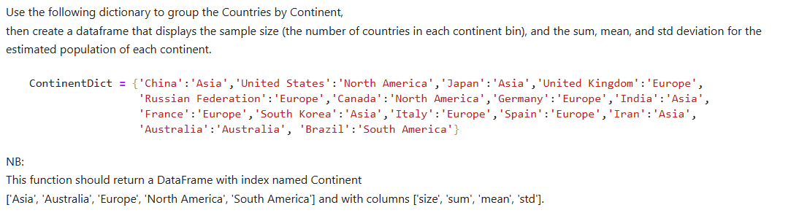

Q10.
Output:

Slide 27
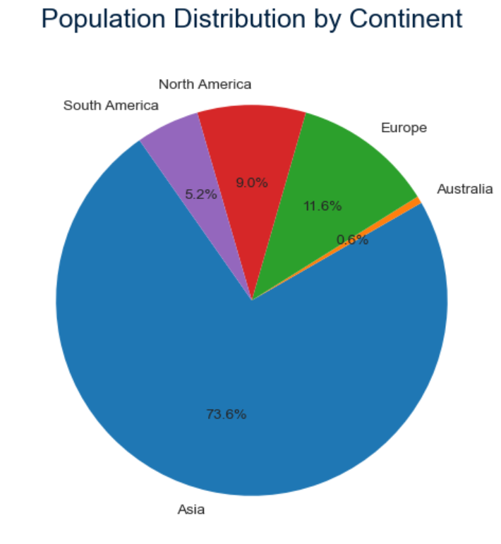
Q10.
Pie Chart:

Slide 28
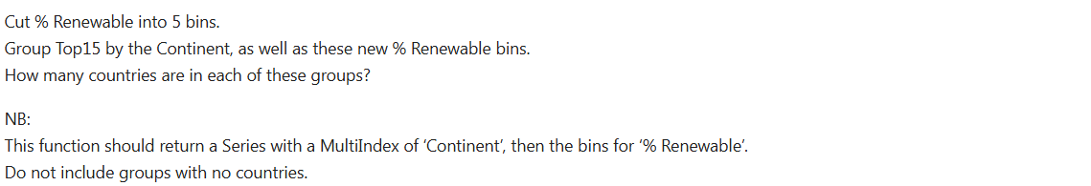
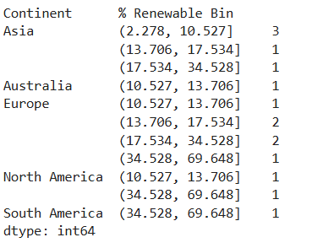
Q11.
Output:

Slide 29
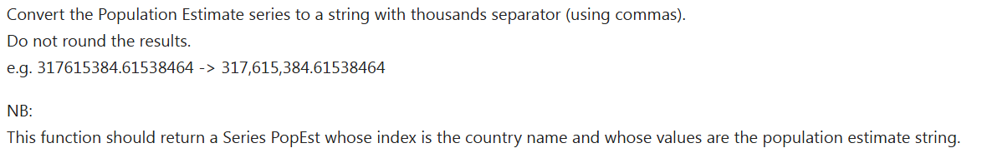
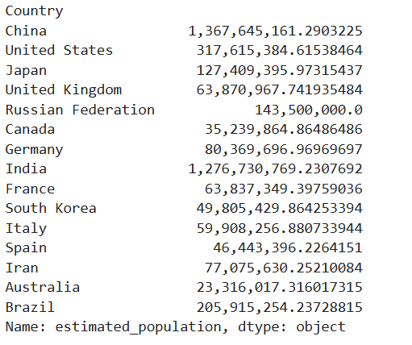
Q12.
Output:

Slide 30
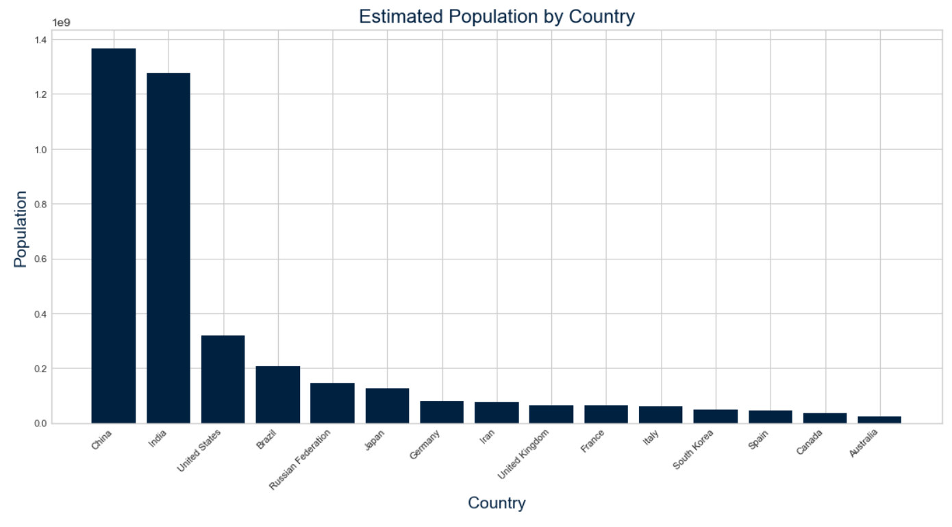
Q10.
Pie Chart:

Slide 31

Thank you!

