Slide 1
Lab 1 Installing Linux
Professor: Dr. Hsung-Pin Chang
TA: Yung-Tung Chou
Operating System Lab

Slide 2
Outline
Introduction
Install virtual machine on Windows
Install Ubuntu on a virtual machine
Exercise
References

Slide 3
Introduction
We can install Linux on a physical machine
In addition, we can also install it on a virtual
machine

Slide 4
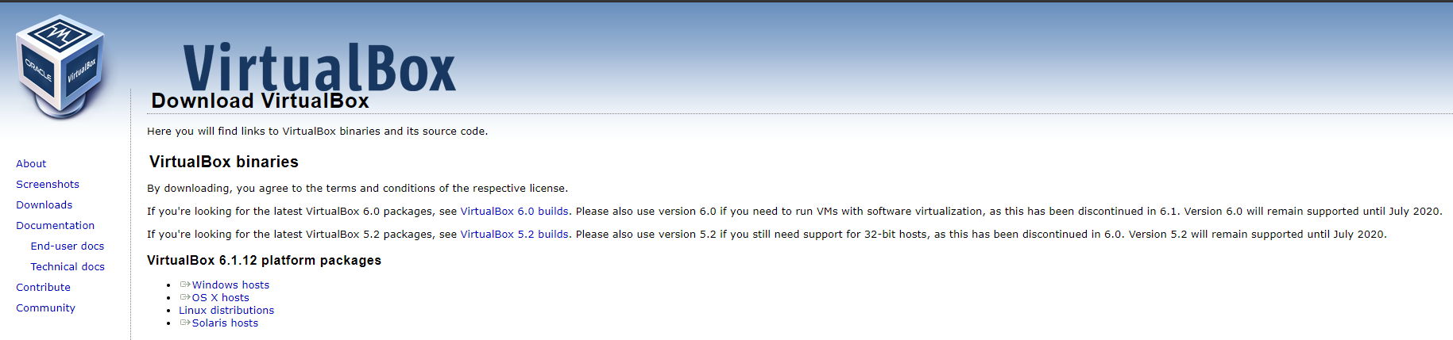
Install virtual machine on Windows (1/9)
Step1 - download VM from the Internet
https://www.virtualbox.org/wiki/Downloads

Slide 5
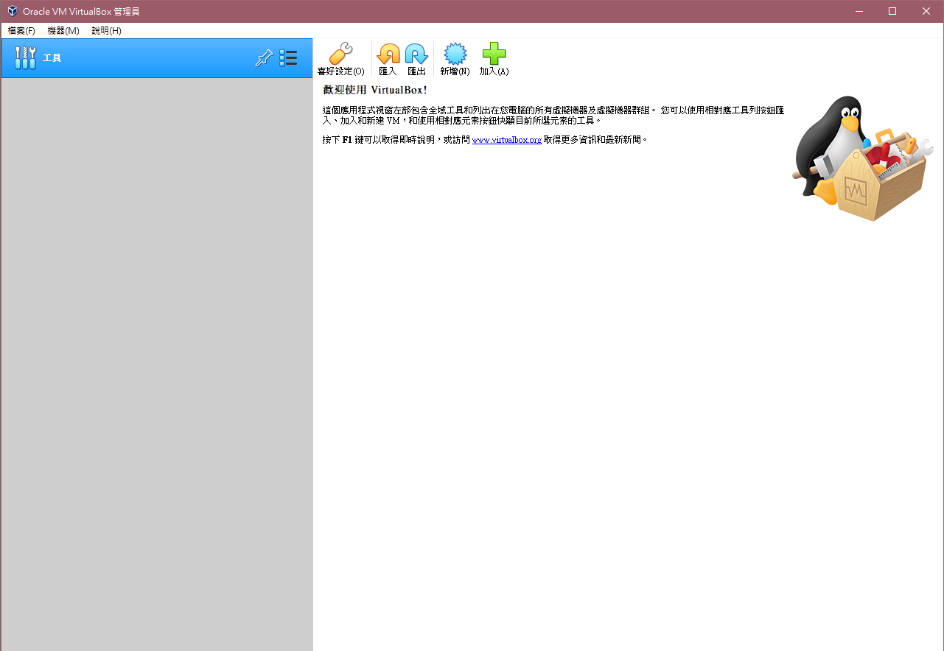
Install virtual machine on Windows (2/9)
Step2 - create a new VM

Slide 6
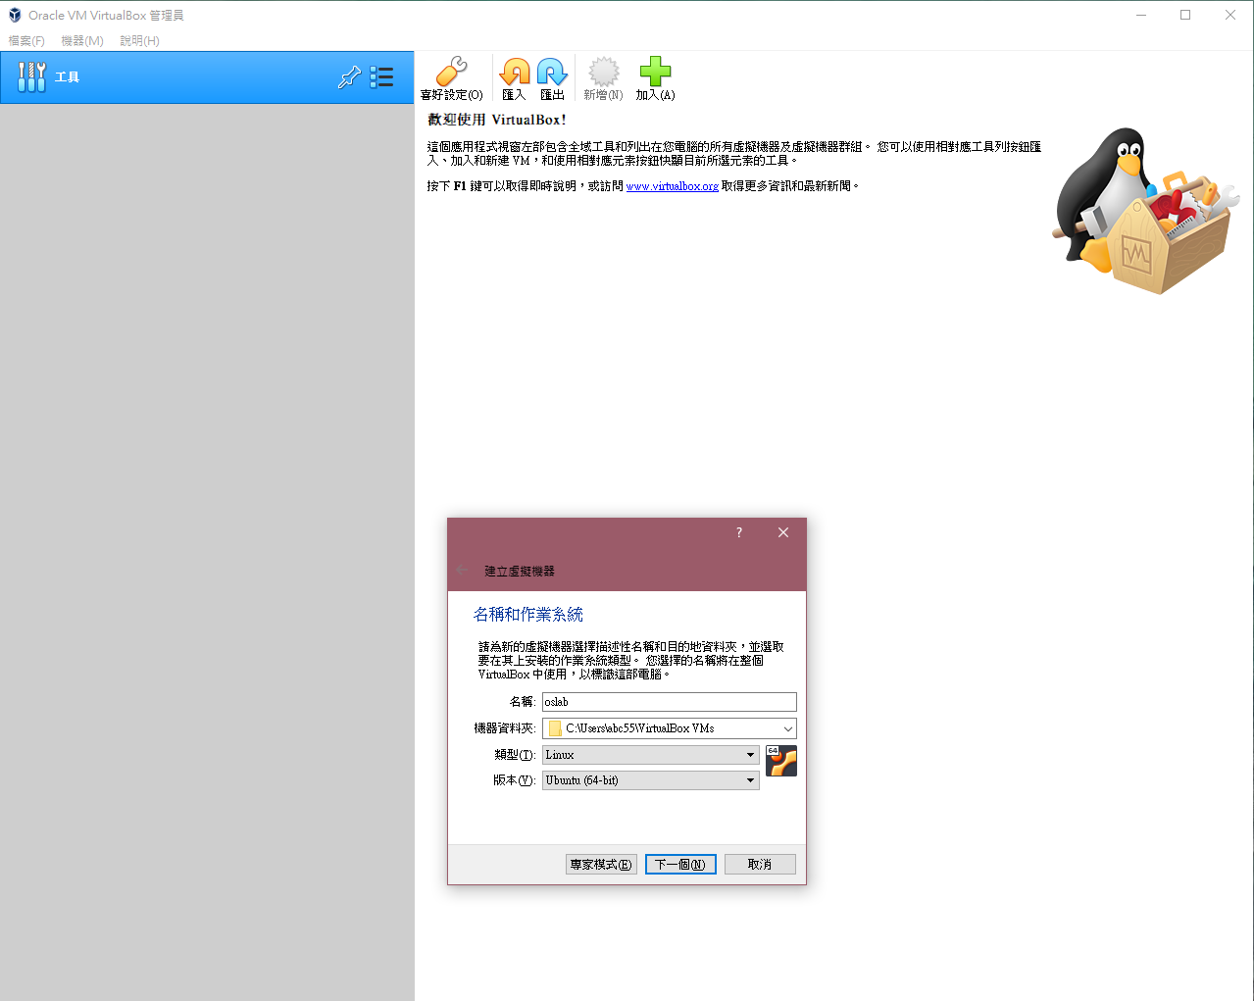
Install virtual machine on Windows (3/9)
Step3 - enter the VM’s name and choose the OS type

Slide 7
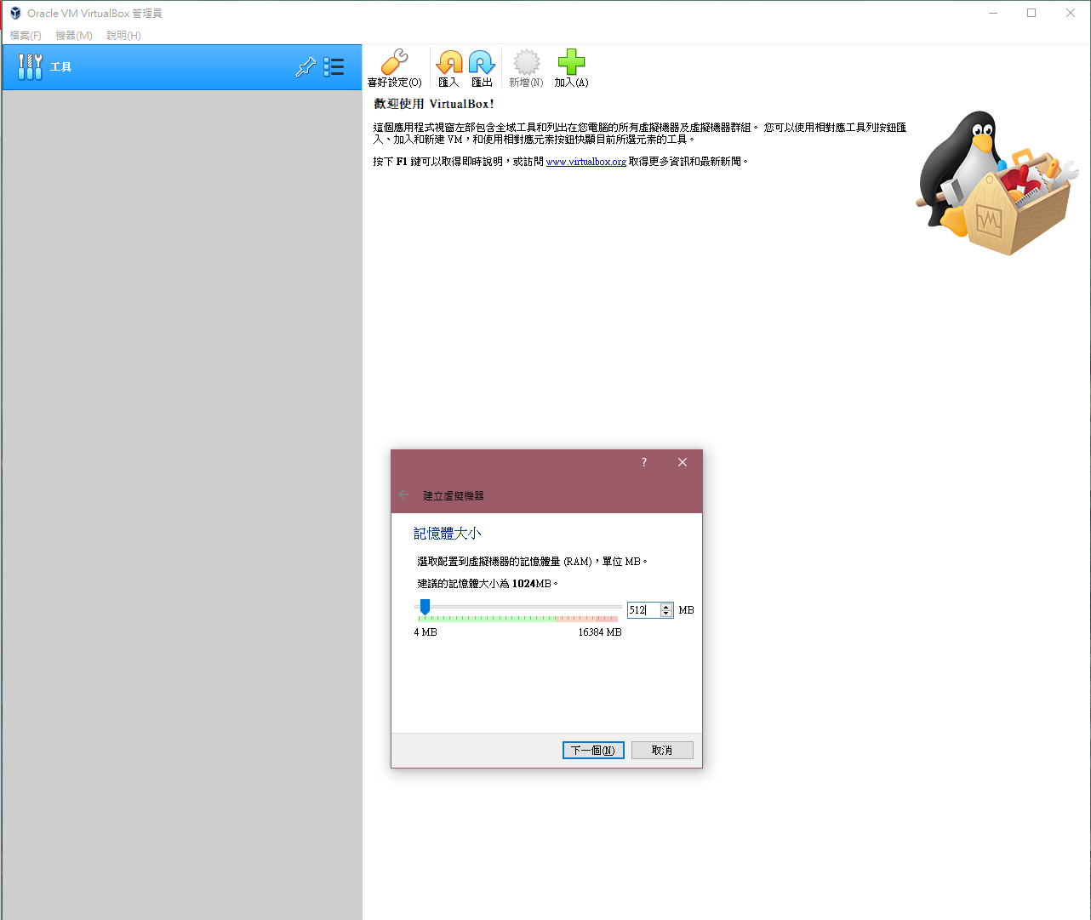
Install virtual machine on Windows (4/9)
Step4 – allocate memory

Slide 8
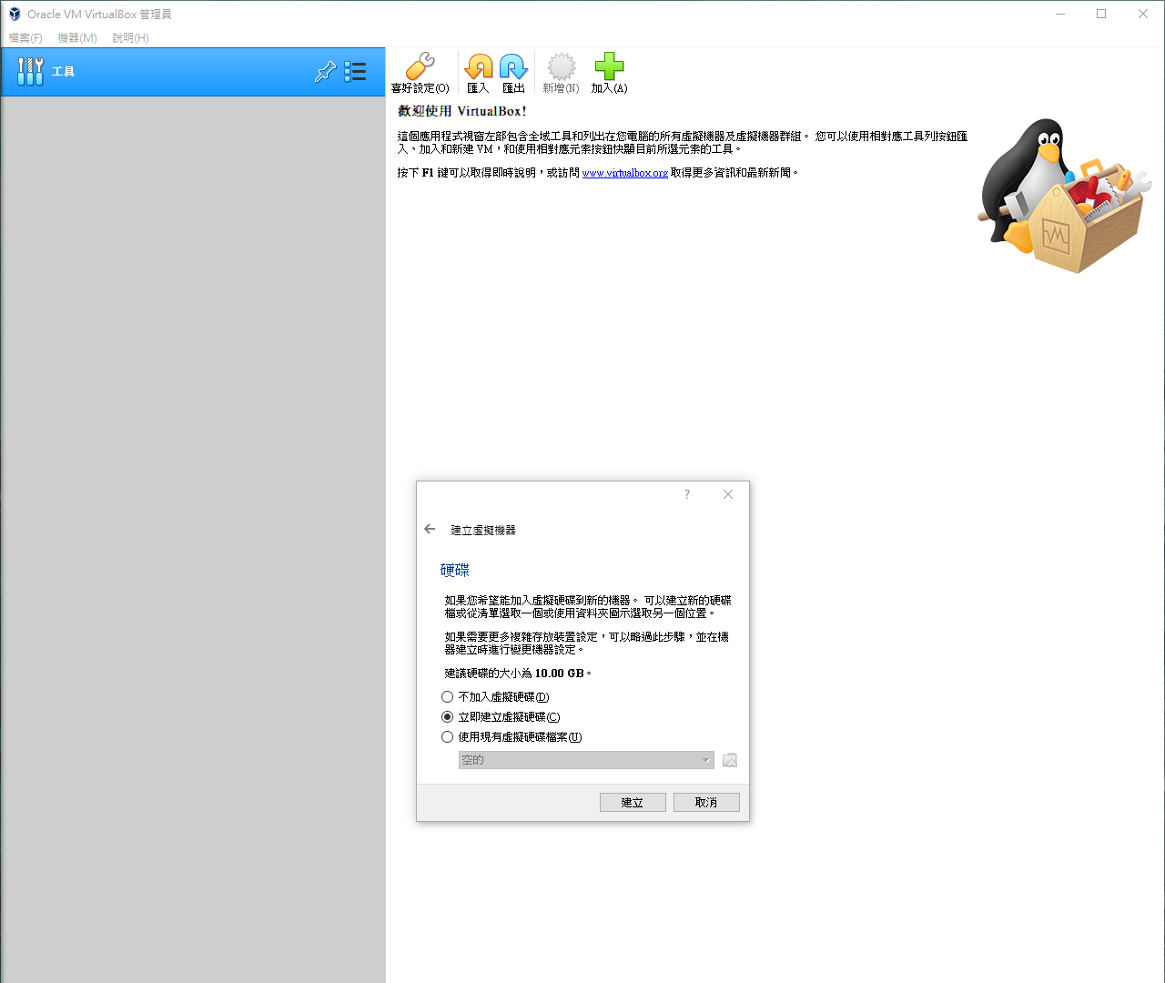
Install virtual machine on Windows (5/9)
Step5 - create a virtual disk

Slide 9
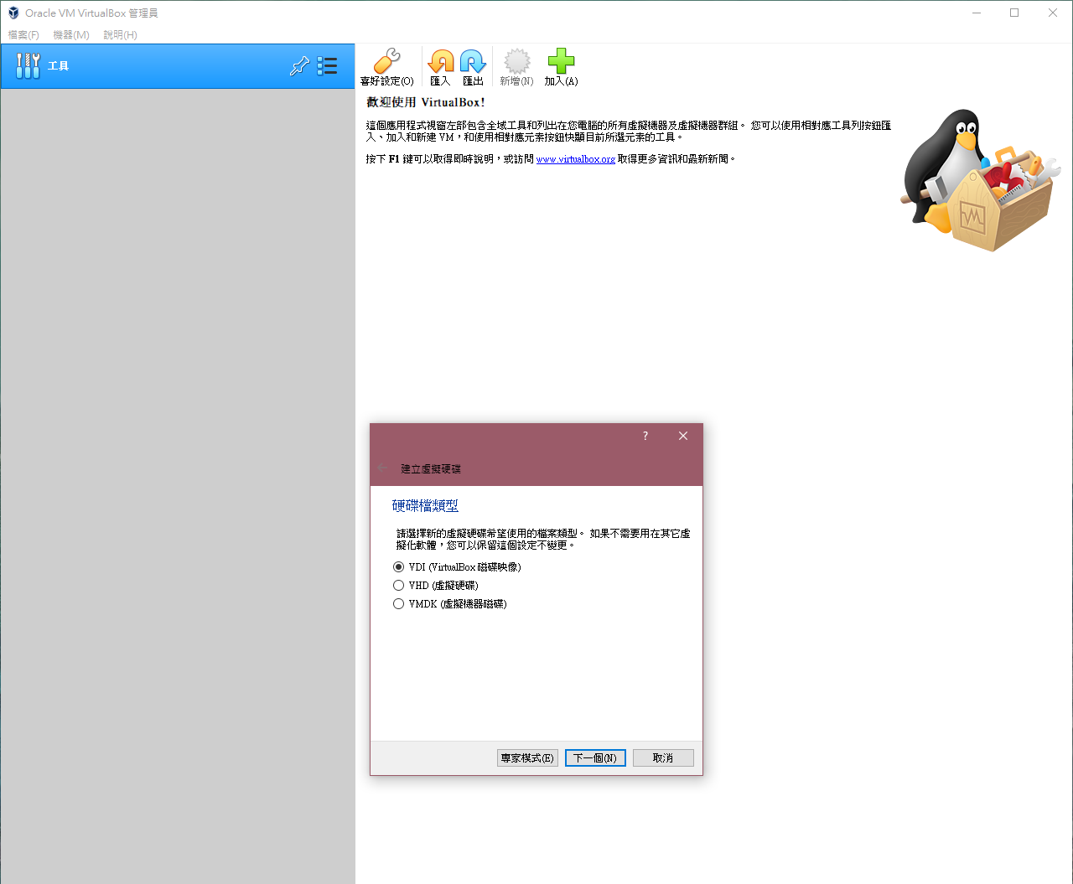
Install virtual machine on Windows (6/9)

Slide 10
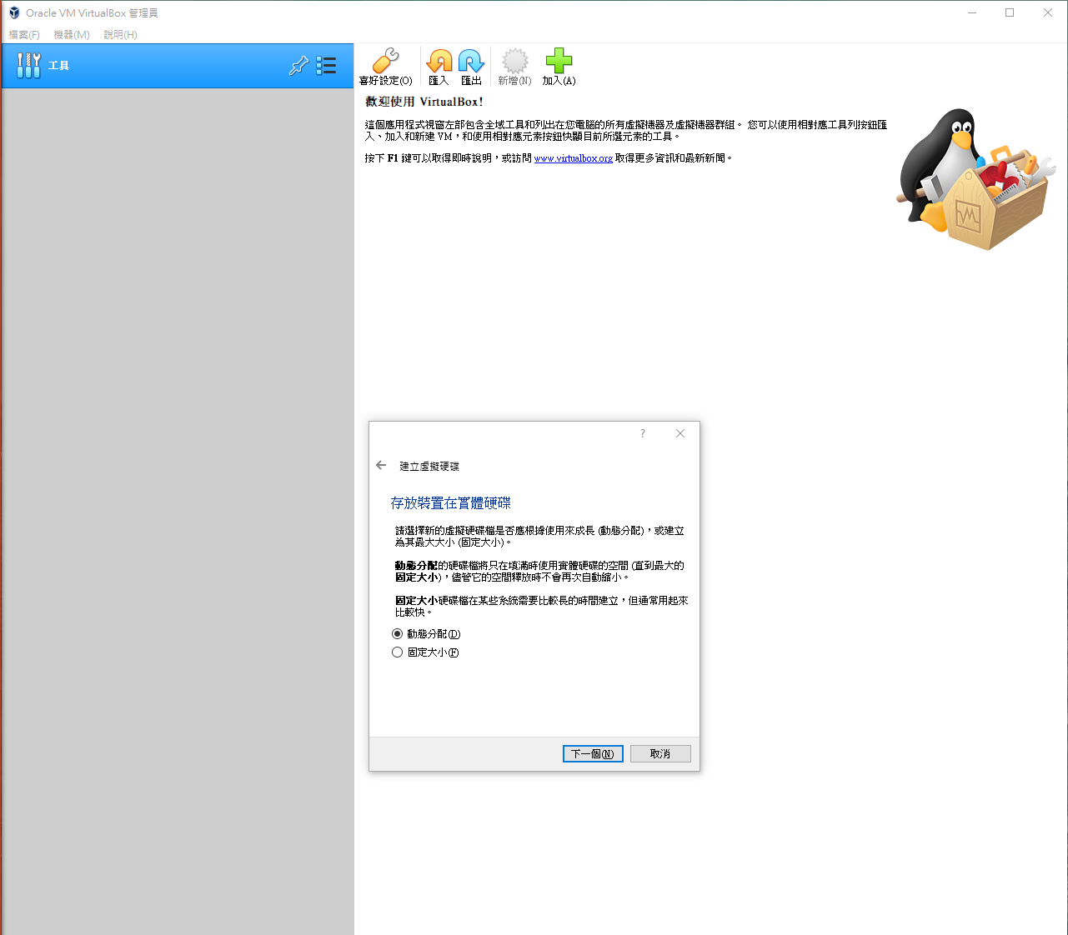
Install virtual machine on Windows (7/9)

Slide 11
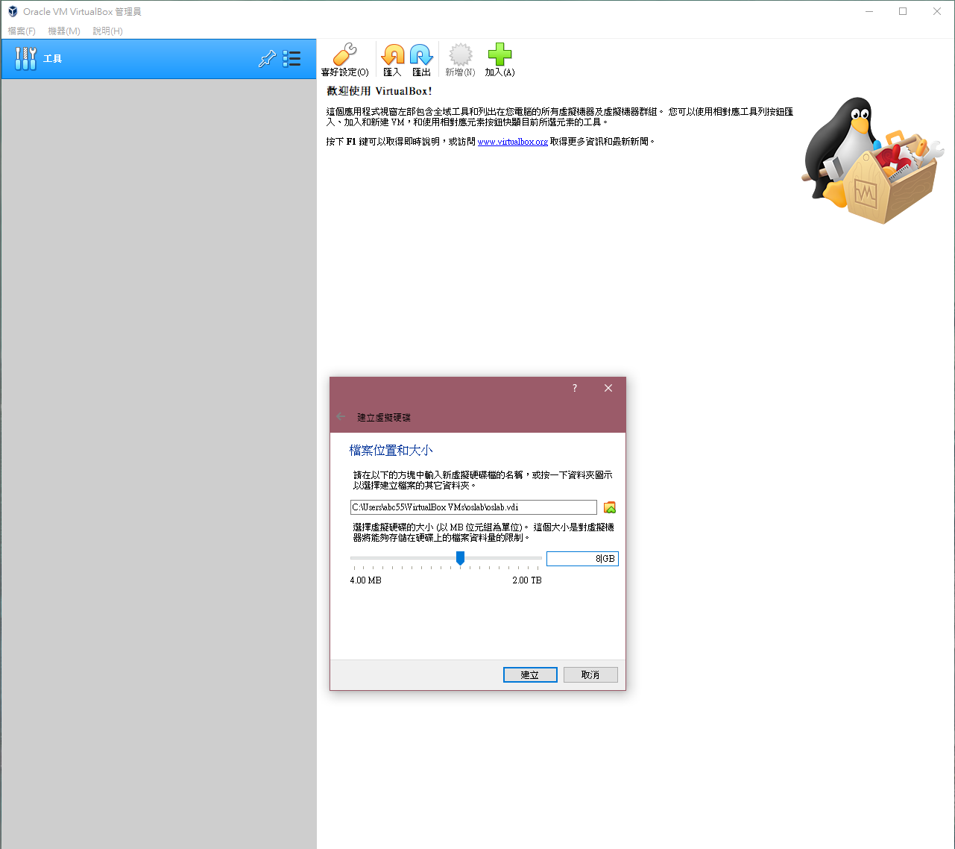
Install virtual machine on Windows (8/9)
Step6 - choose the (virtual) disk’s size

Slide 12
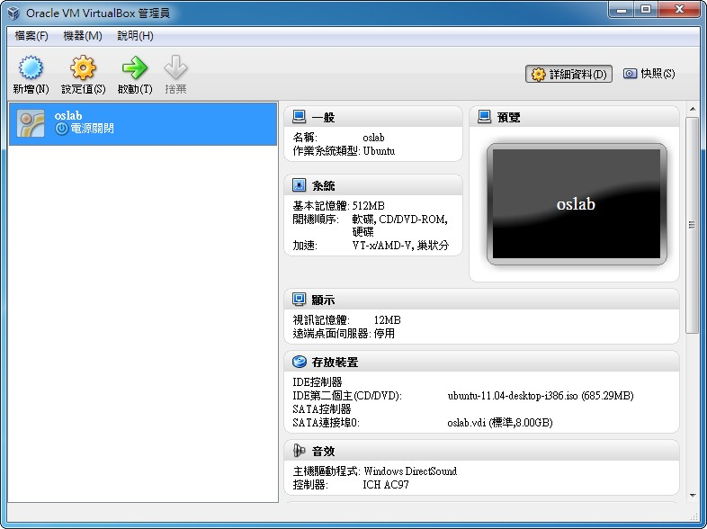
Install virtual machine on Windows (9/9)
Step8 - create VM successfully

Slide 13
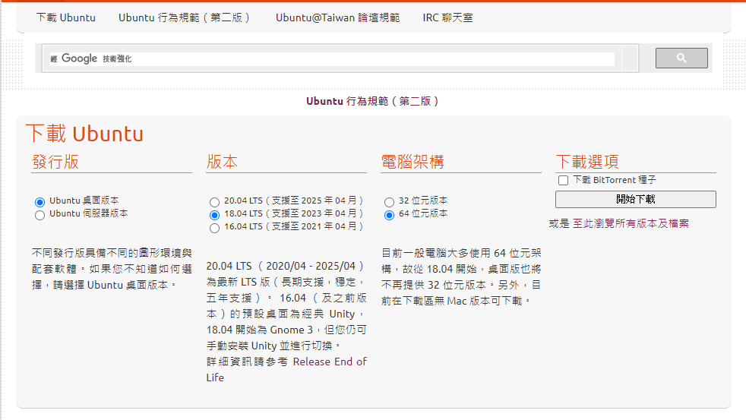
Install Linux on VM (1/11)
Step1 - download Ubuntu from the Internet
http://www.ubuntu-tw.org/modules/tinyd0/

Slide 14
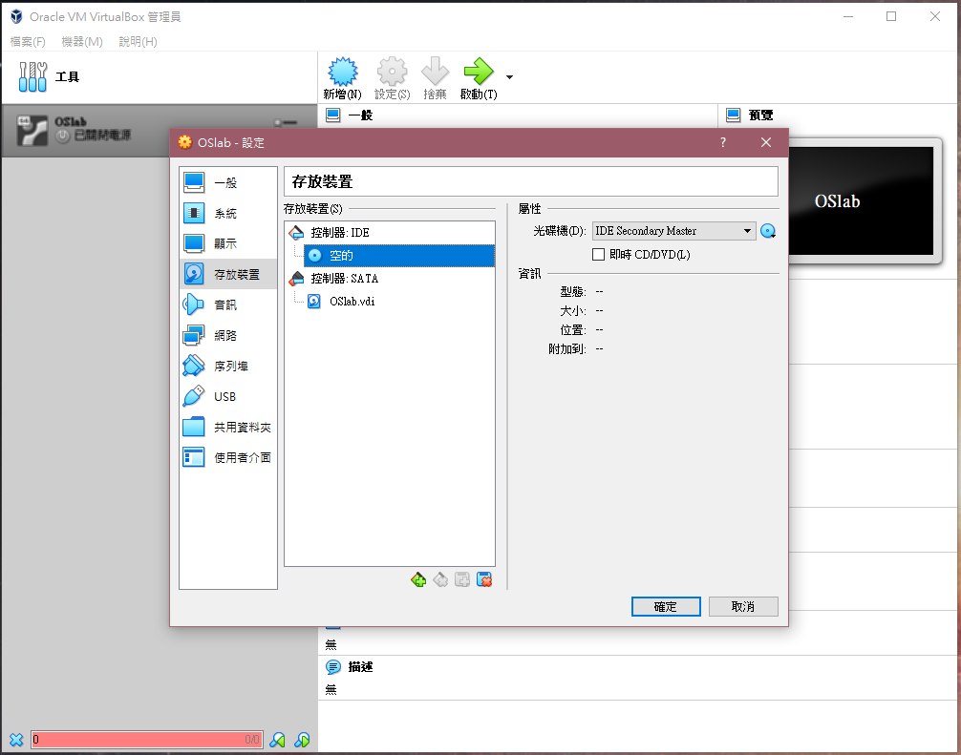
Install Linux on VM (2/11)
Step2 - choose the VM and the storage device

Slide 15
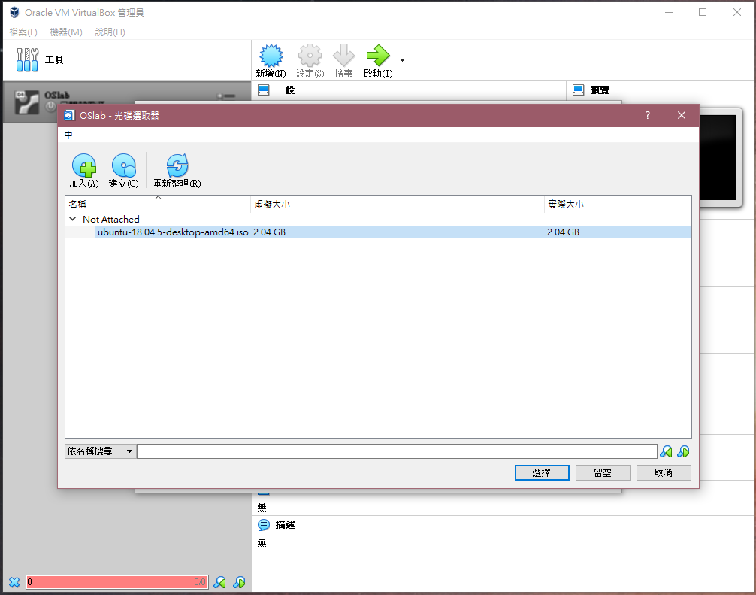
Install Linux on VM (3/11)
Step3 - add the Linux system file

Slide 16
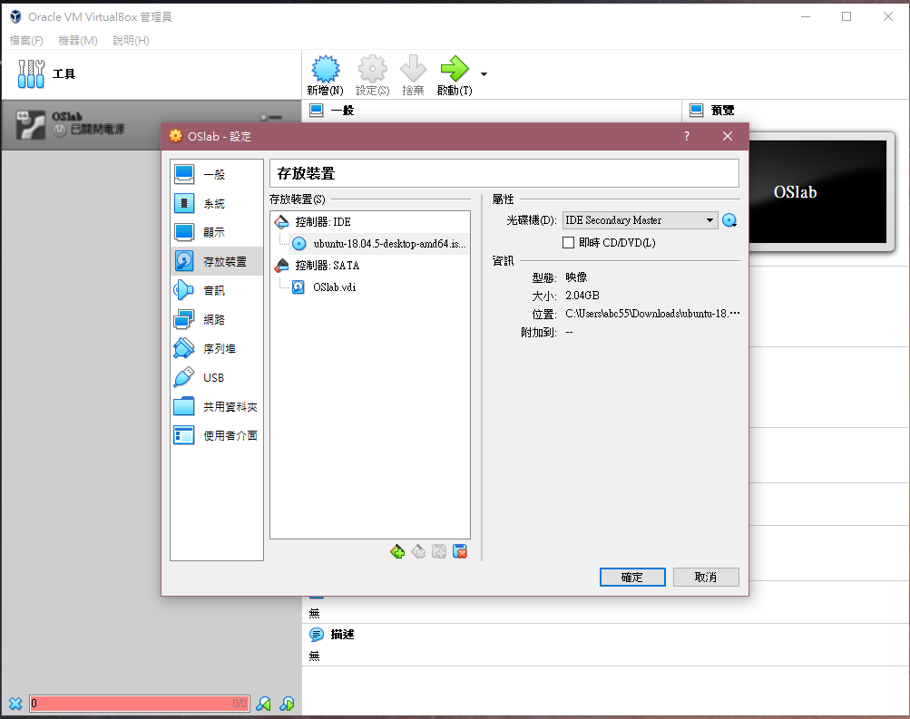
Install Linux on VM (4/11)

Slide 17
Install Linux on VM (5/11)
Step4 - start the virtual machine
Step5 - the virtual machine will load the Linux set-up file automatically

Slide 18
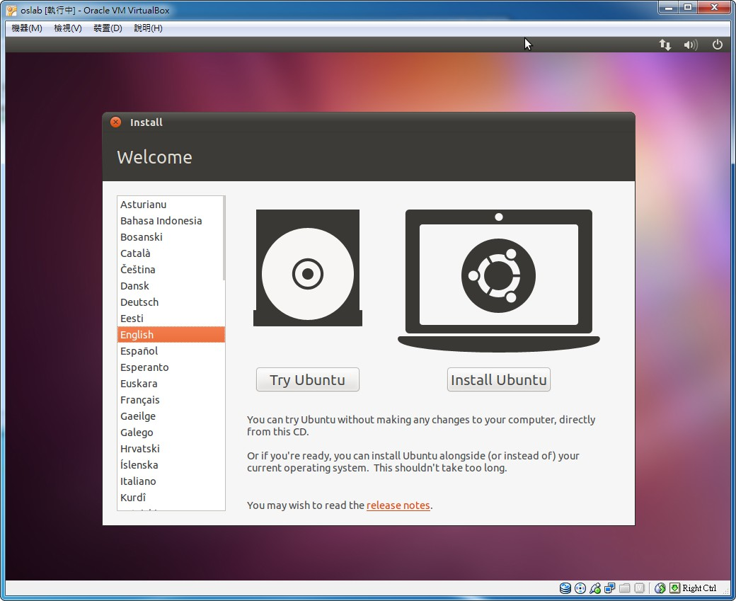
Install Linux on VM (6/11)
Step6 - choose the language

Slide 19
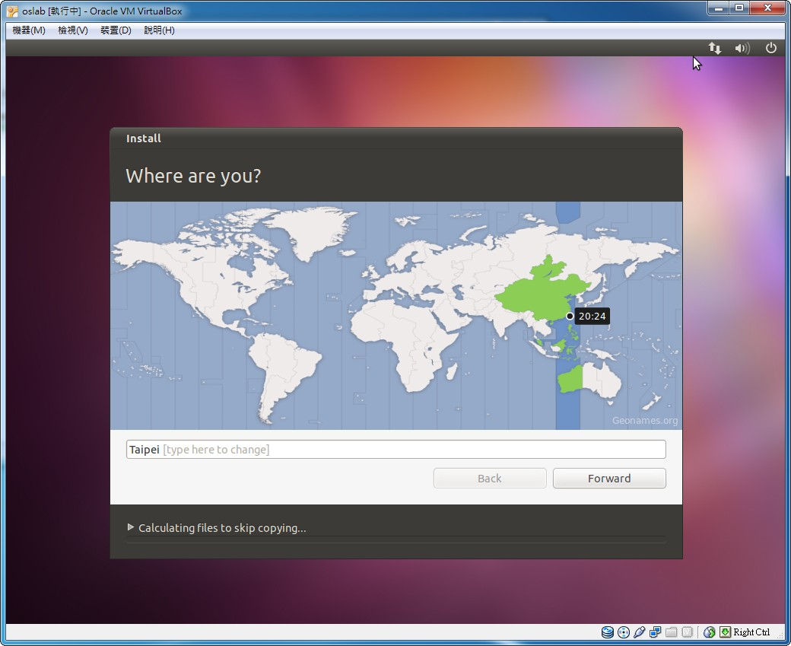
Install Linux on VM (7/11)
Step7 - choose the region and time zone

Slide 20
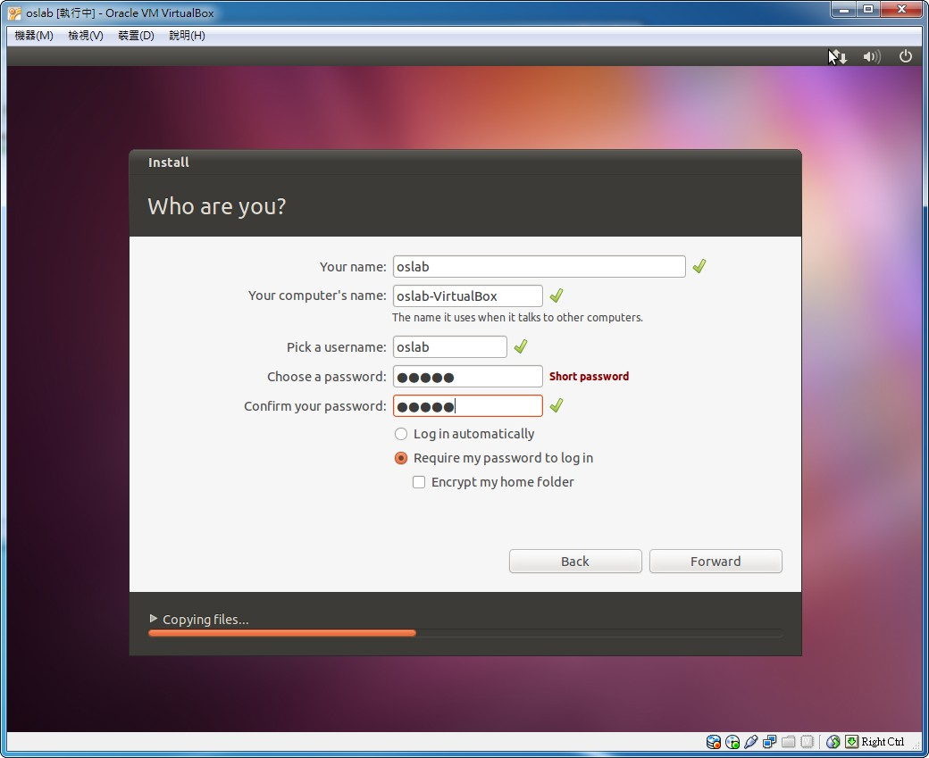
Install Linux on VM (8/11)
Step8 - create user accounts

Slide 21
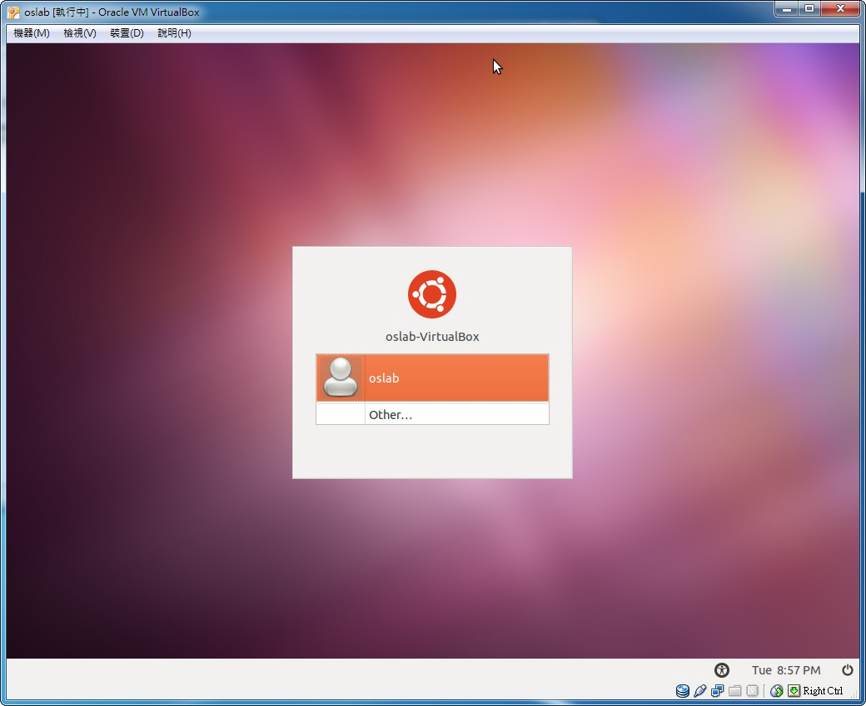
Install Linux on VM (9/11)
Step9 - log in

Slide 22
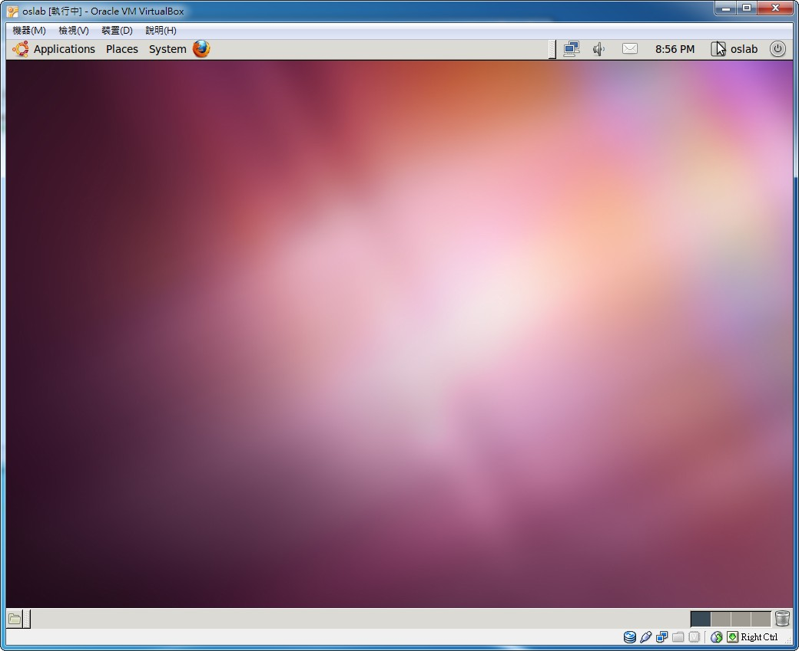
Install Linux on VM (10/11)
Step10 - finish

Slide 23
Install Linux on VM (11/11)
The installation steps of Linux on VM on Ubuntu are similar to that on Windows
https://steemit.com/vm/@oneleo/oracle-vm-virtualbox-ubuntu-18-04-desktop

Slide 24
Exercise
Install VirtualBox (60 pt)
Create a new Download the Ubuntu CD image from Ubuntu
website (15 pt)
virtual machine in VirtualBox and install Ubuntu in the virtual machine (15 pt)

Slide 25
References
Ubuntu
http://www.ubuntu-tw.org/modules/tinyd0/
VirtualBox
http://www.virtualbox.org/wiki/Downloads
VirtualBox 安裝及設定Ubuntu 18.04
https://hth322.pixnet.net/blog/post/183391361-%E5%AE%89%E8%A3%9Dubuntu%E5%9C%A8oracle-vm-virtualbox%E7%B4%AE%E8%A8%98

