Slide 1
Lab 2 Shell Script
NCHU OSLAB
TA : Yung-Tung Chou

Slide 2
Outline
Introduction
Vim Basics
Bash Shell Scripting Tutorial
Exercise

Slide 3
Introduction
A shell script is a script written for the shell, or command line interpreter, of an operating system
It is often considered a simple domain-specific programming language (DSL)

Slide 4
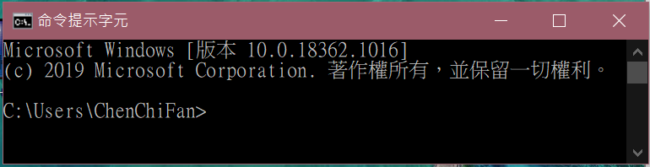
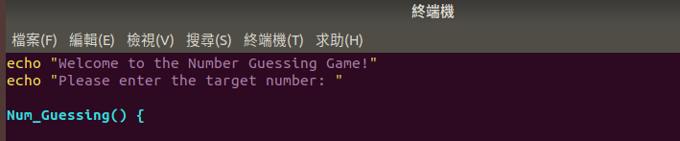
cmd
Windows:
指令程式
shell
Linux:
shell script

Slide 5
Introduction
Typical operations performed by shell scripts include
file manipulation
program execution
printing text

Slide 6
Vim Basics
Vim is a popular and cross-platform editor
Shell open : ctrl + alt + t
Type vim /path/to/file in shell to open a file
Start typing something by pressing i
Exit vim by pressing Esc then writting :q + Enter
Save your file similarly but using :w

Slide 7
Vim Basics
Hello Vim!
Install Vim through apt-get command in shell
Create a file named “helloworld”
Type “Hello World!” using insert mode
Return to normal mode by pressing Ese
Save and quit the file

Slide 8
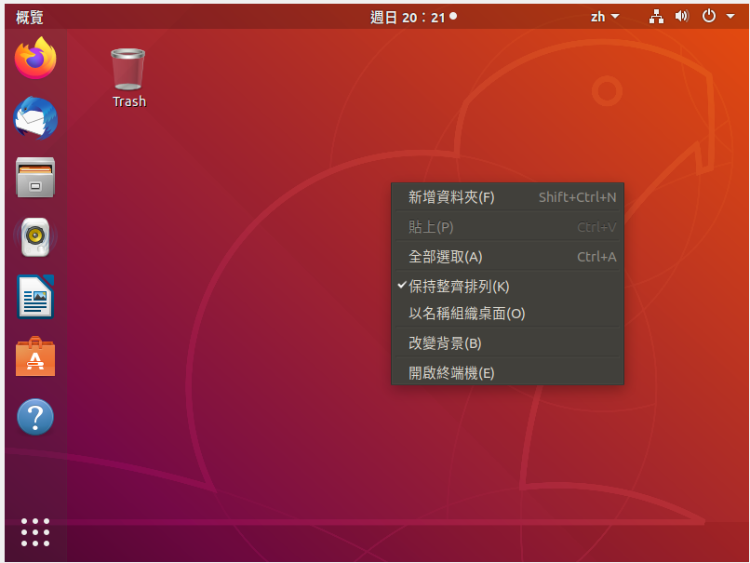
Step 1. Open Terminal Window
Open Terminal window

Slide 9
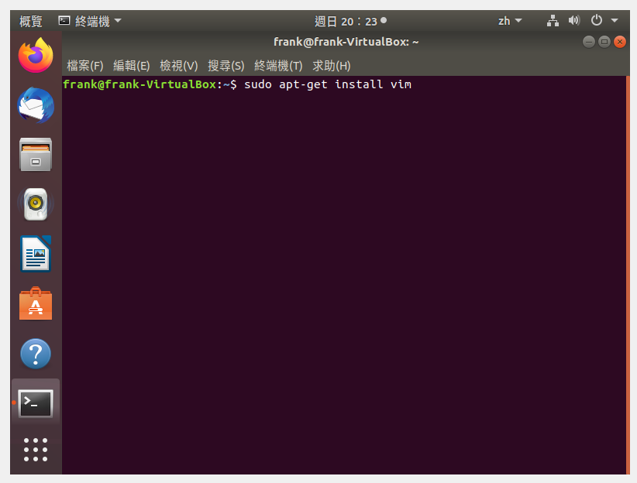
Step 2. Install Vim by Advanced Packaging Tool (APT)
Type “sudo apt-get install vim” to install Vim in shell

Slide 10
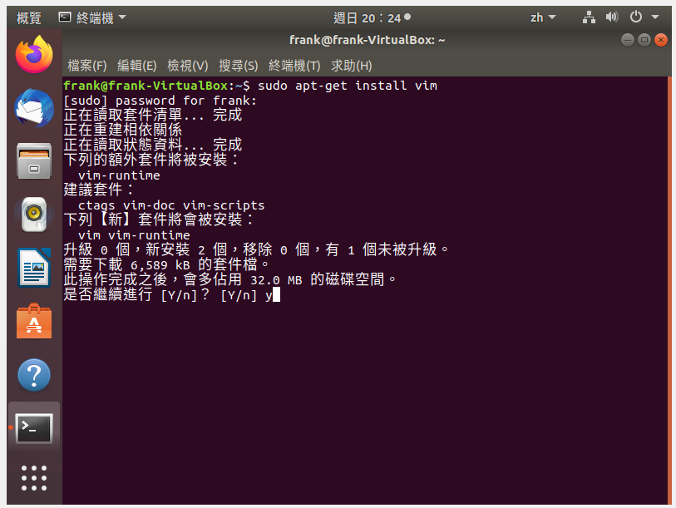
Step 3. Review and Confirm
Review the summary and type “Y” to continue

Slide 11
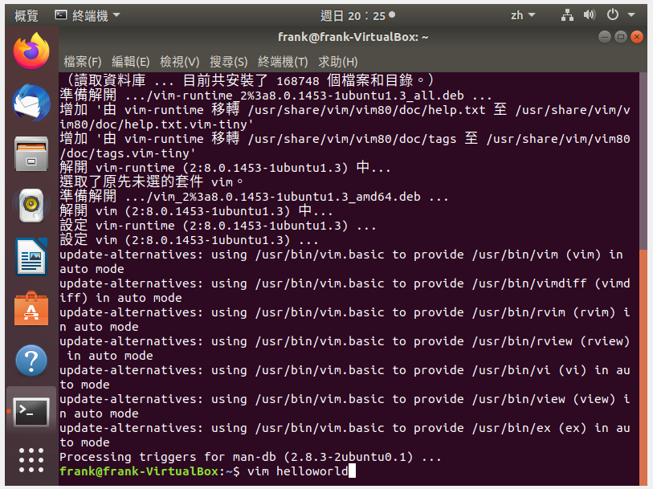
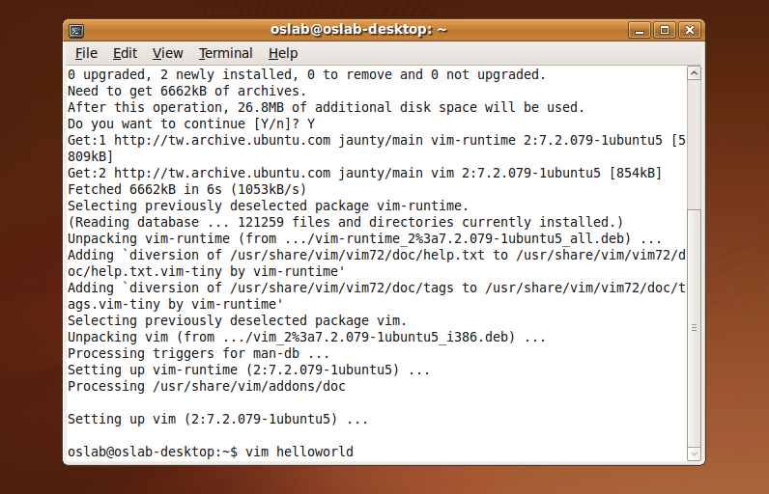
Step 4. Create a file named helloworld
Type “vim helloworld” to create a file named helloworld

Slide 12
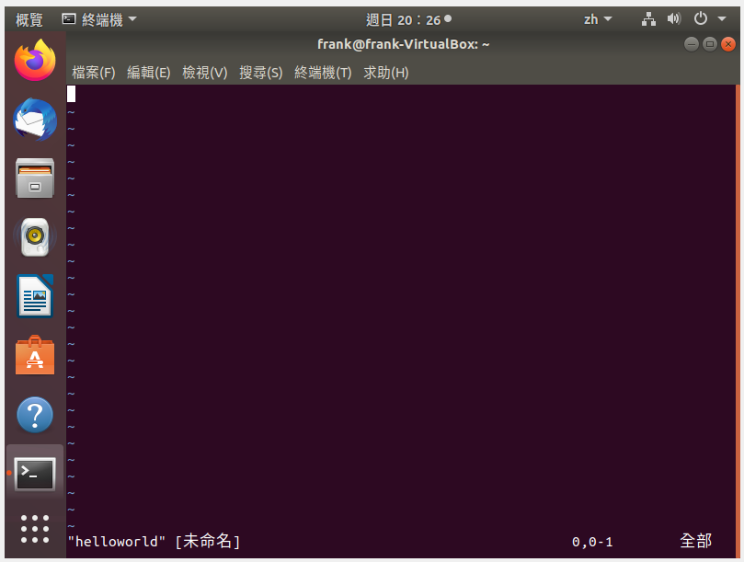
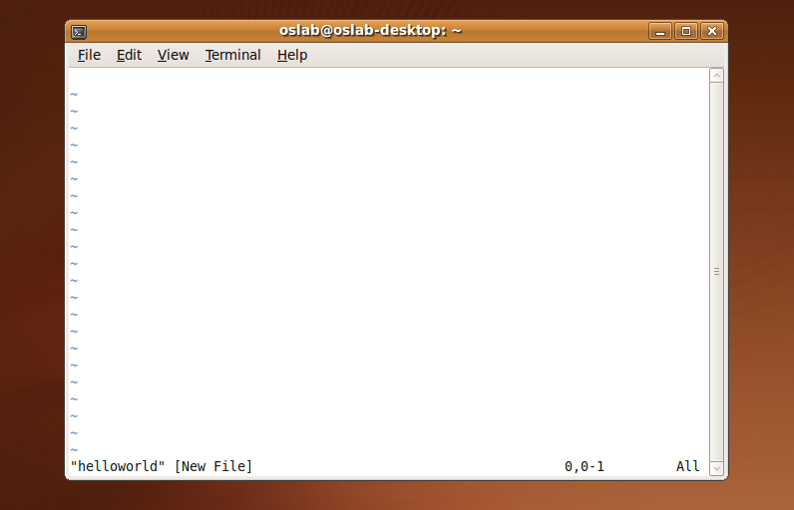
Step 5. Enter Insert Mode
You need to enter insert mode by pressing “i” before typing something

Slide 13
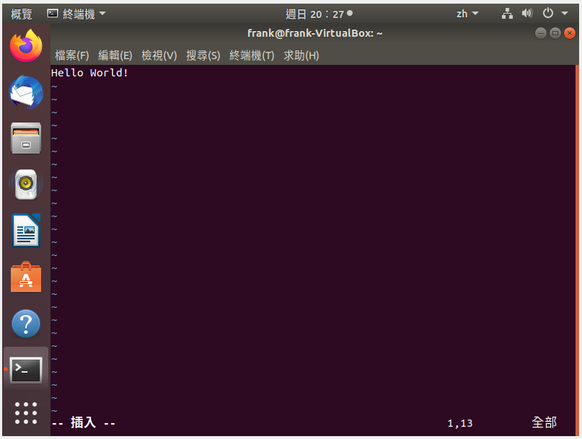
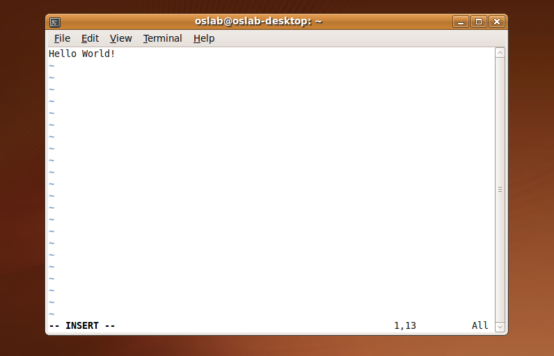
Step 6. Type something
Notice the “-- INSERT --” on bottom left and you can type something now

Slide 14
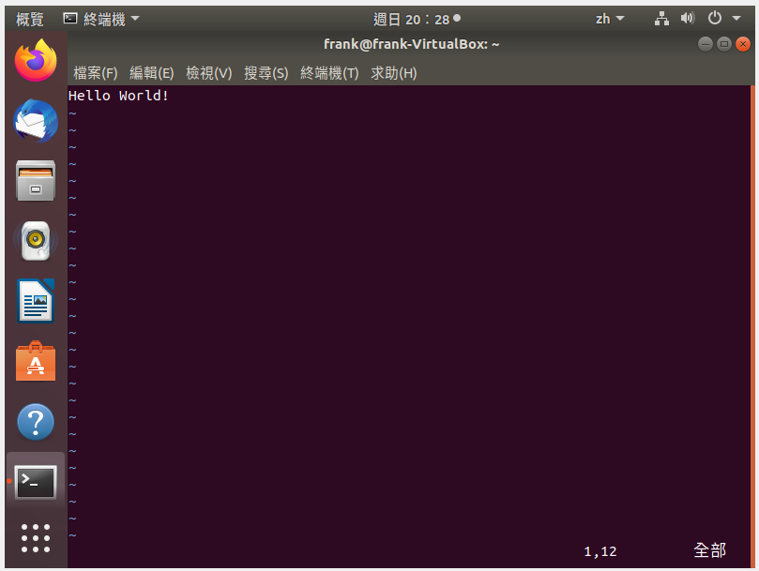

Step 7. Return to Normal Mode
Press “Ese” to return to normal mode

Slide 15
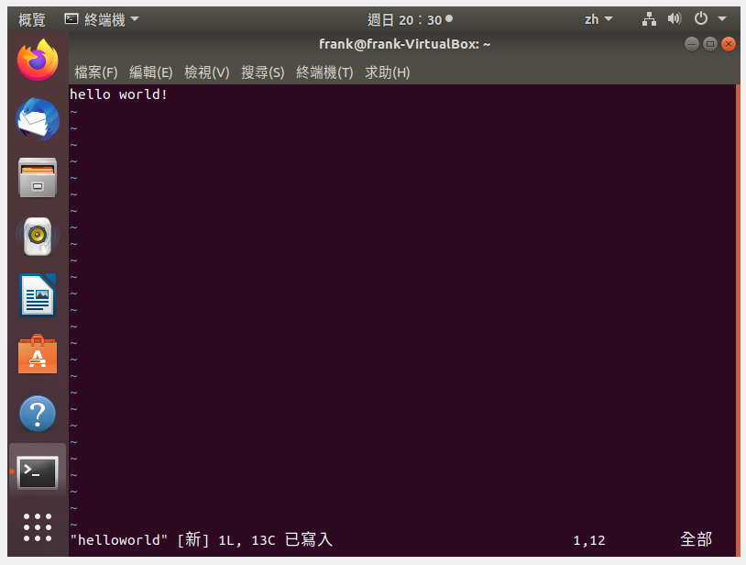

Step 8. Save the File
Type “:w” in normal mode to save your file

Slide 16
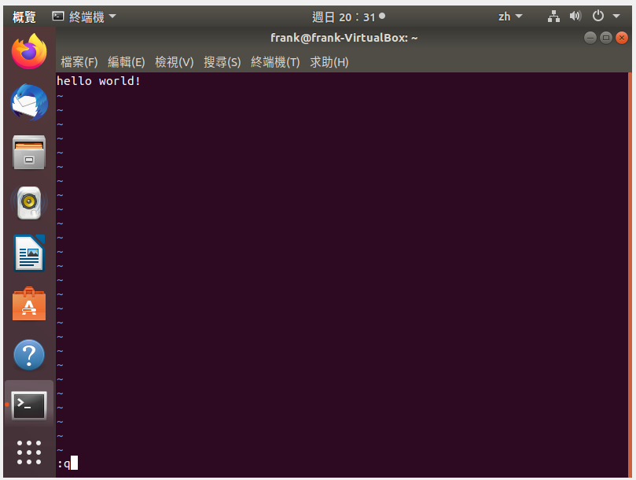

Step 9. Quit Vim
Type “:q” in normal mode to quit Vim

Slide 17
Note : 1) Shell open : ctrl + alt + t 2) vim open : vim helloworld.sh 3) before typing : i 4) Exit : Esc 5) Save the File : :w 6) Quit Vim : :q + Enter

Slide 18
Bash Shell Scripting Tutorial
Bash is a free software Unix shell written for the GNU Project
It is the default shell on most systems built on top of the Linux kernel as well as on Mac OS X and Darwin
You still can do the same thing by other programming languages like Perl, Python, etc

Slide 19
Bash Shell Scripting Tutorial
Hello World!
The simplest Hello World example

Slide 20
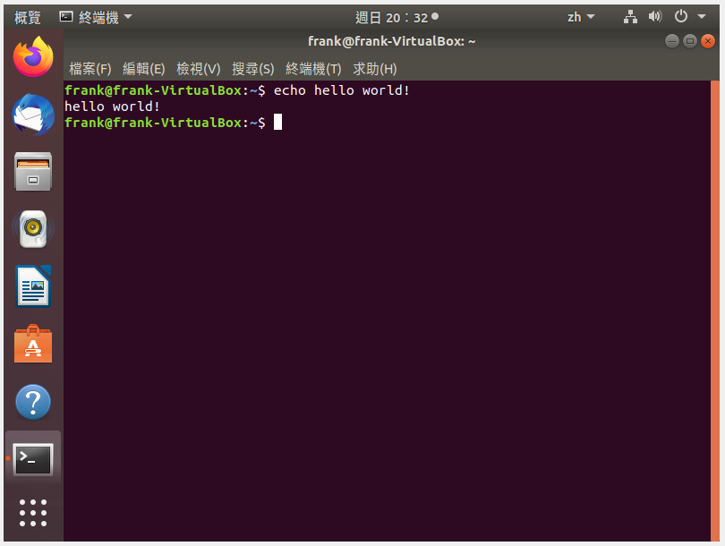
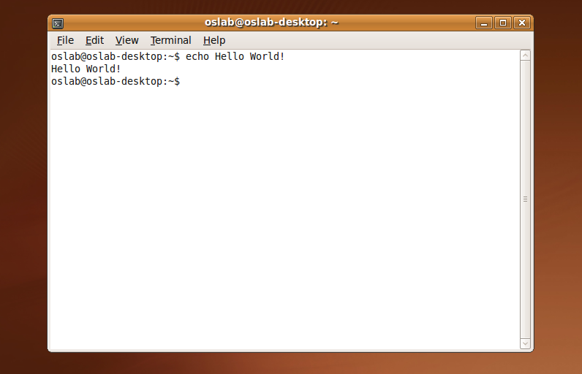
Hello World in Shell
Just simply type “echo Hello World!” in your shell and it’s done!

Slide 21
Bash Shell Scripting Tutorial
Hello World using .sh File
Now let’s use .sh file to do the same thing

Slide 22
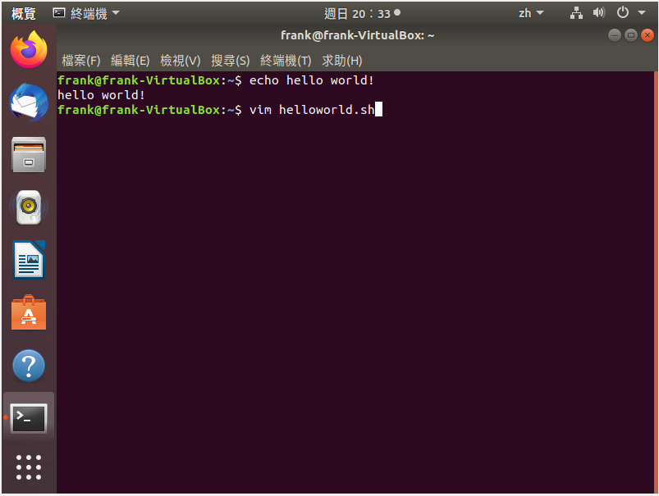
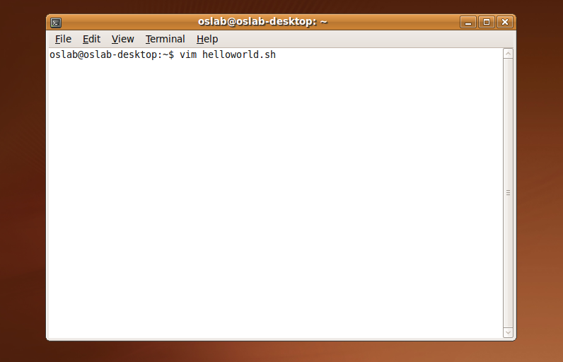
Step 1. Create a file with .sh extension
Type “vim helloworld.sh” in shell to create a new shell file

Slide 23
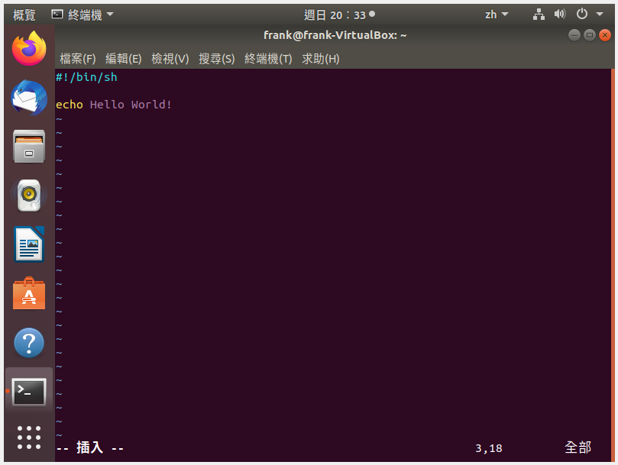
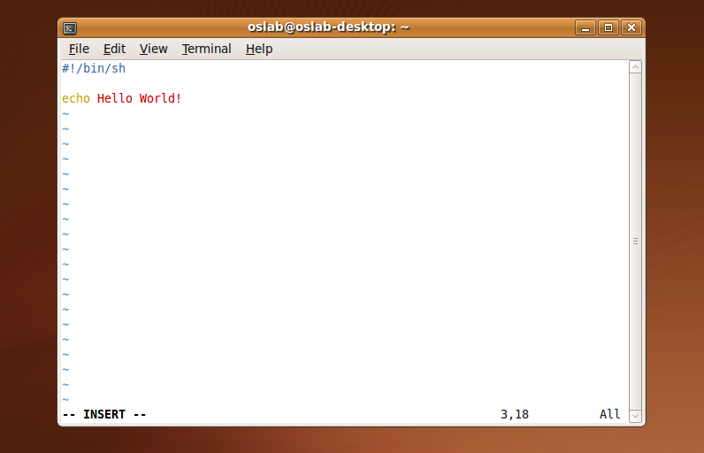
Step 2. Write the script
Enter the insert mode to write our hello world script

Slide 24
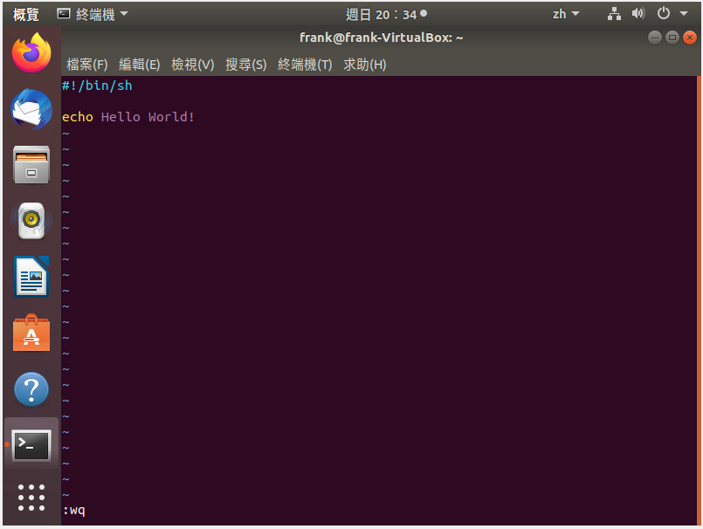

Step 3. Save and Quit the File
Return to the normal mode and type “:wq” to save and quit the file

Slide 25
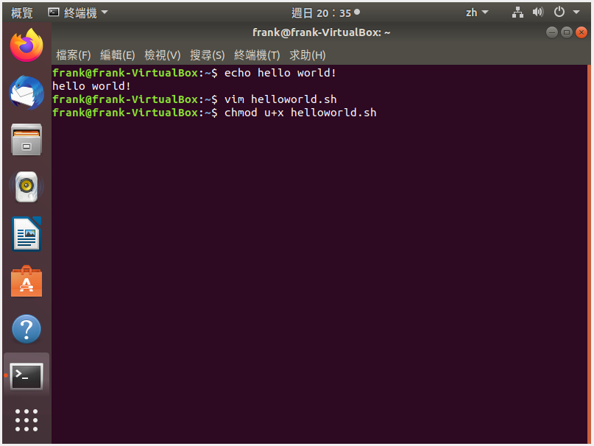
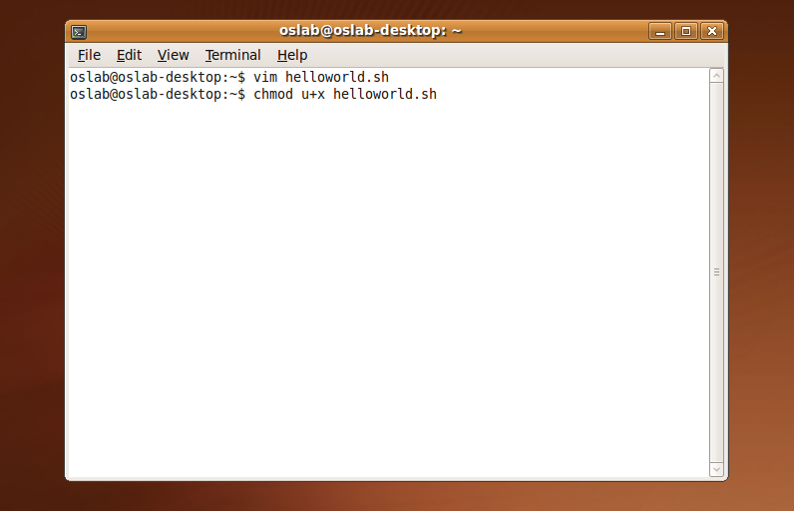
Step 4. Grant execute permission
Use chmod command to grant execute permission to the shell file

Slide 26

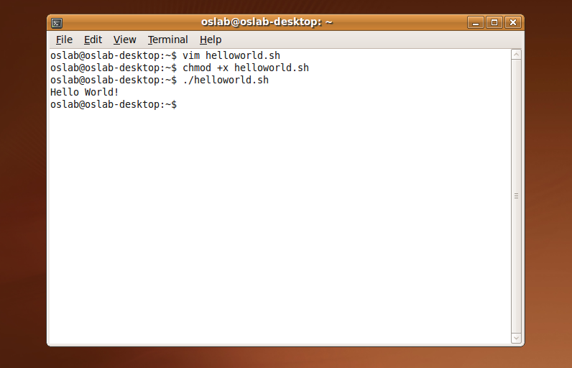
Step 5. Execute the script
Now we can execute the script directly by “./helloword.sh” command

Slide 27
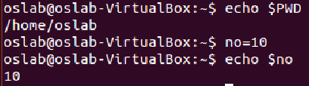
Bash Shell Scripting Tutorial
Variable in Shell
There are two types of variable
System variables
Ex: use “echo $PWD” to print your current working directory
User defined variables (UDV)
Ex: use “no=10” to set variable no and use “echo $no” to print 10 on your screen

Slide 28
Bash Shell Scripting Tutorial
Shell Arithmetic
+ - * /
Syntax: expr op1 math-operator op2
$ expr 1 + 3 # print 4
$ expr 2 - 1 # print 1
$ expr 10 \* 3 # print 30
$ echo `expr 6 + 3` # print 9
space
Upper left corner
on keyboard

Slide 29
Bash Shell Scripting Tutorial
More about Quotes
Double quotes (“): Anything enclosed in double quotes removed meaning of that characters (except \ and $)
Single quotes (‘): Enclosed in single quotes remains unchanged
Back quotes (`): To execute command

Slide 30
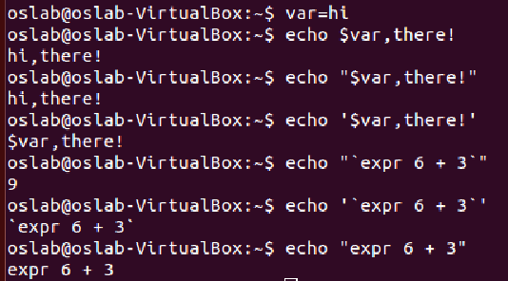
Bash Shell Scripting Tutorial
More about Quotes
$ var=Hi
$ echo $var, there!
Hi, there!
$ echo “$var, there!”
Hi, there!
$ echo ‘$var, there!’
$var, there!

Slide 31
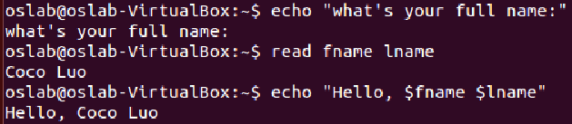
Bash Shell Scripting Tutorial
The read Statement
Syntax: read variable1 variable2 …
Example:
echo “What’s your full name:”
read fname lname
echo “Hello, $fname $lname.”
What’s your full name: Chuck Bass
Hello, Chuck Bass.

Slide 32
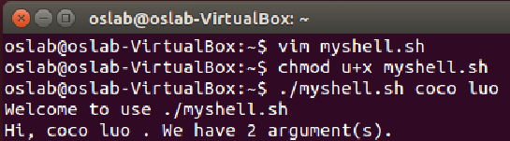
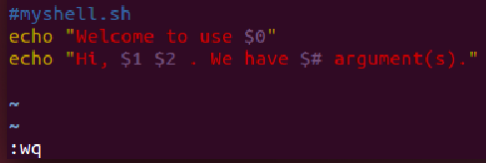
Bash Shell Scripting Tutorial
Arguments
Step 1
Step 3
Step 4
# myshell.sh
echo “Welcome to use $0”
echo “Hi, $1 $2. We have $# argument(s).”
$ ./myshell.sh Chuck Bass
Welcome to use ./myshell.sh
Hi, Chuck Bass. We have 2 argument(s).
Step 2

Slide 33
Bash Shell Scripting Tutorial
Pipes
A pipe is a way to connect the output of one program to the input of another without any temporary file
Ex: think about the ls and sort commands
We can use ls to list directory contents
We can also use “ls | sort -r” to list sorted directory contents reversely
A
B

Slide 34
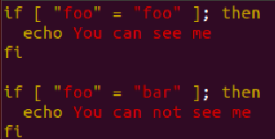

Bash Shell Scripting Tutorial
Conditionals
if-then
if [ “foo” = “foo” ]; then
echo You can see me
fi
if [ “foo” = “bar” ]; then
echo You cannot see me
fi
space

Slide 35
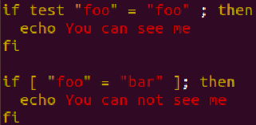
Bash Shell Scripting Tutorial
Conditionals
test command or [ expr ]
used to see if an expression is true
returns 0 for true and nonzero for false
Use test command:
if test “foo” = “bar”; then
echo You cannot see me
fi
Use [ expr ]:
if [ “foo” = “bar” ]; then
echo You cannot see me
fi

Slide 36
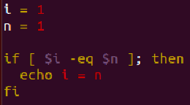
Bash Shell Scripting Tutorial
Conditionals
test command or [ expr ]
-eq | is equal to
-ne | is not equal to
-lt | is less than
-le | is less than or equal to
-gt | is greater than
-ge | is greater than or equal to
Operators for Mathematics

Slide 37
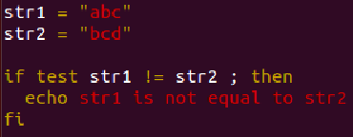
Bash Shell Scripting Tutorial
Conditionals
test command or [ expr ]
str1 = str2 | str1 is equal to str2
str1 != str2 | str1 is NOT equal to str2
str1 | str1 is NOT NULL or not defined
-n str1 | str1 is NOT NULL or does exist
-z str1 | str1 is NULL and does exist
Operators for Strings

Slide 38

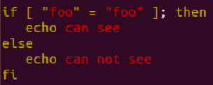
Bash Shell Scripting Tutorial
Conditionals
if-then-else
if [ “foo” = “foo” ]; then
echo You can see me
else
echo You cannot see me
fi

Slide 39
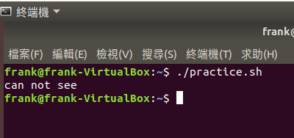
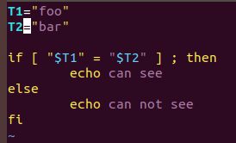
Bash Shell Scripting Tutorial
Conditionals
Conditionals with variables
T1=”foo”
T2=”bar”
if [ “$T1” = “$T2” ]; then
echo You can see me
else
echo You cannot see me
fi

Slide 40
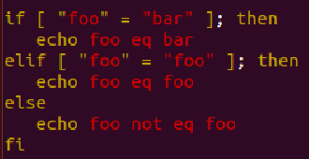

Bash Shell Scripting Tutorial
Conditionals
if-then-elif-then-else
if [ “foo” = “bar” ]; then
echo You cannot see me
elif [ “foo” = “foo” ]; then
echo You can see me
else
echo You still cannot see me
fi

Slide 41
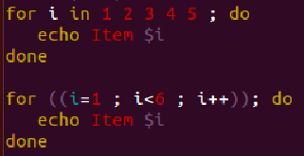
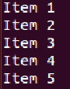
Bash Shell Scripting Tutorial
Loops
for loop
for i in 1 2 3 4 5; do
echo Item $i
done
for ((i=1; i<6; i++)); do
echo Item $i
done
Result:
Item 1
Item 2
Item 3
Item 4
Item5

Slide 42
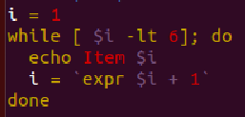
Bash Shell Scripting Tutorial
Loops
while loop
i=1
while [ $i -lt 6 ]; do
echo Item $i
i=`expr $i + 1`
done
Result:
Item 1
Item 2
Item 3
Item 4
Item5

Slide 43
Bash Shell Scripting Tutorial
The case Statement
Syntax
case $var in
pattern1) command;;
pattern2) command;;
patternN) command;;
*) command;;
esac

Slide 44
Bash Shell Scripting Tutorial
The case Statement
Example: name.sh
case $1 in
"Chuck") echo "Chuck Bass";;
"Nate") echo "Nate Archibald";;
"Blair") echo "Blair Waldorf";;
"Serena") echo "Serena van der Woodsen";;
*) echo "Enter a character’s first name " \
"in Gossip Girl..."
esac

Slide 45
Bash Shell Scripting Tutorial
The case Statement
Result
$ ./name.sh
Enter a character’s first name in Gossip Girl…
$ ./name.sh Serena
Serena van der Woodsen
$ ./name.sh Chuck
Chuck Bass
$ ./name.sh Blair
Blair Waldorf

Slide 46
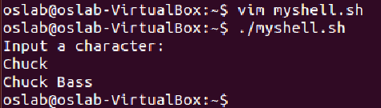
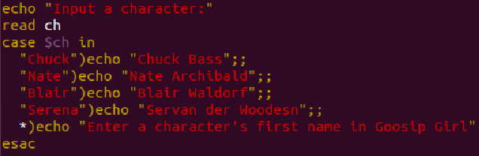

Slide 47
Bash Shell Scripting Tutorial
Function
Example
num=10
PrintNumber() {
echo “The number is $num!”
}
PrintNumber;
Result:
The number is 10!

Slide 48
Exercises
Number Guessing Game
Define the number range between 1 and 10
Ask the user to enter a target number at beginning
Keep narrowing down the number range until the player guessing the right target number

Slide 49
Exercises
Example:
Welcome to the Number Guessing Game!
Please enter the target number: 7
Please enter a number between 1 and 10: 10
Please enter a number between 1 and 9: 4
Please enter a number between 5 and 9: 7
Bingo!

Slide 50
Exercises
Use echo, read, loop and conditionals [75 pt]
Use function to ask for guessing number [+10 pt]
Use argument to set the target number [+10 pt]
Bonus: use other scripting language like Perl and Python to do the same thing. [+5 pt]

Slide 51
重點整理
1) Shell open : ctrl + alt + t
2) vim open : vim helloworld.sh
3) before typing : i 4) Exit : Esc 5) Save the File : :w 6) Quit Vim : :q + Enter // :wq
vim file.sh 創建shell檔
chmod u+x file.sh 授權
./file.sh 執行
if then
if then else
if-then-elif-then-else
Loops 迴圈
for ((i=1; i<6; i++)); do
while [ $i -lt 6 ]; do
echo 印出
expr 算數
quotes 引號（“）（'）（`）
read 讀取
Arguments 參數
Conditional 判斷

Slide 52
References
Shell script
Advanced Packaging Tool (APT)
New to Vim
BASH Programming - Introduction
Linux Shell Scripting Tutorial
Common LINUX Command

