Slide 1
1) FB of the last deliverable
2) Opening data 1～3
3) Filtering by Flight ID
4) Filtering by destionation

Slide 2
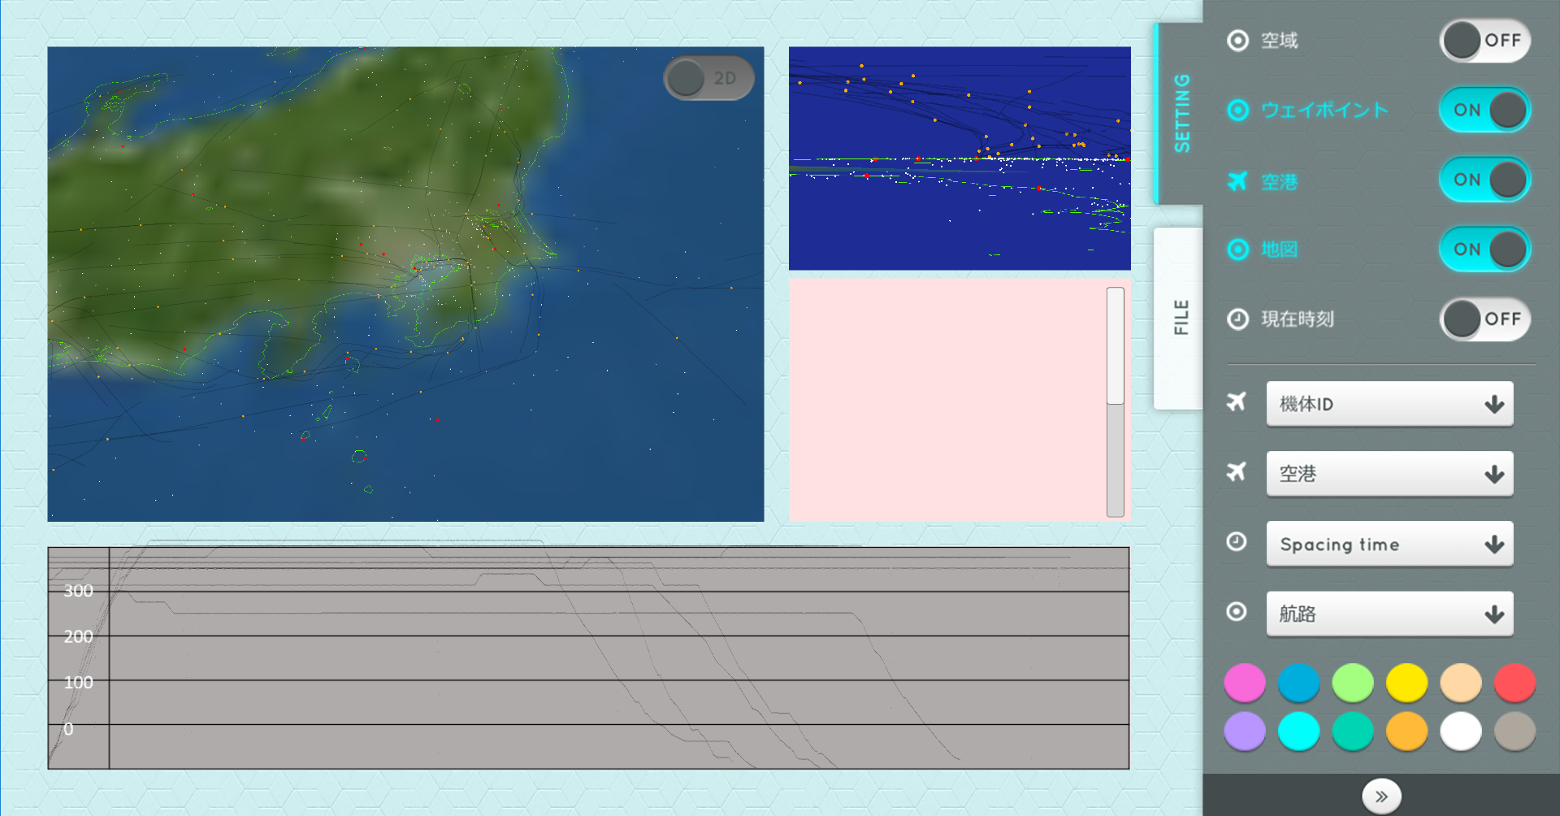
FB of the last time
1) Replace the map from “japanline-gmt.dat” to “japanline-gmt-high.dat”.
2) Texture can be removed

Slide 3
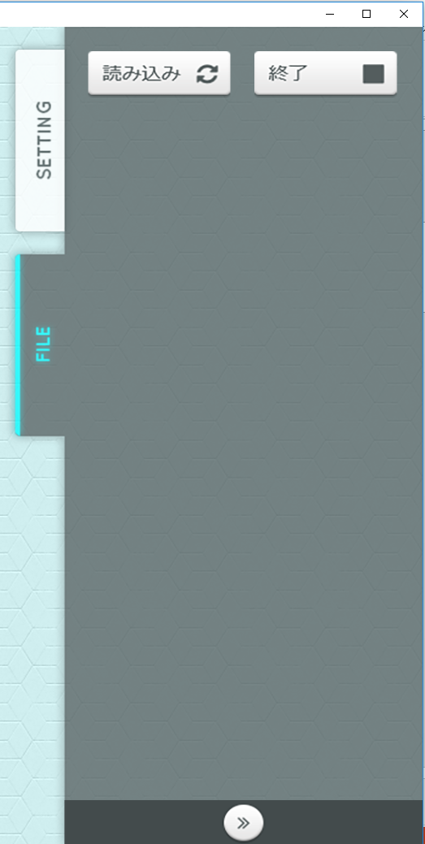
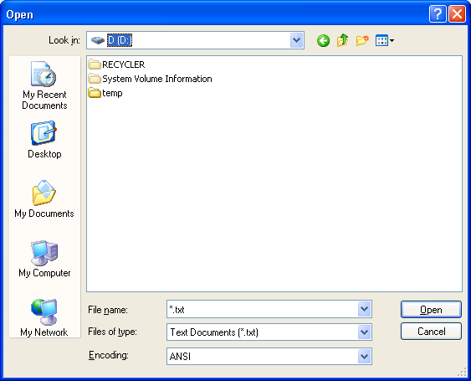
Opening data(1)
In this app, 3 types of data are to be loaded by user’s selection.
1) Flight Data(Flight data is point data where the plane actually passed through)
2) Flight Plan(Flight Plan is scheduled point data where to pass through during its flight.) [ 3) General coordinate data(long, lat, altitude) : not necessary to develop in this step]
By clicking the button, user can select a file to load.

Slide 4
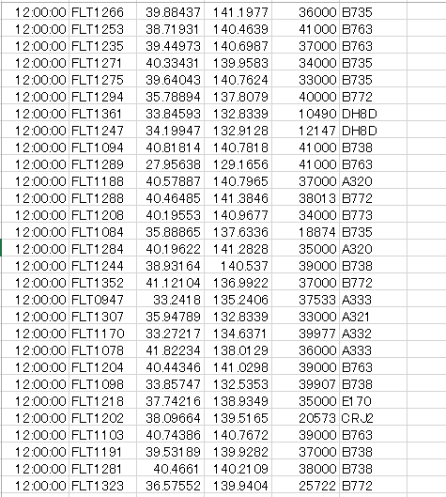
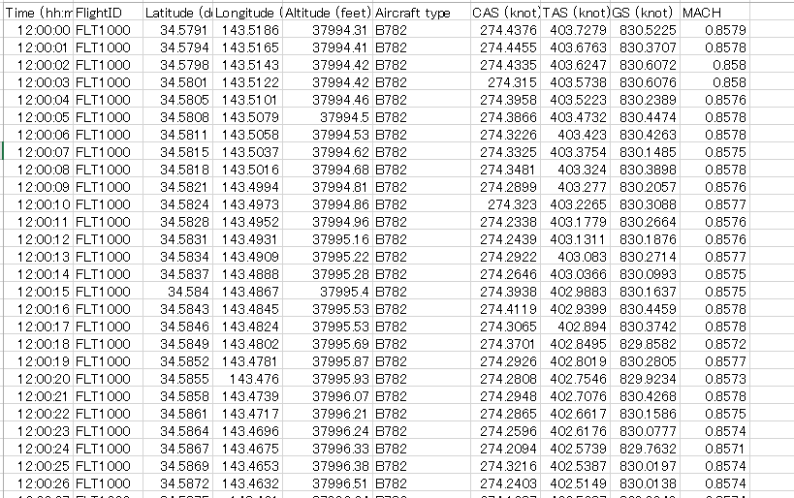
Opening data(2) : Flight Data
trk20120508_12_18.csv
Ftrk_sample_mod.csv
These columns are to be explained in the further step
“Ftrk_sample_mod.csv” is the final format for this app.
In “Ftrk_sample_mod.csv”, there is only 1 Flight ID because this is a sample.
But there will be multiple Flight IDs in the actual Flight Data to visualize.

Slide 5
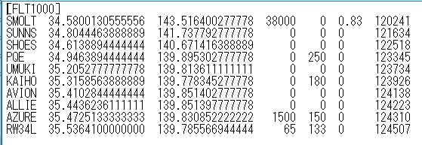
Opening data(3) : Flight Plan
“Fp_sample_mod2.txt” is the sample Flight Plan data associated with Ftrk_sample_mod.csv
“Flight ID” column in Flight Data and the first line in Flight Plan is corresponding.
Ftrk_sample_mod.csv
Fp_sample_mod2.txt
If a user loads Flight Plan:
- Points in the Flight Plan Data are visualized
- The text on the first left is displayed near the point
The last line of Flight Plan is its landing point(the flight’s destination)

Slide 6
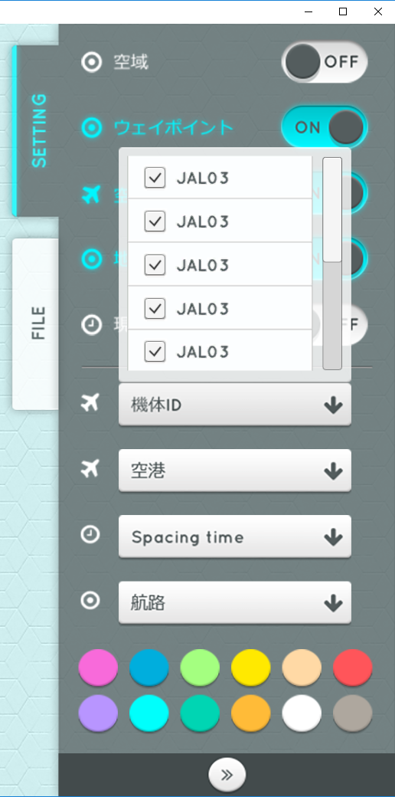
Filtering by Flight ID
FLT1000
This column is “Flight ID”.
Flight ID is loaded in this list.
Switch visible/invisible of the flight by checking the box on the left.

Slide 7
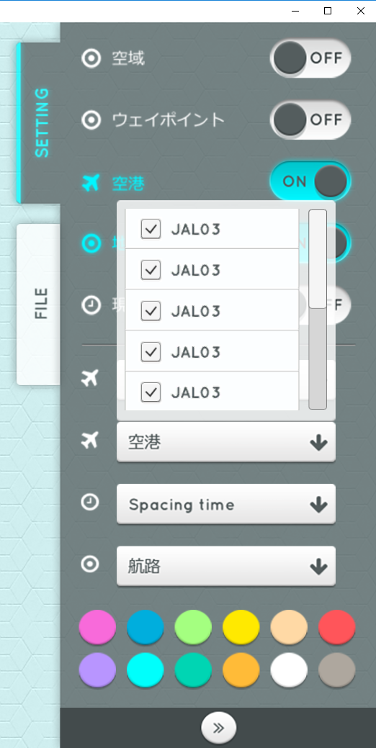
Filtering by destination
RW34L
The last line of Fight Plan data is its landing point(destination).
The landing points are to be listed here(in this case RW34L).
Switch visible/invisible of the flight by checking the box on the left.

