Slide 1
Recently Work Report
Reporter: Zhiyuan Zheng
Supervisor: Yong Shi
2022-4-25

Slide 2
Outline
Part I: AGN-driven outflow in dwarf galaxy SDSSJ0228-0901
Background
Data analyzing
Results
Conclusions
Part II: Short Time Scale Change-Look AGN
Background
Data analyzing

Slide 3
Part I
AGN-driven Outflow in Dwarf Galaxy: SDSSJ0228-0901

Slide 4
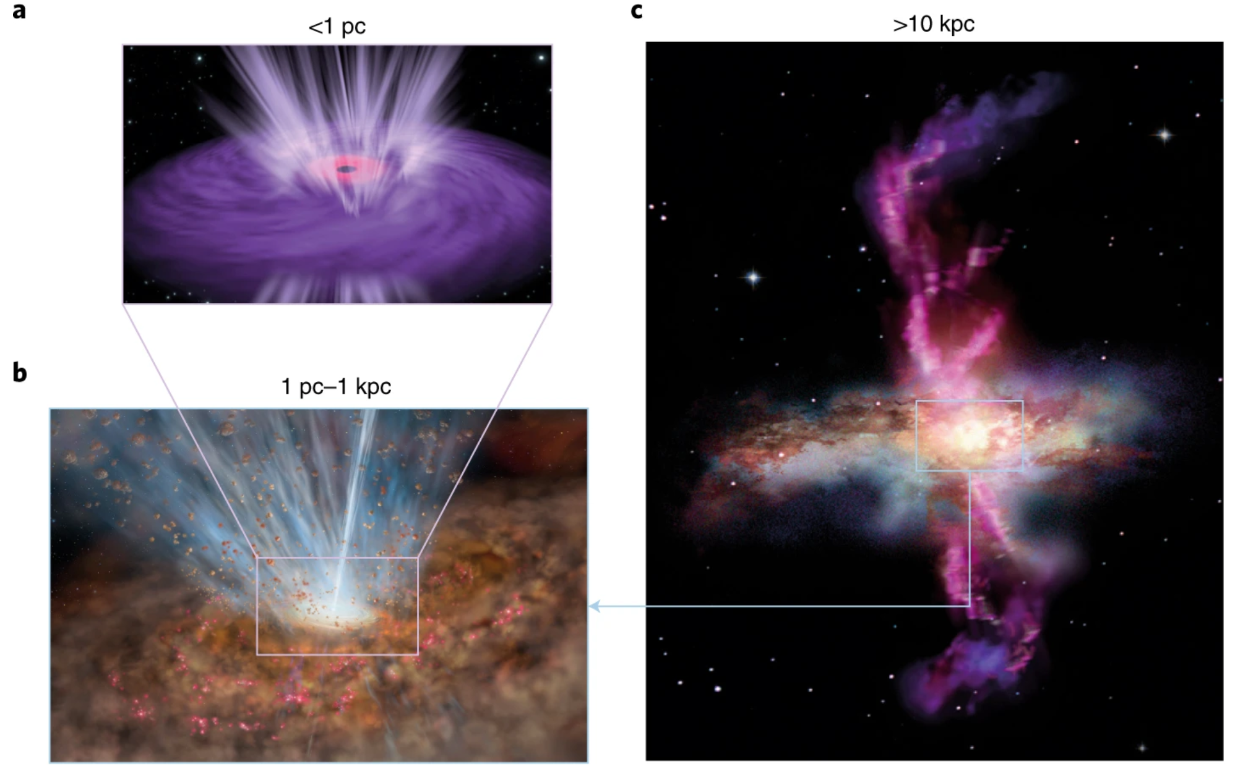
Background
Co-evolution of SMBH and galaxy
AGN feedback
Massive galaxies: important
(Rupke & Veilleux 2011,2013,2015), Harrison et al. (2014)
Dwarf galaxies: less important
Starburst Dwarfs, (Martin-Navarro & Mezcua 2018)
Artist conception of AGN-driven outflow. Cicone et al.(2018)

Slide 5
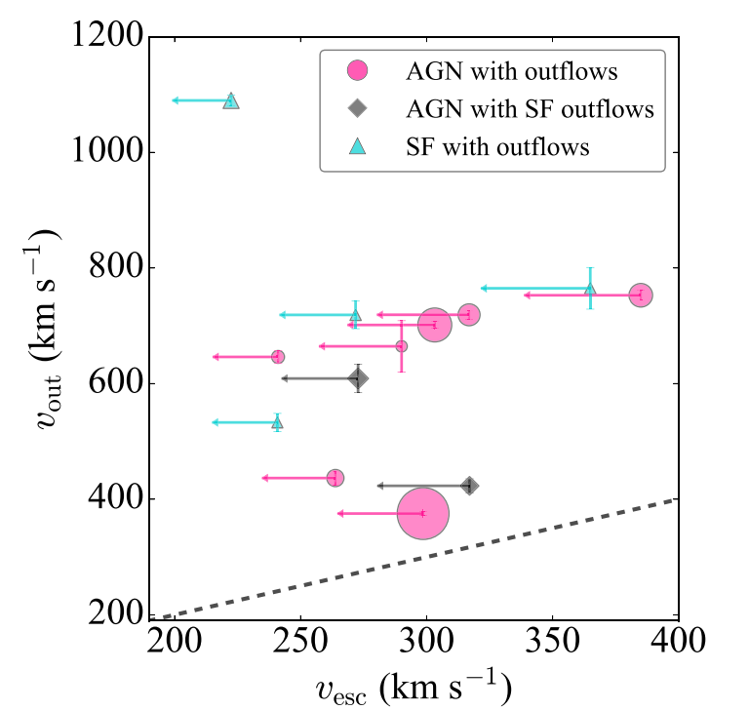
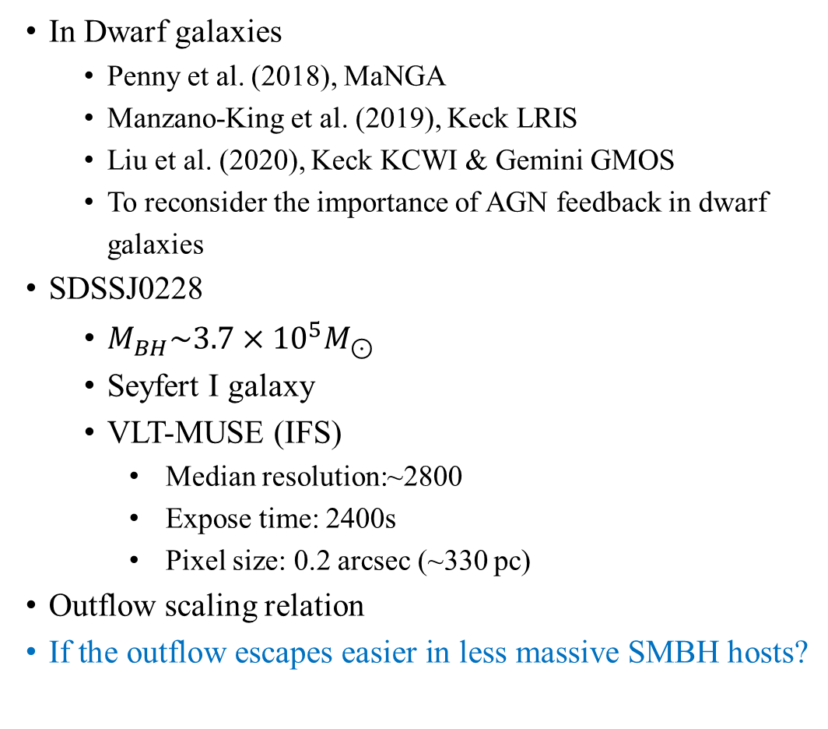
Background
In Dwarf galaxies
Penny et al. (2018), MaNGA
Manzano-King et al. (2019), Keck LRIS
Liu et al. (2020), Keck KCWI & Gemini GMOS
To reconsider the importance of AGN feedback in dwarf galaxies
SDSSJ0228
$M_{BH}\sim 3.7×{10}^{5}M_{⊙}$
Seyfert I galaxy
VLT-MUSE (IFS)
Median resolution:~2800
Expose time: 2400s
Pixel size: 0.2 arcsec (~330 pc)
Outflow scaling relation
If the outflow escapes easier in less massive SMBH hosts?
Manzano-King et al. (2019)

Slide 6
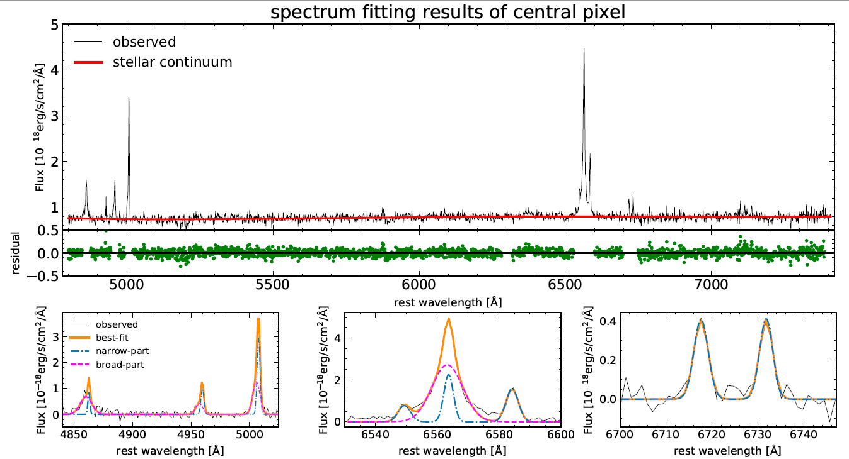
Spectrum Fitting Results

Slide 7
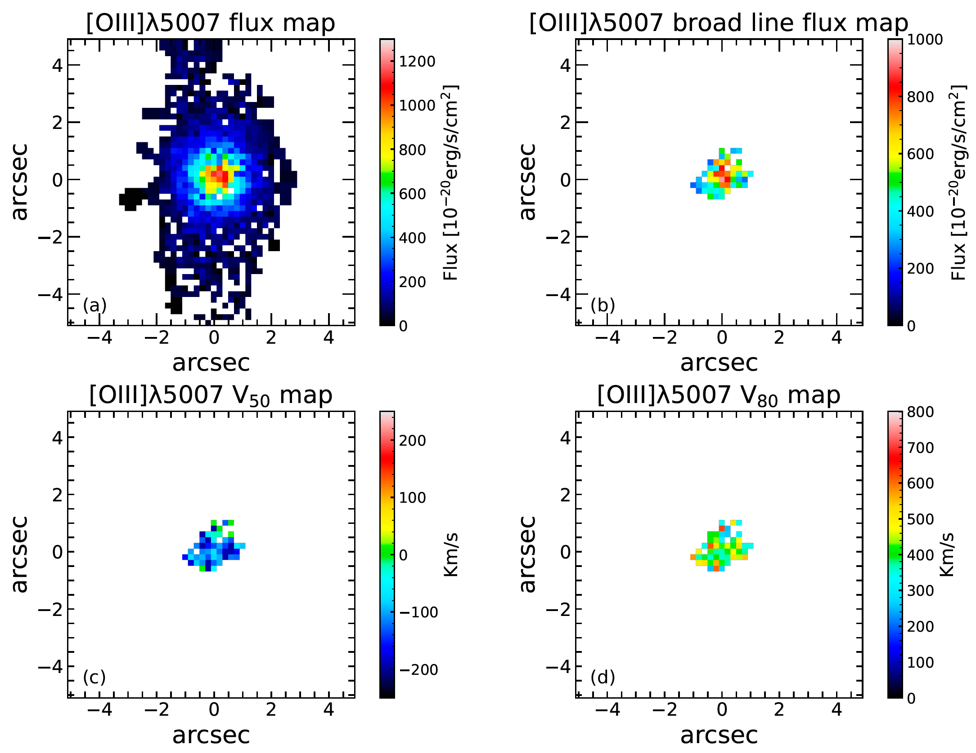
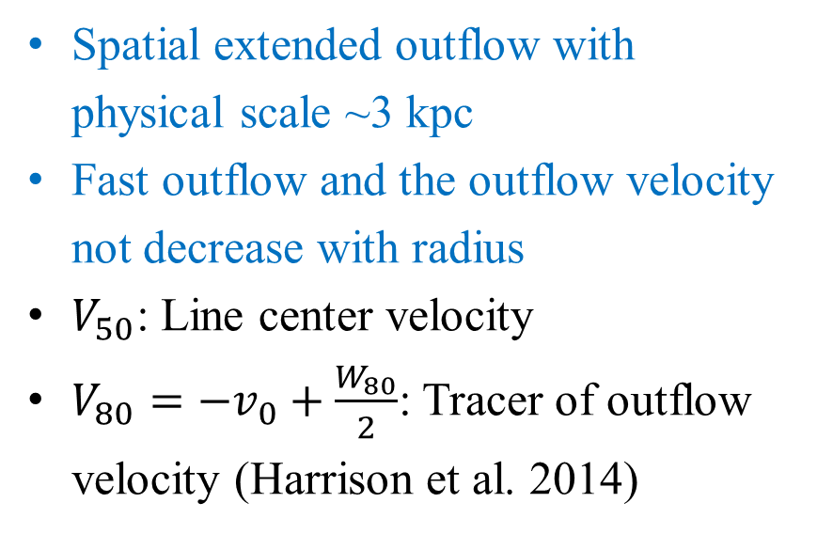
Spatial Distribution of Outflow
Spatial extended outflow with physical scale ~3 kpc
Fast outflow and the outflow velocity not decrease with radius
$V_{50}$: Line center velocity
$V_{80}=−v_{0}+\frac{W_{80}}{2}$: Tracer of outflow velocity (Harrison et al. 2014)

Slide 8
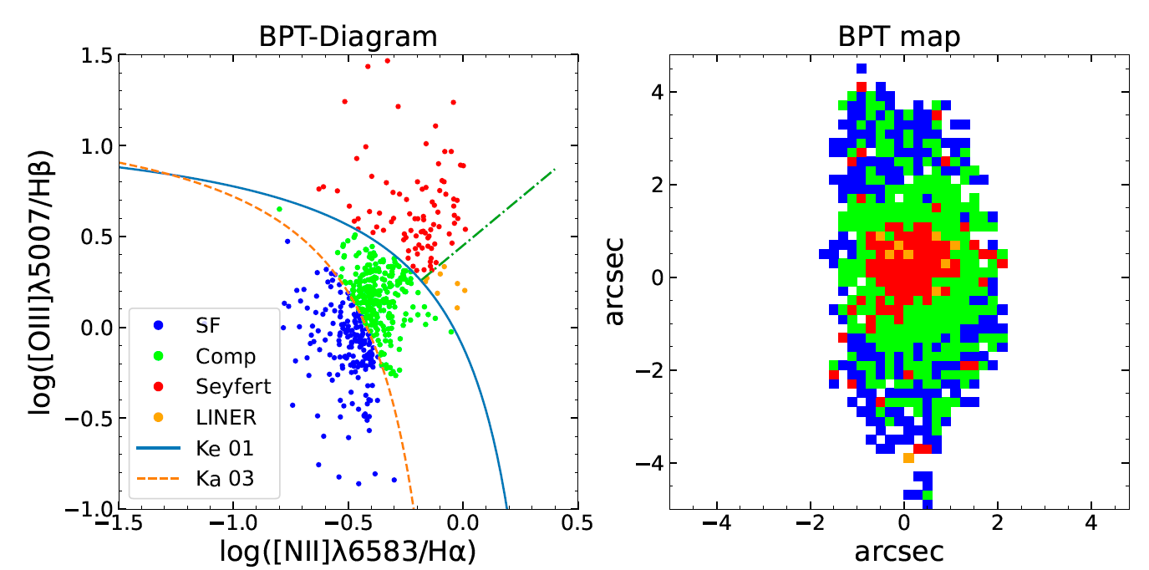
BPT Diagram
It is the AGN that driven such a fast outflow

Slide 9
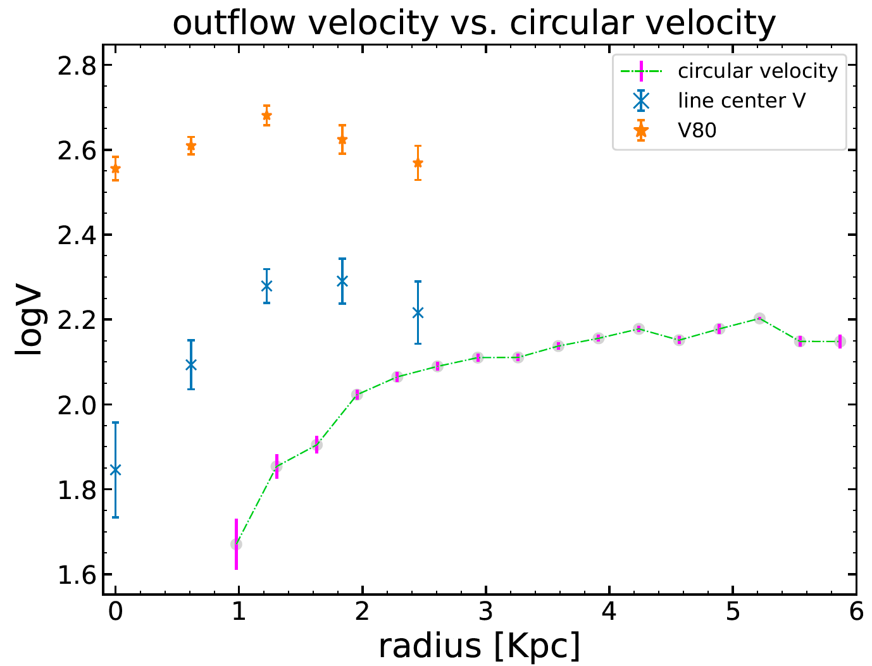
Outflow Velocity vs Circular Velocity
Outflow velocity is larger than the maximum circular velocity
This outflow may escape from the gravitational potential of the galaxy

Slide 10
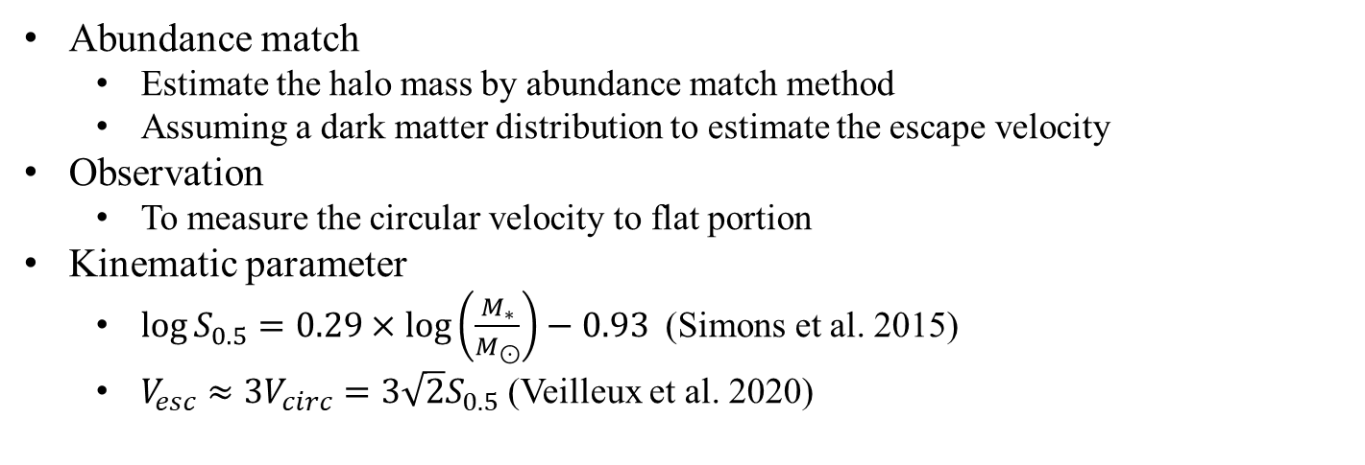
Outflow Scaling Relation
 | quantity | method | error
Liu et al. (2020) | 5 | Abundance match | --
SDSSJ0228 | 1 | From observation | ~4%
McElroy et al. (2015) | 17 | Kinematic parameter | ~30%
Abundance match
Estimate the halo mass by abundance match method
Assuming a dark matter distribution to estimate the escape velocity
Observation
To measure the circular velocity to flat portion
Kinematic parameter
$\log{S_{0.5}}=0.29×\log\left(\frac{M_{∗}}{M_{⊙}}\right)−0.93$ (Simons et al. 2015)
$V_{esc}≈3V_{circ}=3\sqrt{2}S_{0.5}$ (Veilleux et al. 2020)

Slide 11
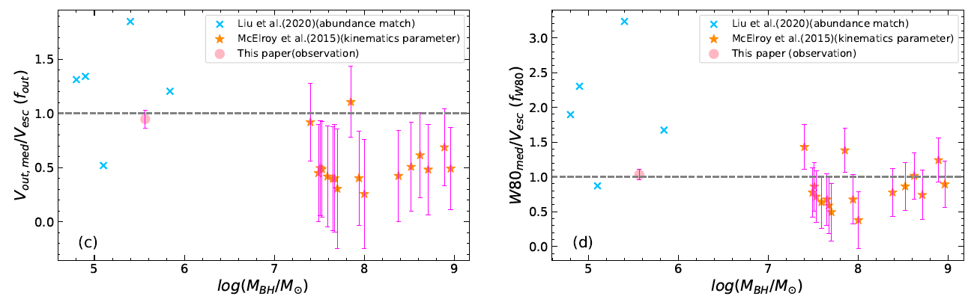
Outflow Scaling Relation
AGN-driven outflow escape easier in less massive SMBH host galaxies

Slide 12
Summary
We find a fast AGN-driven outflow which may escape from the galaxy’s gravitational potential in less massive SMBH hosts: SDSSJ0228-0901.
We find that AGN-driven outflow may escape easier in less massive SMBH host galaxies.

Slide 13
Part II
Short Time Scale Change-Look AGN

Slide 14
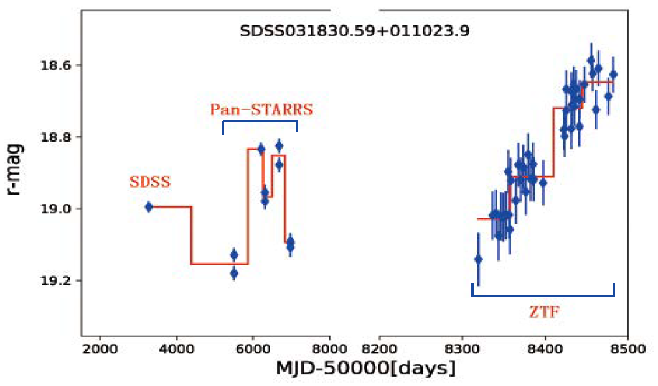
Background
CL-AGN
Luminosity change largely in a short time scale (a few years or shorter) which can not be explained by damped random walks model.
Raising a challenge to the AGN unification model
Several mechanism
Moving cloud to change the foreground absorption
Tidal disruption events
Evolution in accretion rates and different AGN types
Examine the different mechanism by analyzing the spectrum between SDSS and new GTC-OSIRIS observations.

Slide 15
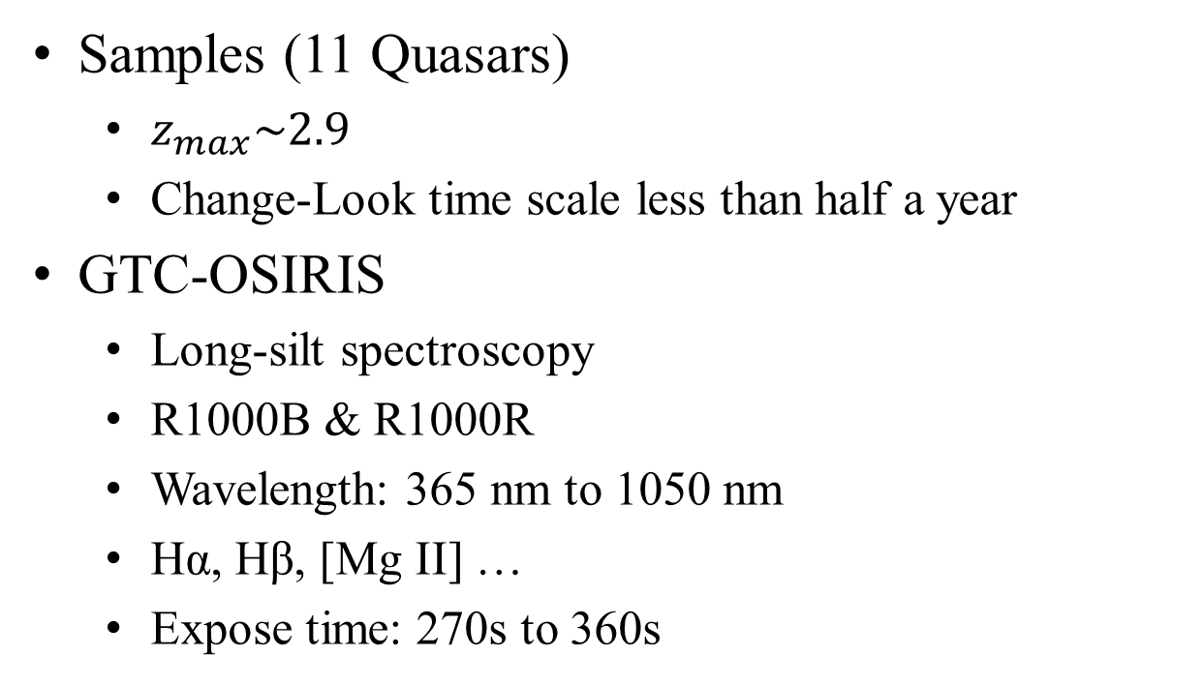
Data analyzing
Samples (11 Quasars)
$z_{max}\sim 2.9$
Change-Look time scale less than half a year
GTC-OSIRIS
Long-silt spectroscopy
R1000B & R1000R
Wavelength: 365 nm to 1050 nm
Hα, Hβ, [Mg II] …
Expose time: 270s to 360s
Now, working on the GTC-OSIRIS raw data reduction.
That’s all, Thanks for listening !

Slide 16
