Slide 1
A Fast Outflow In Dwarf AGN: SDSSJ022849.51-090153.8
报告人：郑致远
指导老师：施勇
2021-06

Slide 2
Outline
Background
Source information
Data analysis
Results
Summary

Slide 3
Background
Internal mechanism of galaxy quenching
Normal galaxy
Supernova feed back
AGN feedback
Dwarf galaxy
Supernova feedback
If AGN feedback is important?
Lack of IFU observation
SDSSJ022849.51-090153.8
AGN host in dwarf galaxy (Dwarf AGN)
Outflow
Q: If the AGN-driven outflow can make the gas escape from the dwarf galaxy?

Slide 4
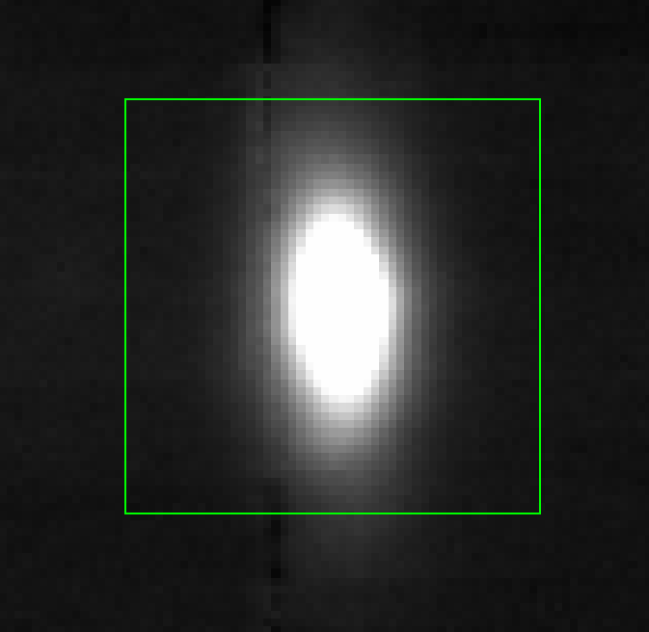
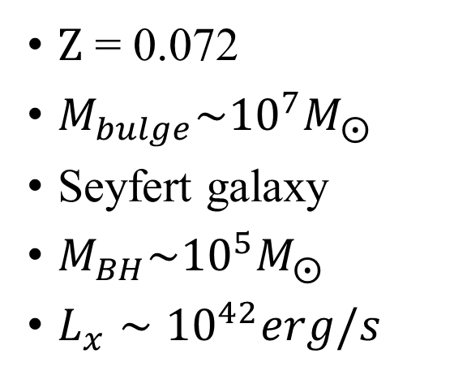
SDSSJ022849.51-090153.8
$Z$ = 0.072
$M_{bulge}\sim {10}^{7}M_{⨀}$
Seyfert galaxy
$M_{BH}\sim {10}^{5}M_{⨀}$
$L_{x}∼{10}^{42}erg/s$
Chilingarian et al. (2018)
r-band image (MUSE)

Slide 5
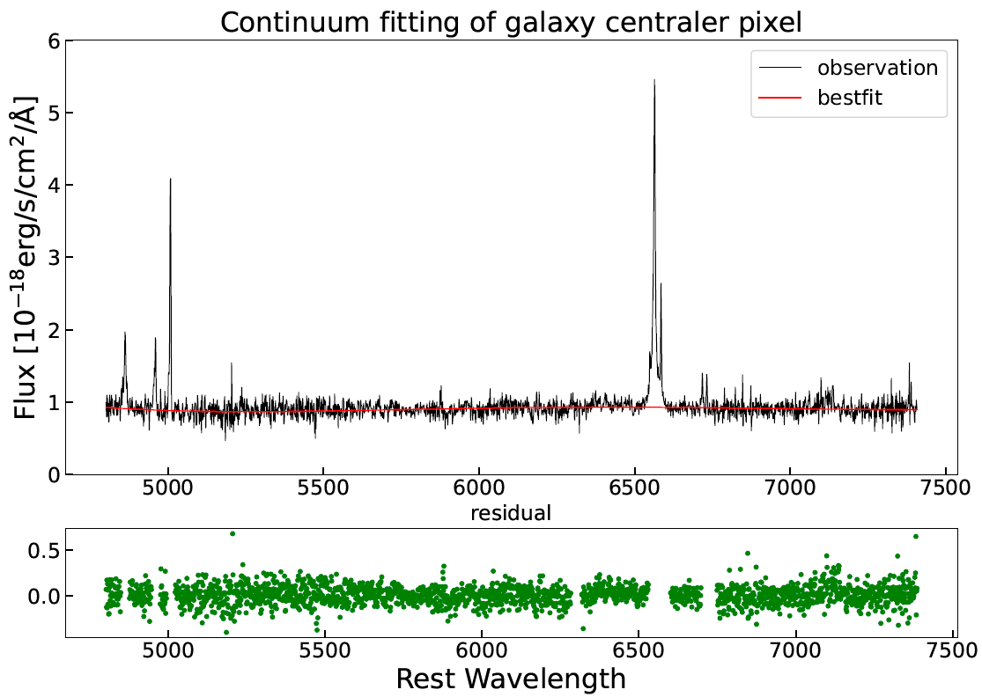
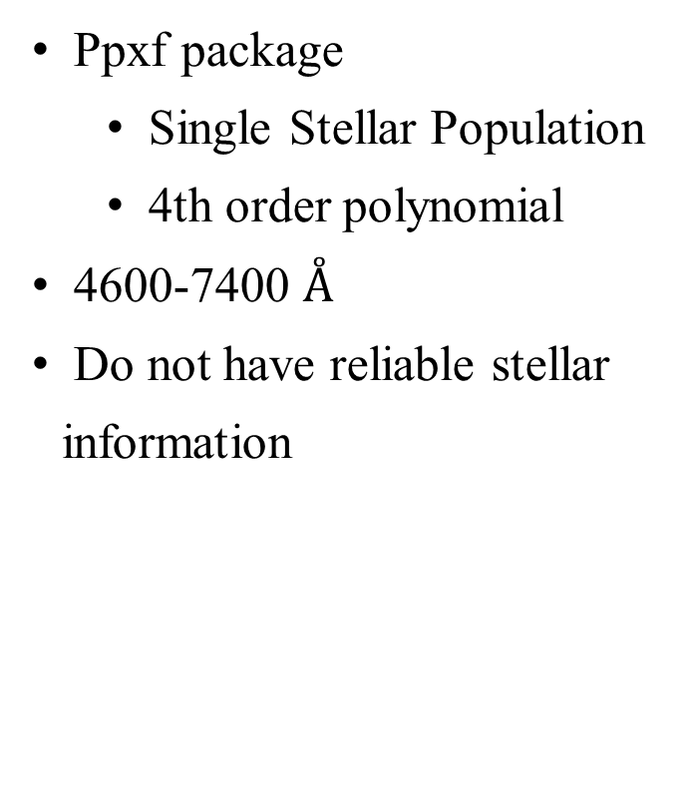
Continuum fitting
Ppxf package
Single Stellar Population
4th order polynomial
4600-7400 $Å$
Do not have reliable stellar information

Slide 6
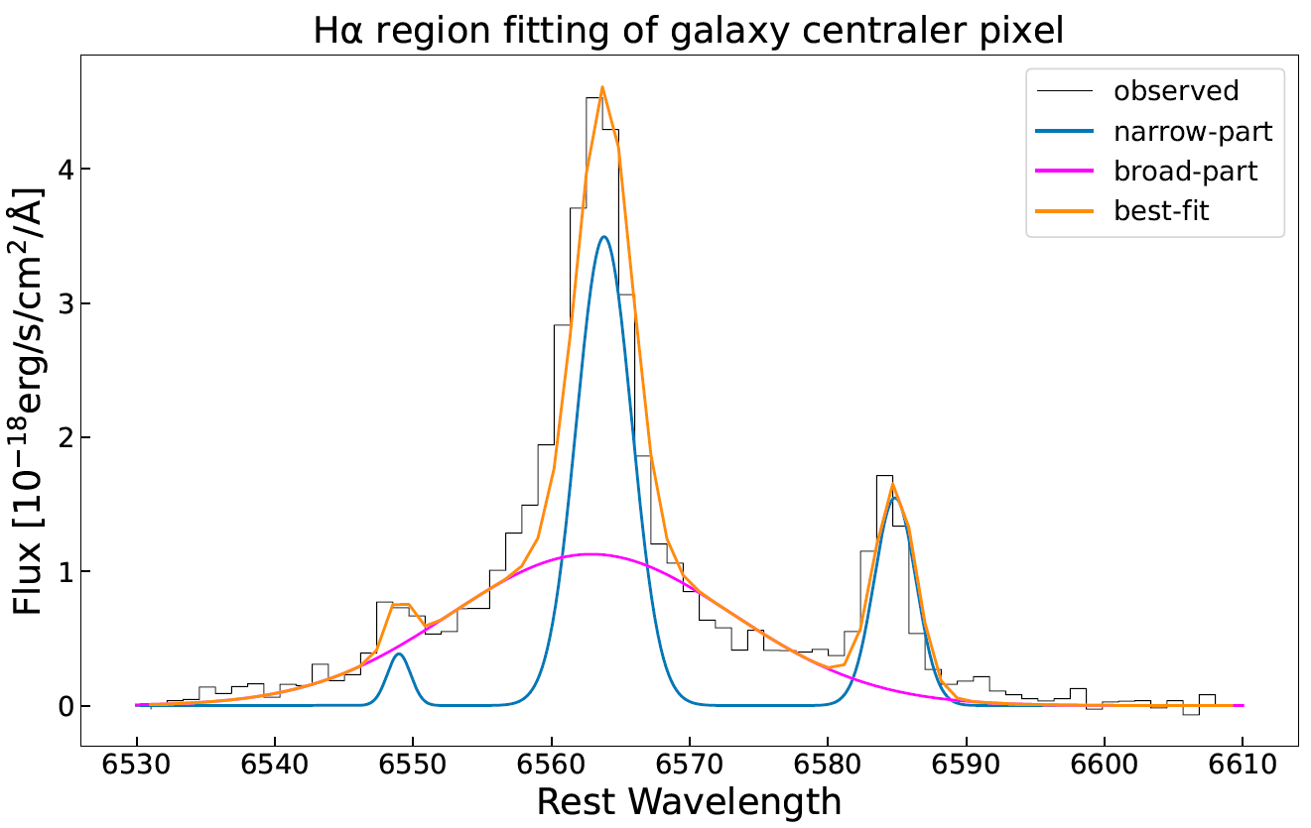
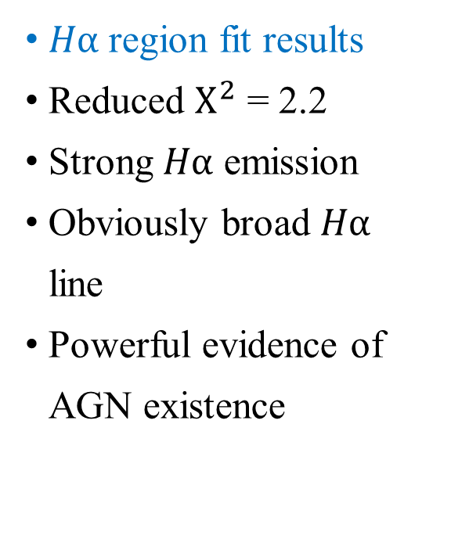
Emission line fitting
$Hα$ region fit results
Reduced $Χ^{2}$ = 2.2
Strong $Hα$ emission
Obviously broad $Hα$ line
Powerful evidence of AGN existence

Slide 7
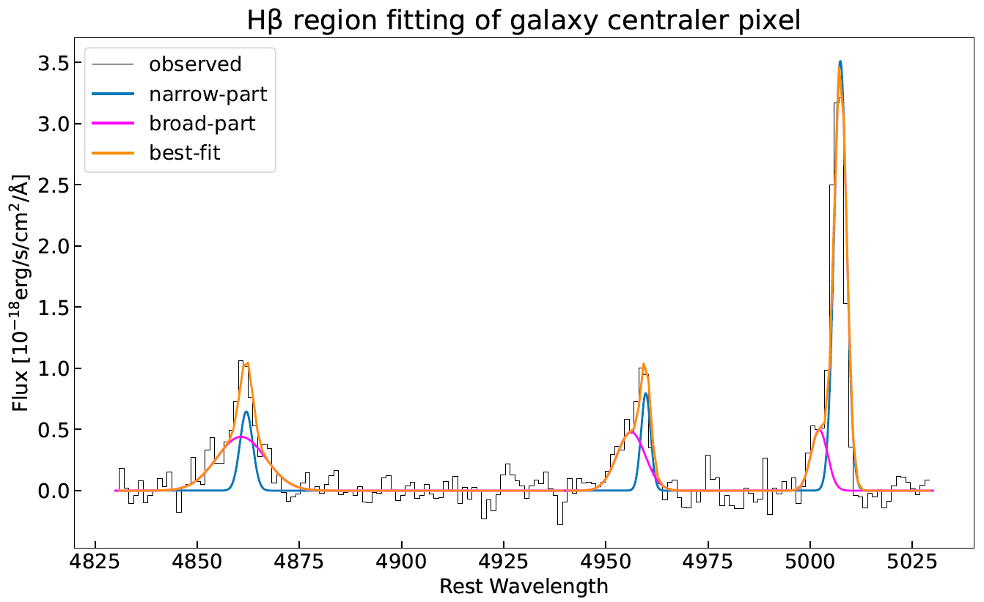
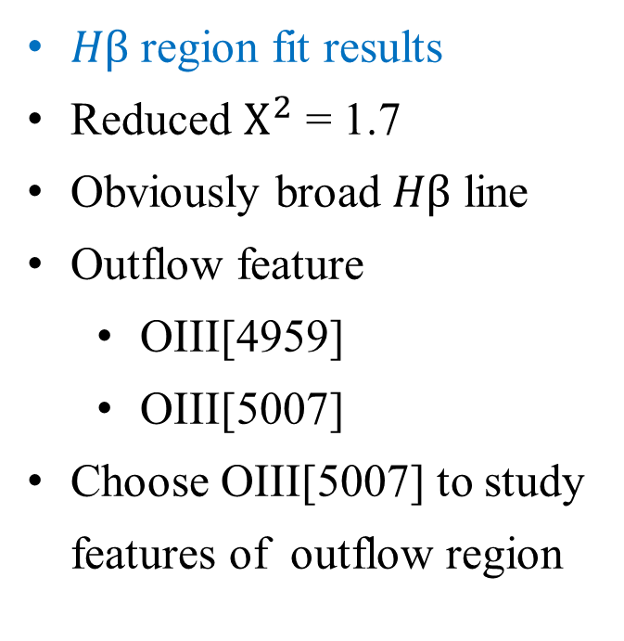
Emission line fitting
$Hβ$ region fit results
Reduced $Χ^{2}$ = 1.7
Obviously broad $Hβ$ line
Outflow feature
OIII[4959]
OIII[5007]
Choose OIII[5007] to study features of outflow region

Slide 8
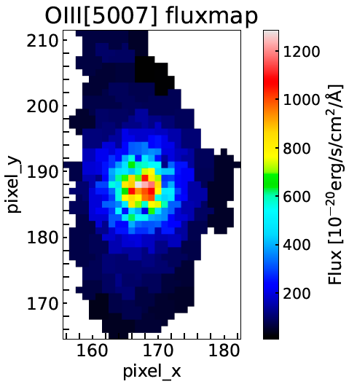
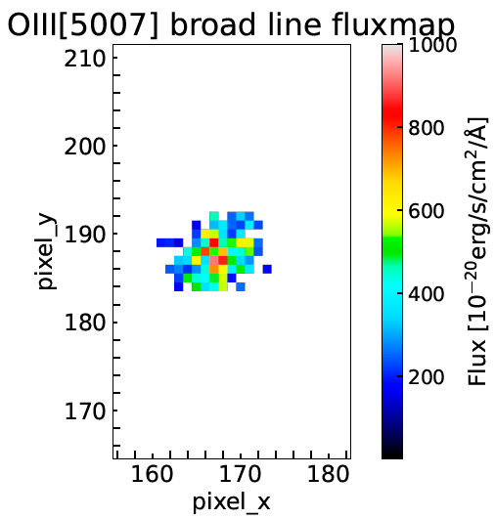
OIII[5007] Flux Map
SNR>2

Slide 9
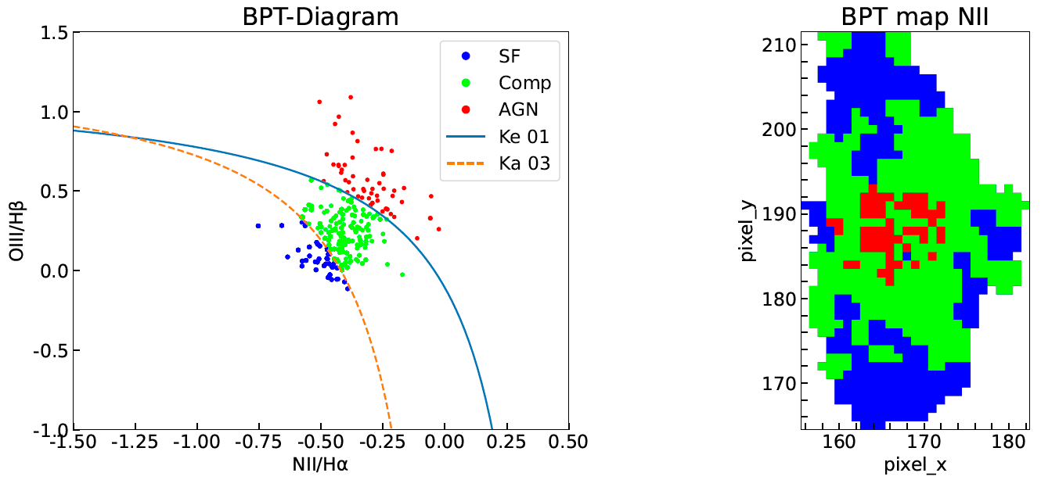
BPT Diagram (NII)
The outflow maybe driven by AGN !

Slide 10
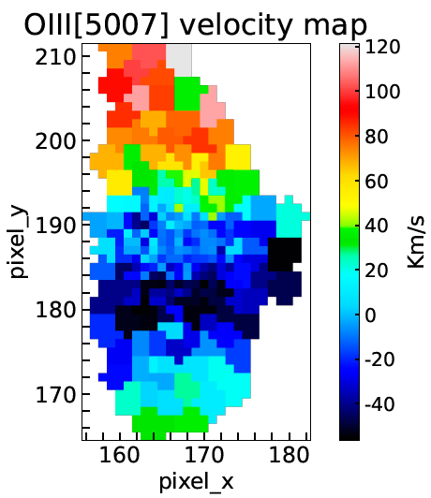
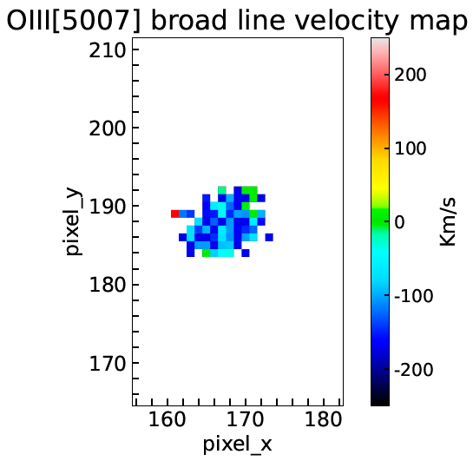
OIII[5007] Velocity Map
SNR>2
Almost all outflow region are blue shift
The outflow velocity is about 200 Km/s
The outflow may escape from the galaxy

Slide 11
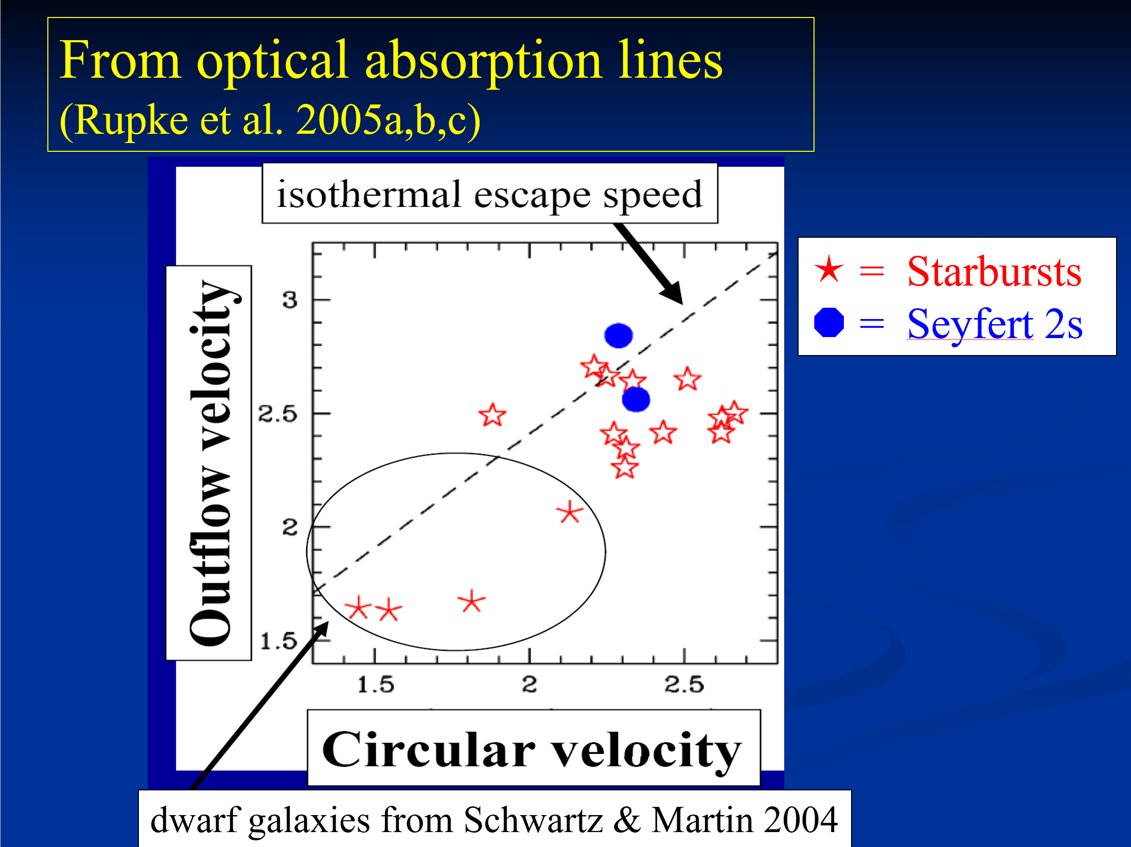
Next Step
Figure from Chen, Y.-M.
To drive the rotation curve from velocity map
To verify if the outflow in SDSSJ0228 can escape from the galaxy

Slide 12
Summary
By fitting the optical spectrum, we find a fast outflow feature in galaxy SDSSJ022849.51-090153.8.
The velocity of broad OIII[5007] is all about 200 Km/s, and do not decrease with radius. This indicates that the outflow may escape from the galaxy.
From the BPT diagram, we infer that the strong outflow may be driven by the AGN.

Slide 13
Thanks for listening !

Slide 14
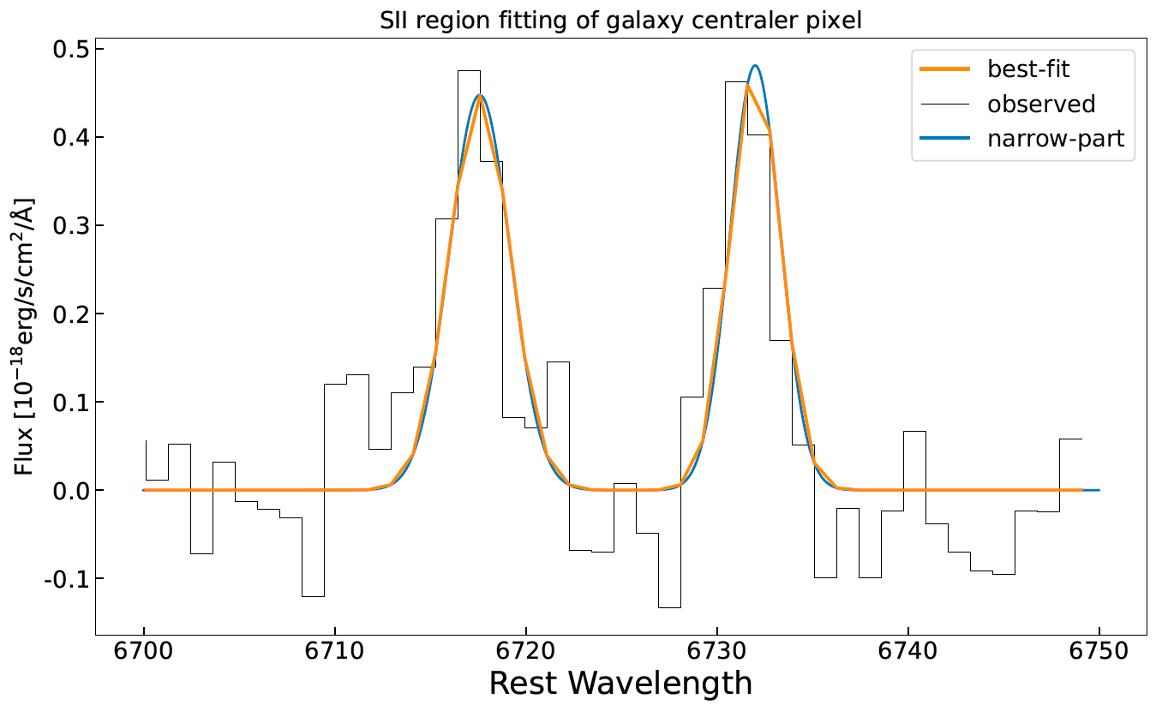
Emission line fitting

Slide 15
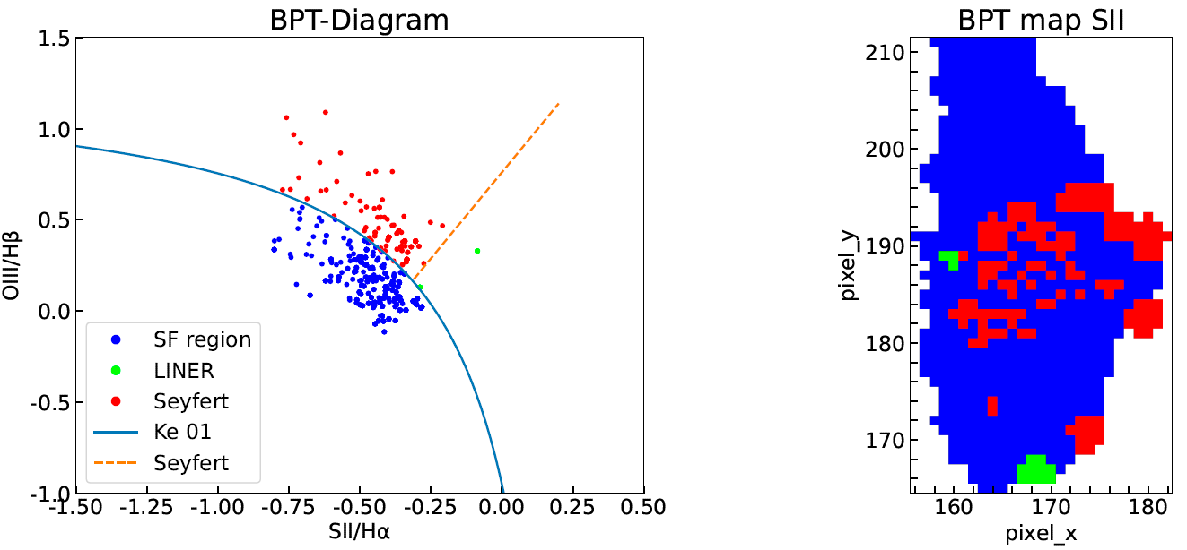
BPT Diagram (SII)

Slide 16
