Slide 1
DEEP LEARNING and Artificial intelligence

Slide 2
Introduction
By 2021, we would need 19 zeta bytes of storage as we will acquire 163 ZB of data. 1 ZB = 1 million PB and 1 PB = 1 million GB. Thus 1 ZB = 10^24 bytes. http://www.business-standard.com/article/international/data-storage-demand-to-multiply-four-fold-by-2025-117070500271_1.html

Slide 3
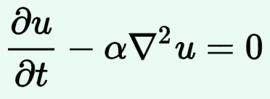
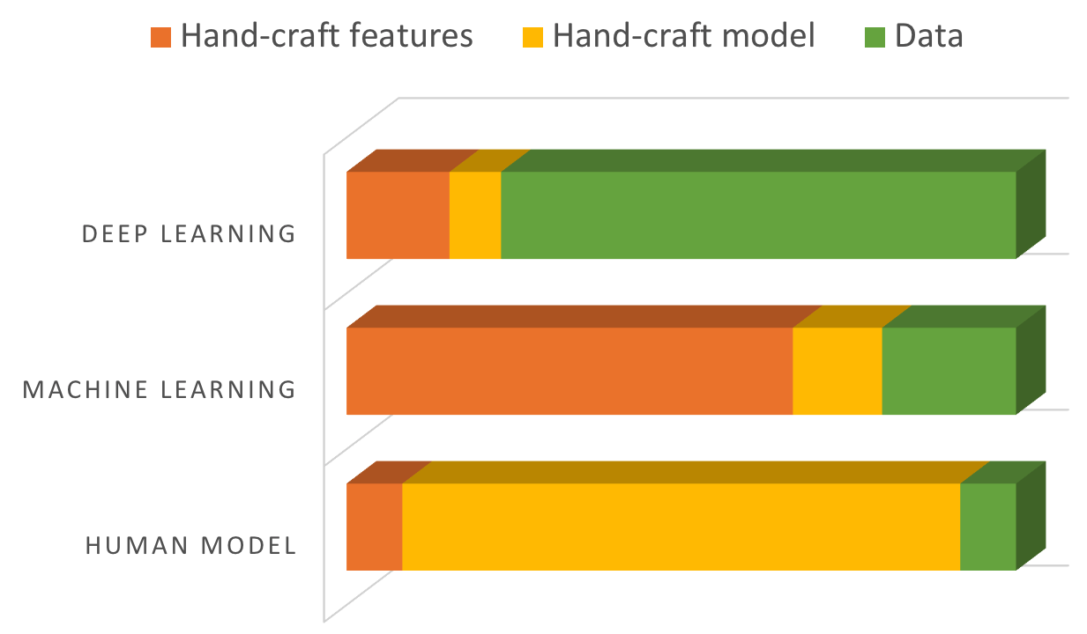
Notes:
Model (differential or integral). Not much data needed but needed human intuition to determine whether the model will fit data. We now have lot of data. We are asking computer to get the model.
Feature engineering. Too much data to sift and figure out if there is any feature we can use for prediction.
Deep learning. It arrived at the right time. Pre-internet, we did not have lot of data. Now we have lot of data. We cannot store all. We need to analyze.

Slide 5
Deep learning
Convolutional neural network (CNN) (cat or dog, tumor or no tumor in image)
Recurrent neural network (RNN) – what is the next word?

Slide 6
RISKS and challenges

Slide 7
General purpose gpu
Latest Volta card
5120 cores
1.37GHz
7 TFLOPS double precision
14 TFLOPS single precision
http://www.nvidia.com/object/tesla-servers.html

Slide 8
Massive parallelization by gpgpu
A and B are matrices of size 1000x1000. We need to compute A+B.
If the operation is done serially, we will need 1 million cycles for the computation to finish.
We can trivially parallelize this task by taking every element in A and the corresponding element in B and pass them to one of the 5000 cores in the GPGPU. Thus we can add 5000 values in A and B at the same time.
If there are 5000 cores, we can complete the matrix addition in 200 cycles which is a speedup of 5000.

Slide 9
Tensor processing unit
Tensor processing unit (TPU) for training and prediction
Developed by Google to be used with Tensorflow
Currently in 2nd generation

Slide 10
Computational challenges
Lot of CPU, GPU, storage and memory. NVIDIA stock is a testament to that.
Software
Lot of labelled or un-labelled data needed
Interpretability of the model

Slide 11
Labelled data
Deep learning needs lots of data and data is hard to find in medicine.
Transfer learning alleviates this problem to an extent.
Labelling requires expertise and hence expensive.

Slide 12
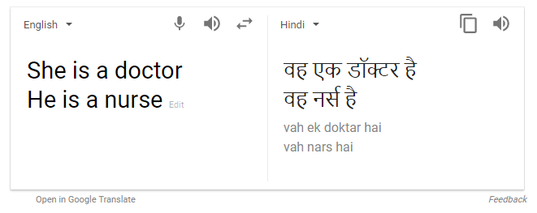
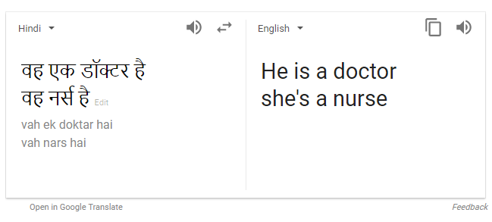
BIAS

Slide 13
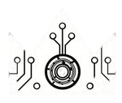
BIAS
http://beauty.ai/
Chatbots shutdown http://www.bbc.com/news/world-asia-china-40815024

Slide 14
interpretability
Linear models are easy to interpret but do not represent real world
Complex models better fit the real world but are not interpretable
Interestingly even humans are not interpretable
Deep learning models with attention identify the region in the image used for making decision

