Slide 1
GRADIENT DESCENT and learning characteristics

Slide 2
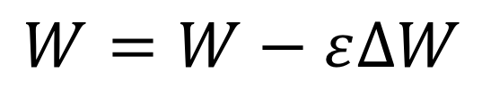
COST FUNCTION
Cost
$$W=W−ε∆W$$
W

Slide 3
LOW learning rate
Cost
1
2
3
W

Slide 4
High learning rate
Cost
1
3
2
W

Slide 5
CHOOSING A learning rate
Loss
Low
High
Good
Epoch

Slide 6
overfitting
Poor fitting
y
Overfitting
x

Slide 7
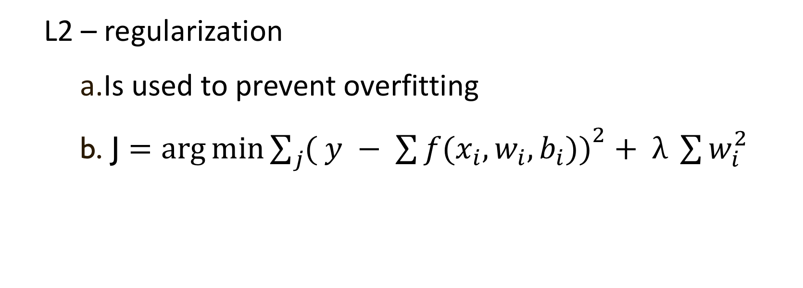
Avoiding overfitting
L2 – regularization
Is used to prevent overfitting
J $=\arg{\min{\sum_{j}{{( y − \sum{f(x_{i}, w_{i}, b_{i}))}}^{2}}}}+ λ \sum{w_{i}^{2}}$

Slide 8
High bias in testing
High bias as the system is under-fit and will fail for test data even if it performs fine for training
Under-fitting
y
x

Slide 9
High Bias and loss curve
Loss
Testing
Training
Epoch

Slide 10
High variance in testing
High variance as the system is over-fit and will fail for test data even if it performs fine for training
Over-fitting
y
x

Slide 11
High variance and loss curve
Loss
Testing
Training
Epoch

Slide 12
references
http://ruder.io/optimizing-gradient-descent/index.html
http://ruder.io/deep-learning-optimization-2017/
http://apmonitor.com/me575/uploads/Main/optimization_book.pdf for an overview of optimization
Ian Goodfellow et.al., “Deep learning”, Pages 77-93 and also Chapter 8.

