Slide 1
LINEAR regression

Slide 2
Fitting a line

Slide 3
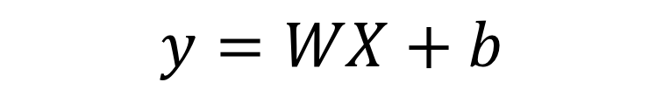
Linear regression model
$$y=WX+b$$
Where W is the slope of the line and b is the intercept

Slide 4
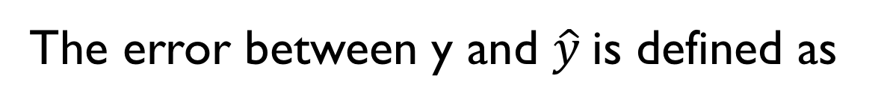
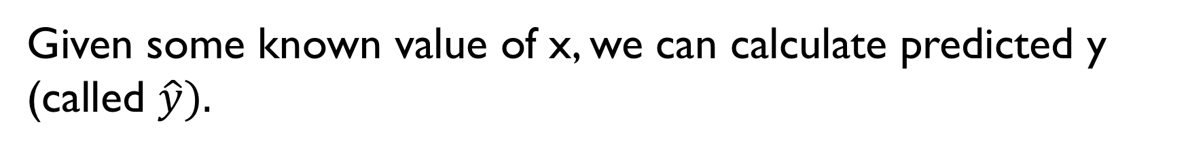
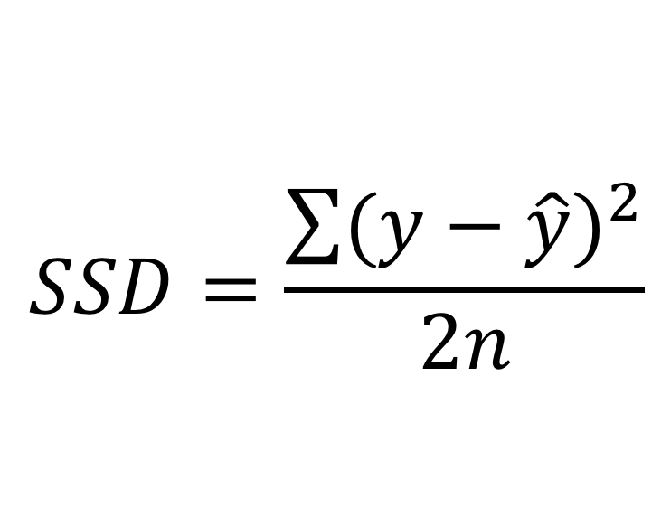
Loss / cost
Given some known value of x, we can calculate predicted y (called $\hat{y}).$
The error between y and $\hat{y}$is defined as
$$SSD=\frac{\sum{{(y−\hat{y})}^{2}}}{2n}$$
Open gradient_descent.pptx

Slide 5
Training, testing and validation
Given a data of size N, we split the data in to three parts: training, testing and validation.
The data is first split in to two parts: training/validation and testing data.
The training/validation data is split in to training and validation data.
The training data is fed to the training process. After every epoch, the model is tested with the validation data.
After the model has converged to satisfaction, the testing data is used to check if the model performed well. At no time, the testing data is used for training.
X1
X2
X3
Y
VALIDATION
TESTING

