Slide 1
Auto encoder

Slide 2
Single node
X
Σ
Z
σ
O
Y
NODE

Slide 3
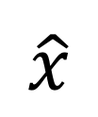
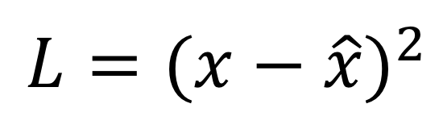
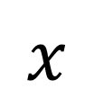
architecture
ENCODER
DECODER
Input and Output are the same
$$x$$
$$\hat{x}$$
$$L={(x−\hat{x})}^{2}$$
INPUT
HIDDEN
OUTPUT

Slide 4
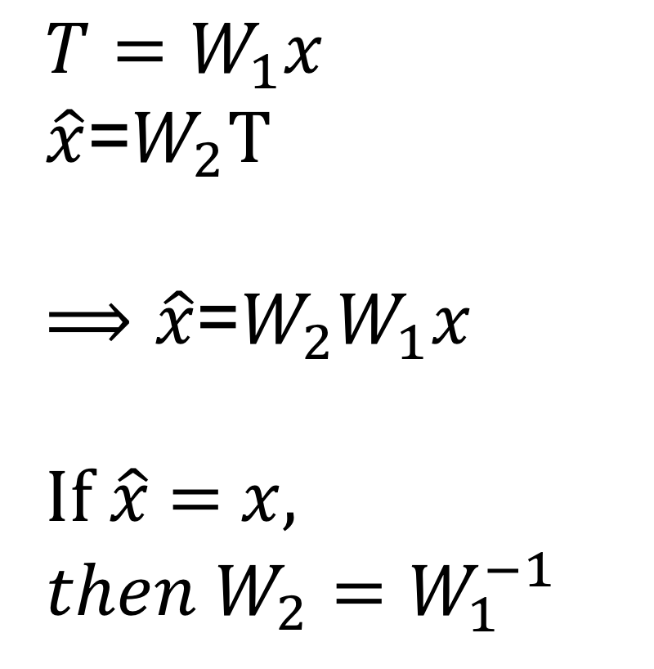

architecture
$$T=W_{1}x$$
$\hat{x}$=$W_{2}$T
$⟹\hat{x}$=$W_{2}W_{1}x$
If $\hat{x}$ = $x,$
$${then W}_{2}=W_{1}^{−1}$$
ENCODER
DECODER
$$T$$
$$x$$
$$\hat{x}$$
If we neglect biases, the auto-encoder is learning an approximation of identity function.
INPUT
HIDDEN
OUTPUT

Slide 5
use
Anomaly detection
Denoising autoencoder to remove noise from images
Inpainting autoencoder – fix missing pixels in images
Super-resolution autoencoder – convert low resolution to high resolution

Slide 6
reference
Ian Goodfellow et.al., “Deep learning”, Chapter 14
http://ufldl.stanford.edu/tutorial/unsupervised/Autoencoders/ Good discussion on visualizing auto-encoder learning
https://towardsdatascience.com/autoencoders-are-essential-in-deep-neural-nets-f0365b2d1d7c provides multiple use cases for auto-encoders
https://www.jeremyjordan.me/variational-autoencoders/ explains variational auto-encoders
https://www.youtube.com/watch?v=5WoItGTWV54&feature=youtu.be&t=26m32s video from CS231n
https://weiminwang.blog/2017/06/23/credit-card-fraud-detection-using-auto-encoder-in-tensorflow-2/ auto-encoder for fraud detection

