Slide 1
Additional topics

Slide 2


Pre-processing data
All classes preferably must be uniformly distributed
Data augmentation
Image flips
Rotation
Random scaling
Color jitter
Add noise
https://github.com/mdbloice/Augmentor
https://www.pexels.com/photo/animal-pet-cute-kitten-45201/

Slide 3
Weight initialization
Zero initialization
All weights and biases set to zero
Slow convergence
Poor learning as the weights remain the same
Random initialization
Assign random values between (0, ε)
Better convergence
c. Breaks symmetry in weight updates
Xavier initialization
He initialization
Transfer learning

Slide 4
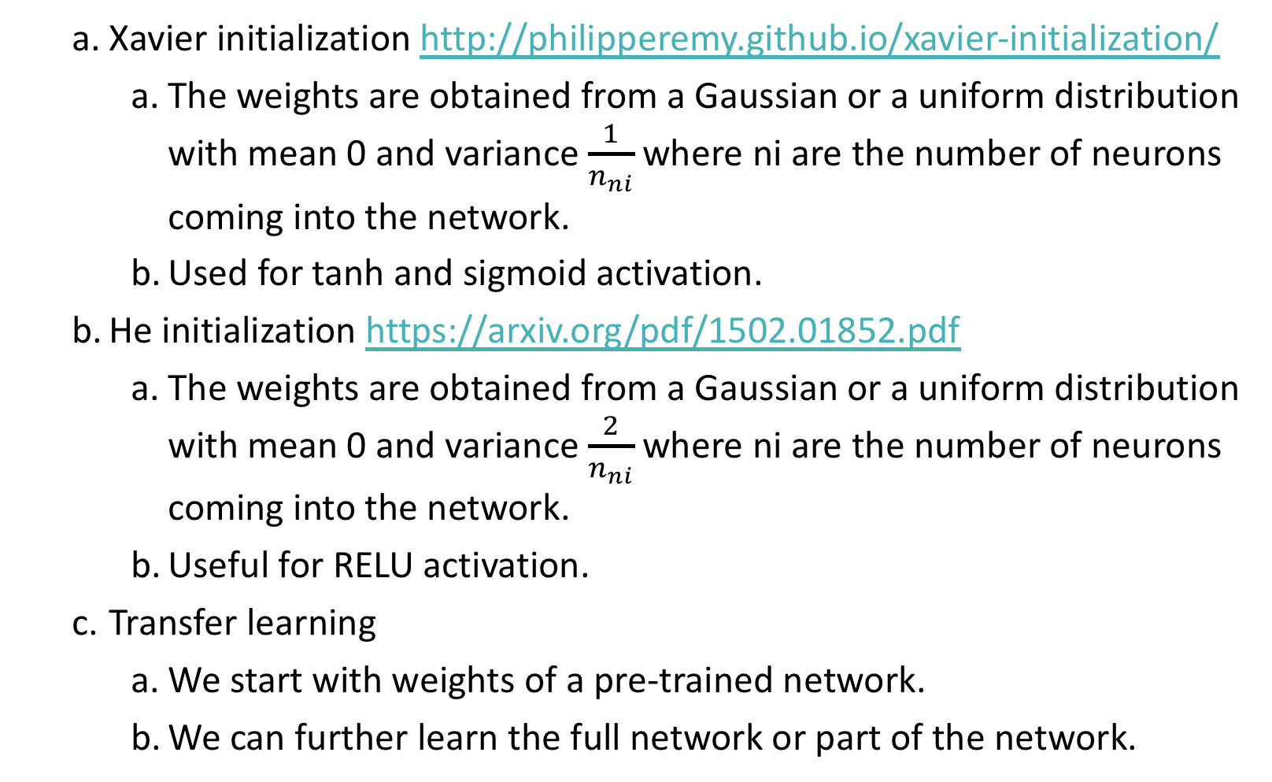
Weight initialization
Xavier initialization http://philipperemy.github.io/xavier-initialization/
The weights are obtained from a Gaussian or a uniform distribution with mean 0 and variance $\frac{1}{n_{ni}}$ where ni are the number of neurons coming into the network.
Used for tanh and sigmoid activation.
He initialization https://arxiv.org/pdf/1502.01852.pdf
The weights are obtained from a Gaussian or a uniform distribution with mean 0 and variance $\frac{2}{n_{ni}}$ where ni are the number of neurons coming into the network.
Useful for RELU activation.
Transfer learning
We start with weights of a pre-trained network.
We can further learn the full network or part of the network.

Slide 5
Need for normalization
x₂
x₂
x₁
x₁

Slide 6
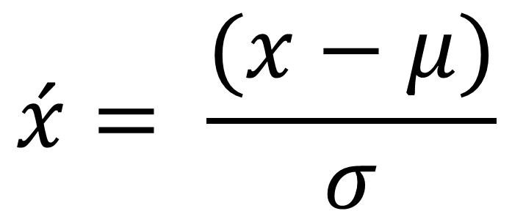
Normalization of input data
$$\acute{x}= \frac{(x−μ)}{σ}$$

Slide 7
Batch normalization
Layer1
Layer2
Layer3
Layer4

Slide 8
Batch normalization
Layer1
Layer2
Layer3
Layer4

Slide 9
Batch normalization
https://arxiv.org/abs/1502.03167

Slide 10
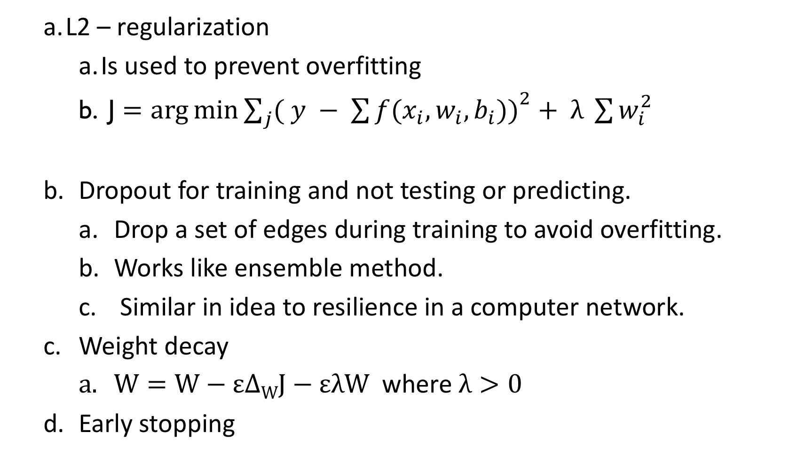
Regularization
L2 – regularization
Is used to prevent overfitting
J $=\arg{\min{\sum_{j}{{( y − \sum{f(x_{i}, w_{i}, b_{i}))}}^{2}}}}+ λ \sum{w_{i}^{2}}$
Dropout for training and not testing or predicting.
Drop a set of edges during training to avoid overfitting.
Works like ensemble method.
Similar in idea to resilience in a computer network.
Weight decay
$W=W−ε∆WJ−ελW$ where $λ>0$
Early stopping

Slide 11
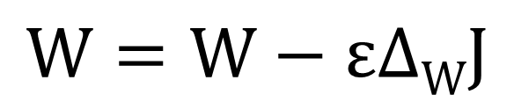
Optimization and COST FUNCTION
Cost
$$W=W−ε∆WJ$$
W

Slide 12
LOW learning rate
Cost
1
2
3
W

Slide 13
High learning rate
Cost
1
3
2
W

Slide 14
Optimization methods
First order methods
Stochastic Gradient Descent (SGD)
SGD+Momentum
Nesterov momentum
Adam – best default choice
RMSprop
Second order method
Broyden–Fletcher–Goldfarb–Shanno (BFGS)
Limited-memory BFGS (L-BFGS) which does not work well with mini-batch
https://arxiv.org/pdf/1609.04747.pdf

Slide 15

SGD with batches
Use small batch of data, so that the memory footprint is small.
It also allows incremental learning
$$W=W−ε∆WJ$$

Slide 16
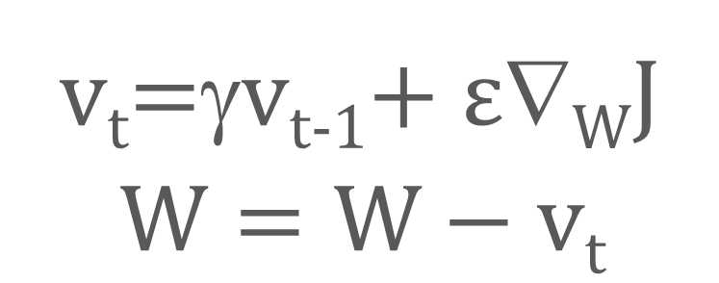
SGD+Momentum
Cost
v_{t}=γv_{t-1}+ $ε$∇_{W}J
$$W=W−vt$$
γ is usually around 0.9
W

Slide 17
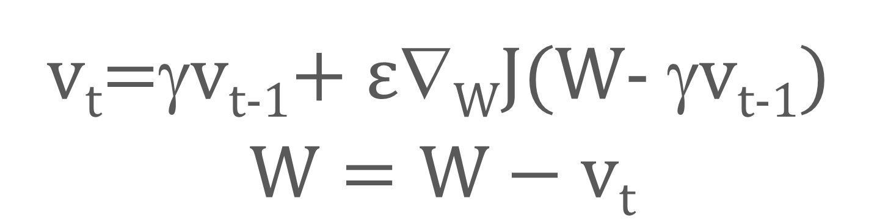
Nesterov momentum (Nesterov accelerated gradient )
v_{t}=γv_{t-1}+ $ε$∇_{W}J(W- γv_{t-1})
$$W=W−vt$$
γ is usually around 0.9

Slide 18
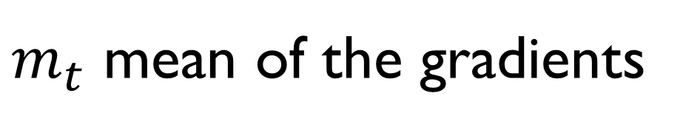
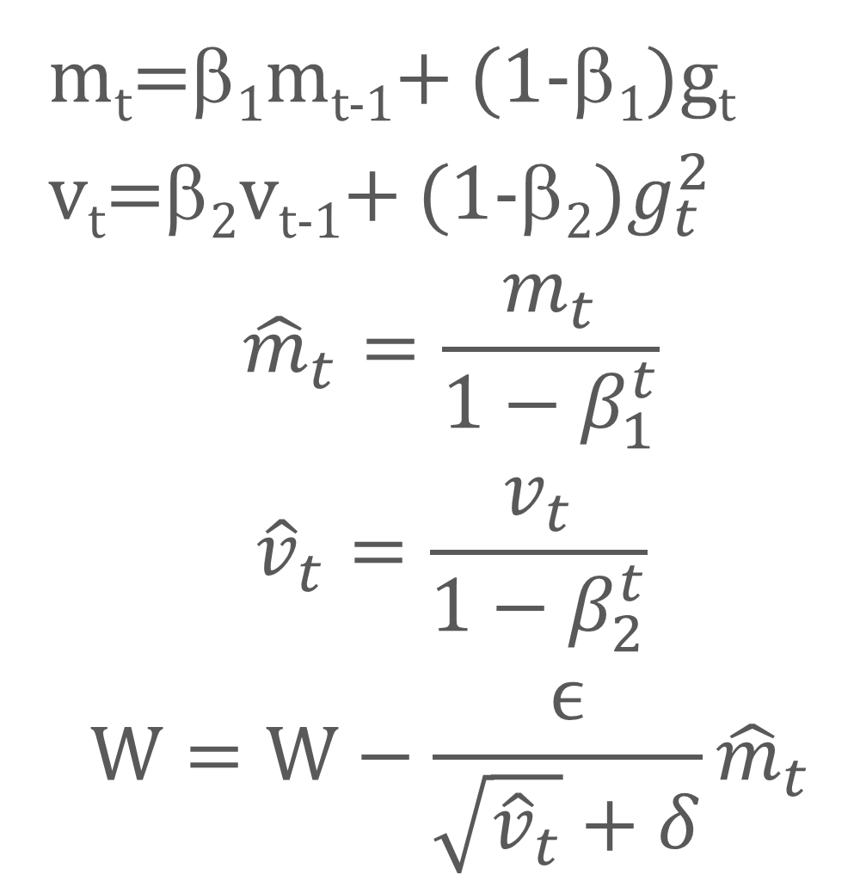
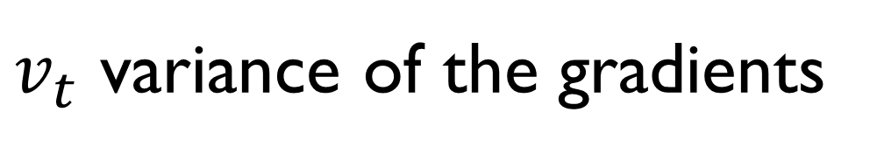
Adaptive Moment Estimation (ADAM)
m_{t}=β₁m_{t-1}+ (1-β₁)g_{t}
v_{t}=β₂v_{t-1}+ (1-β₂)$g_{t}^{2}$
$${\hat{m}}_{t}=\frac{m_{t}}{1−β_{1}^{t}}$$
$${\hat{v}}_{t}=\frac{v_{t}}{1−β_{2}^{t}}$$
$$W=W−\frac{ϵ}{\sqrt{{\hat{v}}_{t}}+δ}{\hat{m}}_{t}$$
$m_{t}$ mean of the gradients
$v_{t}$ variance of the gradients
β₁ = 0.9
β₂ = 0.999
δ = 10⁻⁸

Slide 19
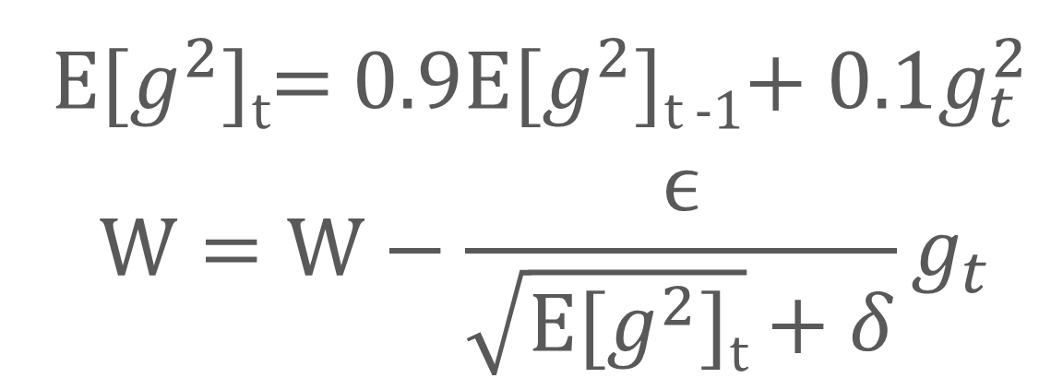
RMSProp
E[$g^{2}$]_{t}= 0.9E[$g^{2}$]_{t -1}+ 0.1$g_{t}^{2}$
$$W=W−\frac{ϵ}{\sqrt{\text{E}\text{[}g^{2}\text{]}\text{t}}+δ}g_{t}$$
E is the decaying running average of gradients

Slide 20
Which one should I use?
SGD and SGD with momentum is simpler than adaptive methods (ADAM, RMSProp etc.) and might work for some deep learning problems. However it might take longer to converge.
Adaptive methods have varying learning rate. The learning rate starts large and then adaptively reduces while the other methods have constant learning rate.
Adaptive methods work best on sparse data where the values will be updated at different rate for different dimension.

Slide 21
Monitoring the learning process
Adjust hyper-parameter starting with learning rate
Check if the loss is decreasing. If increasing, reduce learning rate
Best case if training loss is low and accuracy is high
Use small regularization at the start
If the loss is NaN, then learning rate is too high
Watch loss in tensorboard
Weight update to weight magnitude must be small like 0.001
Modify the activation function
Search for hyper-parameter in random order and not on a grid.
Gradient checking

Slide 22
reference
http://www.mlyearning.org/ - Free book by Andrew Ng.
https://arxiv.org/abs/1803.09820 - A paper on hyper-parameter tuning

