Slide 1
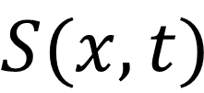

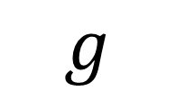

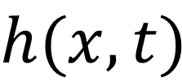

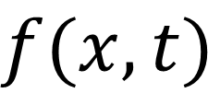
$$z$$
$$g$$
$$h(x,t)$$
Gas phase
Liquid phase
$$f(x,t)$$
Solid phase
$$S(x,t)$$
$$α$$
$$x$$

