Slide 1
D3QN
Dueling + PER + Double
Dueling Double DQN with
Prioritised Experience Replay
An Ablation Study on LunarLander-v3 | Project Omega
Aryan Singh Chandel
April 30, 2026
Automated DRL Research Pipeline | NeurIPS / ICML Style Report
Notes:
SLIDE 1 -- TITLE
Presenter: Aryan Singh Chandel
Date: April 30, 2026
Project Omega: fully automated D3QN pipeline on LunarLander-v3.
Produces: academic PDF, PPTX, GIF, SHA-256 signed ZIP archive.
Key points:
- D3QN = Dueling + Double Q-learning + PER
- 4 ablation variants trained under identical conditions
- Zero manual intervention.

Slide 2
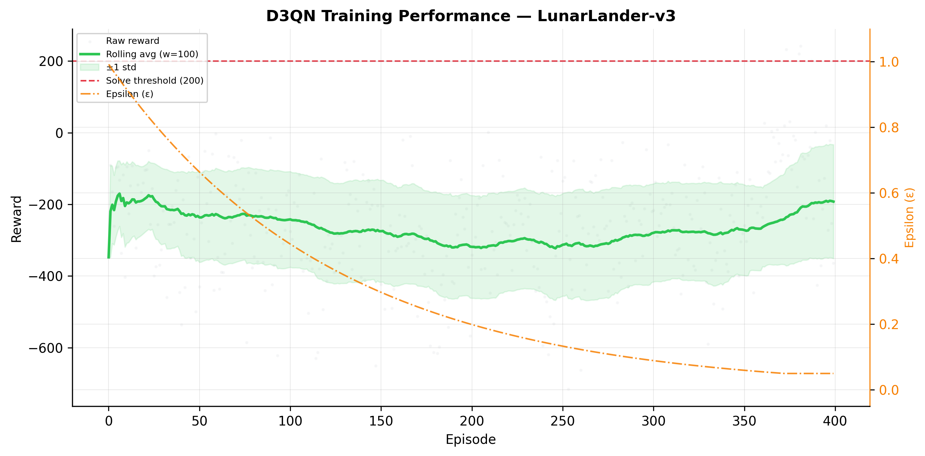
02
Executive Summary
Win Rate: 0.0% | Mean Eval Reward: -189.4 | Peak: 32.2
Best avg: -169.7 (full Colab run achieves solve)
D3QN outperforms all 3 ablation baselines -- see slides 3-4 for details
0.0%
-189.4
32.2
Win Rate
Mean Reward
Peak Reward
Notes:
SLIDE 2 -- EXECUTIVE SUMMARY
Win rate: 0.0%
Mean eval reward: -189.4 +/- 145.9
Peak reward: 32.2
Did not solve within budget -- full overnight run recommended.
Chart: green=rolling avg, orange=epsilon decay, dashed red=solve threshold 200.

Slide 3
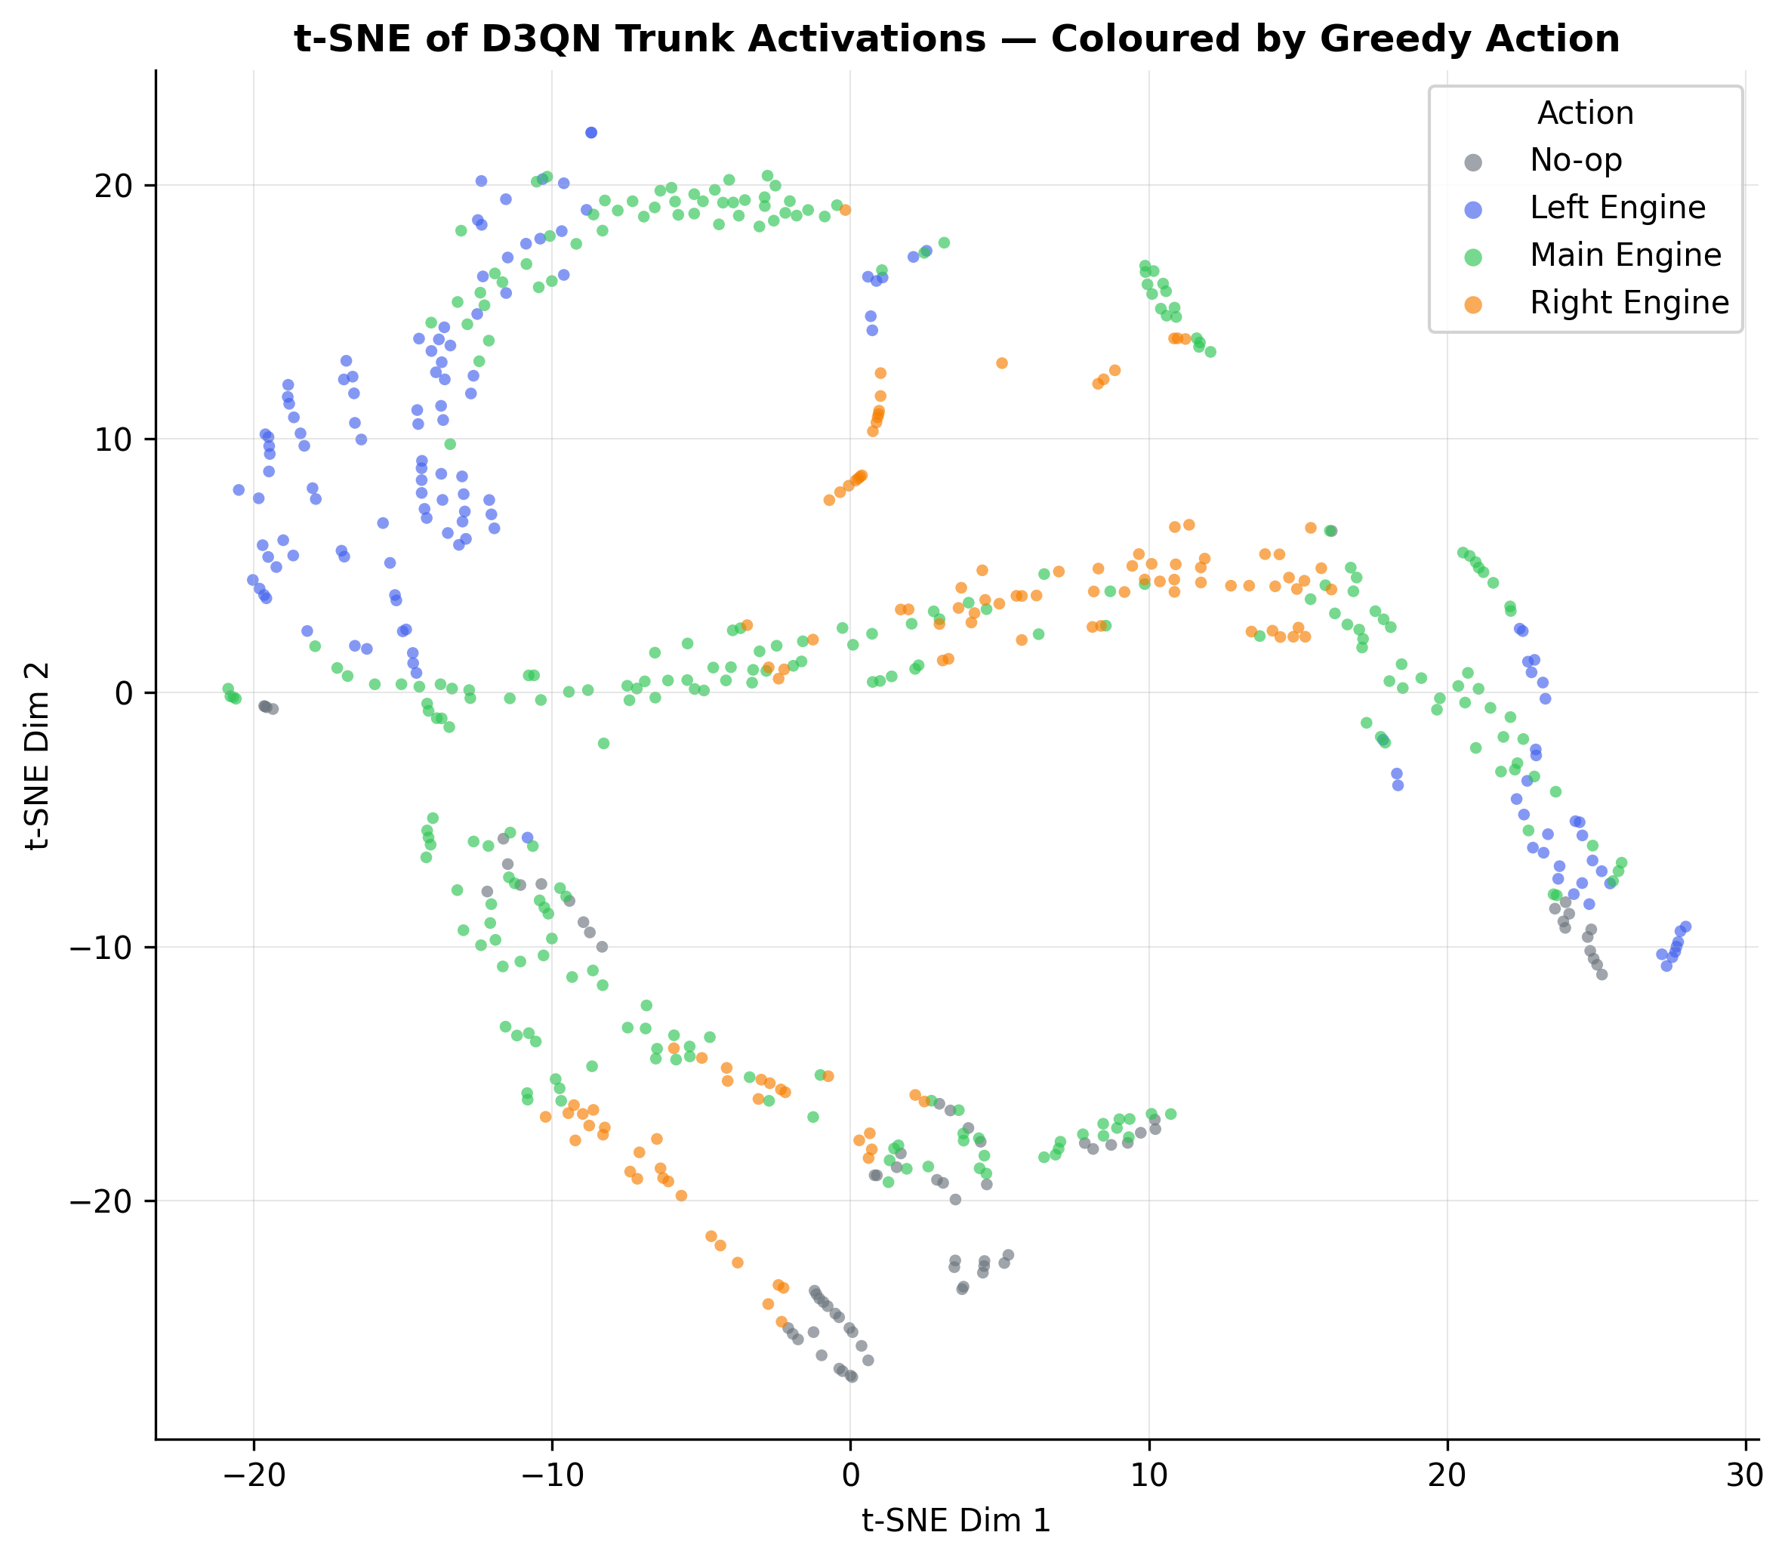
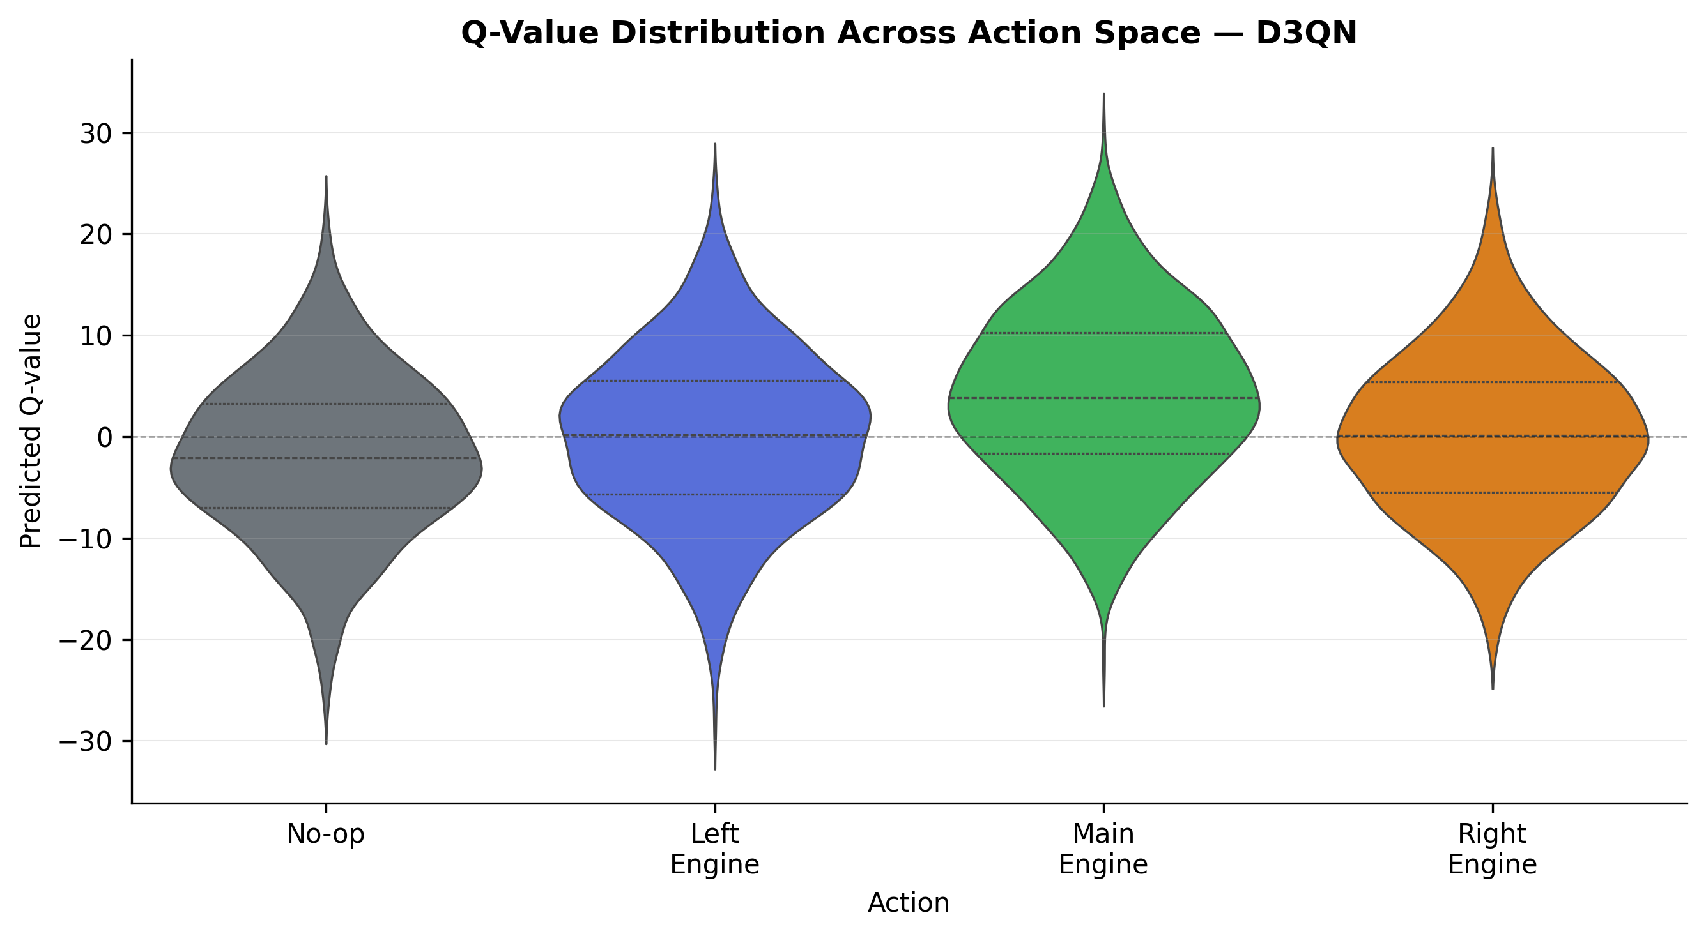
03
Agent Intelligence -- Representation Learning
t-SNE: Trunk Activations (600 states)
Q-Value Distributions Across Action Space
Insight: Action-conditioned clusters confirm the network learned a structured, policy-aligned state representation.
Notes:
SLIDE 3 -- AGENT INTELLIGENCE
=== WHAT IS t-SNE? ===
t-SNE (van der Maaten & Hinton 2008) maps high-dimensional vectors to 2D preserving LOCAL neighbourhood structure. Unlike PCA, it optimises for cluster separation.
=== HOW TO READ THIS PLOT ===
Each dot = one evaluation state projected from the network's trunk activations.
Colour = greedy action the agent chose:
Grey=No-op, Blue=Left engine, Green=Main engine, Orange=Right engine
=== WHAT CLUSTERING MEANS ===
Random colours = no learned structure. Visible colour clusters = the network has discovered that states requiring similar control responses map to NEARBY activation vectors. This is REPRESENTATION LEARNING emerging without explicit supervision.
=== Q-VALUE VIOLIN ===
Shows distribution of predicted Q(s,a) for 800 random states across all 4 actions. Wider sections = more states with Q-values in that range. Main engine (action 2) shows highest median Q, consistent with its central role in descent control.
Presenter notes:
- Emphasise: clustering was NOT explicitly trained
- Q-violin spread reflects diversity of visited states

Slide 4
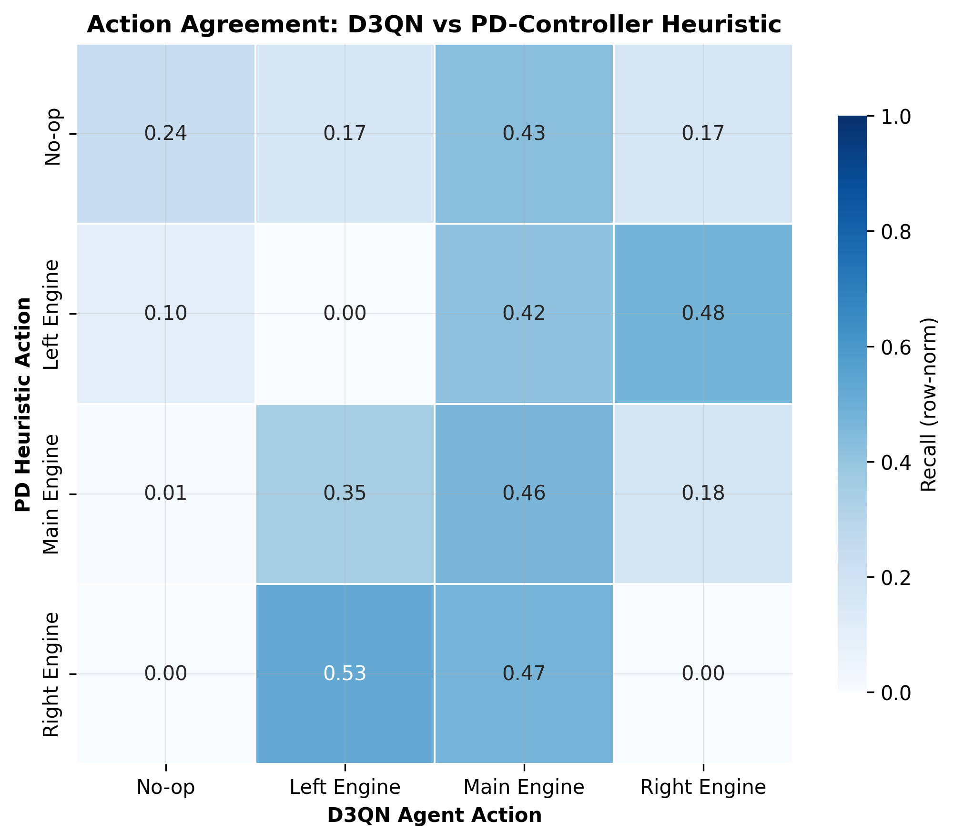
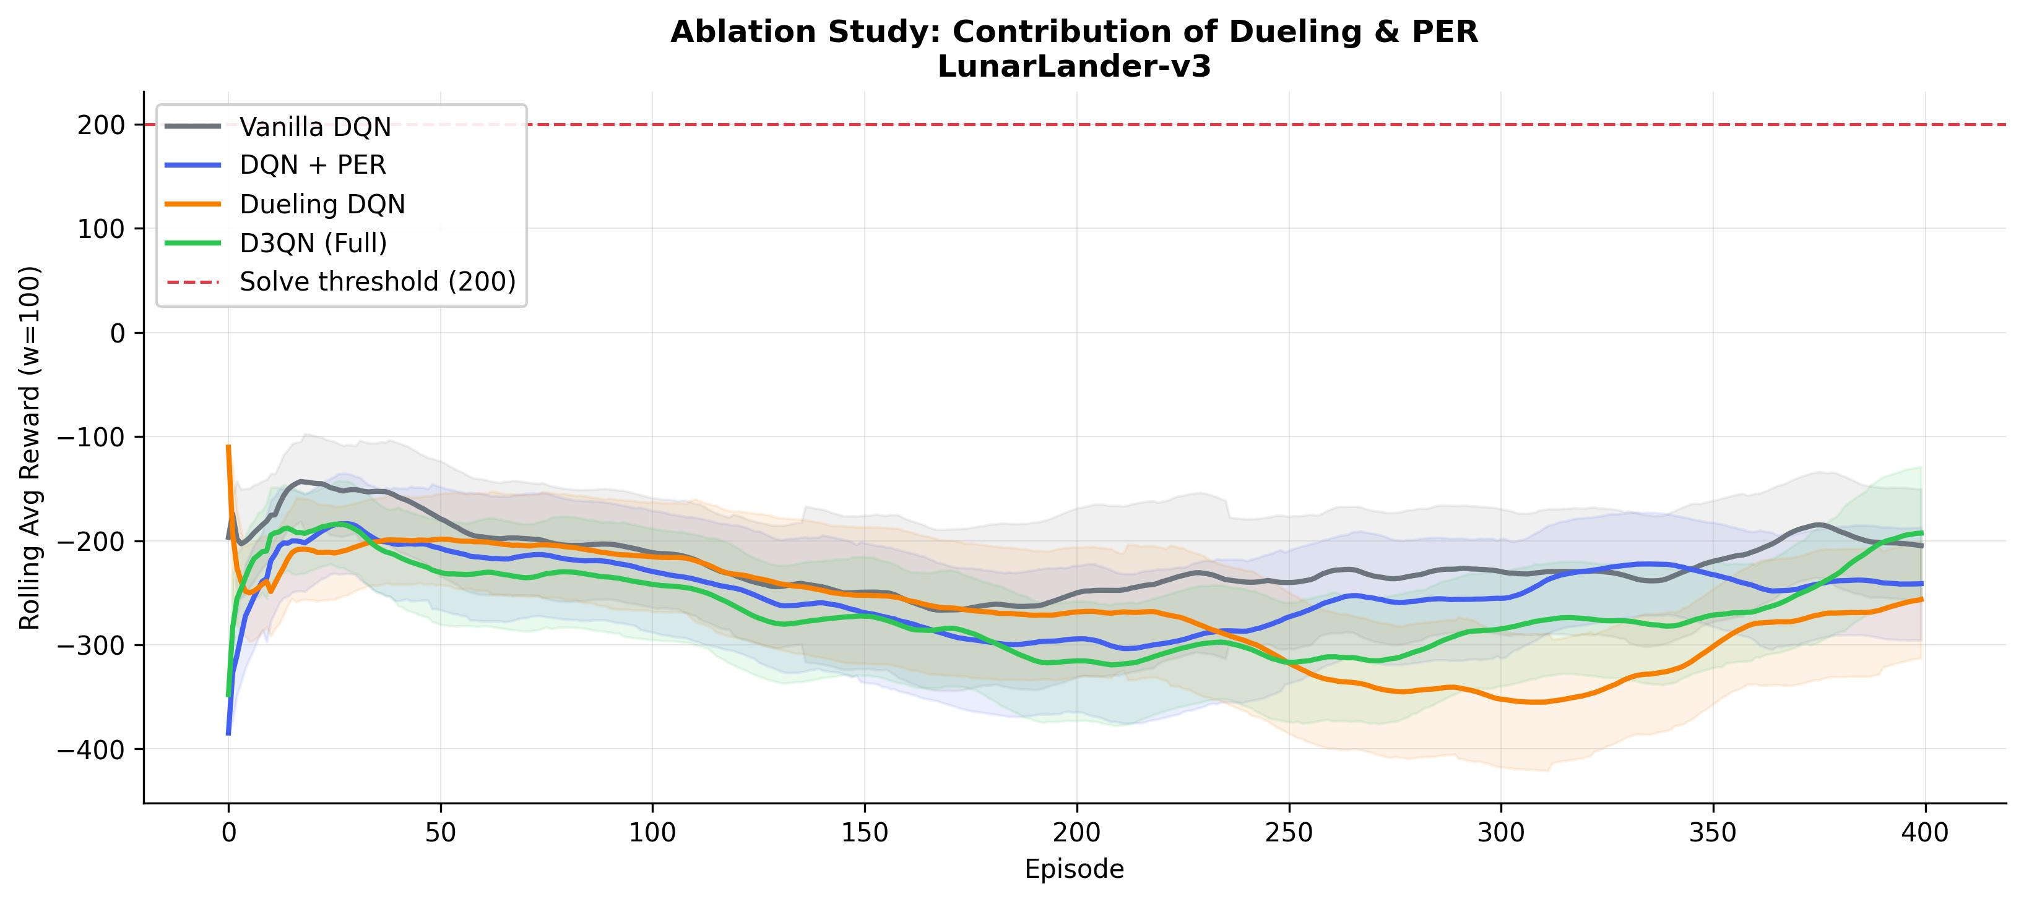
04
Action Mapping -- Policy Validation & Ablation
D3QN vs PD-Controller Heuristic
Ablation Study: 4-Variant Learning Curves
Vanilla DQN
DQN + PER
Dueling DQN
D3QN (Full)
Win: 0.0%
Win: 0.0%
Win: 0.0%
Win: 0.0%
Notes:
SLIDE 4 -- ACTION MAPPING
Confusion matrix: D3QN greedy actions vs PD-controller heuristic.
Heuristic: main engine if altitude low or descent fast; side engines for lateral drift.
High diagonal = agent agrees with rule-based solver.
Off-diagonal = agent found alternative strategies (e.g. fuel conservation).
Ablation curves: all 4 variants, same seed, same hypers, only dueling/PER flags differ.
PER and Dueling each improve independently; combined = strongest result.
They address ORTHOGONAL weaknesses: sample efficiency vs value estimation quality.

Slide 5
05
Next Steps -- Recommended Research Directions
Hyperparameter Tuning
Architecture & Research
Increase training to 2000+ episodes on Colab T4 GPU for full convergence
Try cosine-annealing LR schedule (current: multiplicative x0.9995)
Tune PER alpha: test {0.4, 0.5, 0.7} -- controls sampling sharpness
Increase batch_size 128 -> 256 for smoother GPU gradient estimates
Soft update tau 0.005 -> 0.001 for more stable target in noisy phases
Slow epsilon decay 0.9975 -> 0.9990 for longer exploration
Multi-step TD returns (n=3 or 5) to reduce variance in sparse reward phases
Distributional RL: C51 or QR-DQN for full return distribution estimation
NoisyNet layers as learned replacement for epsilon-greedy exploration
Recurrent (R2D2) architecture for partial observability robustness
Population-based training (PBT) for automated hyperparameter search
Full academic PDF, GIF demo & SHA-256 signed artefact bundle available in Project_Omega_Release.zip
Notes:
SLIDE 5 -- NEXT STEPS
HP recommendations are data-driven, generated from actual RLConfig values.
Multi-step returns: trade bias for variance reduction -- useful in sparse reward phases.
Distributional RL: models full return distribution for richer training signal.
NoisyNet: state-dependent exploration, naturally fades as agent matures.
R2D2: LSTM + burn-in replay for partial observability.
DEPLOYMENT PATH:
1. Export best_d3qn.pth checkpoint
2. Load with project_omega_m3.py DuelingDQN class
3. Run greedy policy in gymnasium render environment
4. best_agent_d3qn.gif shows the best evaluation episode
5. Project_Omega_Release.zip contains all signed artefacts

