Slide 1
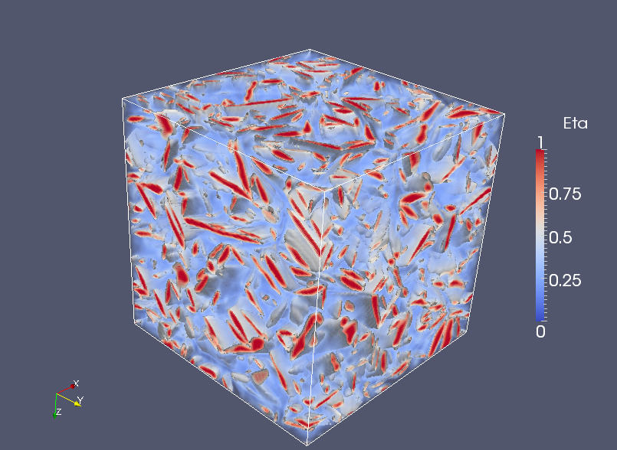
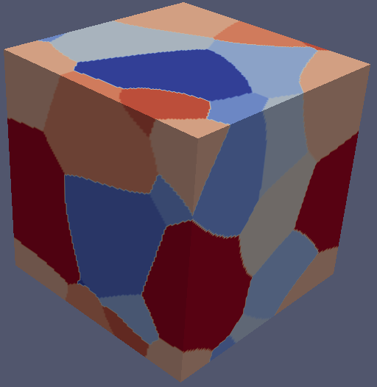
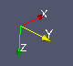
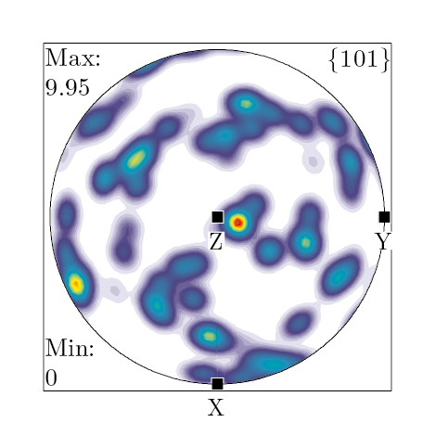

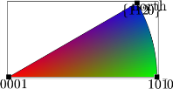



Processing –Microstructure –Texture
Alpha
$α+β$ Microstructure
Beta
2μm
GB
$$Texture$$
X
IPF
Representing $β$ texture {101}_{β} pole
Notes:
joining interface....For example, these are microstructure characterization and mechanical testing done by john in hamish group
400
1600
includes:

